Slide 1
REII LAB 4
CHARTS
AM Pretorius 25022563

Slide 2
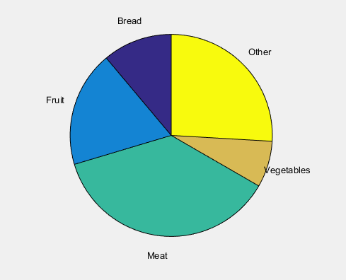
Pie Chart
We would typically use a pie chart to visualize percentages or segments of a whole.
Important elements include the use of colour and labels. The size of each segment represents it’s percentage.
This example shows the food consumption of the average person.

Slide 3
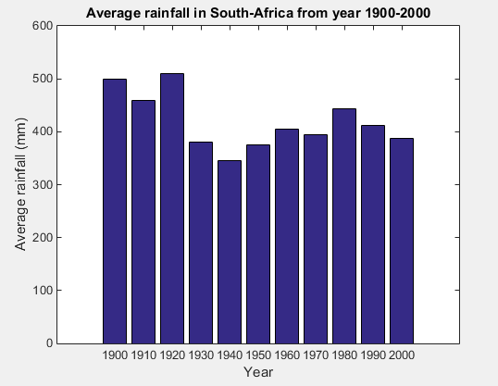
Bar Chart
We would typically use a bar chart to show the magnitude of a specific series. Easily read and understood.
Important elements include the axis labels and the title. As well as an index if more than one element is portrayed.

Slide 4
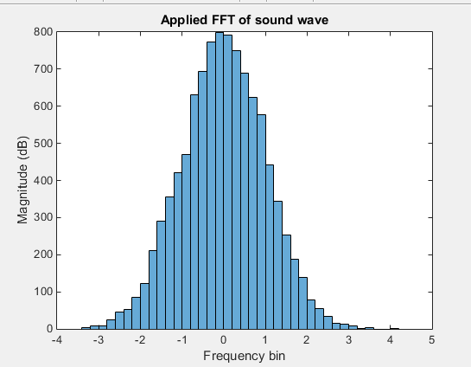
Histogram
A histogram works in much the same way as a bar chart.
Important elements include: no spaces between bars, axis labels and a title.

Slide 5
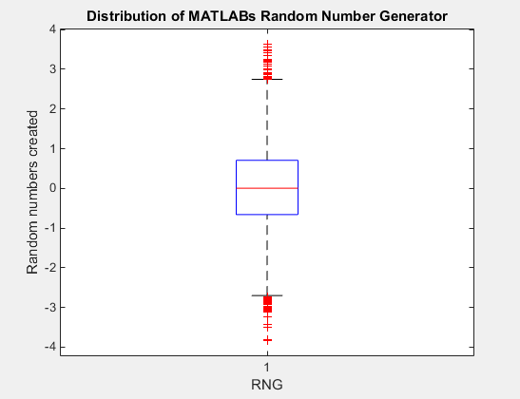
Box Plot
The boxplot is used typically to view the distribution of a data set and to see what the median, first quartile and third quartile is.
Important elements are the largest and smallest values, the quartiles and the median.

Slide 6
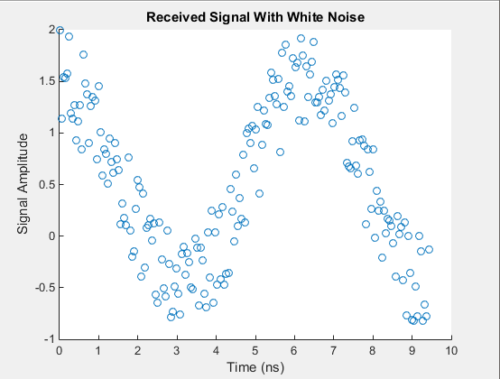
Scatter plot
Scatter plot is typically used to visualize the density and distribution of a data series.
Important elements include: Axis legends, title and data points that can cross over eachother.

Slide 7
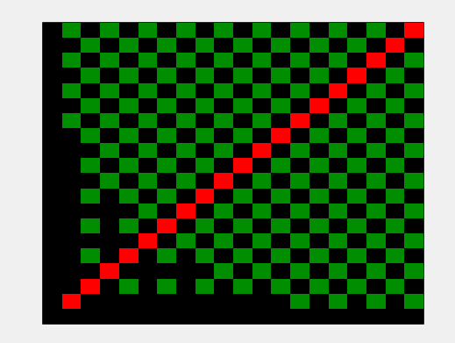
Heatmap
A heat map is used to visualize the differences in data density between data sets.
Important elements include colour and the shape of the graph.

Slide 8
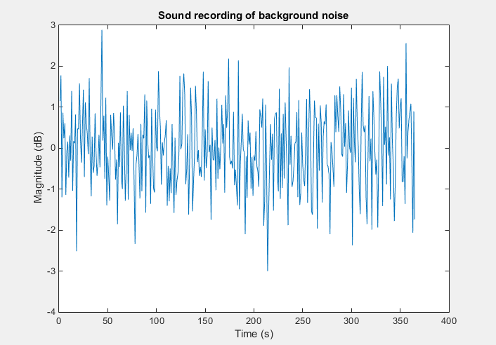
Time Series
The time series is used to show a change in data over time. It is a common graph that is easily understandable.
Elements include: Axis legends, title and lines connecting data points for each value on the x-axis.

