Slide 2
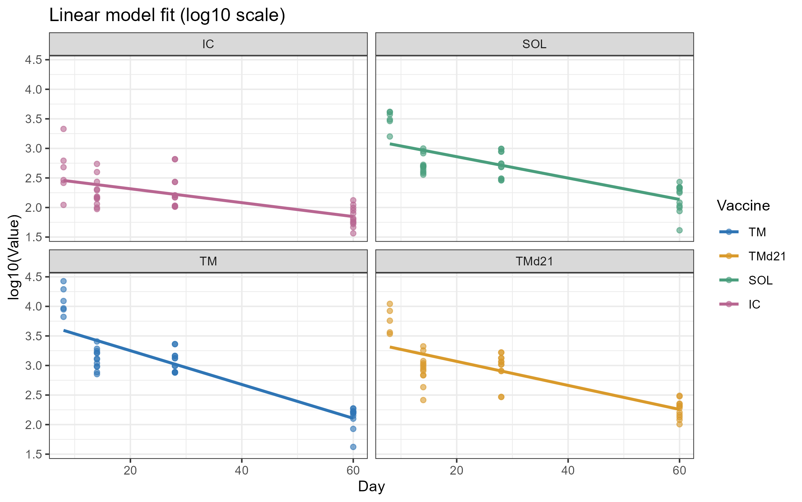
CD4 tet+
Doing lm fit for each group separately

Slide 3
Biphasic decay
Hard to do with this data
Only 4 exact timepoints
No same mouse id (no longitudinal sampling)
The best to get biphasic decay is to fit a liner breakpoint model
Another complication – what is the breakpoint?
Currently, testing if the breakpoint s at the 2nd or 3rd timepoint

Slide 4
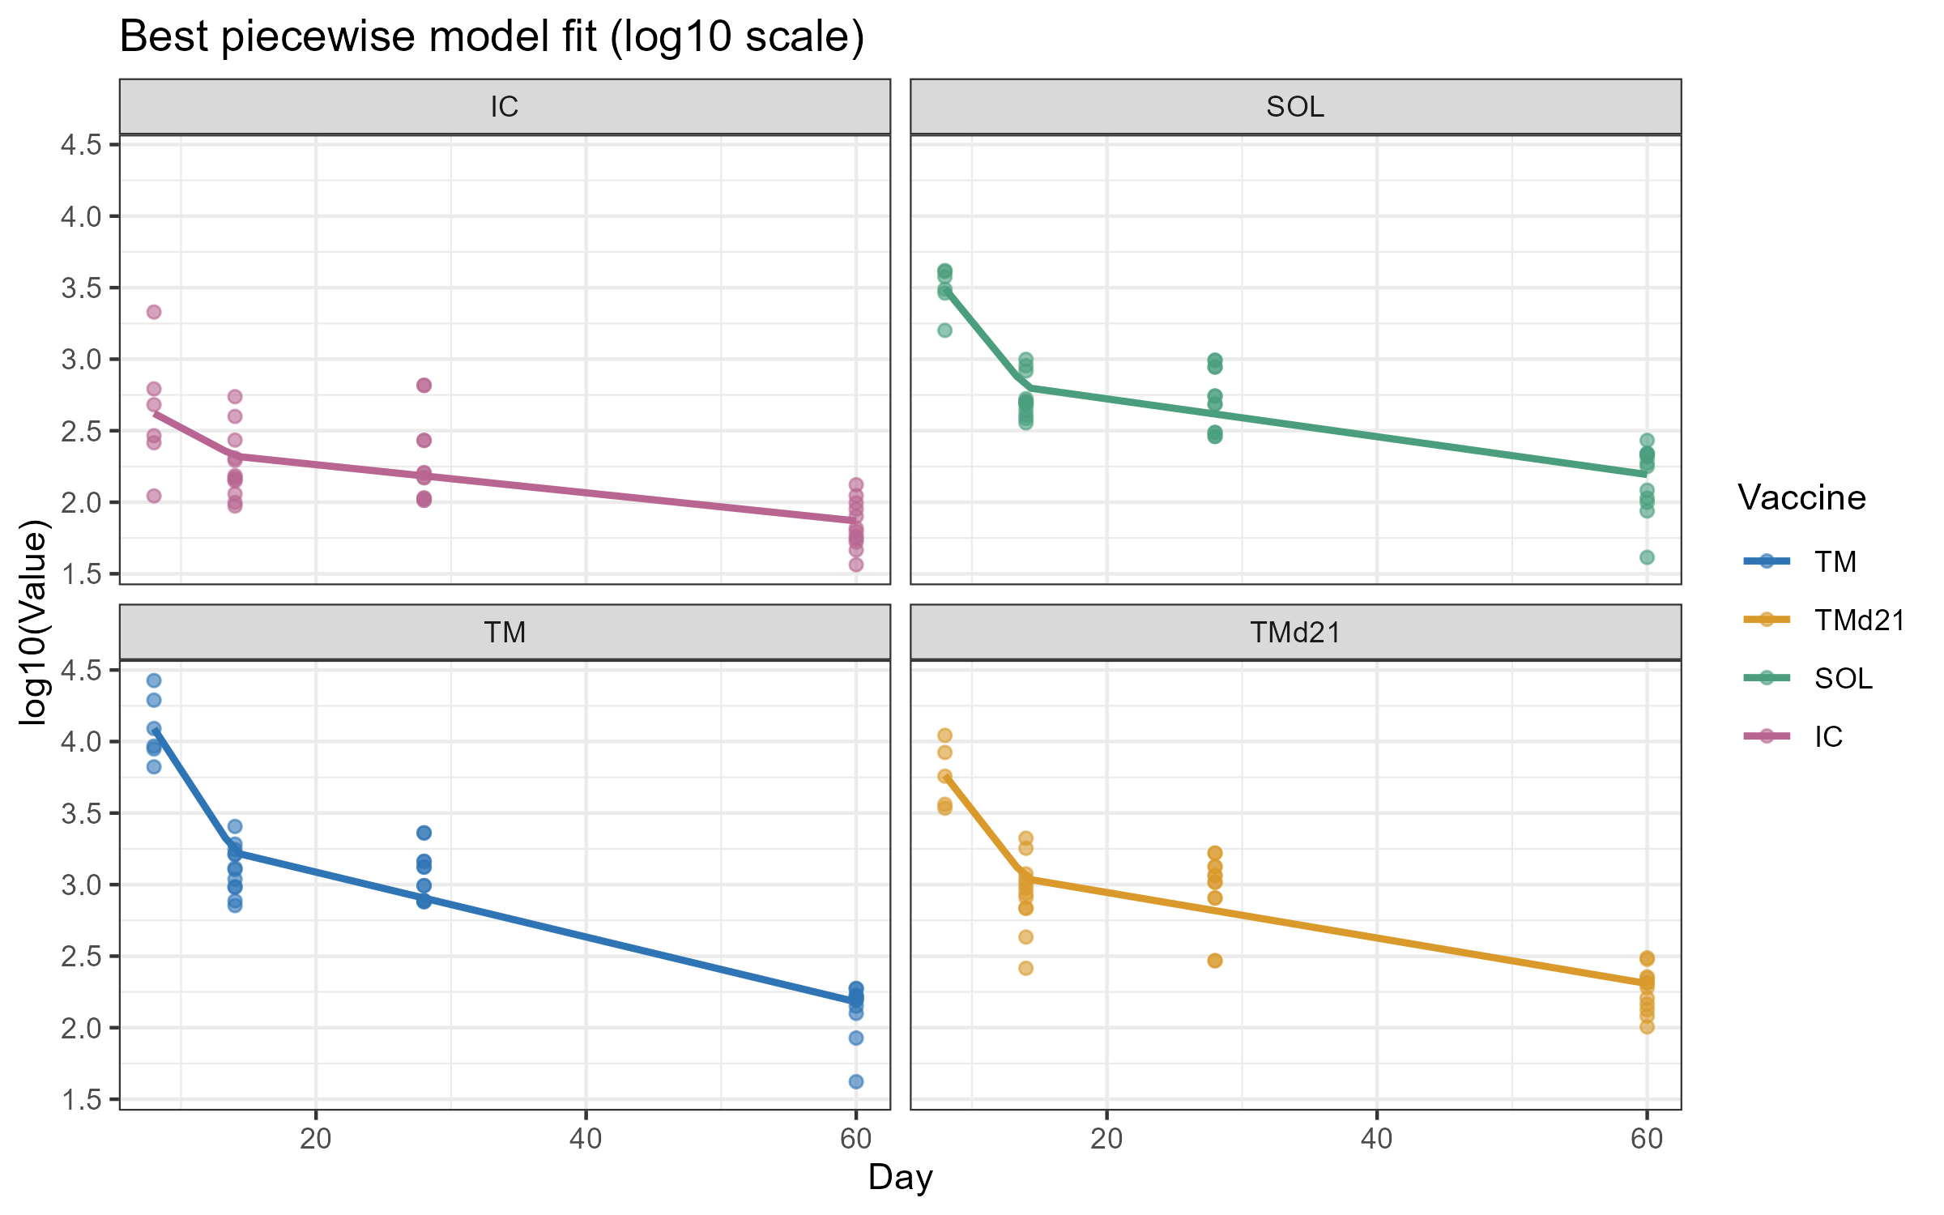
CD4 tet+
For each vaccine group, find the best breakpoint with lowest AIC

Slide 5
Testing which model is the best
Always keep the intercept as free parameters for each group

Slide 6
Linear model
Linear model – total of 15 combinations
  Every vaccine has its own slope (4 slopes) – 1
  Choose which 2 of the 4 vaccines pair up (3 slopes, one shared for 2 grups, 2 different slopes) – C(4,2) = 6
  Two pairs : Pair them up (2 shared slopes) – 3
  Choose which 3 vaccines share a slope – C(4,3) = 4

Slide 7
# | Slope combo
1 | A | B | C | D
2 | AB | C | D
3 | AC | B | D
4 | AD | B | C
5 | BC | A | D
6 | BD | A | C
7 | CD | A | B
8 | AB | CD
9 | AC | BD
10 | AD | BC
11 | ABC | D
12 | ABD | C
13 | ACD | B
14 | BCD | A
15 | ABCD
Every vaccine has its own slope
3 slopes, one shared for 2 groups
2 shared slopes
which 3 vaccines share a slope
Every vaccine different slope

Slide 8
Piecewise model
For each vaccine, the breakpoint is either 14 or 28. That's 2 options per vaccine × 4 vaccines = 16 combinations

Slide 9
# | A | B | C | D
1 | 14 | 14 | 14 | 14
2 | 14 | 14 | 14 | 28
3 | 14 | 14 | 28 | 14
4 | 14 | 14 | 28 | 28
5 | 14 | 28 | 14 | 14
6 | 14 | 28 | 14 | 28
7 | 14 | 28 | 28 | 14
8 | 14 | 28 | 28 | 28
9 | 28 | 14 | 14 | 14
10 | 28 | 14 | 14 | 28
11 | 28 | 14 | 28 | 14
12 | 28 | 14 | 28 | 28
13 | 28 | 28 | 14 | 14
14 | 28 | 28 | 14 | 28
15 | 28 | 28 | 28 | 14
16 | 28 | 28 | 28 | 28

Slide 10
Piecewise model
Same 15 combinations for the early decay like the linear model
Same 15 combinations for the late decay like the linear model
Total combination is 16x15x15 = 3600

Slide 11
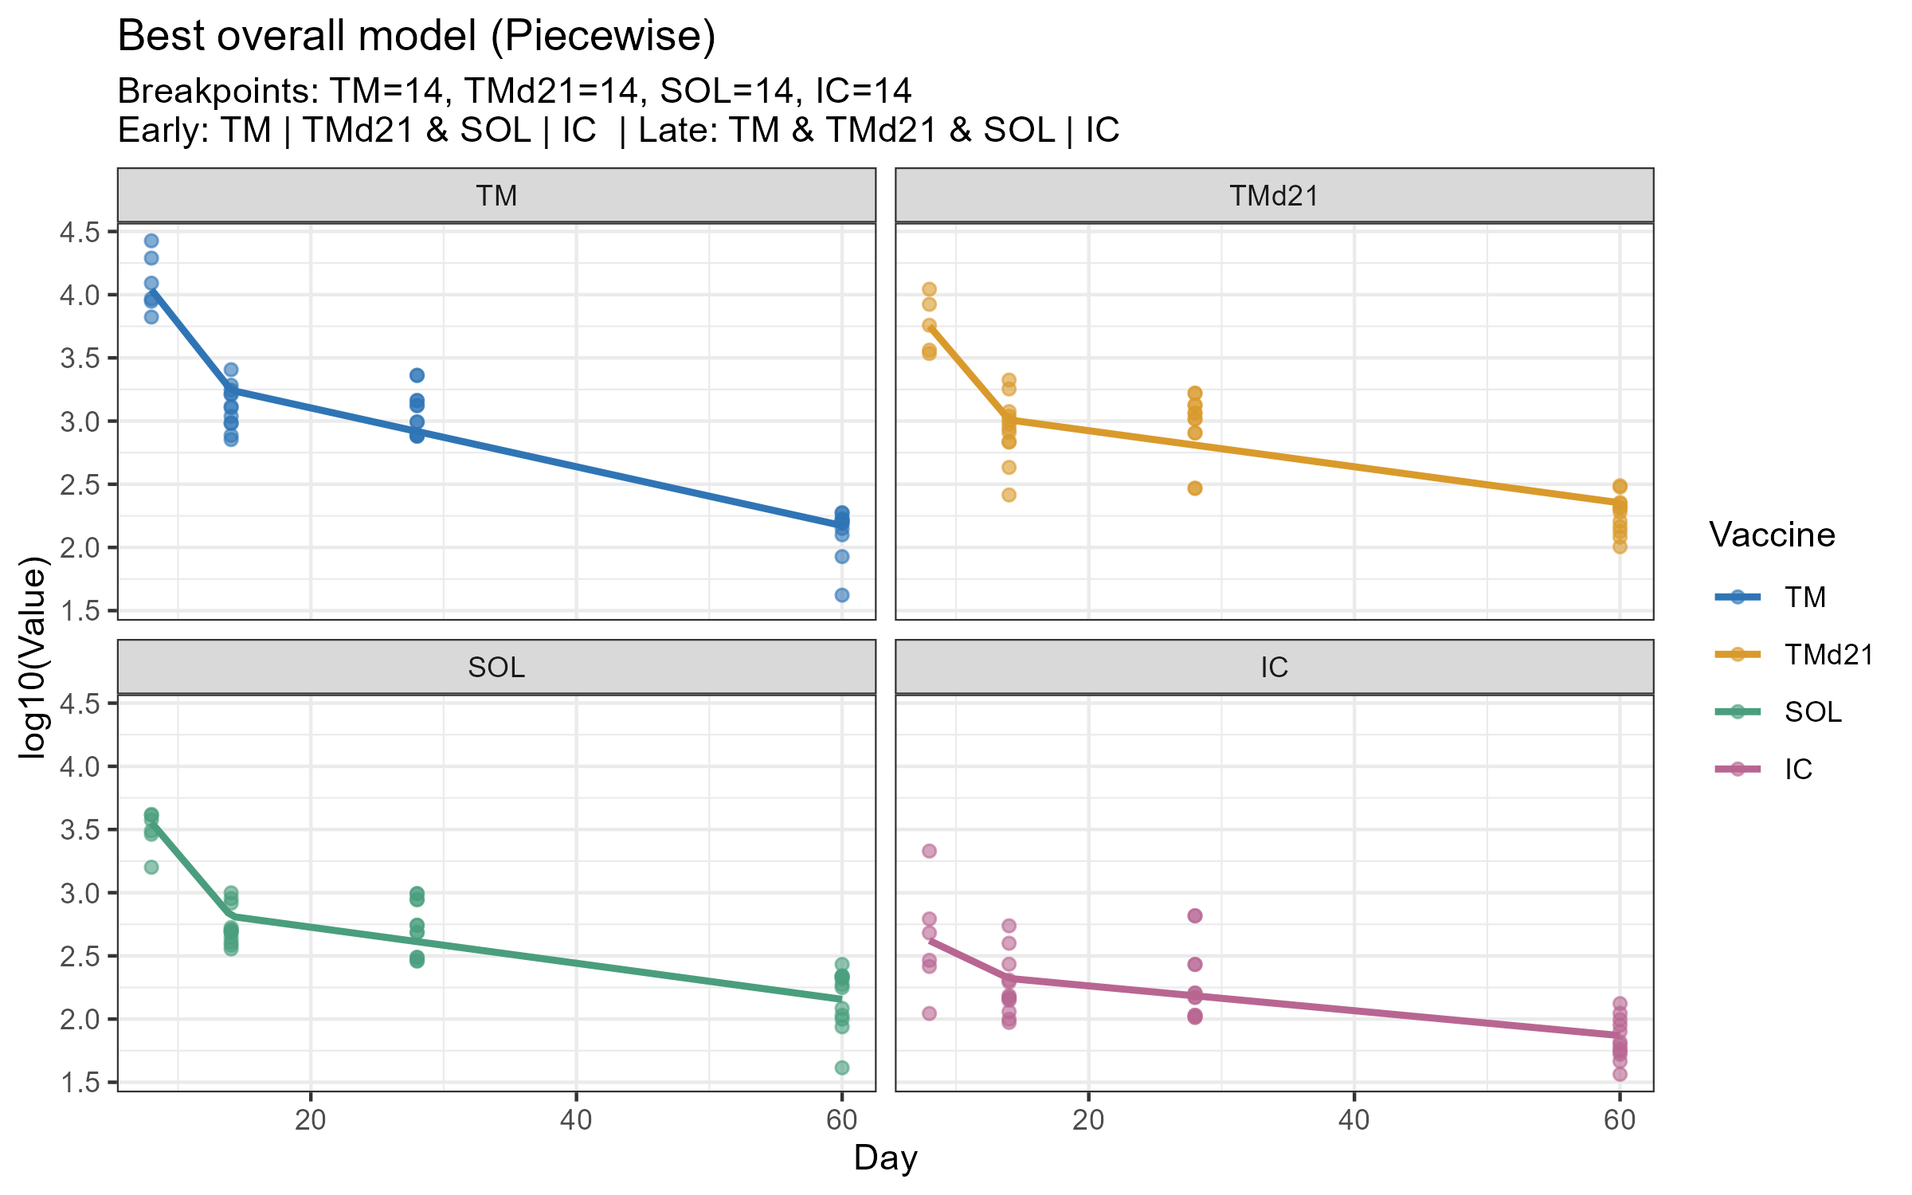
The best model (lowest AIC)

Slide 12
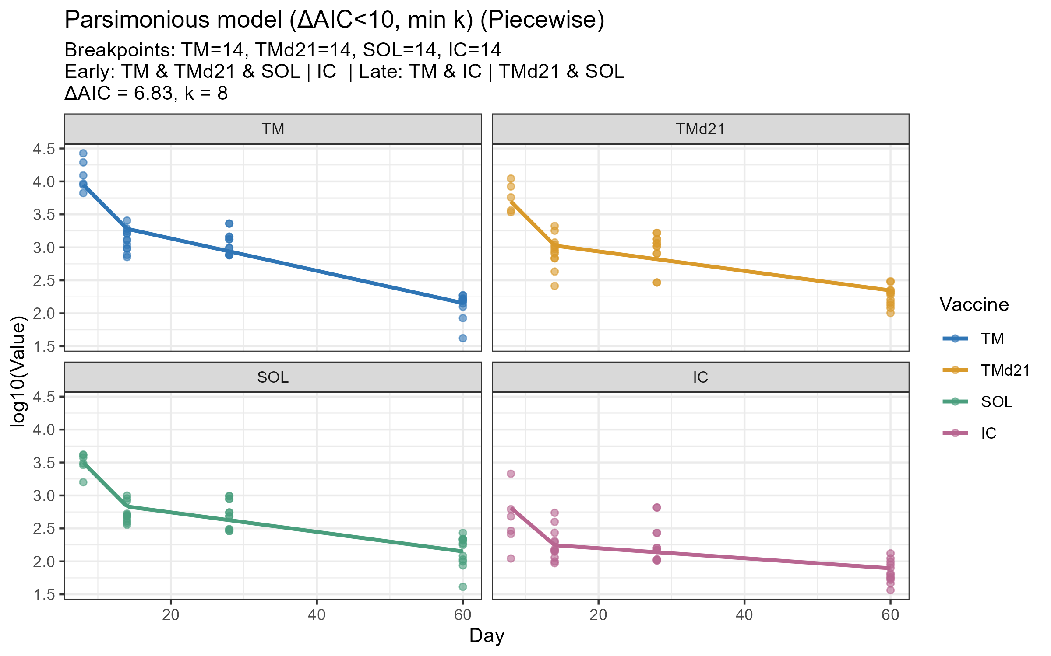
The best parsimonious model (lowest AIC)
Get all models with delta AIC <10 and pick the least number of parameter

Slide 13
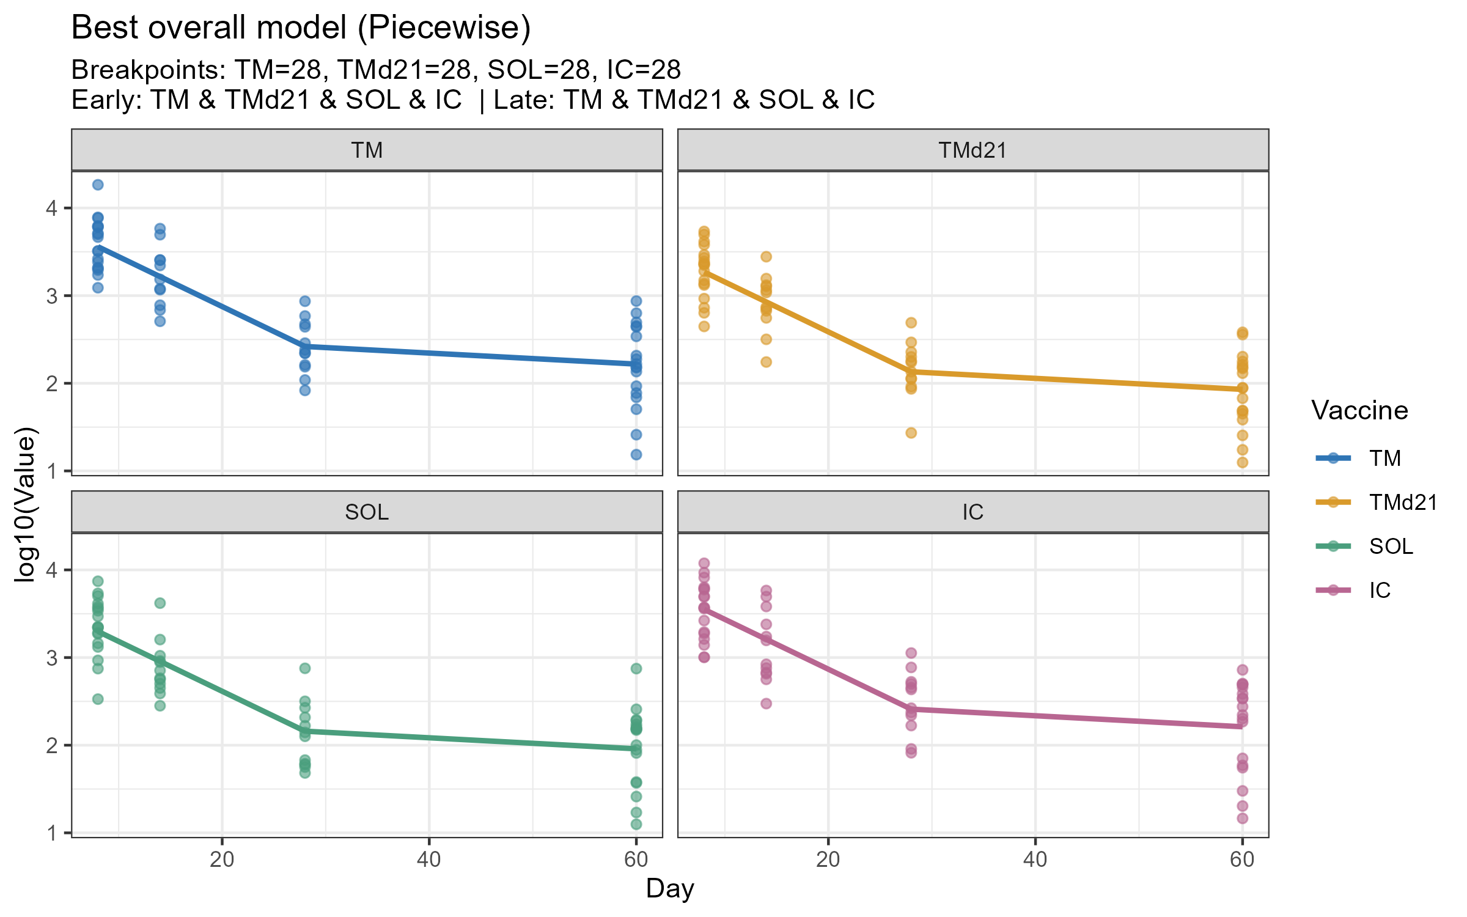
CD8 tet+

Slide 14
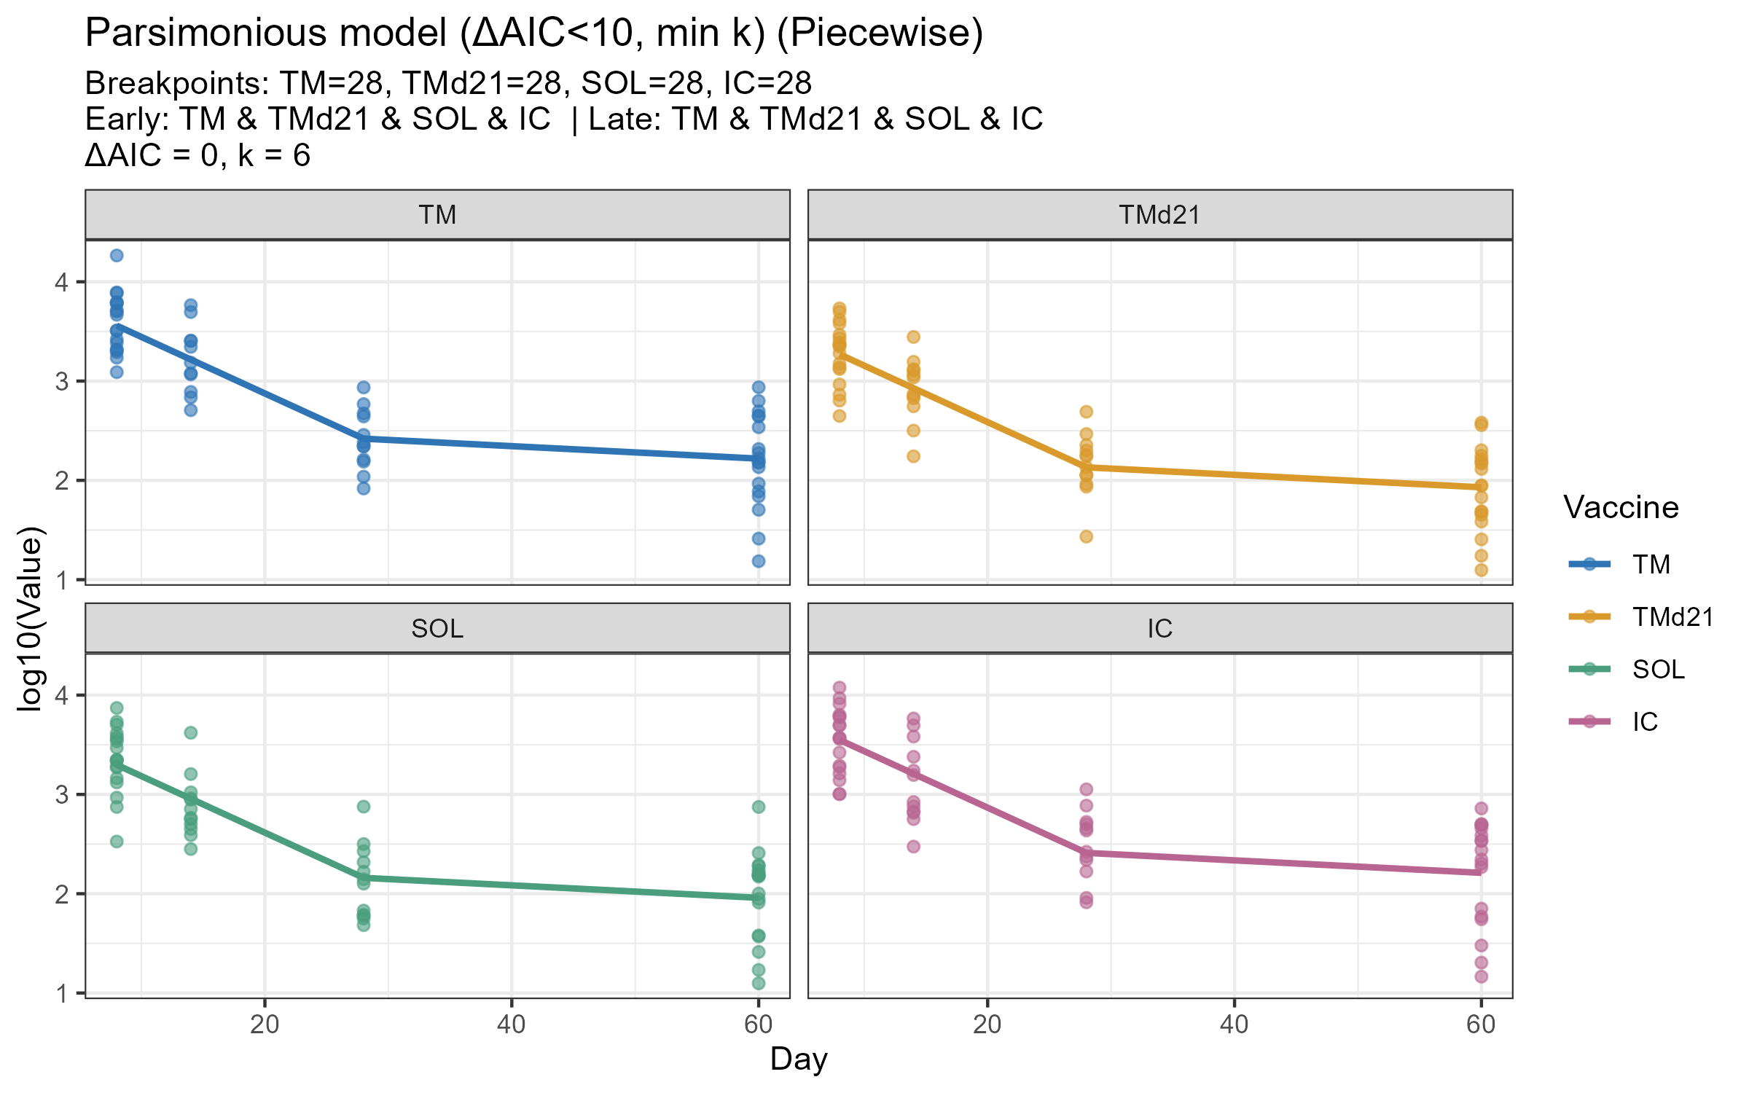
CD8 tet+

