Slide 2
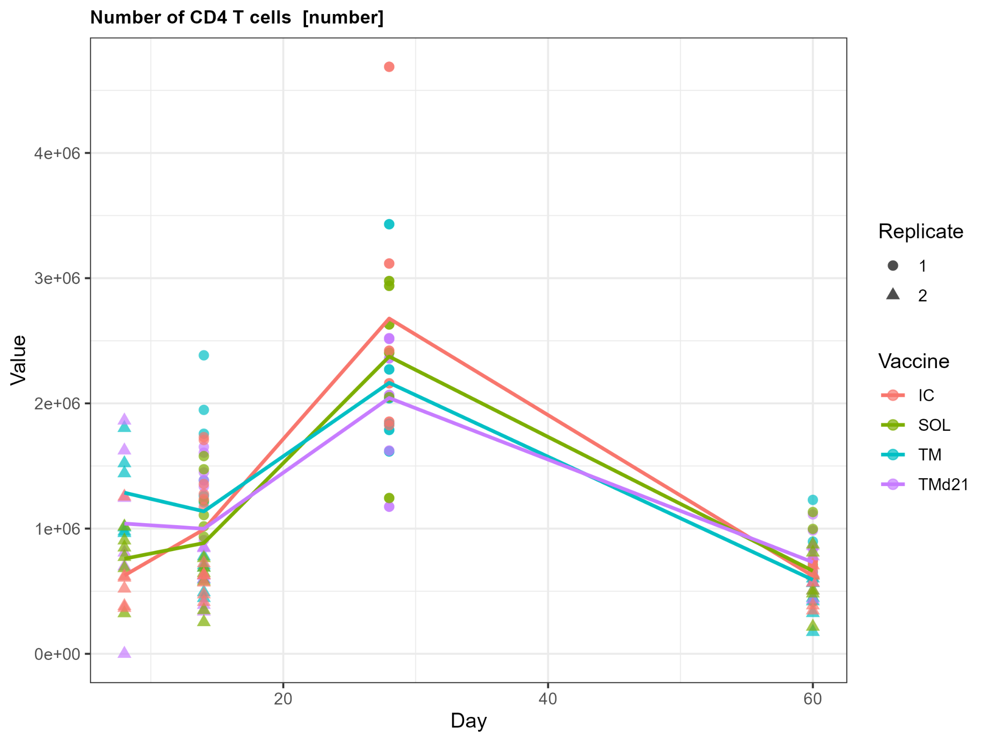
Bulk CD4 is not affected much

Slide 3
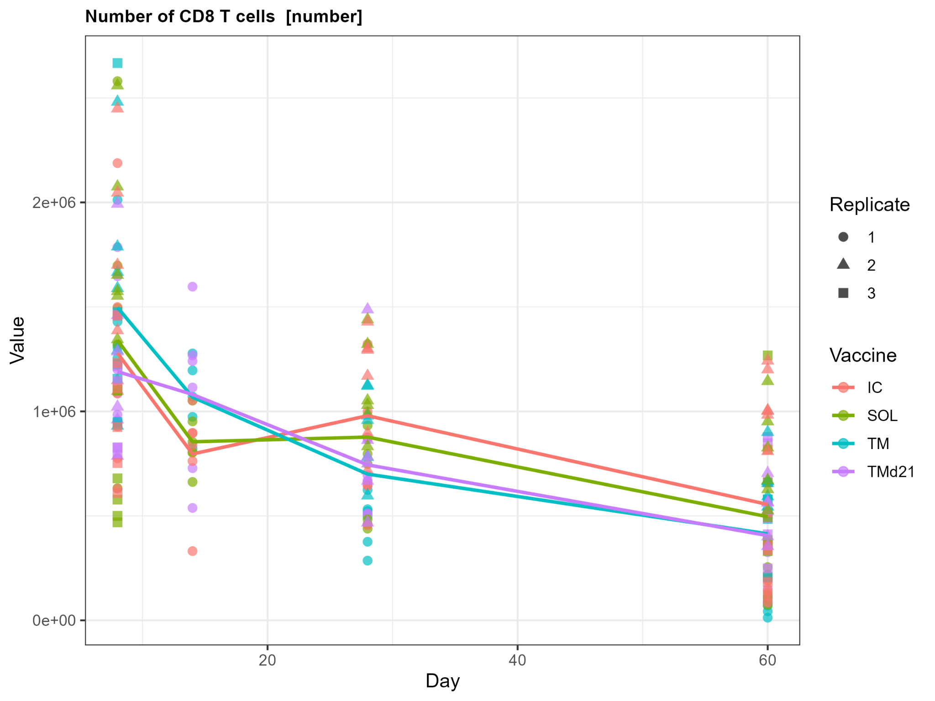
Bulk CD8 is not affected much

Slide 4
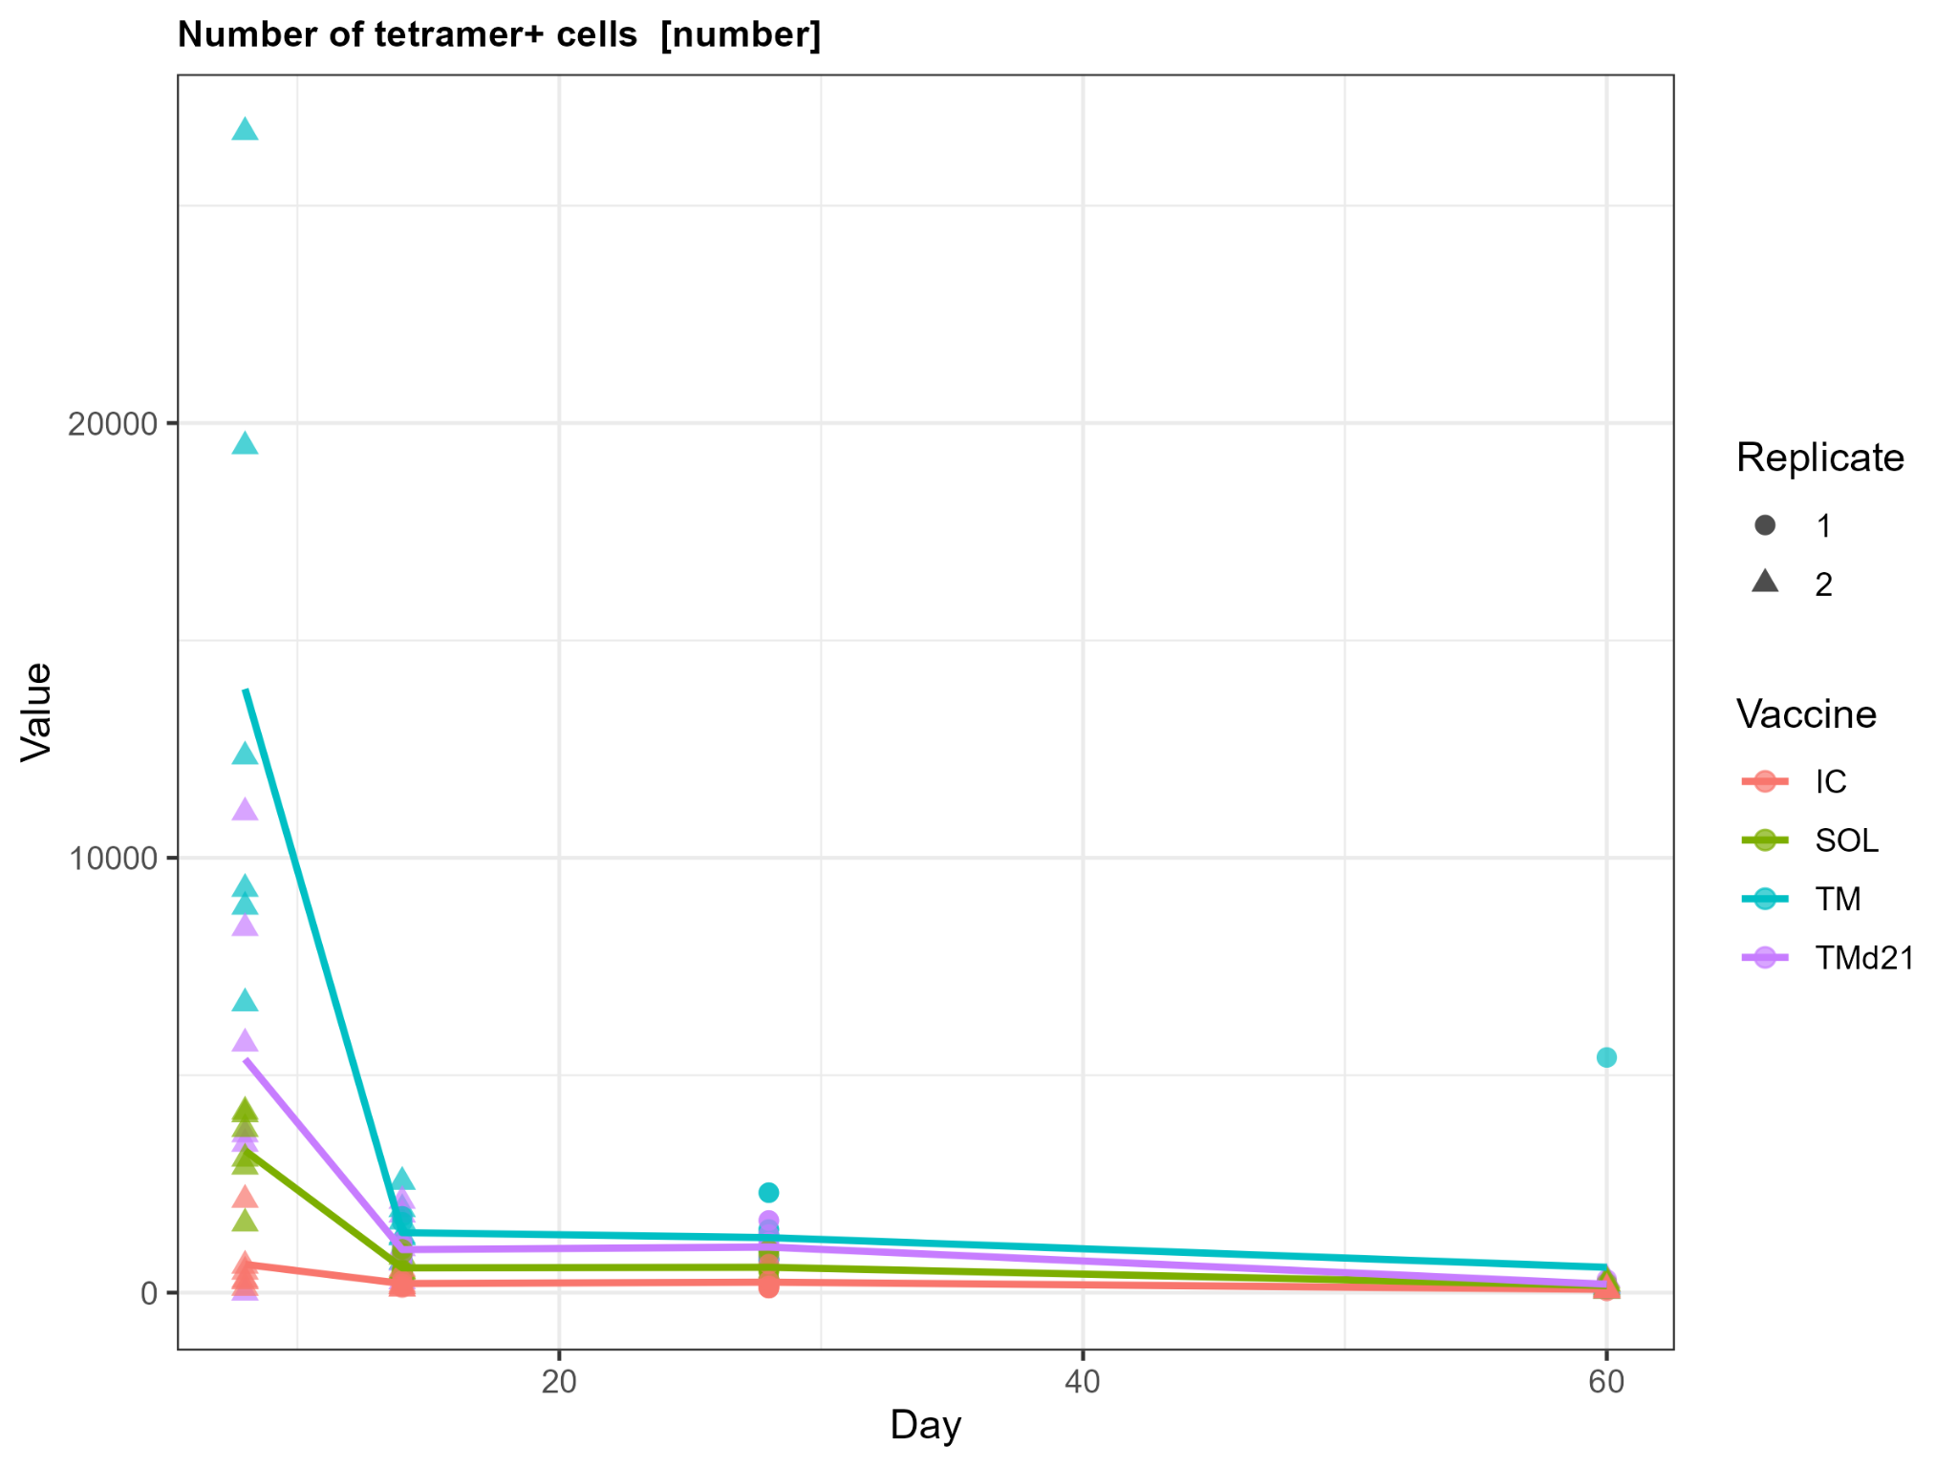
TM induces a very large early antigen-specific CD4
CD4 Tet+
TM>TMd21>SOL>IC

Slide 5
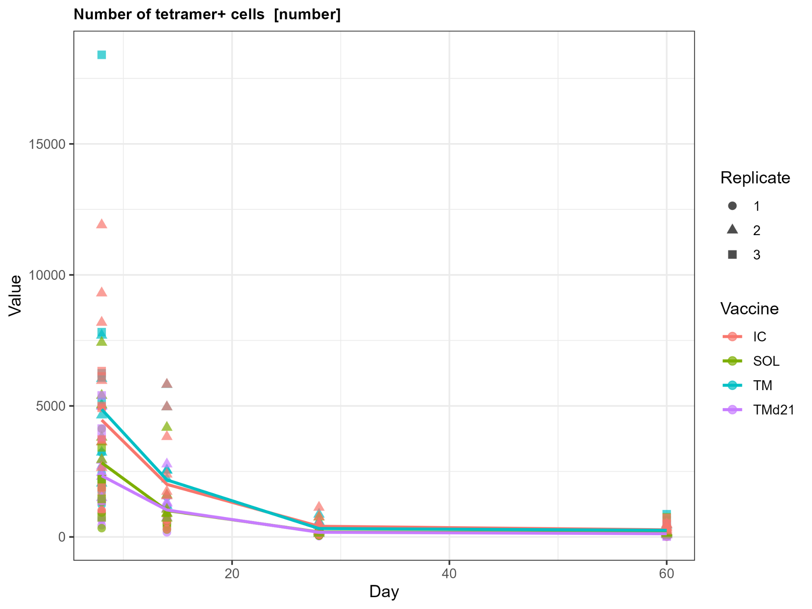
Not as clearly separated as CD4
CD8 Tet+
TM>IC>SOL>TMD21

Slide 6
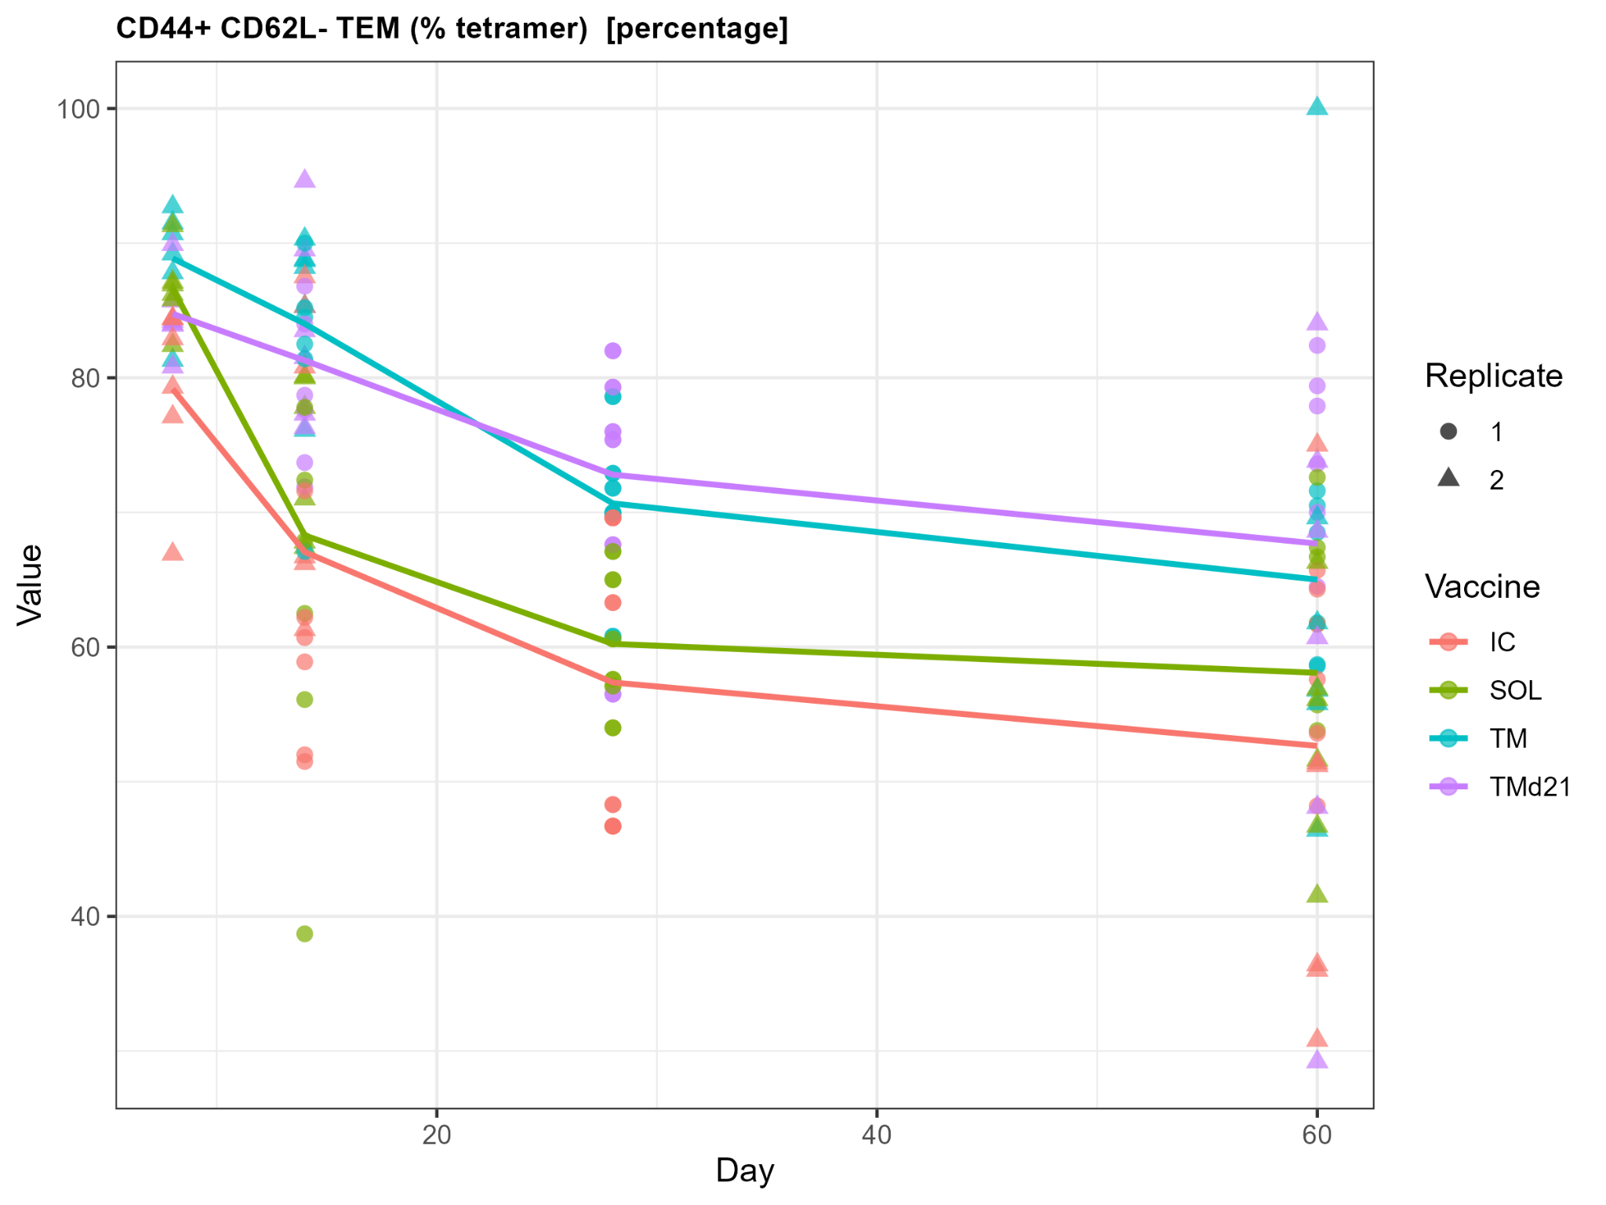
The burst CD4 response is mostly effector
CD4 Tet+
TM>TMd21>SOL>IC

Slide 7
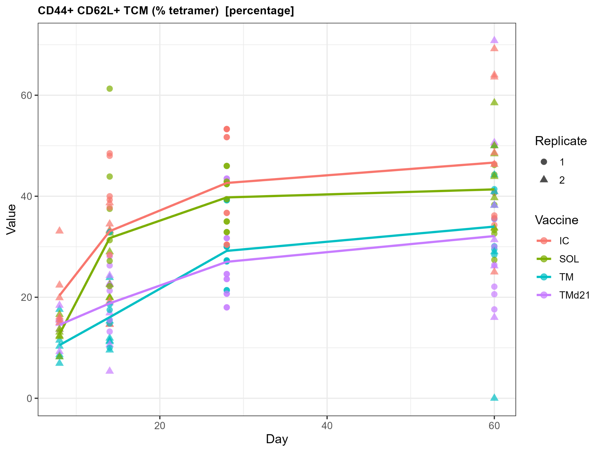
The burst CD4 response is mostly effector
CD4 Tet+
TM>TMd21>SOL>IC

Slide 8
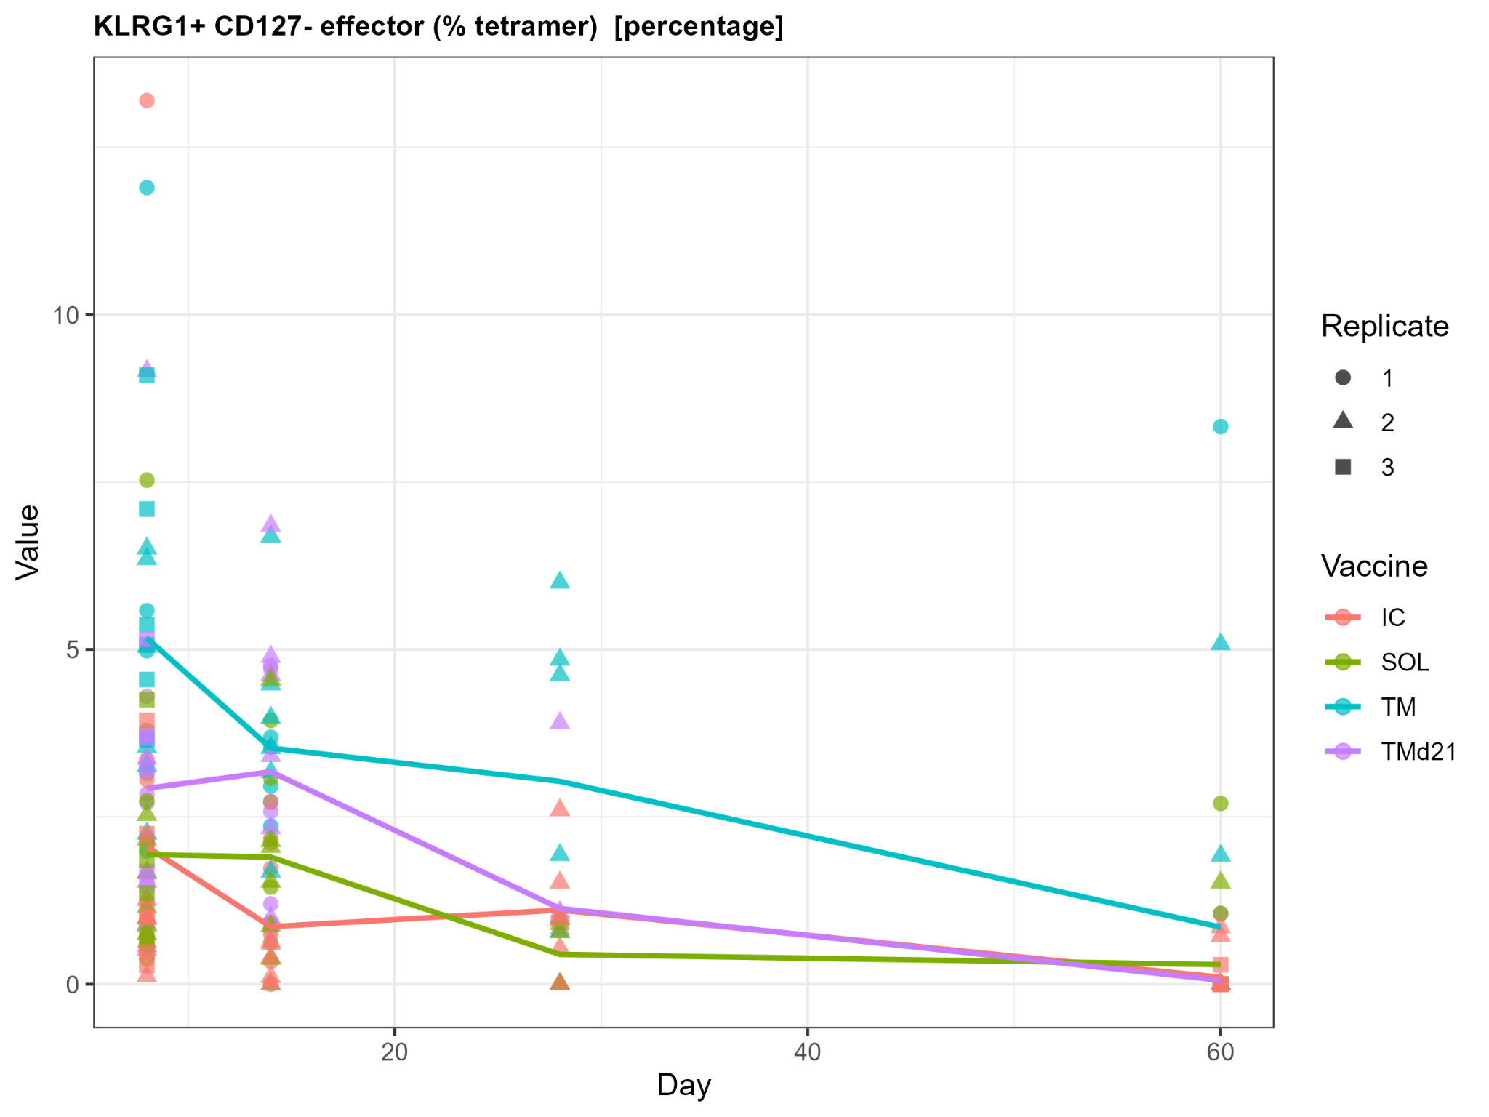
TM drives mostly effector-like resp in CD8
CD8 Tet+
TM>TMd21>SOL>IC

Slide 9
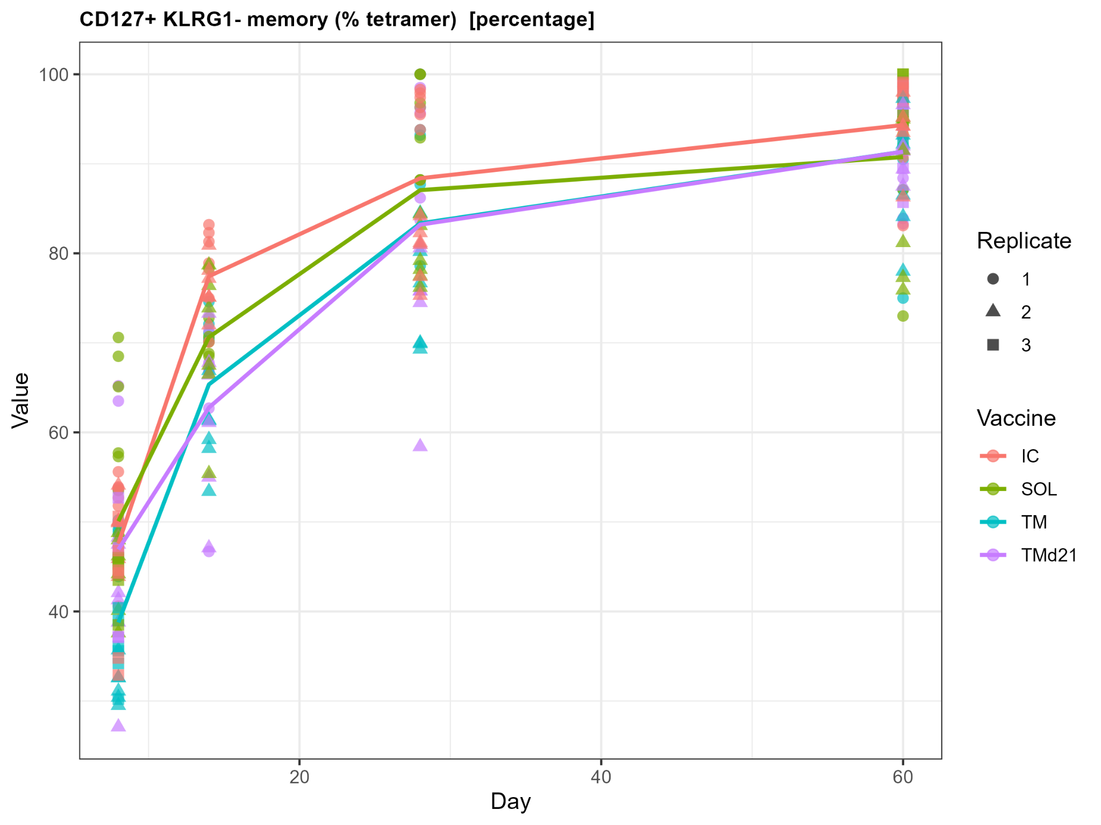
TM drives mostly effector-like resp in CD8
CD8 Tet+
TM>TMd21>SOL>IC

Slide 10
Take home
TM: large, rapid and effector-rich
TM is the strongest overall cellular immunogen in these figures
IC: weak CD4 but relatively strong CD8

