Slide 1
Census
Sample every unit
in the population

Slide 2
Simple Random Sample
Sample n units at random, any
combination of
n units being equally
likely to be selected

Slide 3
Linear Systematic Random Sample
Sample n units at random, with a
fixed skip k=N/n after selecting the
first unit at random from the first k in the population

Slide 4
Stratified Simple Random Sample
Break the population
Into groups (strata);
Take a Simple Random Sample from every
stratum

Slide 5
One-stage Cluster Sample
Break the population
into groups (clusters);
Take a Simple Random Sample of clusters,
and then a census of
units in each selected
cluster

Slide 6
Two Stage Cluster Sample
Break the population
Into groups (clusters);
Take a Simple Random Sample of clusters, and then a Simple Random Sample of units within each selected cluster

Slide 7
Objectives Target Population
Survey Population Sample Frame
Coverage error Frame Bias
Validity Reliability (measurement error) Recall Bias
Sampling Error Selection Bias Non-random selection
Design survey instrument
Sample Design Select Sample
Contact Sample
Noncontact/ Unit nonresponse
Collect data from sample members
Interviewer error False response Mode effect
Item non-response Current events/survey timing
Capture, code, edit data
Processing errors Coding, editing errors
Calculate weights Post-survey adjustments
Adjustment errors Incorrect non-response model
Create estimates and perform analyses
Model error/misspecification Incorrect treatment of complex sample design
Report and Evaluate
Incorrect interpretation of results

Slide 8
Objectives Target Population
Survey Population Sample Frame
Design survey instrument
Sample Design Select Sample
Contact Sample
Collect data from sample members
Capture, code, edit data
Calculate weights Post-survey adjustments
Create estimates and perform analyses
Report and Evaluate

Slide 9


Population or process
...
sample
sample
Observable variables
sample
Data presentation
sample
Population parameters $μ, σ, …$
sample
sample
……
Sample
statistics
$$\overline{x}, s, …$$
Statistical Inference

Slide 10
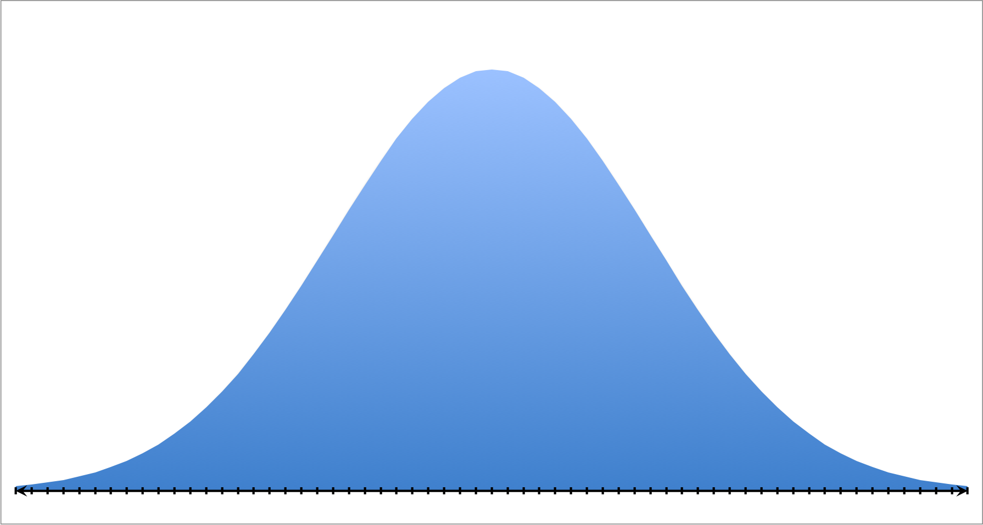

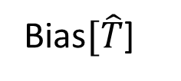
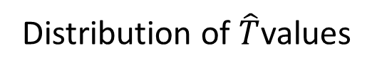

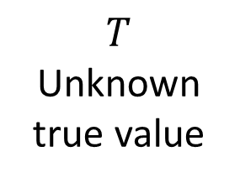
Distribution of $\hat{T}$values
SE$[\hat{T}$] Standard
Error
$T$
Unknown
true value
$E[\hat{T}$] Expected value of the estimator
Bias$[\hat{T}$]

Slide 11
Low Precision
High Precision
Biased
Unbiased

Slide 12
Target Population
In scope and
In coverage
Survey
Population
Out of
coverage
Sample Frame
Out of scope

Slide 13
Target Population
Target
Population
Sample Frame

Slide 14
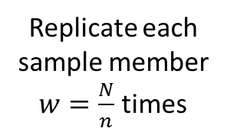
Population of size N
Synthetic Population of size N
1
1
Sample of size n
1
n
Replicate each
sample member
$w=\frac{N}{n}$ times
N
N

Slide 15
Population
sample
sample
sample
sample
sample
sample
Actual sample
sample
sample
sample

Slide 16
Population
pseudosample
pseudosample
pseudosample
pseudosample
pseudosample
pseudosample
sample
pseudosample
pseudosample
pseudosample

Slide 17
ID | PSU | Income | … | Weight | Rep01 | Rep02 | Rep03 | Rep04
1 | A |  |  | 100 | 0 | 138.1 | 126.1 | 134.9
2 | A |  |  | 100 | 0 | 138.1 | 126.1 | 134.9
3 | A |  |  | 100 | 0 | 138.1 | 126.1 | 134.9
4 | B |  |  | 80 | 107.9 | 0 | 100.9 | 107.9
5 | B |  |  | 80 | 107.9 | 0 | 100.9 | 107.9
6 | B |  |  | 80 | 107.9 | 0 | 100.9 | 107.9
7 | B |  |  | 80 | 107.9 | 0 | 100.9 | 107.9
8 | C |  |  | 120 | 161.9 | 165.7 | 0 | 161.9
9 | C |  |  | 120 | 161.9 | 165.7 | 0 | 161.9
10 | D |  |  | 100 | 134.9 | 138.1 | 126.1 | 0
11 | D |  |  | 100 | 134.9 | 138.1 | 126.1 | 0
12 | D |  |  | 100 | 134.9 | 138.1 | 126.1 | 0
Total |  |  |  | 1160 | 1160 | 1160 | 1160 | 1160

