Slide 1
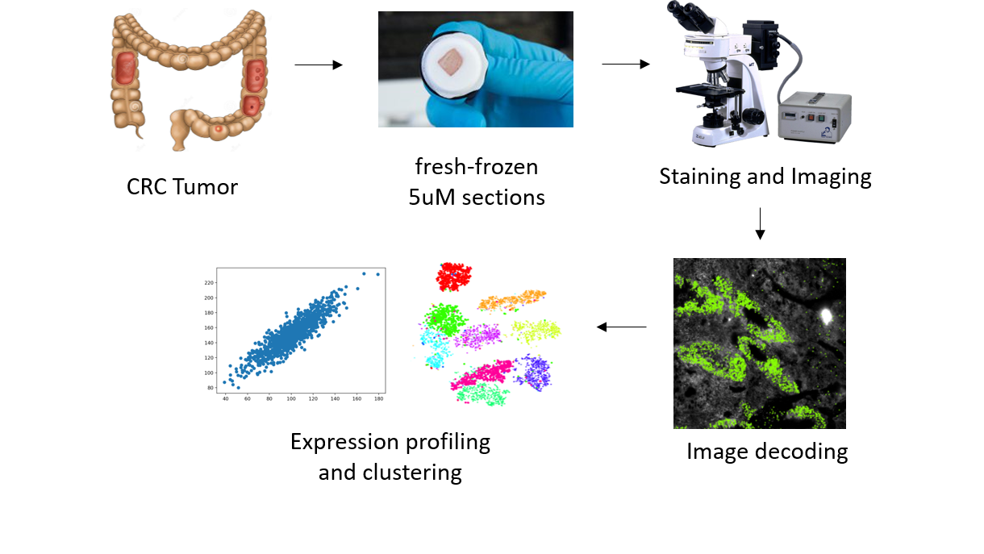
WP2-Schematic

Slide 2
Project Description
Immune checkpoint inhibitors such as anti-CTLA-4 and anti-PD1 drugs have revolutionized the field of cancer therapy. However, sustained treatment responses are observed only in a minority of colorectal cancer patients (MSI-H patients), highlighting the need to better understand the functions and interactions of tumor, stromal and immune cells in the colorectal cancer tumor micro-environment (TME).
In this project, we aim to use multiplex error robust fluorescence-in-situ-hybridization (merFISH) to create accurate, subcellular-resolution cellular profiles of the colorectal TME and study the roles and interactions of different cell types. We will also compare the immune alterations between responders and non-responders to immunotherapy, and identify (spatial) biomarkers that may shed light on the mechanisms of immunotherapy responses.

Slide 3
Project Description
Compared with existing methods for characterizing tumor cell types that rely on sequencing information alone, our merFISH approach stands out in its ability to provide the much-desired in situ spatial information, thus enhancing the accuracy in cell type identification. Such information is key for understanding the molecular and cellular interactions within the tumor microenvironment,

Slide 4
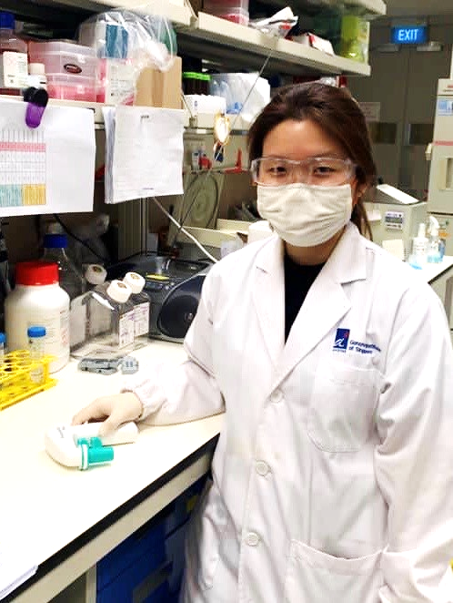
Yurike Laurensia
Single cell spatial transcriptomic is something that I have been wanting to learn as it’s an exciting and innovative technology. It’s interesting to see the gene expression from each cell in the tissue specimen of colorectal cancer patient.
Prior to this, I worked at National Cancer Centre Singapore (NCCS) where I involved in a project to characterize the genetic profile of T-cell lymphoma.

Slide 5
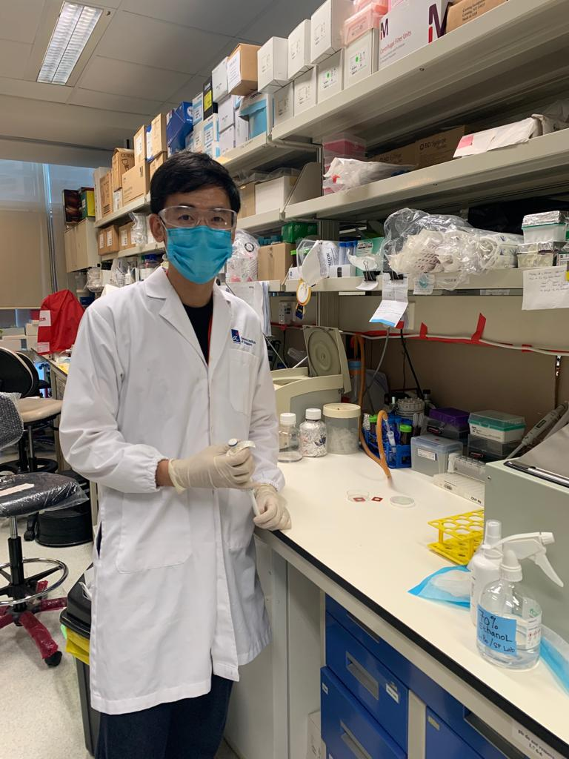
Bo Li
I graduated with a PhD in virology from Harvard University and recently joined GIS as a postdoc.
My scientific interest is in understanding the phenotype and interactions of immune cells in different diseases including cancer and infectious diseases.
My current project focuses on studying the spatial interaction and gene expression patterns of different cell populations in the colorectal cancer tumor microenvironment.
Despite being trained as a web-lab researcher, I am interested in learning about technology development and programming, and Shyam’s lab has offered an unique opportunity to achieve these goals.

Slide 6
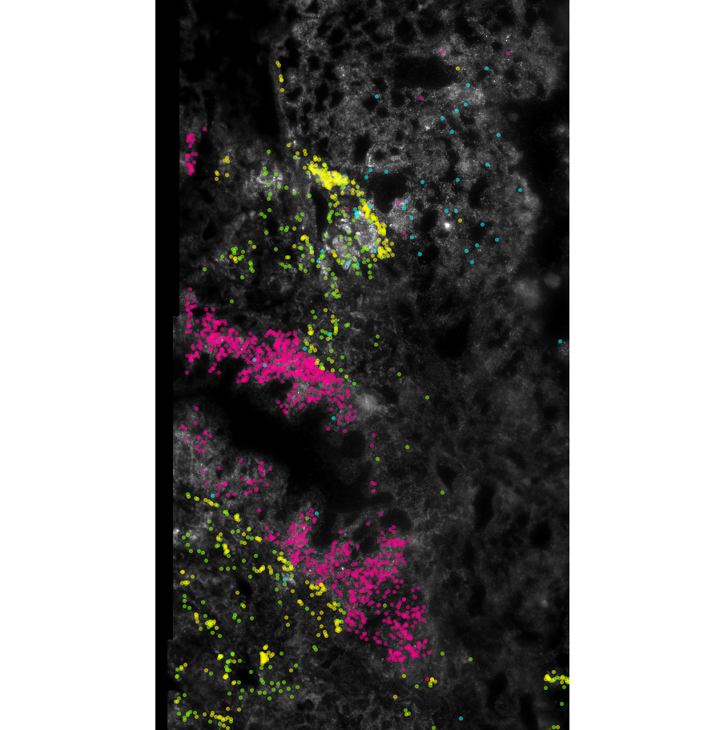
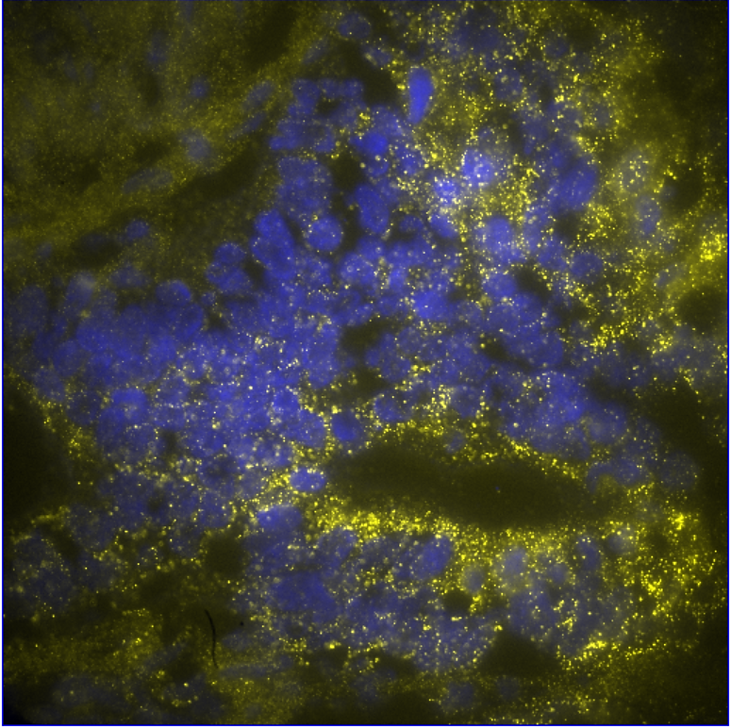
2 images from results for backdrop/header
ACTA2
DAPI
VIM
IGFBP5
MUC4
PSAP

