Slide 1
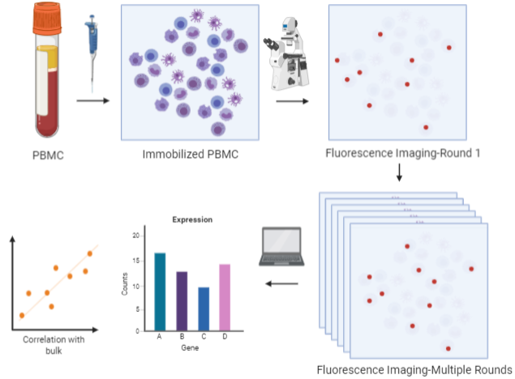
WP3-Schematic

Slide 2
Written Input
Liquid biopsies are minimally invasive and are faster and cheaper.
A quick search on google trends for the term “liquid biopsy” shows an increasing interest since 2015.

Slide 3
Write-up-1
A typical workflow in liquid biopsy involves collection of biological fluids, performing molecular assays and then data mining to quantify useful and relevant disease biomarkers. Many molecular assays adopt a “grind and find” biochemical approach wherein information from multiple cells are averaged to obtain appropriate clinical information. Typically, levels of 6-8 biomarkers are measured from each investigation.
Using our spatial omics technology called MERFISH, the cellular spatial information enabling one to obtain correlations between the location of the biomarker and the health of the individual from whom the sample was collected. MERFISH provides a multiplexing advantage wherein >100 biomarkers can be probed at single shot at greater sensitivity than current methods. These advantages potentially provide greater speed, precision and convenience at lower cost for clinical diagnoses.

Slide 4
Write-up-2
We primarily plan to use this approach to investigate a novel therapeutic strategy for cancer patients called immunotherapy wherein the patient’s natural defenses are boosted to fight cancer. We will perform MERFISH on blood samples to profile potential cancer biomarkers, including those that are known to mediate immune responses, in peripheral immune cells in the blood for cancer diagnosis and longitudinal monitoring.

Slide 5
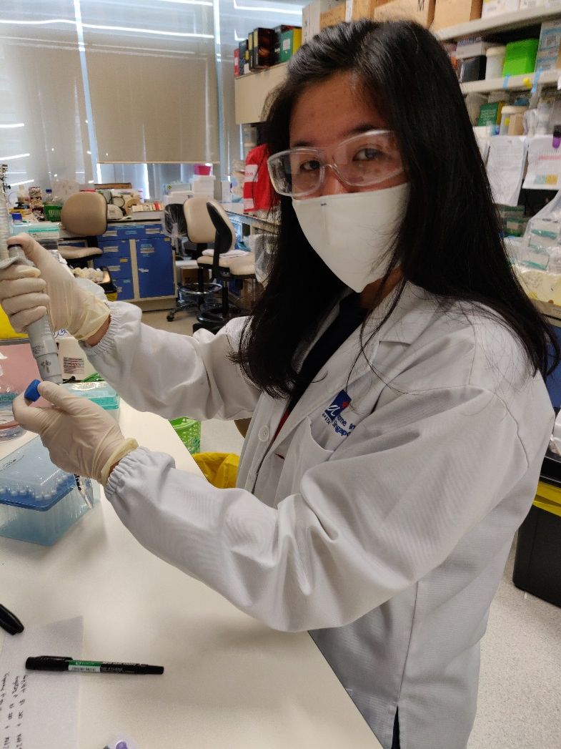
Giovani Claresta Wijaya
An internship at Singapore during my bachelor’s at Atma Jaya Catholic University, attracted me to Singapore.
After my internship, I worked in NCCS on renal cell carcinoma.
Intrigued by spatial transcriptomics, I moved to GIS and I am currently investigating sub-cellular localization of RNA using PBMC as a model system.

Slide 6
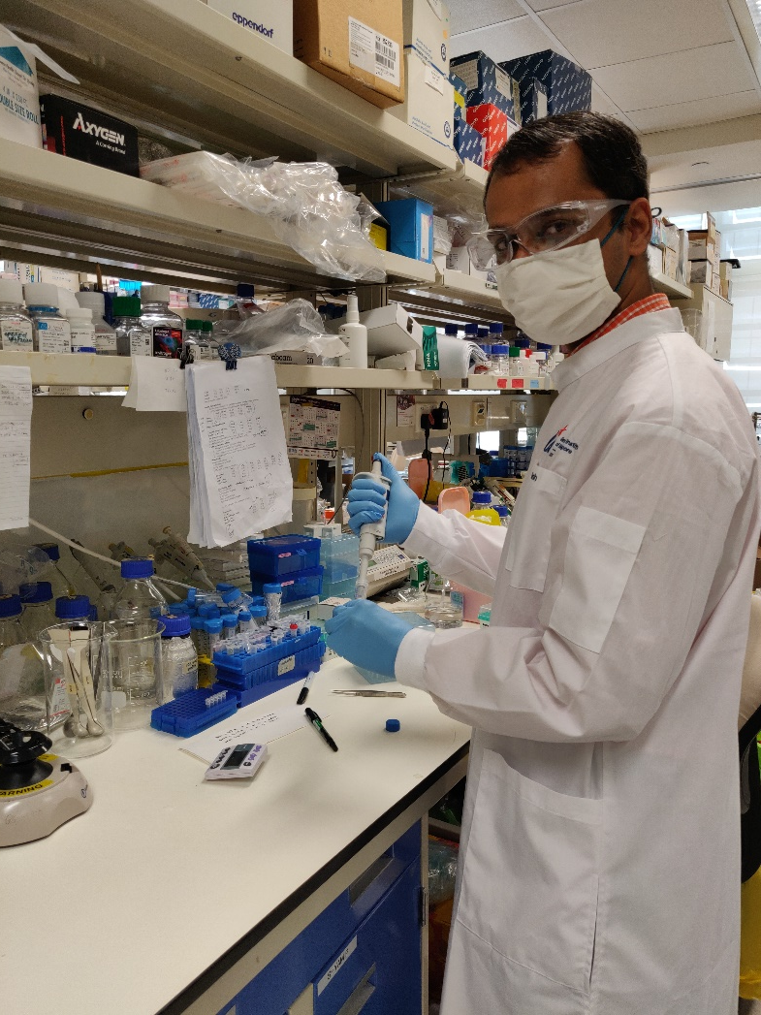
Jagadish Sankaran
I like working at the interface of dry and wet lab in microscopy.
I believe that a diverse team will aid in developing solutions to unmet clinical needs.
I am excited to work at the interface of academia, clinic and industry.
With my wet lab co-worker, I plan to investigate sub-cellular localization of RNA using PBMC and hope to contribute to developing spatial transcriptomic assays to investigate aberrant gene expression in CRC.

Slide 7
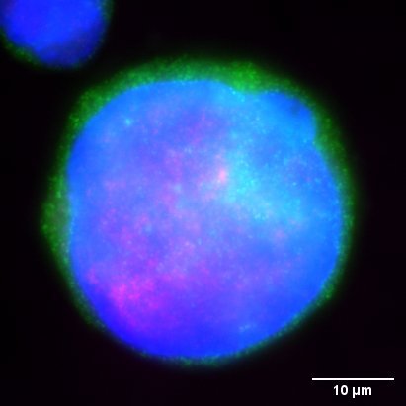
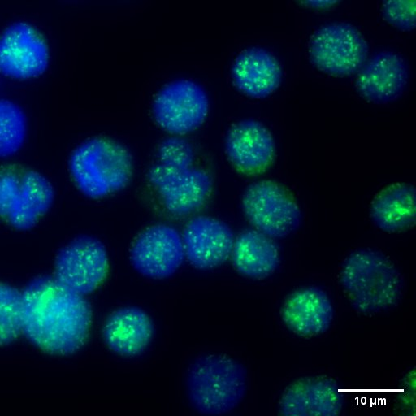
2 images from results for backdrop/header
Jurkat Malat1-GAPDH-DAPI
PBMC Malat1-DAPI

