Slide 1

Financial Accounting, IFRS
Twelfth Edition
Global Edition
Chapter 2
Recording Business
Transactions
Copyright © 2024 Pearson Education Ltd. All Rights Reserved.
Notes:
If this PowerPoint presentation contains mathematical equations, you may need to check that your computer has the following installed:
1) MathType Plugin
2) Math Player (free versions available)
3) NVDA Reader (free versions available)

Slide 2
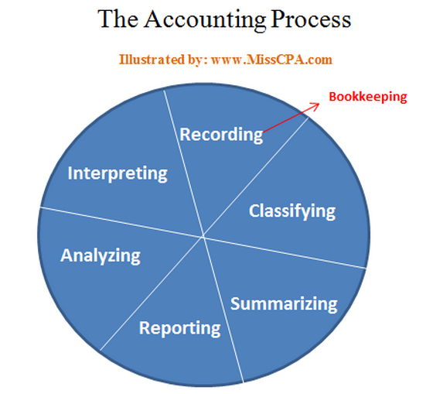
Chapter 1 Review
What is Accounting?
Basic assumptions?
Fundamental qualitative characteristics?
Accounting elements?
Basic Accounting equations?

Slide 3
Chapter 1 Review
The statement that shows transactions with shareholders and records changes in retained earnings is called…
Which statement is (are) stated at a point in time?
Which statement is (are) stated over a period of time?
What are the 3 categories of cash flows?
The order?

Slide 4
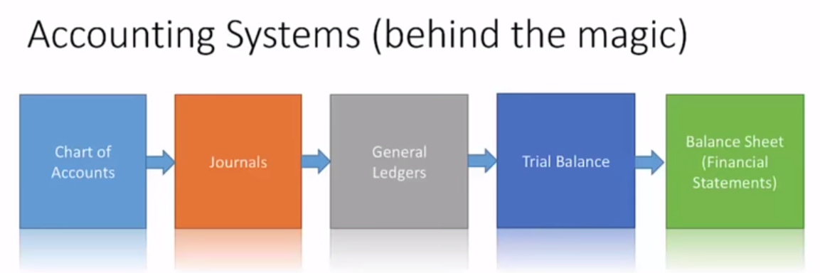
Today’s key points
How to record business transactions?
Double-entry system, rules of debit and credit
T- account

Slide 5
Transactions
Copyright ©2014 Pearson Education
ALL Events that have a on the business and reliably
Selling products
Paying expenses
Have two sides:
Giving
Receiving
Accounting records both sides of transactions
Often called Accounting

Slide 6
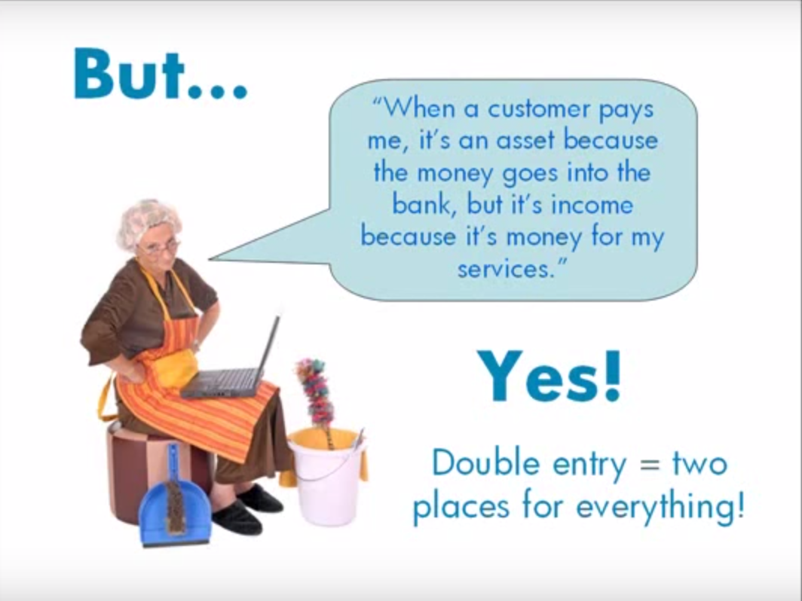

Slide 7
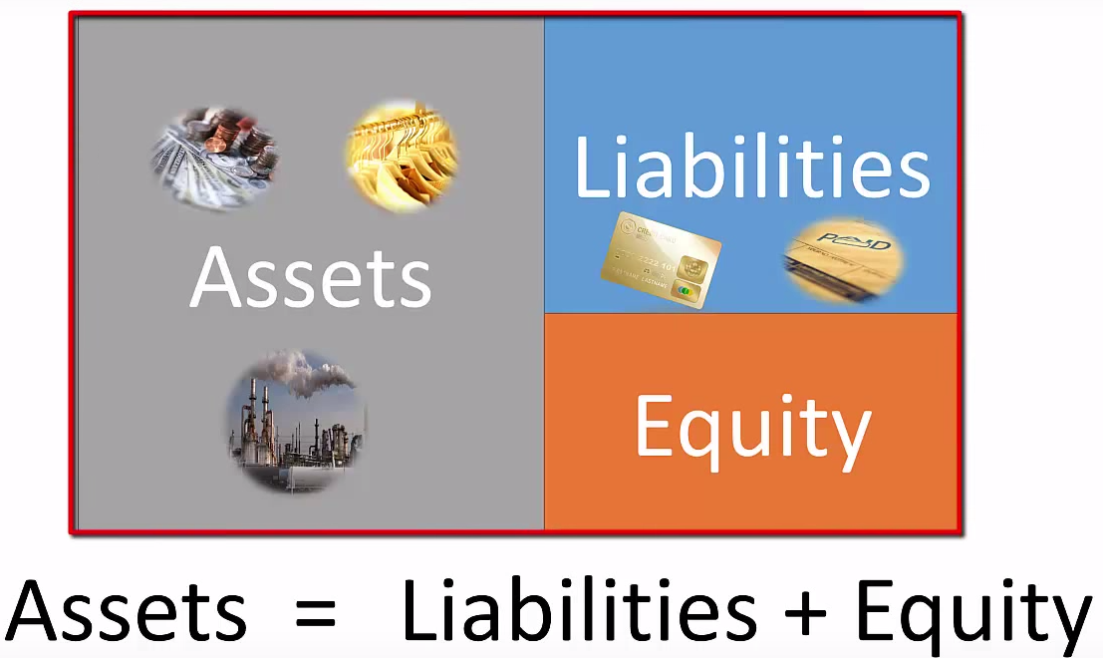
An Account is a record of all the changes in a particular asset, liability and shareholders’ equity element
Basic summary device of accounting
Copyright ©2014 Pearson Education

Slide 8
Assets
Asset Name | Description
Cash | Money and any medium of exchange including bank account balances, paper currency, coins, certificates of deposit, and checks.
Accounts Receivable | Companies sell their goods and services and receives a promise for future collection of cash. The Accounts receivable account holds these amounts. (from )
Notes Receivable | A note receivable is similar to an account receivable, but a note receivable is more binding because the borrower signs a note, often with a specific interest rate. (from )
Inventory | The products a company sells to customers. Other titles for this account include and Merchandise inventory.
Prepaid Expenses | A future expense that has already been paid. Examples: Prepaid rent, Prepaid insurance, and Supplies.
Land | The Land account shows the cost of the land a company uses in its operations.
Buildings | The costs of office buildings, manufacturing plants, etc.
Equipment, Furniture, and Fixtures | These asset accounts includes items such as computers, office furniture and store shelving.
 | (Land, Buildings, Equipment are commonly combined into PPE)

Slide 9
Liabilities
Liability Name | Description
Accounts Payable | The direct opposite of . A company’s promise to pay a debt arising from a purchase.
Notes Payable | A note payable is the opposite of a . The Notes payable account includes the amounts a company must pay because it signed notes promising to pay a future amount, typically with .
Accrued Liabilities | An accrued liability is a liability for an you have not yet paid. Interest payable and Salary payable are accrued liability accounts for most companies. Income tax payable is another accrued liability.

Slide 10
Shareholders’ Equity
Equity Name | Description
Share Capital | The owners’ investment in the corporation. The corporation receives cash and issues shares to its shareholders. A company’s ordinary share capital ( ) is its most basic element of equity. All corporations have ordinary shares.
Retained Earnings | this account shows the earned by a corporation over its lifetime, minus its cumulative net losses and dividends.
Dividends | Dividends are optional; they are declared by the board of directors and represent a payment back to shareholders
Revenues | the in shareholders’ equity from delivering goods or services to customers: includes sales revenue, service revenue, interest revenue, rent revenue, etc.
Expenses | the cost of a business. Expenses shareholders’ equity, the opposite effect of revenues. Examples include: Cost of goods sold, Salary expense, Rent expense, Advertising expense, Insurance expense, Utilities expense, and Income tax expense. Businesses strive to minimize expenses and thereby maximize net income

Slide 11
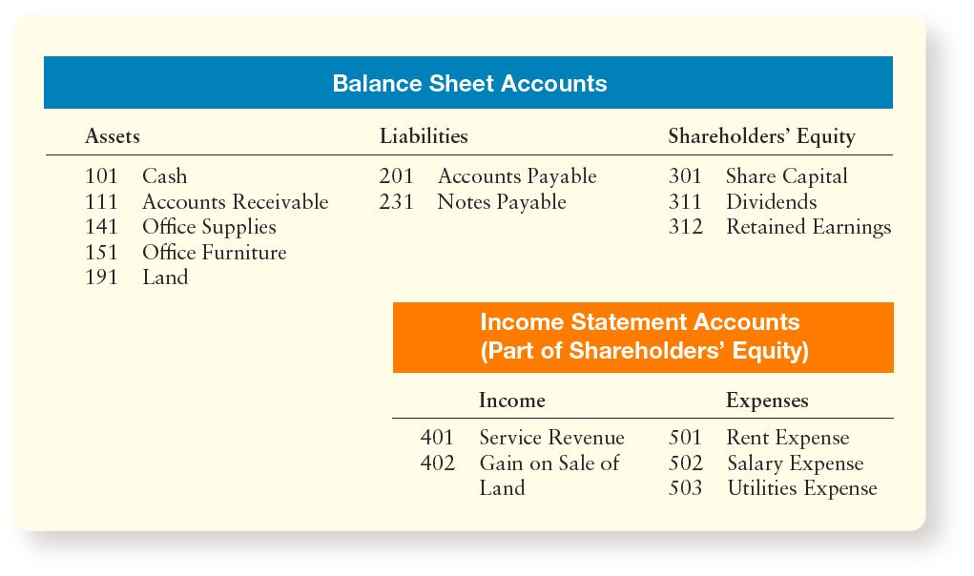
Chart of Accounts: RedLotus Security
Notes:
As you know, the ledger contains the accounts grouped under these headings:
Balance sheet accounts: Assets, Liabilities, and Shareholders’ Equity
Income statement accounts: Incomes and Expenses
Organizations use a chart of accounts to list all their accounts and account numbers. Account numbers usually have two or more digits. Asset account numbers may begin with 1, liabilities with 2, shareholders’ equity with 3, incomes with 4, and expenses with 5. The second, third, and higher digits in an account number indicate the position of the individual account within the category.
For example, Cash may be account number 101, which is the first asset account. Accounts Payable may be number 201, the first liability. All accounts are numbered by using this system.

Slide 12
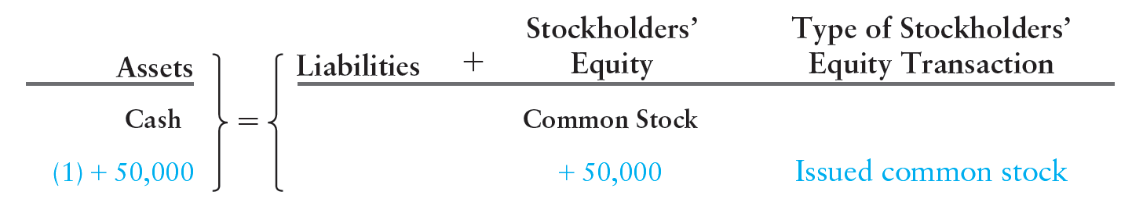
Transaction 1
Analyze the Impact of Business Transactions on the Accounting Equation
On, April 1, Starr Williams and a few friends invest $50,000 to open RedLotus Security, and the business issues common stock to the stockholders.
Notes:
The effect of this transaction is the receipt of cash and the issuance of ordinary share (common stock). Every transactions net amount on the left side of the accounting equation must equal the net amount on the right side.

Slide 13
Transaction 2
RedLotus purchases land for a new location and pays cash of $40,000.
Notes:
This purchase increases an asset, land, and decreases another asset, cash. Keep in mind that total assets must always equal liabilities + equity.

Slide 14
Transaction 3
The business buys supplies on account, agreeing to pay $3,700 within 30 days.
Notes:
This transaction increases both assets and liabilities. The new asset is supplies and the new liability is the $3,700 which will be a credit to Accounts Payable. Assets still equal Liabilities + Equity.

Slide 15
Transaction 4
RedLotus earns $7,000 of service revenue by providing services for customers.
Notes:
The effect on the accounting equation is an increase in the asset Cash and an increase in Retained Earnings.

Slide 16
Transaction 5
RedLotus performs services $3,000 on account, which means that RedLotus lets some customers pay later.
Notes:
RedLotus earns revenues but does not receive cash immediately. This promise from the customers to pay represents an Accounts Receivable, an asset to RedLotus Travel. Revenue is recorded when earned, in other words when the service is performed, regardless of when the cash is received.

Slide 17
Transaction 6
During the month, RedLotus Security, pays $2,700 for the following expenses: rent $1,100; employee salaries, $1,200; and utilities, $400.
Notes:
These expenses decrease RedLotus’ Cash and Retained Earnings. List each expense separately to track the account and facilitate the preparation of the income statement later.

Slide 18
Transaction 7
RedLotus pays $1,900 on account, which means to make a payment toward an account payable.
Notes:
This transaction decreases Cash, an asset, and Accounts Payable, a liability account.

Slide 19
Transaction 8
Starr Williams, the major stockholder of RedLotus Travel, paid $30,000 out of his personal bank account to remodel his home.
Notes:
This is a personal event that would not effect the business.

Slide 20
Transaction 9
In transaction 5, RedLotus performed services for UPS on account. The business now collects $1,000 from UPS.
Notes:
RedLotus collected cash on account, which means that RedLotus will record an increase in Cash and a decrease in Accounts Receivable, both asset accounts.

Slide 21
Transaction 10
RedLotus sells some land for $22,000, which is the same amount RedLotus paid for the land and makes a $2,000 gain.
Notes:
Cash will increase by $22,000, while Land decreases by $20,000. Retained Earnings will increase by $2,000.

Slide 22
Transaction 11
RedLotus Security, declares a dividend and pays the stockholders $2,100 cash.
Notes:
This transactions decreases both Cash and Retained Earnings of the business. However, dividends are NOT an expense. They are a separate shareholders’ equity account.

Slide 23
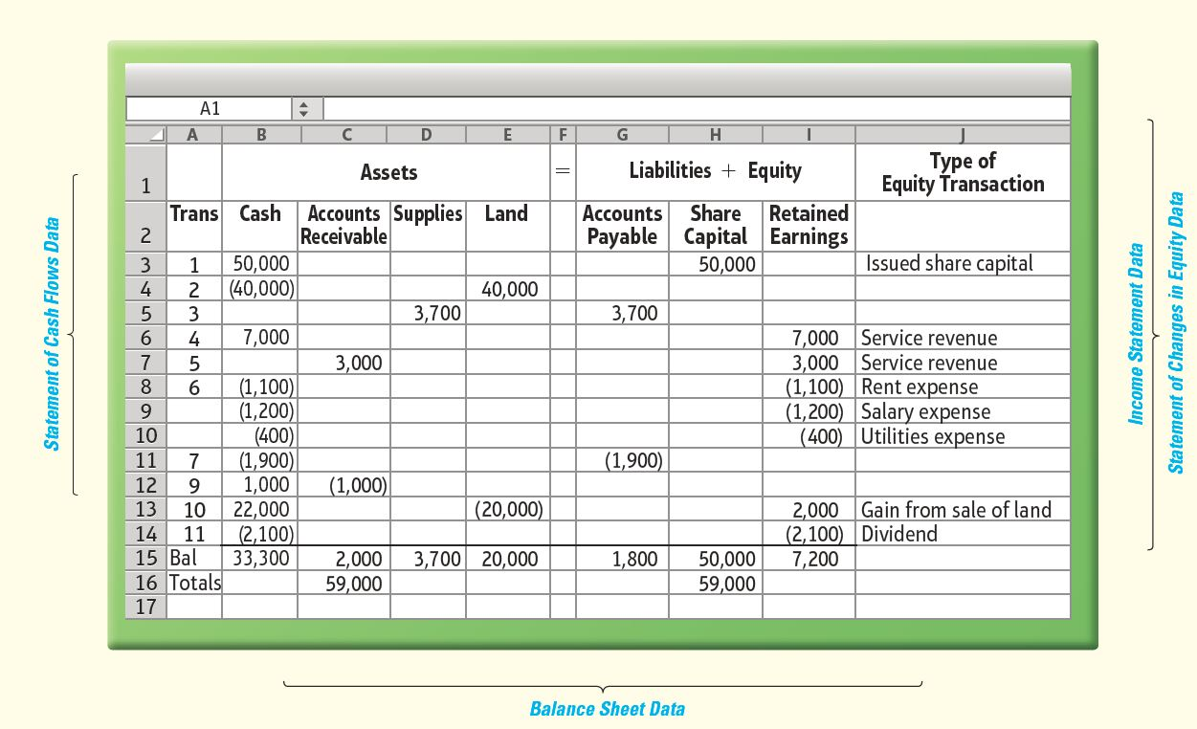
Transaction Analysis: RedLotus Security
Notes:
Exhibit 2-2 summarizes the 11 preceding transactions and provides a transaction analysis. Note that every transactions maintains the accounting equation: Assets = Liabilities + Equity.

Slide 24
Double-Entry Accounting
Copyright ©2014 Pearson Education
Business transactions include two parts
Giving
Receiving
Accounting based on a double-entry system
Each transaction affects accounts

Slide 25
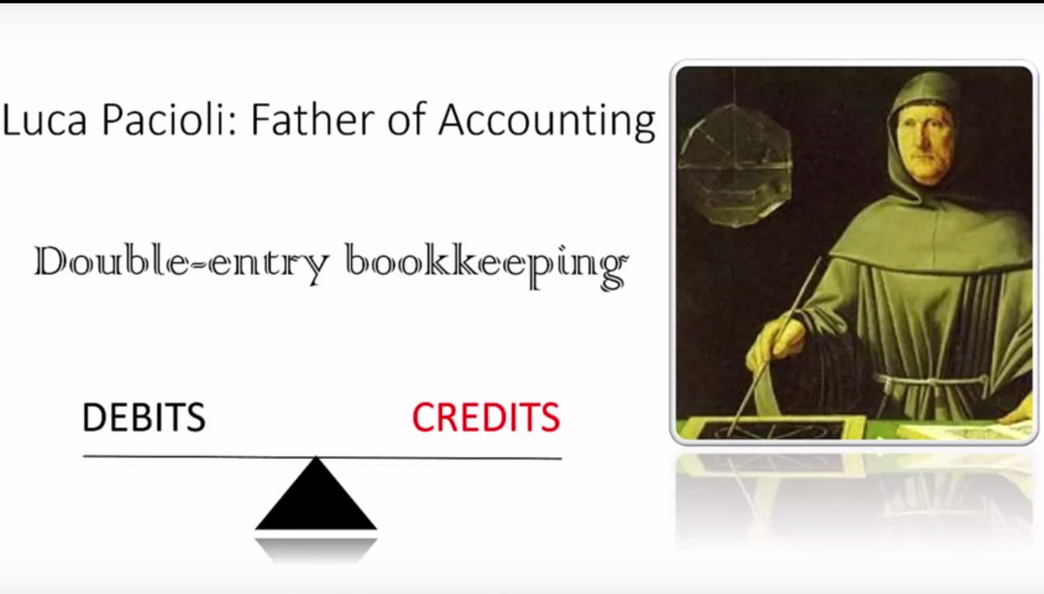

Slide 26
T-Account
Account Title
Left side
Right side
Debit
Credit
Copyright ©2014 Pearson Education

Slide 27
Rules of Debit and Credit
Shareholders’ Equity
Assets
Liabilities
Debit
Credit
Debit
Credit
Debit
Credit
Copyright ©2014 Pearson Education

Slide 28
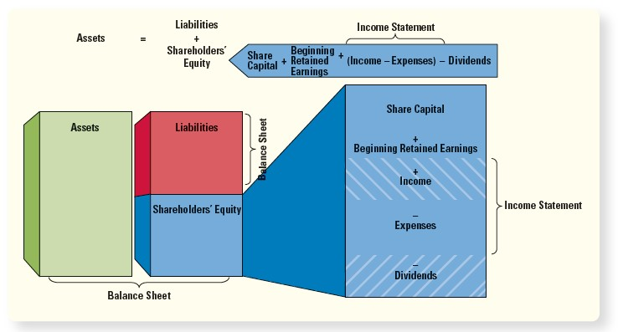
Expansion of the Accounting Equation
Notes:
Exhibit 2-7 shows how the accounting equation may be expanded. It is important to understand all of these rules before proceeding. Shareholders’ equity includes share capital, retained earnings, dividends, and the net effect of revenues minus expenses, known as net income or net loss.

Slide 29
Rules of Debit and Credit
Shareholders’ Equity
Assets
Liabilities
Share Capital
Retained earnings
Debit
Credit
Debit
Credit
Debit
Credit
Debit
Credit
-
-
-
-
Dividends
Debit
Credit
-
Revenue
Expenses
Debit
Credit
Debit
Credit
-
-
Copyright ©2014 Pearson Education

Slide 30
Normal Balances of Accounts
Take 1 minute to fill out what is the normal balance of each type of account
Assets
Liabilities
Shareholders’ Equity overall
Share capital
Retained earnings
Dividends
Revenues
Expenses
Copyright ©2014 Pearson Education

Slide 31
Flow of Accounting Data
Notes:
Exhibit 2-11 above summarizes the flow of accounting data from when the transaction occurs to the posting to the ledger.

Slide 32
Record (Journalize and Post) Transactions in the Books
Journal
Chronological record of transactions
Three steps:
Specify each account affected by the transaction and classify by type
Determine if each account is increased or decreased (debit or credit)
Record in the journal
Notes:
Accountants use a chronological record of transactions called a journal, also known as the book of original entry. The journalizing process follows three steps:
1. Specify each account affected by the transaction and classify each account by type (asset, liability, shareholders’ equity, income, or expense).
2. Determine whether each account is increased or decreased by the transaction. Use the rules of debit and credit to increase or decrease each account.
3. Record the transaction in the journal, including a brief explanation. The debit side is entered on the left margin, and the credit side is indented to the right.
Step 3 is also known as “booking the journal entry” or “journalizing the transaction”

Slide 33
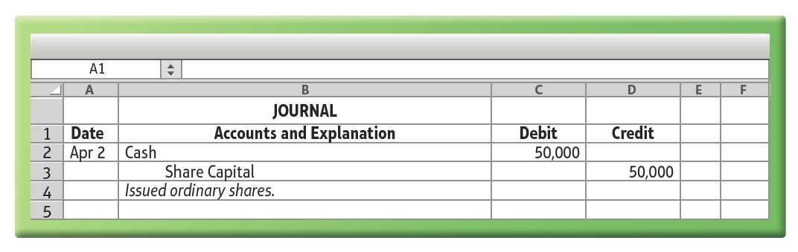
Record (Journalize and Post) Transactions in the Books
Steps to journalize the first transaction of RedLotus Security
Step 1 Business receives $50,000 cash and issues stock
Step 2 Both Cash and Common Stock increase
Step 3 Journalize the transaction:
Notes:
Let’s apply the steps to journalize a transaction in which a company issues stock for $50,000 cash on April 1.
Step 1 The business receives cash and issues stock. Cash and Share Capital are affected. Cash is an asset, and Share Capital is equity.
Step 2 Both Cash and Share Capital increase. Debit Cash to record an increase in this asset. Credit Share Capital to record an increase in this equity account.
Step 3 Journalize the transaction as shown above.
To journalize, first pinpoint the effects (if any) on Cash, as these effects are normally the easiest to identify. Then identify the effects on other accounts.

Slide 34
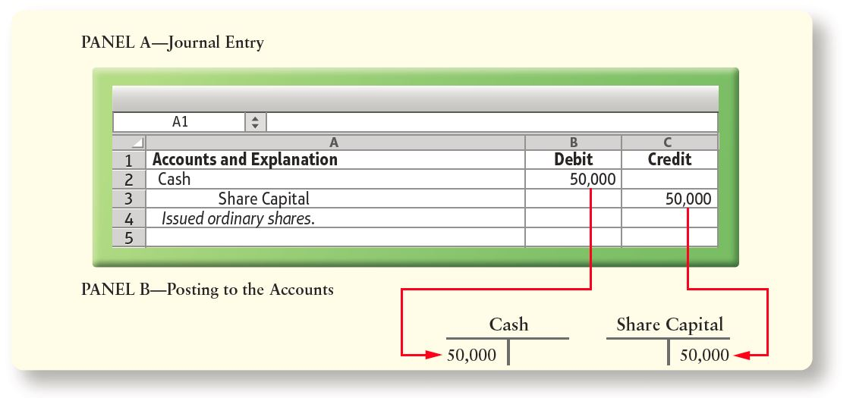
Journal Entry and Posting to the Accounts
Notes:
Exhibit 2-10 shows how RedLotus’s share issuance transaction is posted to the accounts. Debits always remain debits and credits remain credits.

Slide 35
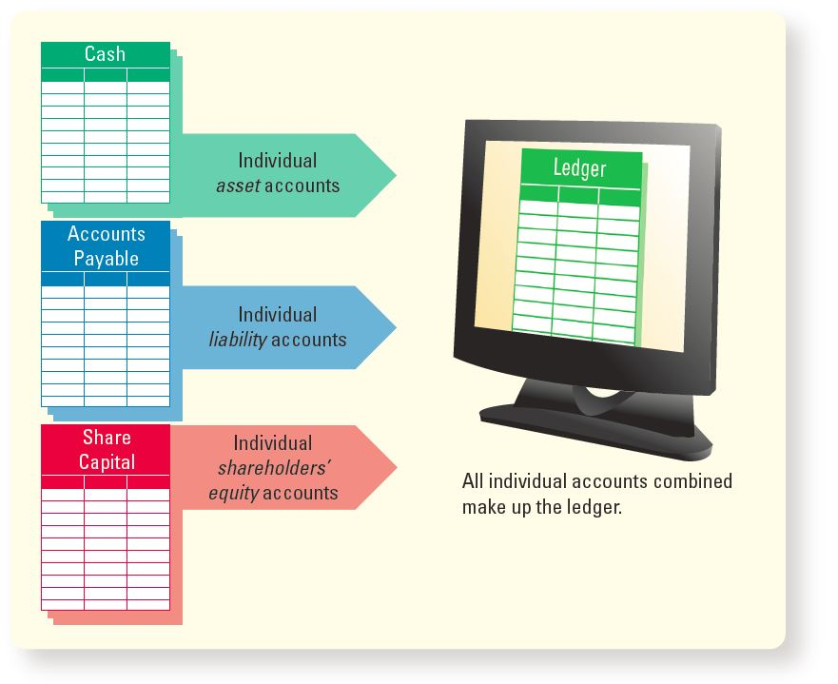
The Ledger
Notes:
The ledger is a grouping of all the T-accounts, with their balances. Exhibit 2-9 shows how asset, liability, and shareholders’ equity accounts are grouped in the ledger. Revenue and expense accounts also appear in the general ledger, which may contain hundreds or even thousands of accounts. Entering a transaction into the journal does not get the data into the ledger. Data must be copied to the ledger through a process called posting. The next slide illustrates posting to the ledger.

Slide 36
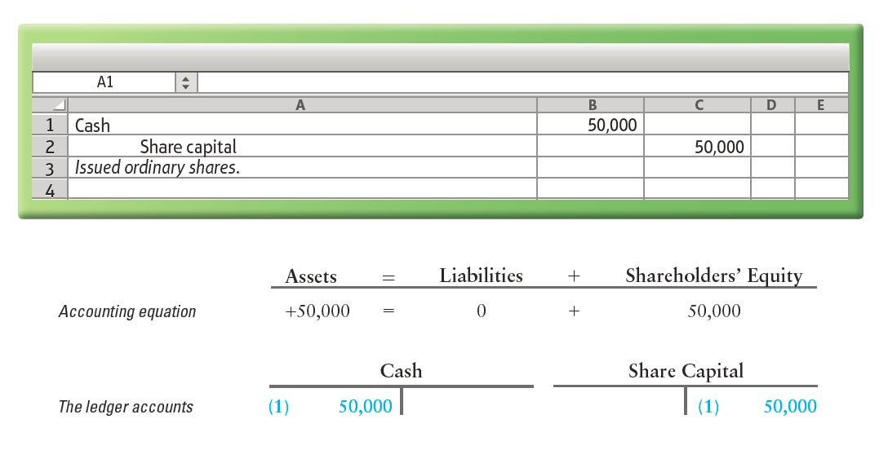
Record Journals Transaction 1 Analysis
(1) Received $50,000 cash and issued stock to the owners

Slide 37
Transaction 2 Analysis
(2) Paid $40,000 cash for land

Slide 38
Transaction 3 Analysis
(3) Purchased supplies for $3,700 on account

Slide 39
Transaction 4 Analysis
(4) Performed services and received cash of $7,000

Slide 40
Transaction 5 Analysis
(5) Performed services for UPS on account, $3,000

Slide 41
Transaction 6 Analysis
(6) Paid cash expenses: rent, $1,100; employee salary, $1,200; utilities, $400

Slide 42
Transaction 7 Analysis
(7) Paid $1,900 on the payable created in transaction 3

Slide 43
Transaction 8 Analysis
(8) Stockholder of RedLotus remodeled her home with personal funds

Slide 44
Transaction 9 Analysis
(9) Received $1,000 on account

Slide 45
Transaction 10 Analysis
(10) Sold land for cash at the land’s cost of $22,000 and a gain of $2,000 is recognized

Slide 46
Transaction 11 Analysis
(11) Declared and paid a dividend of $2,100 to shareholders

Slide 47
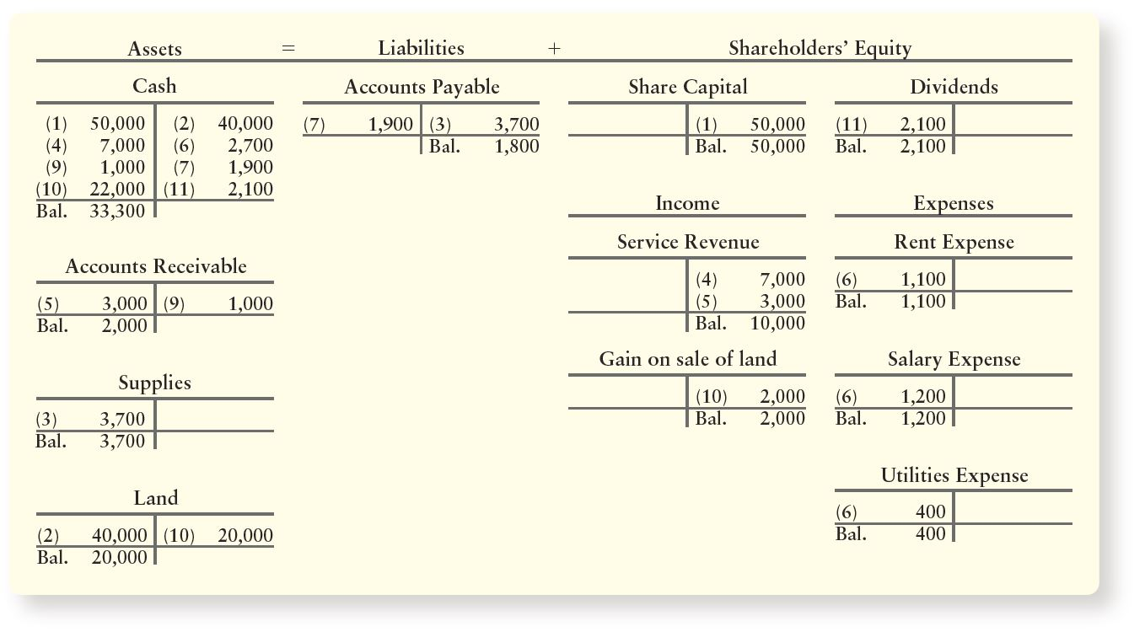
RedLotus Security’s Ledger Accounts after Posting
Notes:
Exhibit 2-12 shows the accounts after all transactions have been posted to the ledger. Group the accounts under assets, liabilities, and shareholders’ equity.
Each account has a balance, denoted as Bal, which is the difference between the account’s total debits and its total credits. For example, the Accounts Payable’s balance of $1,800 is the difference between the credit ($3,700) and the debit ($1,900). Cash has a debit balance of $33,300.

Slide 48
Construct and Use a Trial Balance
Trial Balance
Lists with their balances
Assets listed first, then liabilities and shareholders’ equity
Shows that debits credits
Usually prepared at the end of the period
Facilitates preparation of the financial statements

Slide 49
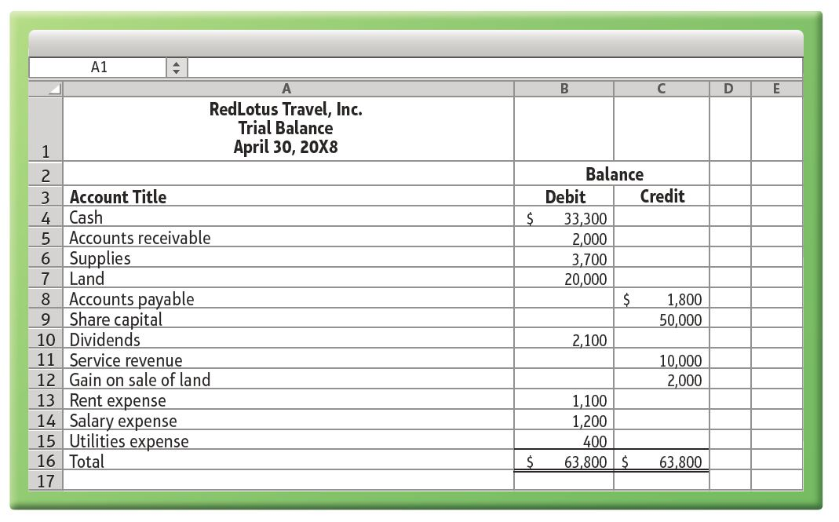
Trial Balance
Notes:
Exhibit 2-12 is RedLotus Security.’s trial balance after all transactions have been posted for April 30, 20X8.

Slide 50
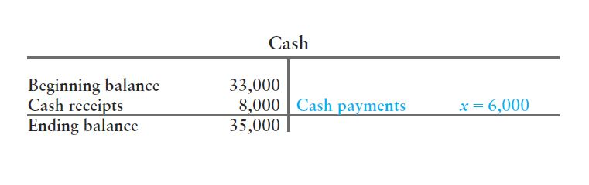
Analyzing Accounts (1 of 3)
Suppose RedLotus’ began May with cash of $33,000. During May, RedLotus’ received cash of $8,000 and ended the month with a cash balance of $35,000.
You can compute total cash payments by analyzing RedLotus’ Cash account:
Notes:
You can often tell what a company did by analyzing its accounts. This is a powerful tool for a manager who knows accounting. For example, if you know the beginning and ending balances of Cash, and if you know total cash receipts, you can compute your total cash payments during the period.

Slide 51
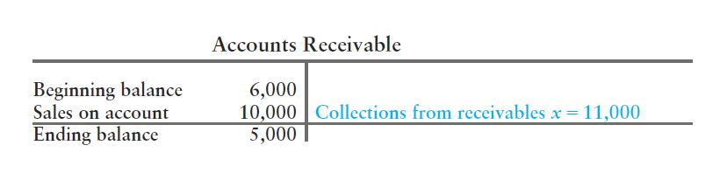
Analyzing Accounts (2 of 3)
You can compute either sales on account or cash collections on account by analyzing the Accounts Receivable account (using assumed amounts):

Slide 52
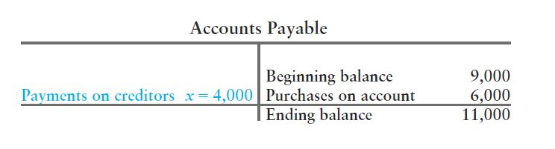
Analyzing Accounts (3 of 3)
You can determine how much you paid on account by analyzing Accounts Payable (using assumed amounts):

Slide 53
Correcting Accounting Errors
Missing account
Trace each account from journal to ledger
Divide out-of-balance amount by 2
Reversing debits and credits doubles the error
Divide out-of-balance amount by 9
If even, error may be a
Slide (writing $200 as $20)
Transposition (writing $210 as $120)
Copyright ©2014 Pearson Education

Slide 54
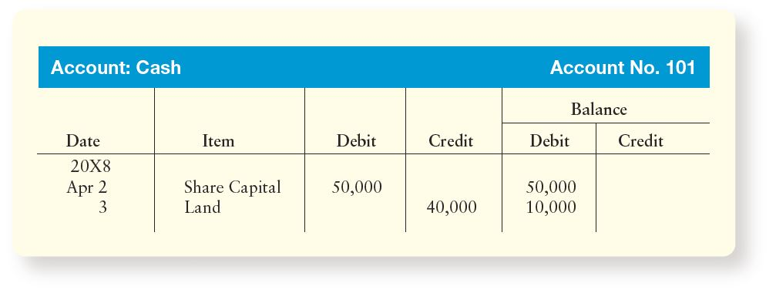
Account in Four-Column Format
Notes:
So far we have only discussed accounts in a two-column T-account format, with the debit column on the left and the credit column on the right.
Another format has four amount columns, as illustrated for the Cash account in Exhibit 2-16. The first pair of amount columns on the left are for the debit and credit amounts of individual transactions. The last two columns are for the account balance. This four-column format keeps a running balance in the two right columns.

Slide 55
Review of Chapter 2
Accounting is based on a double-entry system: Each transaction affects at least two accounts.
Rules of debit and credit (normal balance?)
Assets=Liability + Equity
Debit Credit Credit
Net income=Revenue-Expenses
Credit Credit Debit
Accounting process:
Transactions ➔ Journals ➔ ledger ➔ trial balance ➔ financial statements ➔ business decisions

Slide 56
What will we learn in Chapter 3?
Accrual accounting.
Revenue recognition and matching principles.
Prepare the financial statements.
Adjust the accounts.
Close the book.

