Slide 1
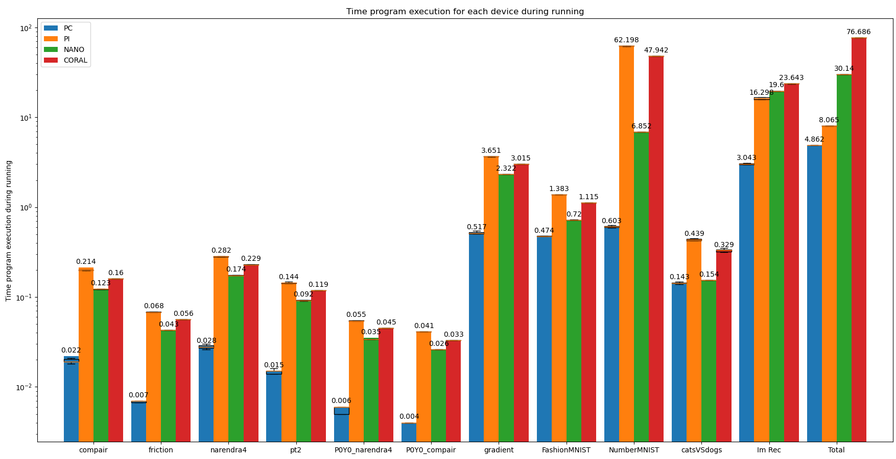
Accelerated edge computing with Neural Networks
Ghent Technology Campus
2019-2020
Introduction
Program setup
The roll out of self driving vehicles requires precise position fixing. To aid to lower latency between position measurements and the calculated position a benchmark is proposed to examine the potential of running Neural Networks (NN) on edge devices like the Nvidia Jetson Nano, Google Coral Dev and Raspberry Pi 3 or a non-edge device like a PC.
Start measurement
Run NN
End measurement
iterations +1
Data extraction
#iterations = 20?
To get a representative benchmark, it is necessary to investigate the performance of different programs on each SBC in an identical manner. In this benchmark X different programs are tested spread across Y categories of Neural Networks as regression and classification. For each program the duration of execution and utilization of the processor unit is measured and stored. To exclude outliers every program will be run for 20 different iterations.
No
Yes
Next program
Data analysis
To compare the equivalence of different SBC, latency data will be compensated for variables like processor usage, clock speed, price and energy usage. The results will be normalised to ease a comparison.
Conclusion
qsdfqfsqdf
Student: Arno Plaetinck
Promotor: Dr. Ir. Nobby Stevens
Co-promotors: Ing. Willem Raes
Ing. Jorik De Bruycker
KU Leuven
Ghent Technology Campus Gebroeders de Smetstraat 1
9000 Ghent
Master in Electronics and ICT Engineering
Technology option Embedded Systems
Academic year: 2019-2020
Date: 6/04/2020

