Slide 1
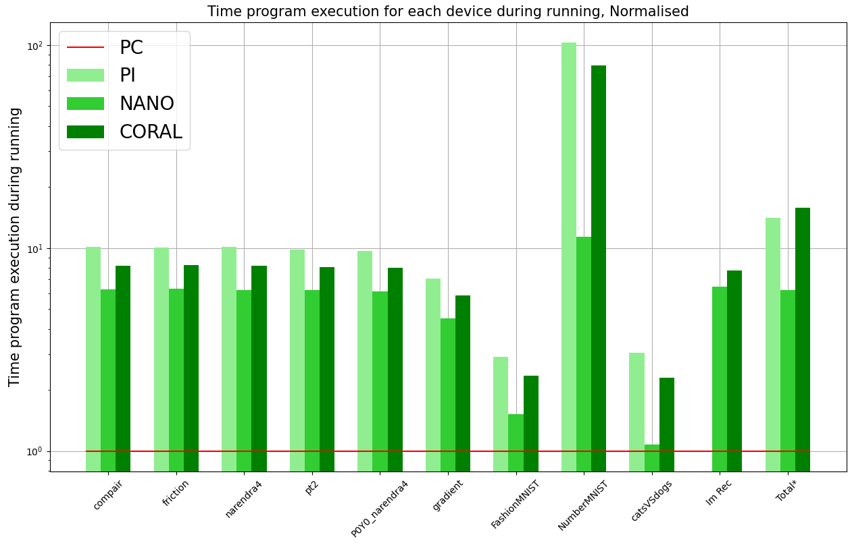
Comparative Study of Single Board Computers for AI Edge Computing Purposes
Ghent Technology Campus
2019-2020
Introduction
Training models:
The deployment of self-driving vehicles is one of many new and interesting low-latency applications. To aid to lower latency during localization in position fixing, a benchmark is proposed to examine the potential of executing a trained Neural Networks (NN) or Machine Learning (ML) algorithm on edge devices like the Nvidia Jetson Nano, Google Coral Dev and Raspberry Pi 3 compared to regular computer.
Setup Data
Train models
Store model
.tflite-file
Running models:
Setup Data
Run models
Store data
Data acquisition
In order to achieve a representative benchmark, it is necessary to investigate the performance of different programs on each edge device in an identical manner. In this benchmark several different programs are tested spread across categories of NN as regression and classification. For each program the duration of execution and utilization of the processor unit is measured and stored. To achieve statistically results, every program will be run for 20 different iterations.
.tflite-file
.csv-file
Plotting results:
.csv-file
Setup
results
Plot results
Devicedata
Data analysis
To compare the performance of different edge devices, latency data will be adjusted for variables like processor usage, clock speed, price and energy usage. The results are normalised to ease a comparison.
Conclusion
The results show that among edge-devices, the Jetson Nano is the Single Board Computer with the lowest latency. When comparing power consumption for the given latency, the Coral Dev is the most power efficient.
Student: Arno Plaetinck
Promotor: Prof. Dr. Ir. Nobby Stevens
Co-promotors: Ing. Willem Raes
Ing. Jorik De Bruycker
KU Leuven
Ghent Technology Campus Gebroeders de Smetstraat 1
9000 Ghent
Master in Electronics and ICT Engineering
Technology option Embedded Systems
Academic year: 2019-2020
Date: 6/04/2020

