Slide 1

Virtualized research architecture
Arnstein Orten

Slide 2

National strategy
Cloud services should always be considered
And chosen where they are cheapest and most expedient
Information security must be catered for

Slide 3
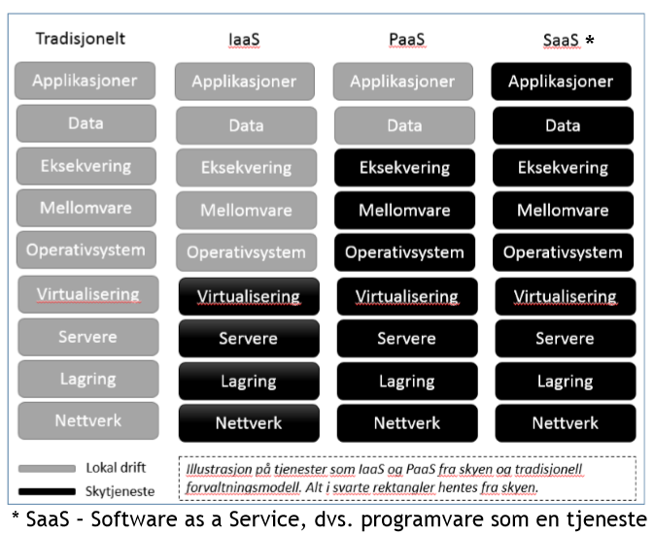
Cloud technology and services
The Cloud Computing concept refers to physical components, software, services, business models and delivery models.
It represents a paradigm shift for production, distribution and use of IT services
Example: Infrastructure as a Service (IaaS) – buy datacentre functionality over the Internet instead of investing locally.

Slide 4
Why choose cloud services?
Very fast to set up
No cost to set up a small instance
Easy scaling
IaaS: Flexibility
...

Slide 5
You can
do it yourself !!!
Now.

Slide 6


UH-sky: OpenStack IaaS
Mini workshop:
Quick background
Log in on web GUI
  Make a machine via Web GUI
  To verify: Log in on the machine via SSH.
Install and set up CLI
  Attach storage via CLI
  Make a new machine via CLI
Play around
  E.g. install a graphical software package
  Or install a web server
  Or install your workflow tools
My lesson notes are at
https://arnsteio.github.io/UH-IaaS-mini-workshop/

Slide 7
Why not use cloud services?
Compliance issues. Data protection
Legacy systems
SaaS / PaaS: inflexibility
Uncertain costs
Skill set

