Slide 1

Virtualized research architecture
Arnstein Orten

Slide 2

National strategy
Cloud services should always be considered
And chosen where they are cheapest and most expedient
Information security must be catered for

Slide 3
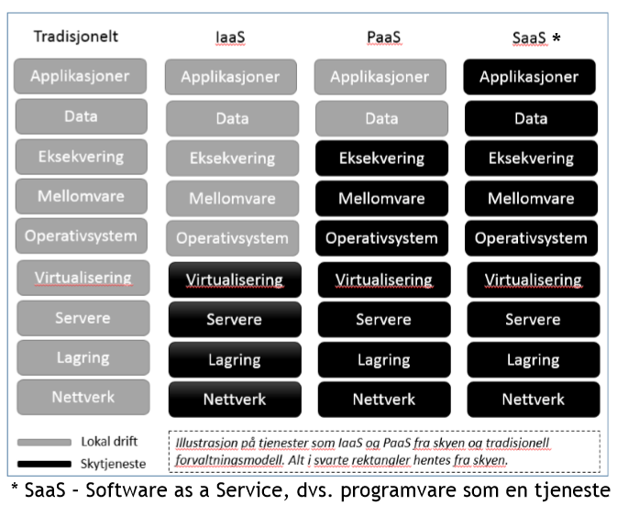
Cloud technology and services
The Cloud Computing concept refers to physical components, software, services, business models and delivery models.
It represents a paradigm shift for production, distribution and use of IT services
Example: Infrastructure as a Service (IaaS) – buy datacentre functionality over the Internet instead of investing locally.

Slide 4
Why choose cloud services?
Very fast to set up
No cost to set up a small instance
Easy scaling
IaaS: Flexibility
...

Slide 5
You can
do it yourself !!!
Now.

Slide 6
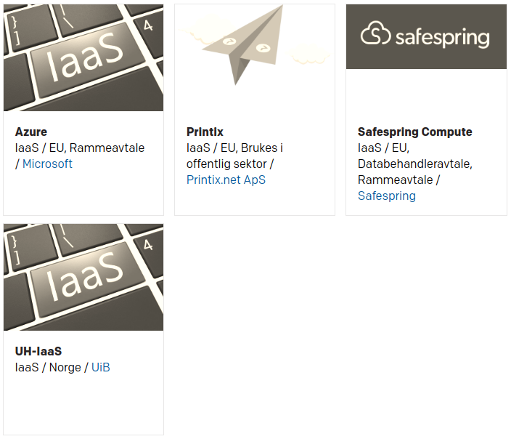
OpenStack sector suppliers
OpenStack: a free and open-source software platform for cloud computing, mostly deployed as IaaS. https://www.uninett.no/sky :
Safespring
UH-IaaS

Slide 7


UH-sky: OpenStack IaaS for the University sector
Please go to
https://arnsteio.github.io/UH-IaaS-workshop/
to continue with the workshop

Slide 8
FINISHED
After here should be thrown away

Slide 9
UH-sky: OpenStack IaaS
Set up CLI
  Install openstack command-line interface
  Log in on web GUI to get the API password
  Set up CLI
Use CLI
  Make a machine
  Log in on the machine
  Attach storage
  Make a new machine and move the storage to that machine
Play around
  E.g. install a graphical software package
  Or install a web server
  Or install your workflow tools
My lesson notes are at
https://arnsteio.github.io/UH-IaaS-mini-workshop/

Slide 10
Install command-line interface
Windows:
  Install Python.
  Ensure that Python directory is defined in the PATH environment variable, then run (as admin):
  C:\>pip install python-openstackclient
  Docs at e.g. https://github.com/naturalis/openstack-docs/wiki/Howto:-Installing-and-configuring-the-OpenStack-commandline-tools-on-Windows
Linux
  apt-get install openstack-cli
  or
  apt install python3-openstackclient
  or
  apt install python-dev python-pip
  pip install python-openstackclient

Slide 11
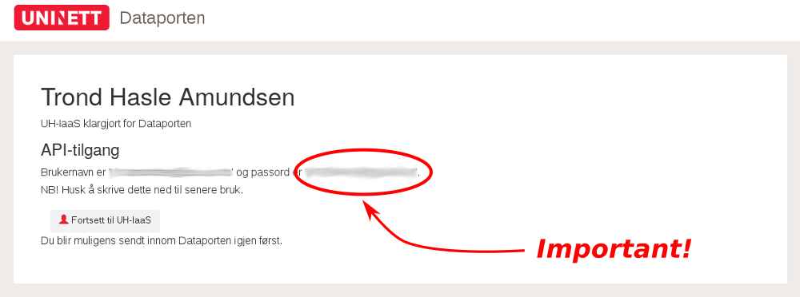
Get API password
Go to https://access.uh-iaas.no/ and log in. Write down the API password!

Slide 12
Set up client interface
arnsteio@☠:~$ cat keystone_rc.sh
export OS_USERNAME=arnstein.orten@geo.uio.no
export OS_PROJECT_NAME=DEMO-arnstein.orten.geo.uio.no
export OS_PASSWORD=<API-password-from-1st-login>
export OS_AUTH_URL=https://api.uh-iaas.no:5000/v3
export OS_IDENTITY_API_VERSION=3
export OS_USER_DOMAIN_NAME=dataporten
export OS_PROJECT_DOMAIN_NAME=dataporten
#export OS_REGION_NAME=bgo
export OS_REGION_NAME=osl
export OS_NO_CACHE=1

Slide 13
Why not use cloud services?
Compliance issues. Data protection
Legacy systems
SaaS / PaaS: inflexibility
Uncertain costs
Skill set

