Slide 1

IoT Firmware Dumpster Fire
Dumping IoT Firmware
for Non-Electrical Engineers
Lucipher | arntsonl@gmail.com | github.com/arntsonl
DC614 – Dec’ 2019

Slide 2
Intro
Who Am I?
Why Would You Do This?
Firmware Dumping vs. Analysis
Hardware Hacking is Fun!

Slide 3
How to Approach the Topic
Consumer IoT Devices are Designed like Discount Computers
Computer:
CPU, Memory, Hard Drive, PSU, Peripherals
PCB Board:
System-on-a-Chip (SoC)/CPU, DRAM, Flash Chips, VCC Regulators, Random ICs

Slide 4
Things You Must Learn (Hint: YouTube)
Reading Chips & Finding Datasheets
PCB Boards & Following Traces
Understanding Voltage (High / Low)
Clock Cycles & Timing (What is a MegaHurts?)

Slide 5
Dumping Firmware Must Knows
SPI, I2C, UART, Etc. are Just Communication Interfaces
Computers -> IoT : USB, Parallel Port, Ethernet Port, Firewire
Chips Usually Follow Their Datasheets
Generally, the “CPU” Does Not Store Firmware

Slide 6
Learn By Doing, Not By Reading
Disassemble Everything!
Start Easy! Find Tutorials on Hackaday/Reddit
Follow Tutorials! CS/CE/EE Schooling Does Not Teach This!
Practice, Rinse, Repeat

Slide 7

Goodwill Hunting
Go to Goodwill, Buy Some Crap
Anything < $10 is Fair Game
My Finds:
Netgear R6200 Internet Route : $4.99
Arris SBG6700-AC Cable Modem : $4.99

Slide 8
Must Have Toolbox
Soldering Gear (Flux, Tips, Kapton, Braid)
Logic Analyzer (DSLogic Plus, Salae Logic Pro 16, ~100mhz)
BusPirate (1-wire, UART, i2C, SPI, limited JTAG)
Arduino or FTDI USB (Easy Serial Interface)

Slide 9
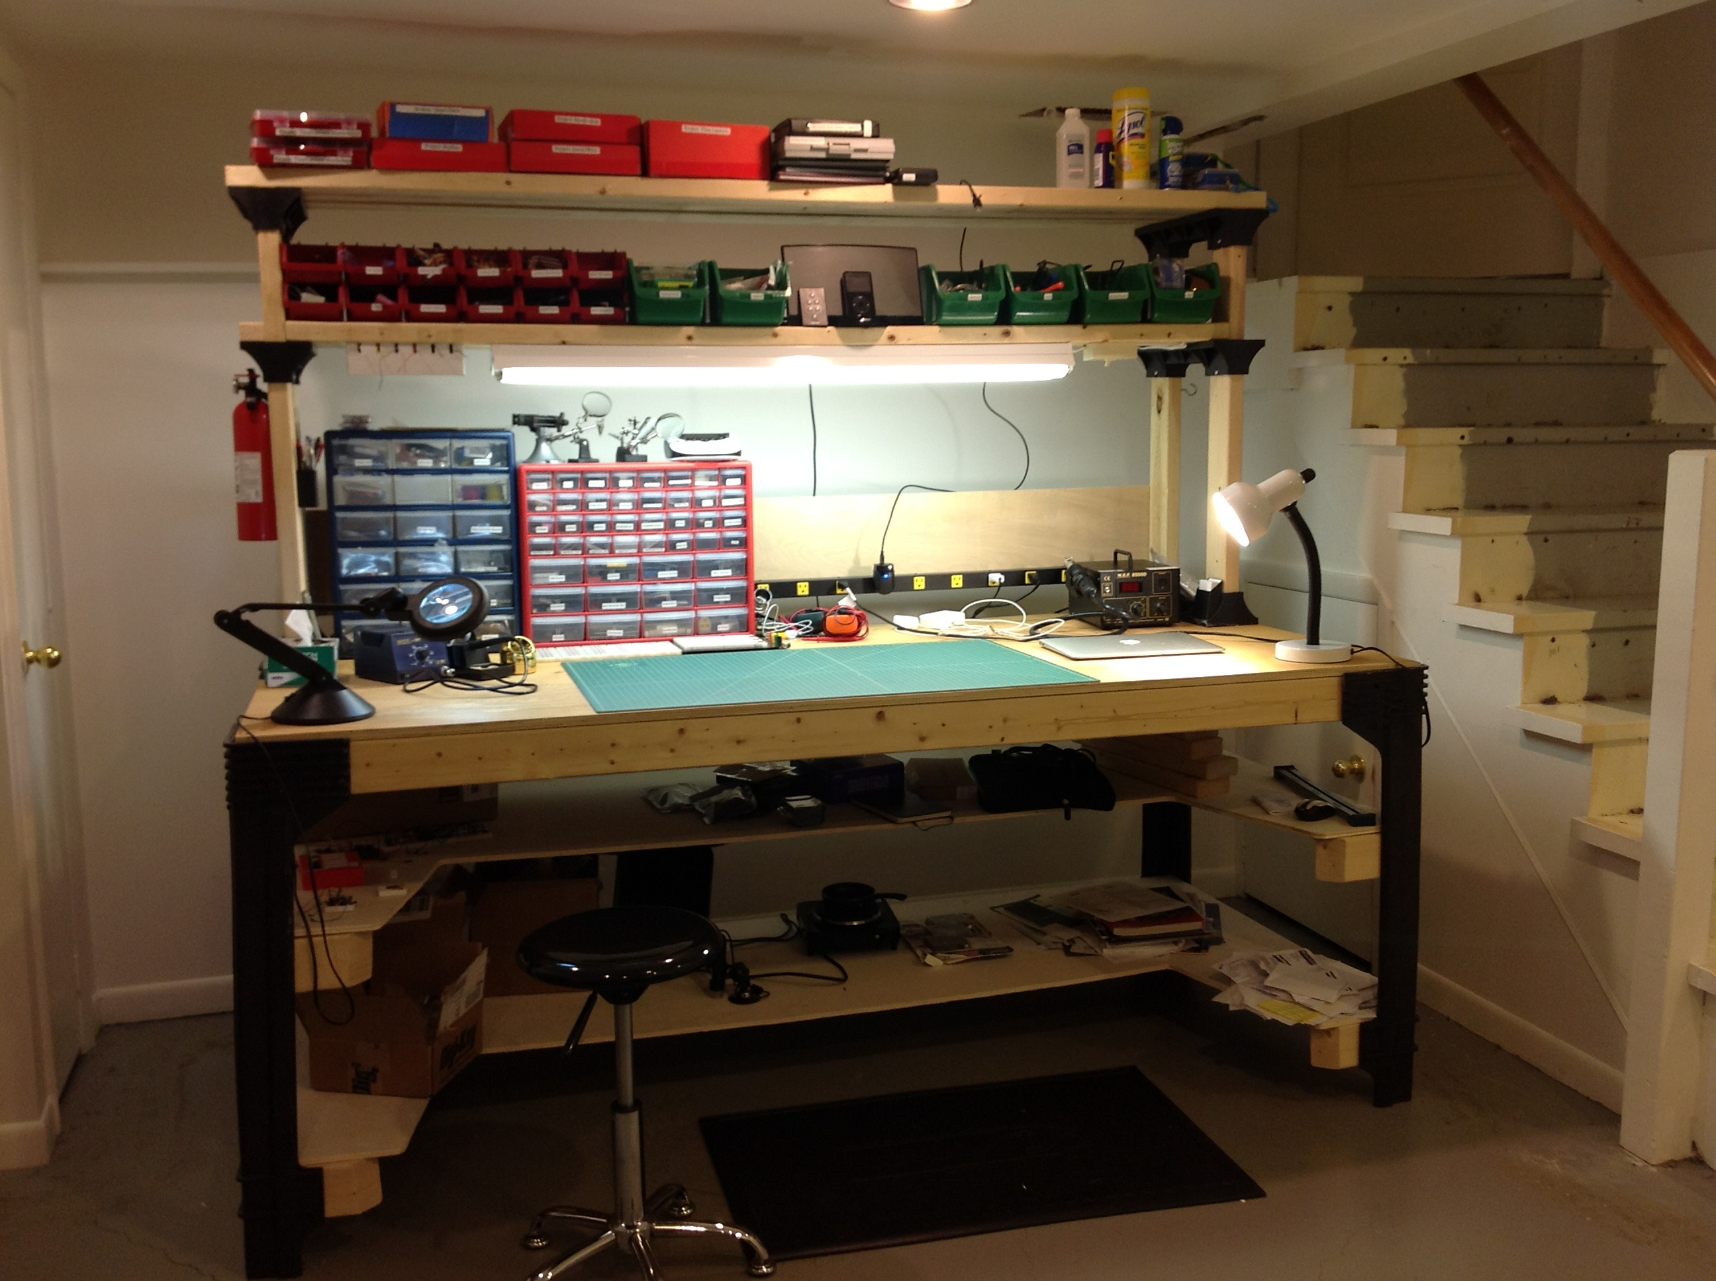
Lab / Nice to Haves
Jeweler’s Loop / Magnifying Headset or Desk Magnifier
Good Lighting / Workmat
Helping Hands / PCB Vice
(Not Mine)

Slide 10

Basic Firmware Dumping – Lesson 1
How Do I Read Chips?

Slide 11
Basic Firmware Dumping – Lesson 1
Find Each Line of Text on the Chip (Logo is Important)
Google the First X Number of Characters of Top Line
Try Just Clumps of Alpha-Numeric (TC, TC58, TC58NVG, TC58NVG0S3), Find Family of Chips

Slide 12
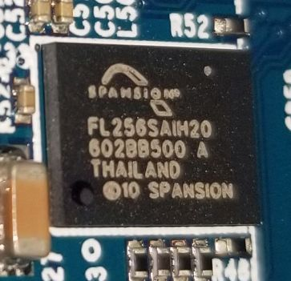
Basic Firmware Dumping – Lesson 1
Example Chip (Phone Camera w/ Sharp Angle)
Chip Maker: Spansion
Part Number: FL256SAIH20
Orientation: Bottom-Left

Slide 13
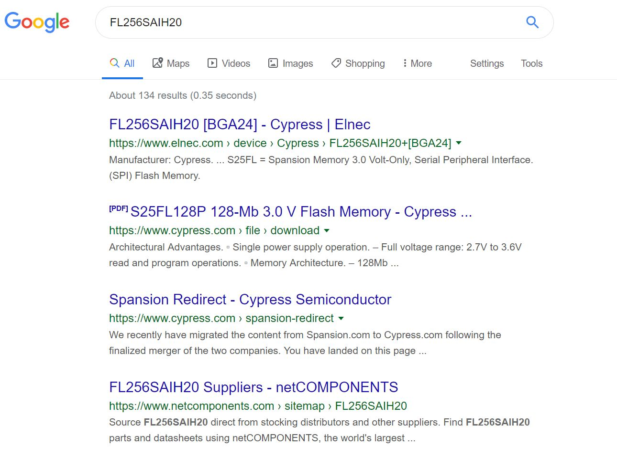
Basic Firmware Dumping – Lesson 1

Slide 14
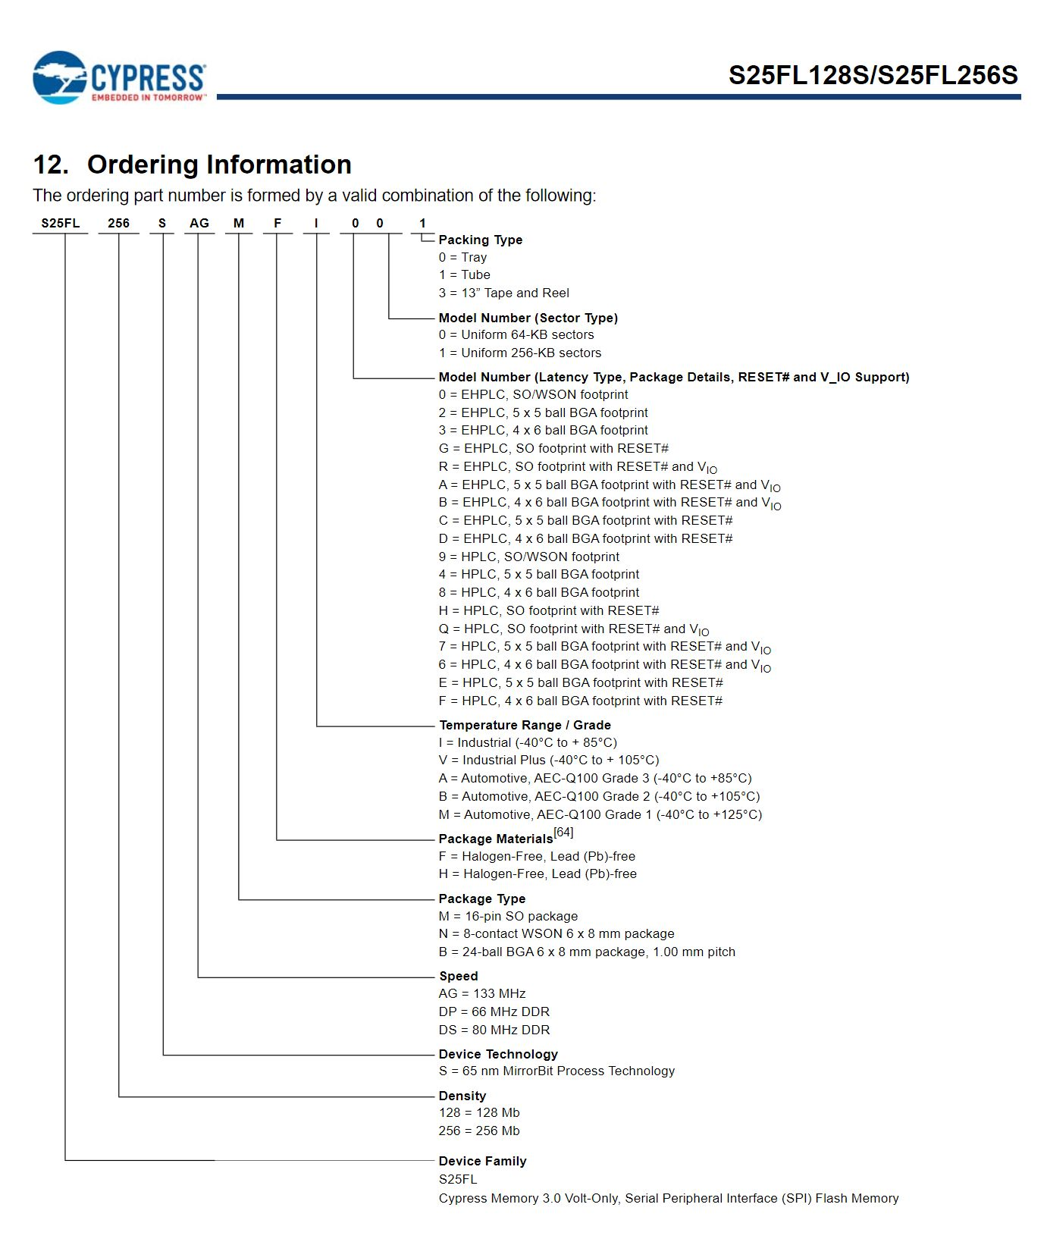
Basic Firmware Dumping – Lesson 1
Translate to Cypress Order:
FL256SAIH20
FL – Device Family (S25FL)
256 – 256 Mb Density
S – 65 nm MirrorBit
AIH – Probably Package/Operating
2 – 5x5 Ball BGA
0 – Uniform 64-KB Sectors
Could Be Wrong, YOLO

Slide 15
Basic Firmware Dumping – Lesson 1
Usually “128” or “256” are size in Mbytes
Often You Identify a Non-Flash Chip
Work Through the Chips
Chinese Clones (STLink->CMS, Etc.)

Slide 16
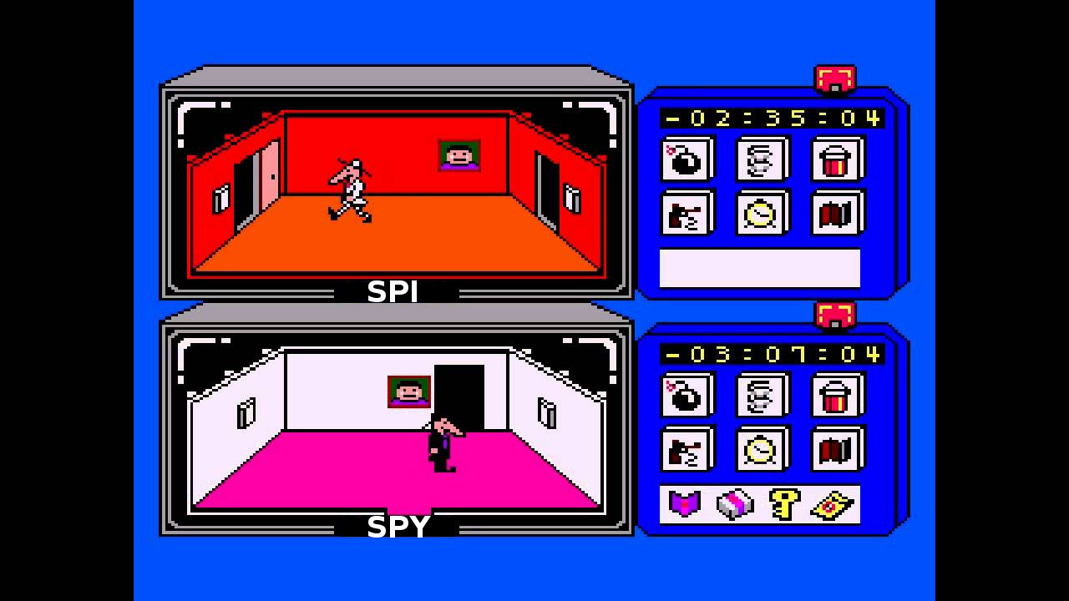
Basic Firmware Dumping – Lesson 2
Dumping Chip In-Circuit with SPI
(Pronounced Spy)

Slide 17
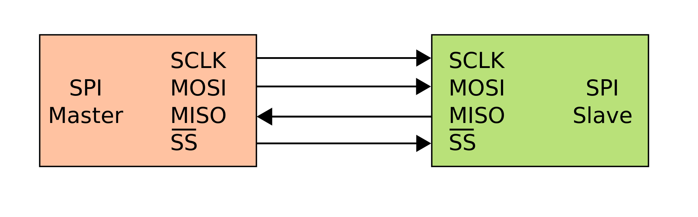
Basic Firmware Dumping – Lesson 2
BusPirate is SPI Master, Flash Chip is SPI Slave
https://en.wikipedia.org/wiki/Serial_Peripheral_Interface

Slide 18
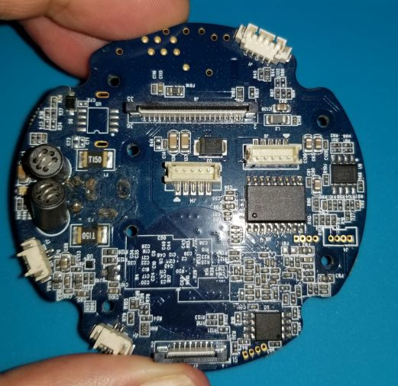
Basic Firmware Dumping – Lesson 2
Which Chip is Flash?
Guesses Anyone?

Slide 19
Basic Firmware Dumping – Lesson 2
Find a SPI Flash Chip with Available Pins/Connections
Datasheet says Interface (I2C, SPI, Etc.)
Connect SPI Interface (BusPirate) to MOSI, MISO, CS#, CLK, VCC, (Connect/Bridge Hold & WP to VCC)
“flashrom” to Interface and Dump Chip

Slide 20
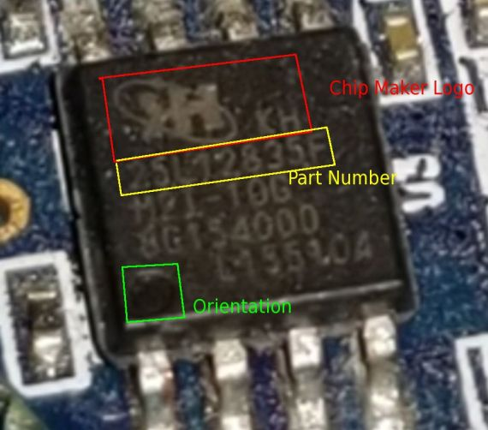
Basic Firmware Dumping – Lesson 2
Zmodo IoT 360 Wi-Fi Camera
“KH” Brand, 25L12835F, 8 Pins
Clearly Marked SPI Flash Chip
Easy to Reach Pins, Good Example

Slide 21
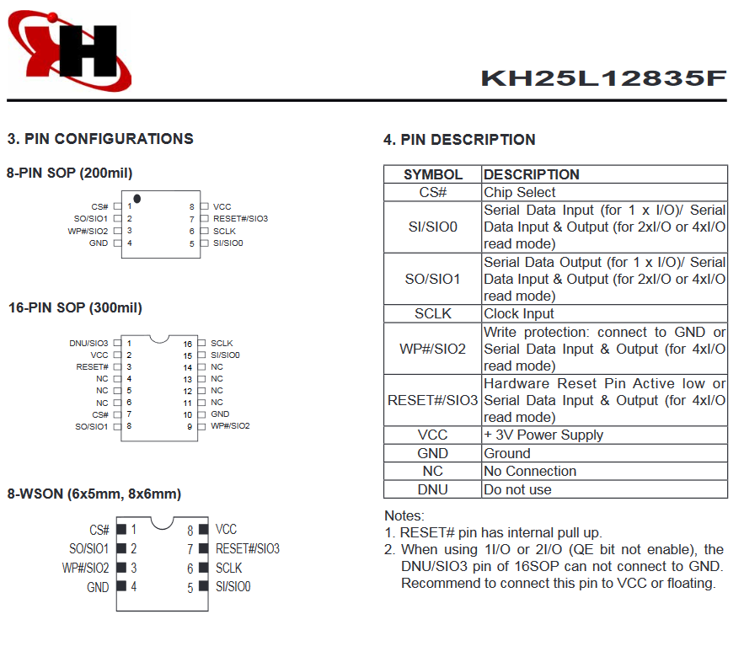
Basic Firmware Dumping – Lesson 2
KH25L12835F
8-PIN SOP
Notes:
SO/SIO1 = MISO
SI/SIO0 = MOSI
WP/RESET = Bridge VCC

Slide 22
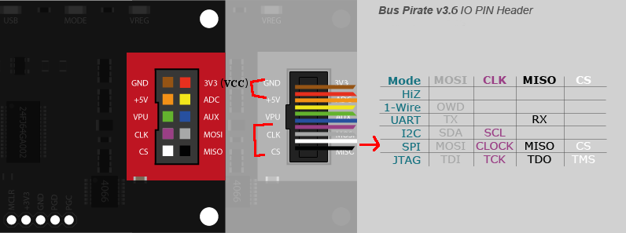
Basic Firmware Dumping – Lesson 2
BusPirate v3.6 (SPI Interface)

Slide 23
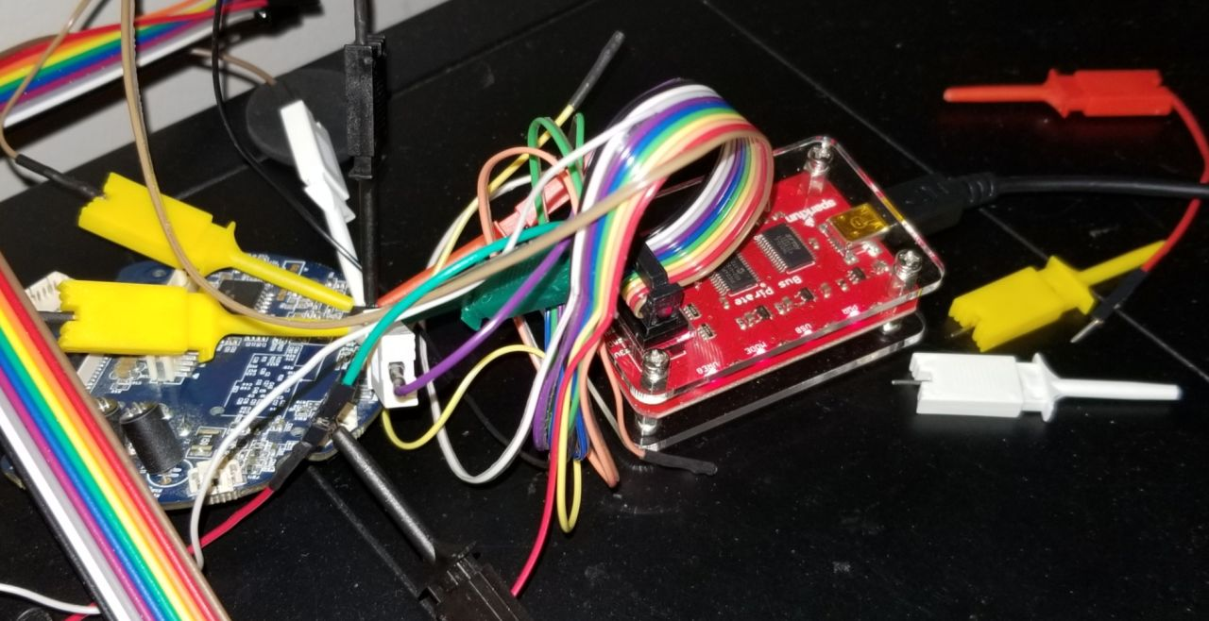
Basic Firmware Dumping – Lesson 2

Slide 24
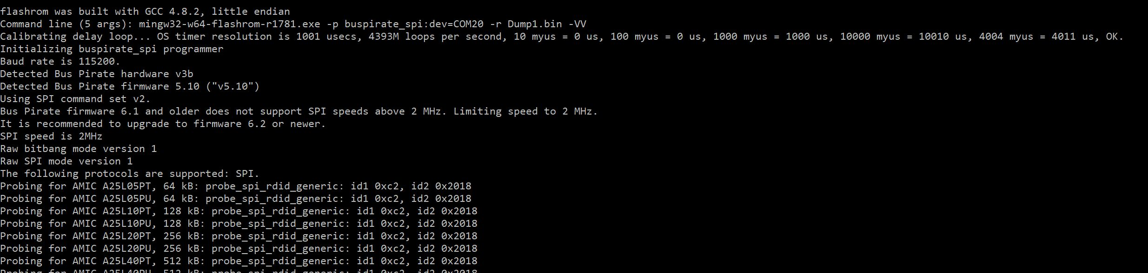
Basic Firmware Dumping – Lesson 2

Slide 25
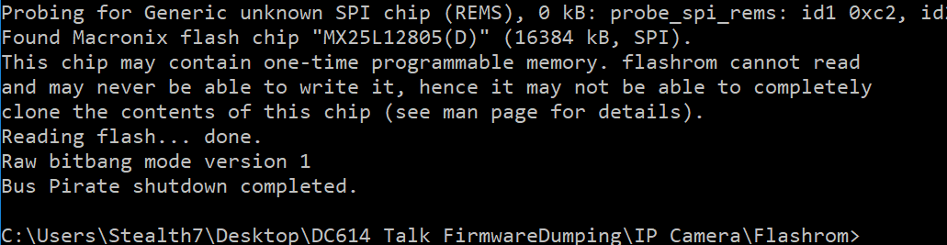
Basic Firmware Dumping – Lesson 2

Slide 26
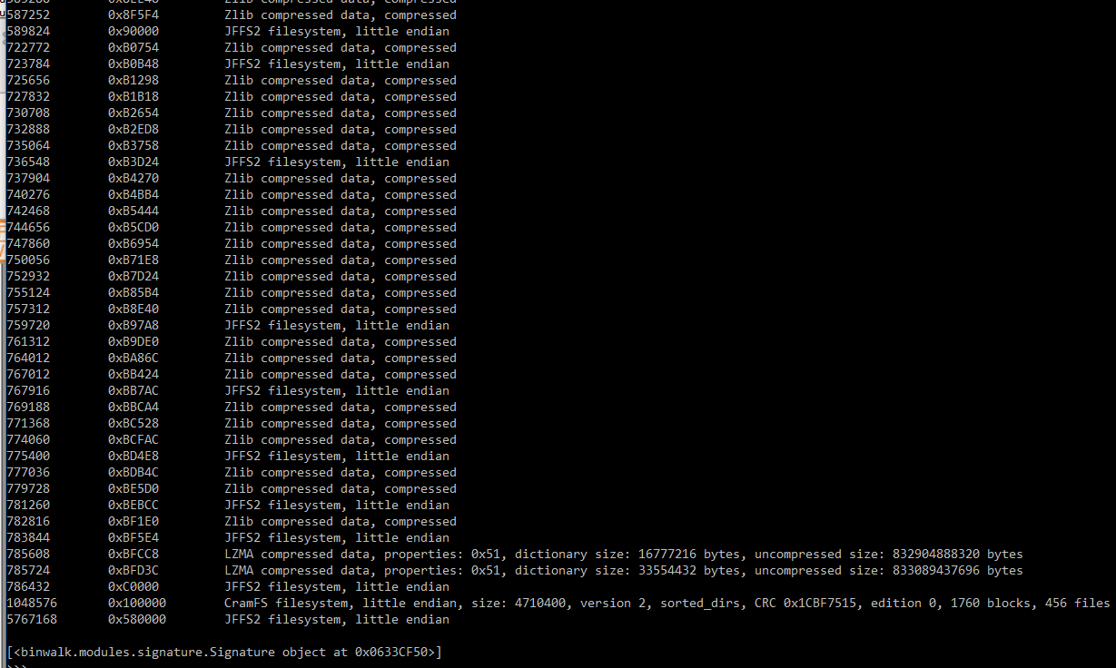
Basic Firmware Dumping – Lesson 2

Slide 27
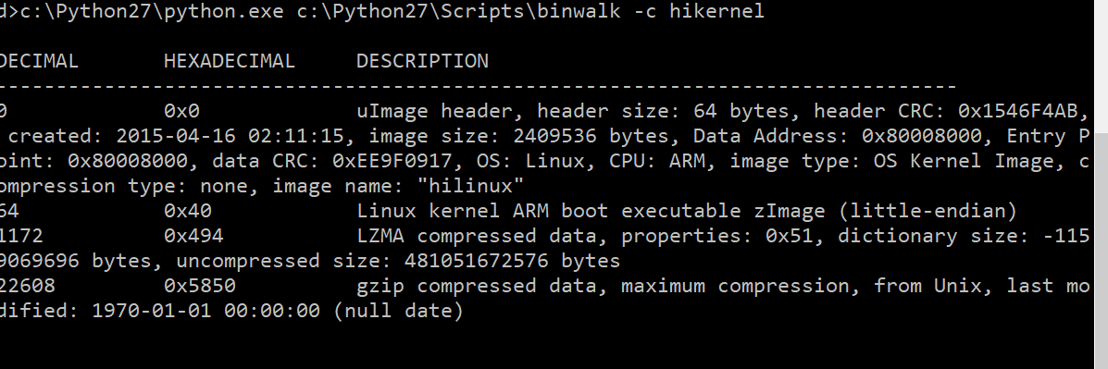
Basic Firmware Dumping – Lesson 2

Slide 28
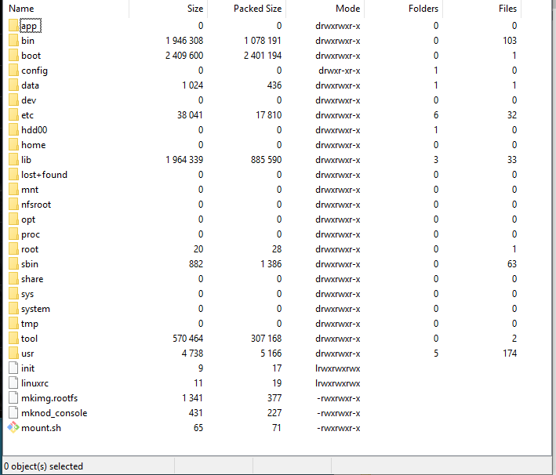
Basic Firmware Dumping – Lesson 2

Slide 29

Basic Firmware Dumping – Lesson 3
Finding Debug Pins

Slide 30
Basic Firmware Dumping – Lesson 3
Look for Open Contact Points / Test Points
Rows of 4x2 or 4x1 are Usually Chip Testing/Boot Testing
Photoshop / GIMP Traces on Front/Back
Sometimes YOLO (Gut Feeling)

Slide 31
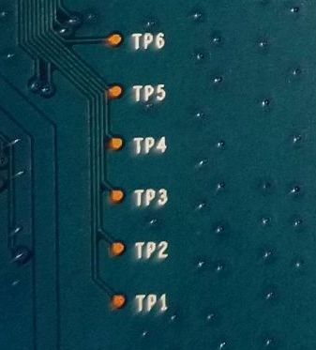
Basic Firmware Dumping – Lesson 3
Netgear Router has mysterious TP1-6 Pins (Test Point?)
Take a Clear Picture of the Front and Back
Place Both Layers in GIMP/Photoshop

Slide 32
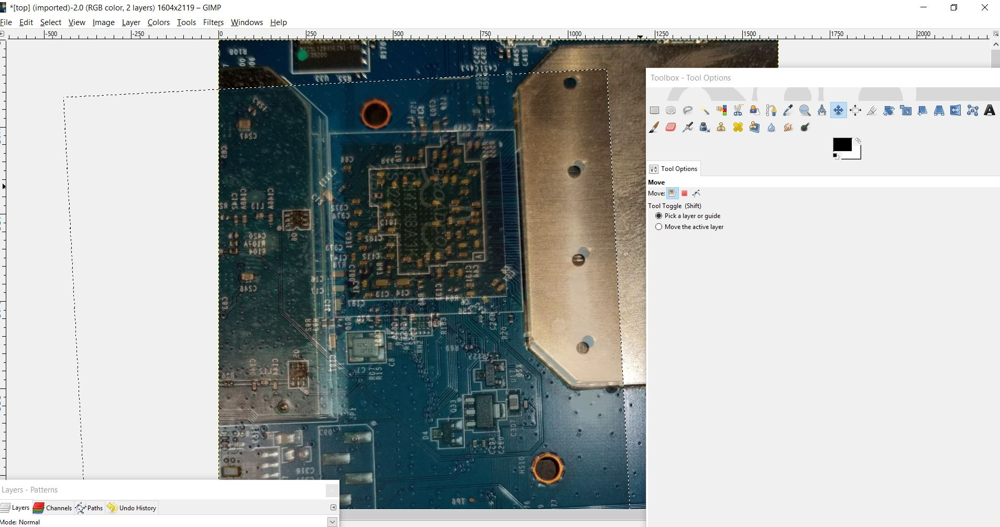
Basic Firmware Dumping – Lesson 3
Top Layer as “Bottom”, Bottom Layer as “Top”, Rotate/Scale

Slide 33
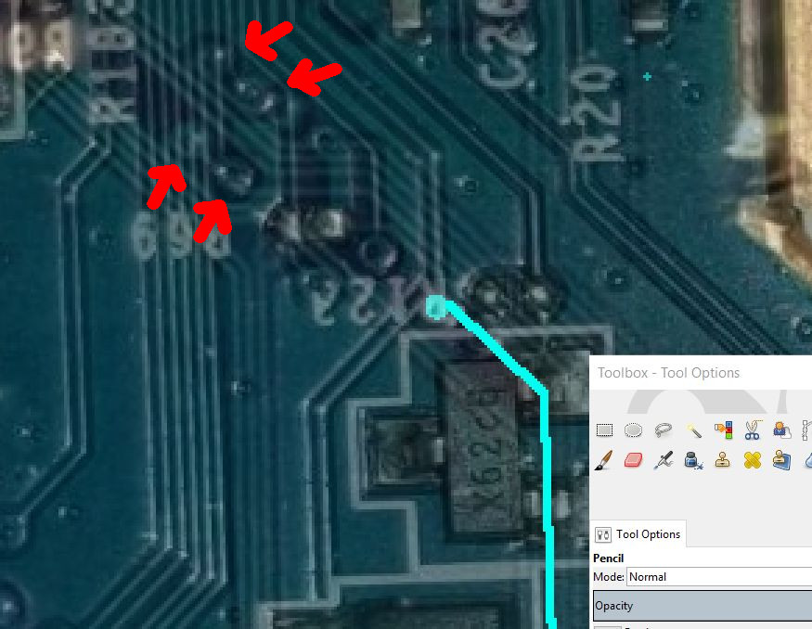
Basic Firmware Dumping – Lesson 3
Pins are Not Aligned (Had to Adjust as Lines Made)

Slide 34
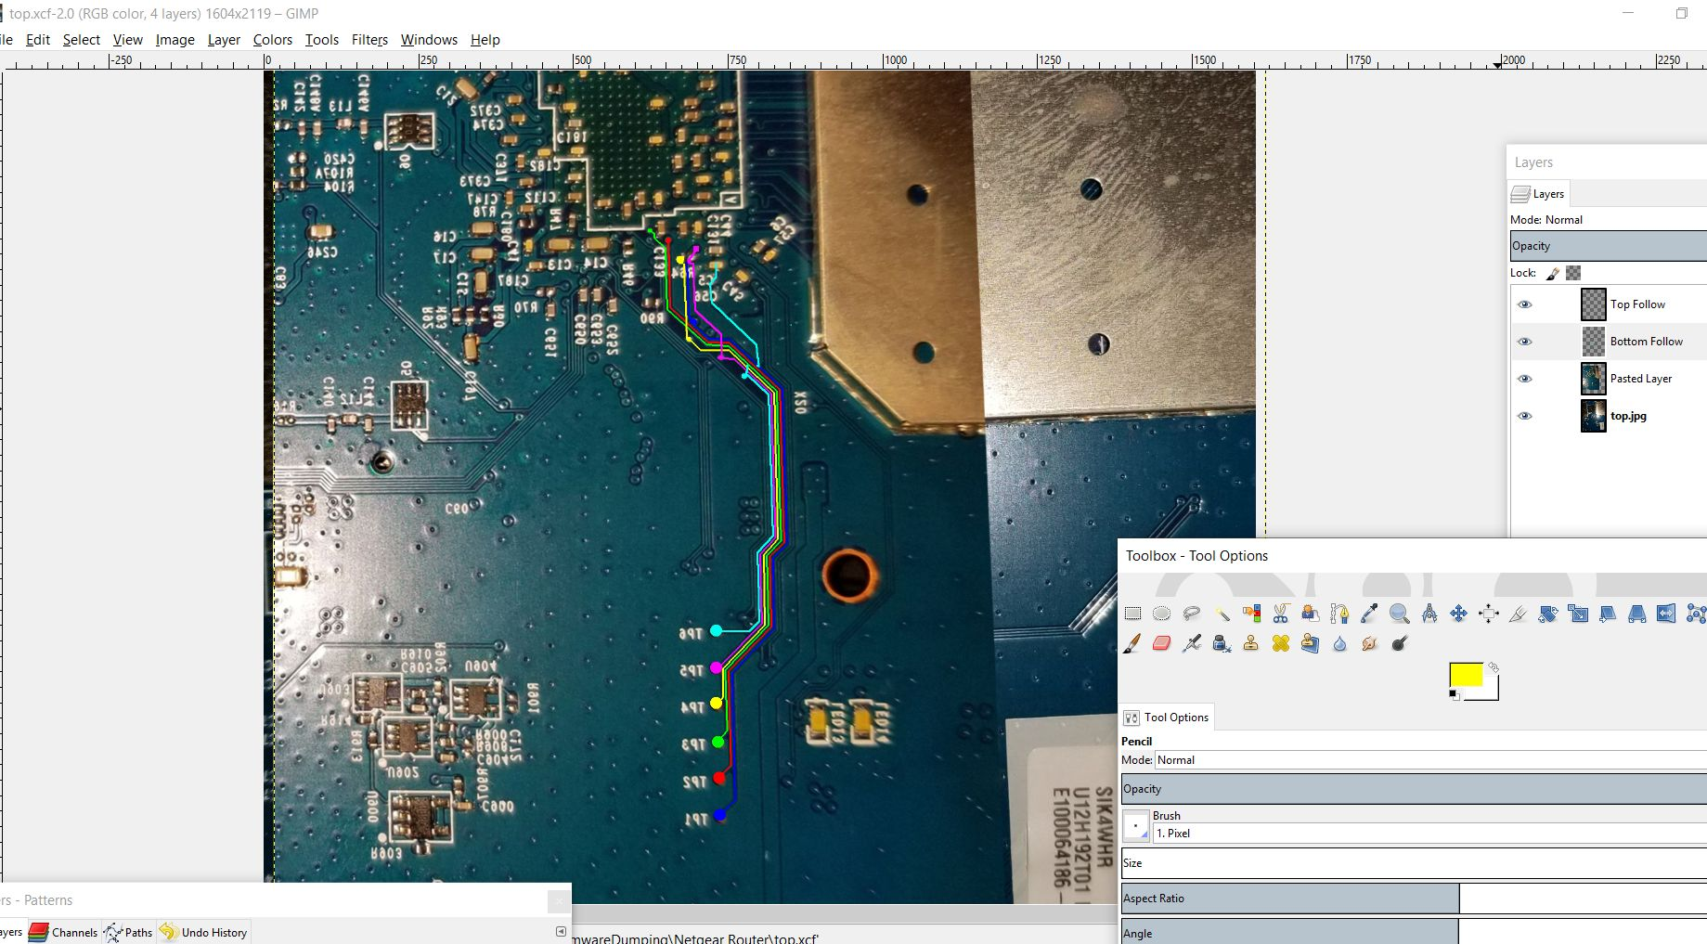
Basic Firmware Dumping – Lesson 3

Slide 35
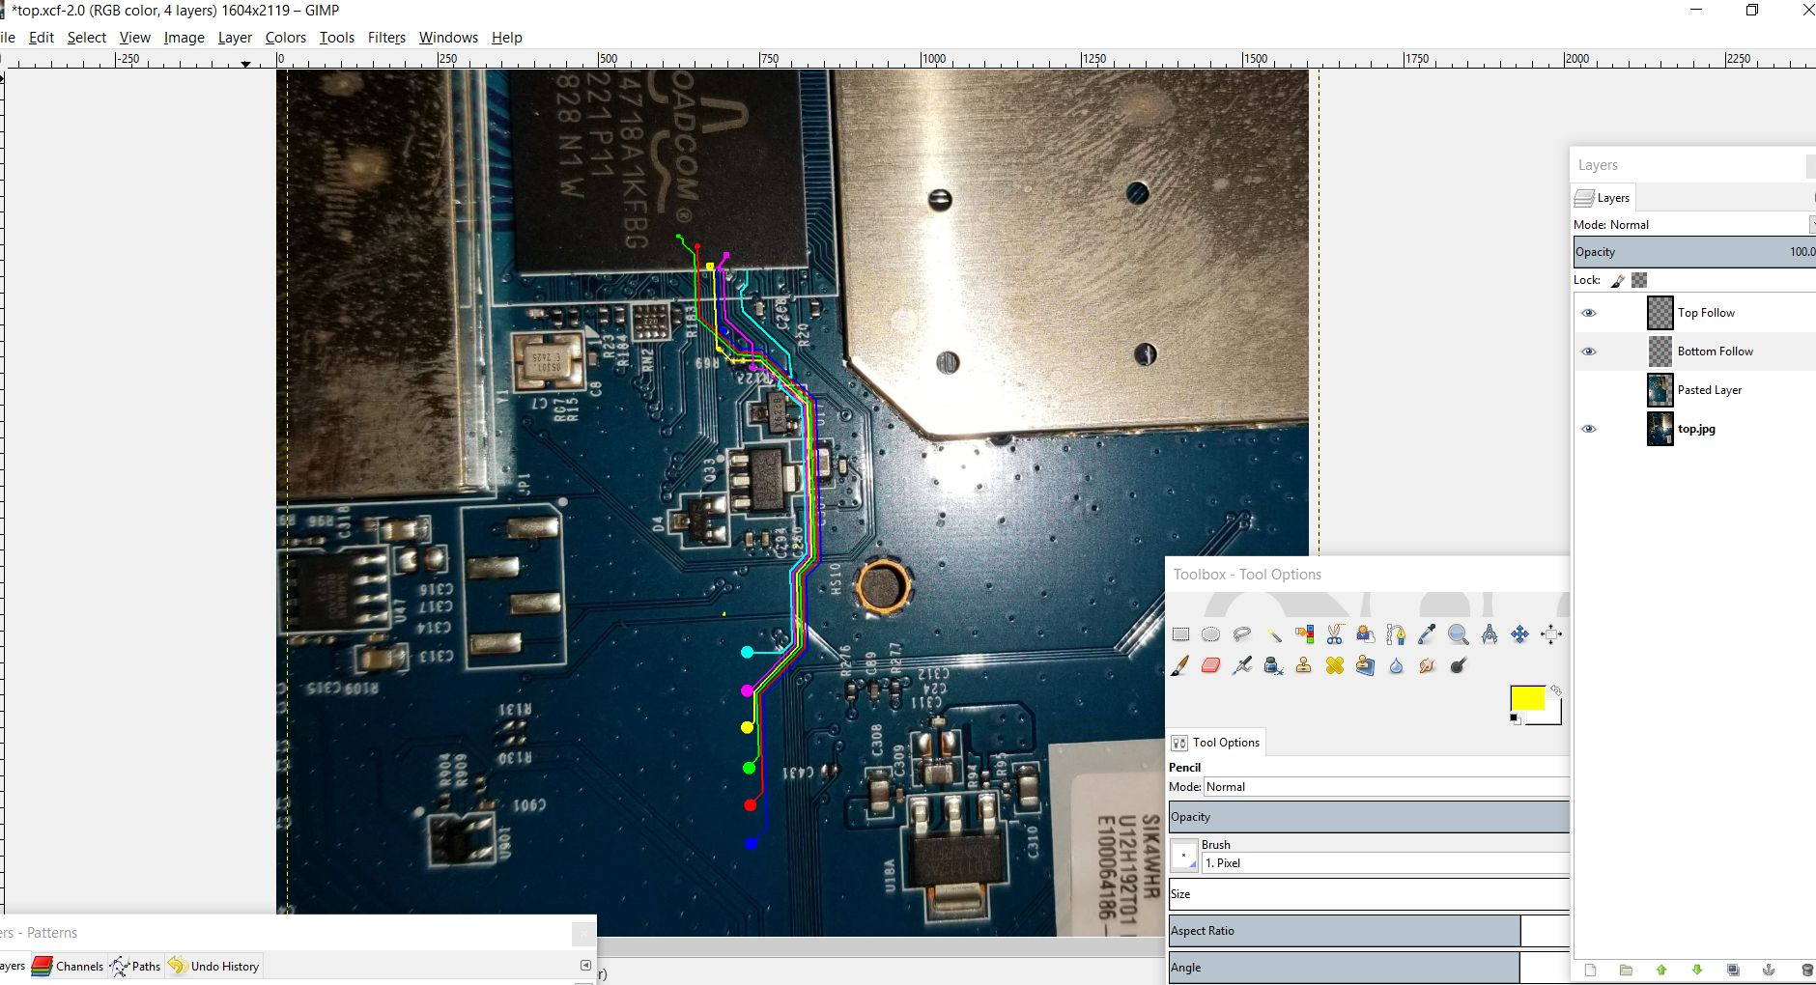
Basic Firmware Dumping – Lesson 3

Slide 36
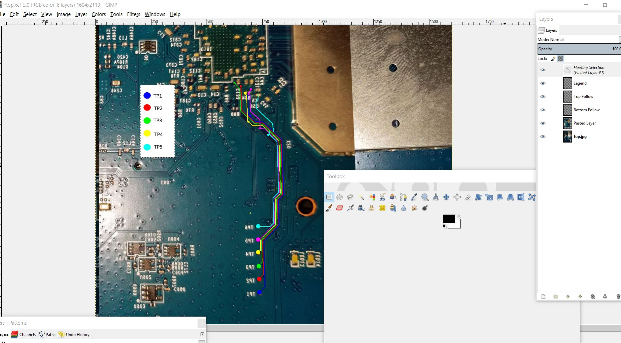
Basic Firmware Dumping – Lesson 3

Slide 37
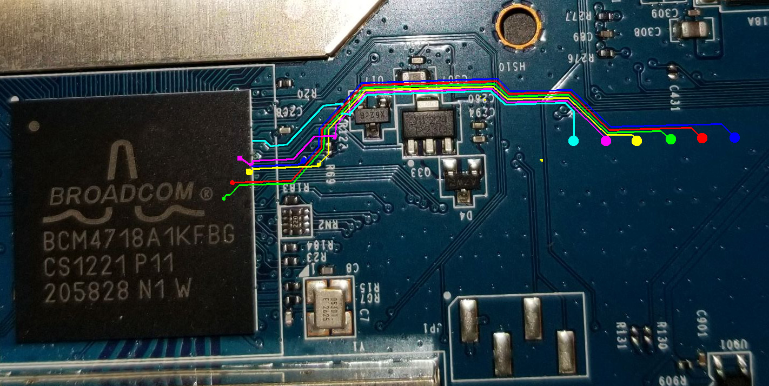
Basic Firmware Dumping – Lesson 3

Slide 38
Basic Firmware Dumping – Lesson 3
These TPs are Going to the Broadcom…
The JTAG interface, collectively known as a Test Access Port, or TAP, uses the following signals to support the operation of boundary scan.
TCK (Test Clock) – this signal synchronizes the internal state machine operations.
TMS (Test Mode Select) – this signal is sampled at the rising edge of TCK to determine the next state.
TDI (Test Data In) – this signal represents the data shifted into the device’s test or programming logic. It is sampled at the rising edge of TCK when the internal state machine is in the correct state.
TDO (Test Data Out) – this signal represents the data shifted out of the device’s test or programming logic and is valid on the falling edge of TCK when the internal state machine is in the correct state.
TRST (Test Reset) – this is an optional pin which, when available, can reset the TAP controller’s state machine.
TL;DR 6 Pins are Most Likely JTAG

Slide 39
Basic Firmware Dumping – Lesson 3
Interfacing JTAG Gives CPU Level Access and Commands
OpenOCD on Pi is Awesome
Custom JTAG Interface Tools (> $2000)
“BlackMagic Probe”, Arm Cortex M0 (Defcon 27 Badge)

Slide 40
Basic Firmware Dumping – Lesson 3
Sniff the Signals with a Logic Analyzer (Salae Pro, DSLogic, etc.)
In OpenOCD: dump_image <filename> <starting address> <size>
Left as Exercise for the Reader… (I ran out of time)
https://openwrt.org/docs/techref/hardware/port.jtag
https://openwrt.org/docs/guide-user/hardware/debrick.ath79.using.jtag

Slide 41
UART Hunting
Serial Interface, TX/RX, Baud Rate, Common on Arduino Boards
Look for 4-Pin Connection Points (Imagine a Test Connector in a Factory)
Using a Multimeter or Logic Analyzer, find the GND pin, and watch for 3v spikes on the other 3 pins (one should be VCC).
(Examples on Next Slides)

Slide 42
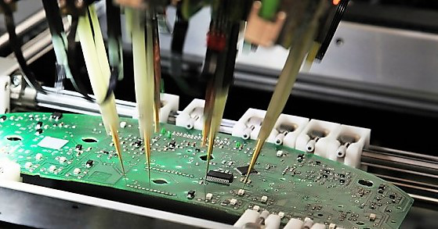
UART Hunting – Factory Test Pins

Slide 43
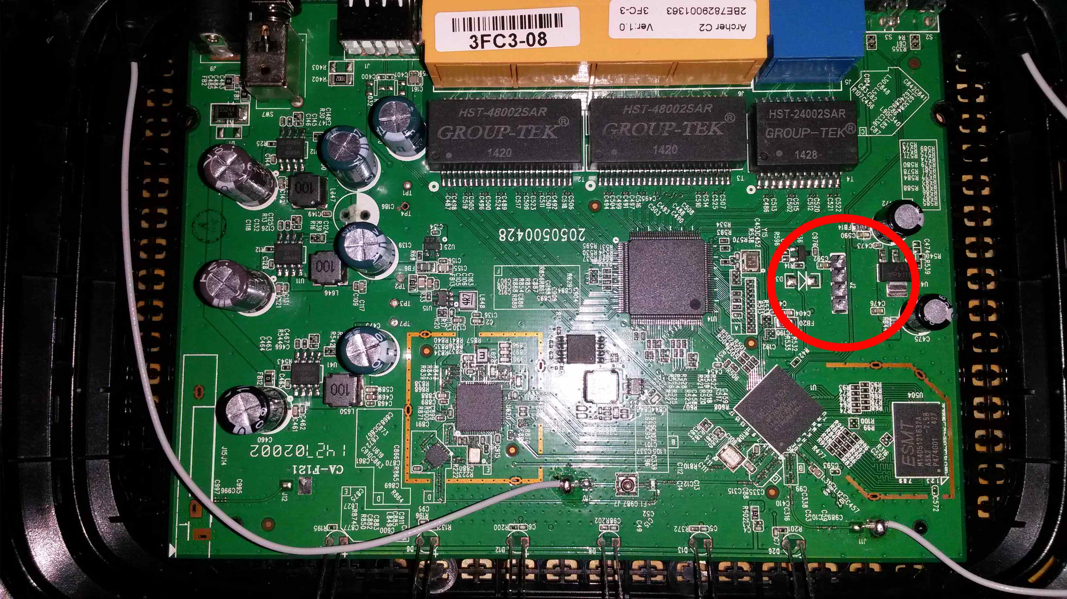
UART Hunting – Example (Not Mine)

Slide 44
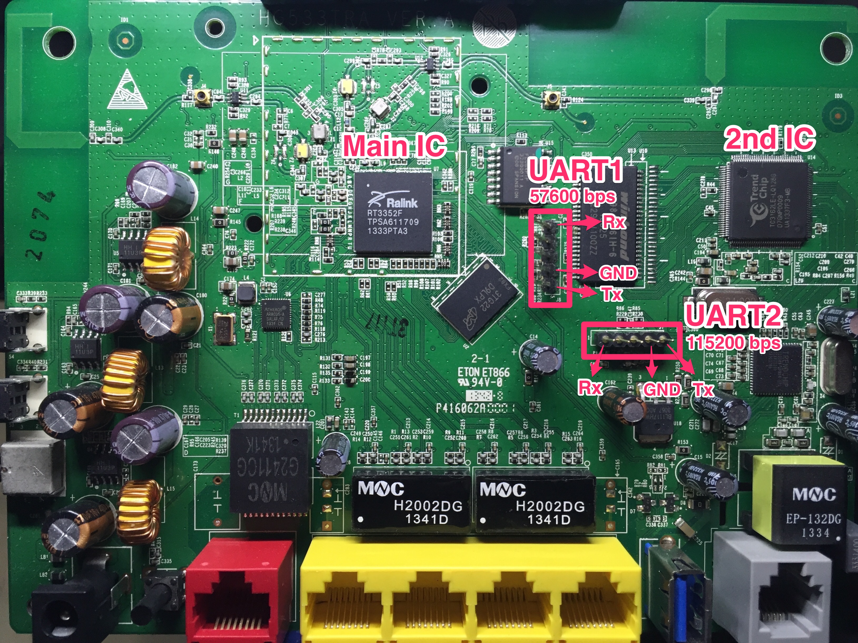
UART Hunting – Example (Not Mine)

Slide 45
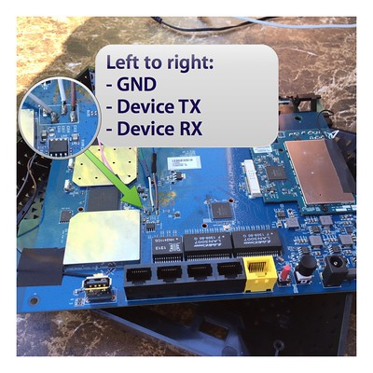
Google the Answer (Work Backwards)
Work Backwards From the Solution
These Were Next to Our TPs!
Pro-Tip: Hardware Hacking is
a Rabbit Hole!
https://shadow-file.blogspot.com/2015/07/abandoned-part-10.html

Slide 46
Get To It!
Go Break Some Stuff! Dump Things!
Spend a Day Identifying Chips
Find Well Documented Boards, Walk-Through Tutorials
Get Comfortable with Being Uncomfortable

Slide 47
Takeaways
Firmware Updates are Often Partial Patches
Hardware is Not Easy. Practice!
Poke Things, Learn Tools, Get Swole
Don’t Break Your Vital Equipment (Life Lesson)

Slide 48

Questions?
Thank You!
https://github.com/arntsonl/Presentations

