Slide 1

Contact
Aroa Barberan Poblete
Contact agenda

Slide 2
Index
Introduction
Targets
Technologies and tools
Frameworks
Version control
Other development tools

Slide 3
Contact storage is a simple application to store contacts.
Forget remembering all the phones of all the people you know and fearing to lose that old notebook.
With this application you can have as many contacts as you wish, without limit.
You can create, edit, delete, personalize, identify them quickly by your photo …
Everything is advantages.
Introduction

Slide 4
To be able to enjoy all the advantages of this application, the first thing you should do is register, a message will arrive to the indicated email and finally verify it.
Once registered, all the contacts of this user are listed.
Create, update, delete contact and groups
(if you delete the group you can choose between removing the contacts together with the group or only the group)
Each contact can be assigned to none or many groups.
2. Targets

Slide 5
5. Add to favorites the contacts you want
(these will be the first contacts that appear when they are listed)
6. Merge duplicate contacts.
7. Search contact and show details.
8. Export and import csv contacts
(you can choose to import all contacts or only those that are added as favorites)
9. Close session.
2. Targets

Slide 6

3. Technologies and tools

Slide 7
Laravel
React
It will be used for the login system, email verification and consult the database.
It will be used to front-end to page web
So it will be organized by components
3.1 Frameworks

Slide 8
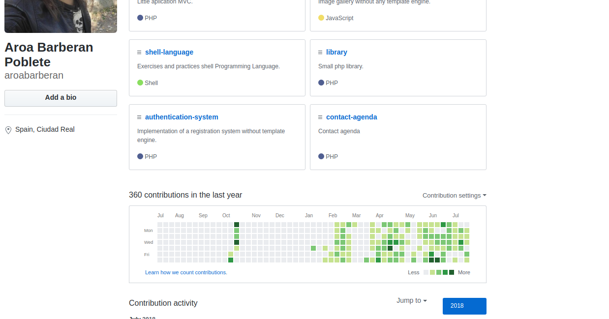
I will use github to manage the changes that I am making throughout the project where you will be able to see the follow-up of what I am doing
3.1 Version control

Slide 9
LAMP
NPM
JSON
CSS3
HTML5
Javascript
Bootstrap
Filezilla
Visual studio code
Composer
Let’s encrypt
Chrome
Mozilla
Edge
Draw.io
Google doc
Google presentation
Google cloud Platform
3.1 Other development tools

Slide 10
End

