Slide 1

SHARK ATTACKS
Pricing Risk by Activity
A data cleaning & EDA practice project — Global Shark Attack File (GSAF)
Aroa · Ironhack Data Analytics Bootcamp — Week 2 Quest

Slide 2

Project Overview
Dataset: Global Shark Attack File (GSAF) — 7,103 recorded incidents, 1845–2026, 254 countries.
Hypothesis: certain activities (swimming, surfing, diving, fishing...) carry more shark-attack risk than others.
Business case: a travel/water-sports insurer wants to price shark-attack risk by activity, not with one blanket rate.
7,103
recorded incidents
180+
years of records
254
countries
Shark Attacks — Data Cleaning Practice | 2

Slide 3

What Was Actually Messy
Inconsistent categories
Fatal Y/N held Y, N, y, ' N', 'Y x 2', and even the year 2017 by mistake.
Free-text ages
Age was "20's", "30+", "teen", "21, 34,24 & 35" (multi-victim) — not a number.
Four mixed date formats
ISO timestamps, "27-Feb-25", ordinal dates with no year ("23rd June"), and ranges ("1900-1905").
Silent duplicate categories
"Swimming" and "Swimming " (trailing space) counted as two different activities.
Shark Attacks — Data Cleaning Practice | 3

Slide 4

The Cleaning Pipeline
clean_shark_data() — 9 chained techniques in cleaning.py
1
2
3
Drop & rename columns
Strip whitespace
Normalize categories
Empty/admin columns removed, headers to snake_case.
Fixes categories silently duplicated by stray spaces.
type / sex / fatal mapped to a fixed set + "Unknown".
4
5
6
Clean country names
Regex age extraction
Multi-format date parsing
Uppercase + fix known typos.
Pulls a numeric age out of free text, or leaves NaN.
Ordinal-suffix strip + year merge, cascading to NaT.
+ fill remaining unknowns and drop exact duplicates after cleaning.
Shark Attacks — Data Cleaning Practice | 4

Slide 5
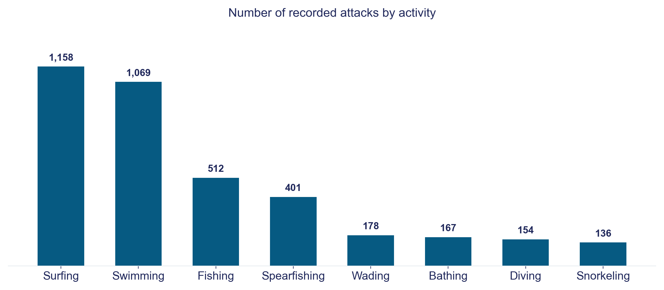
Which Activities Get Attacked Most?
Shark Attacks — Data Cleaning Practice | 5

Slide 6
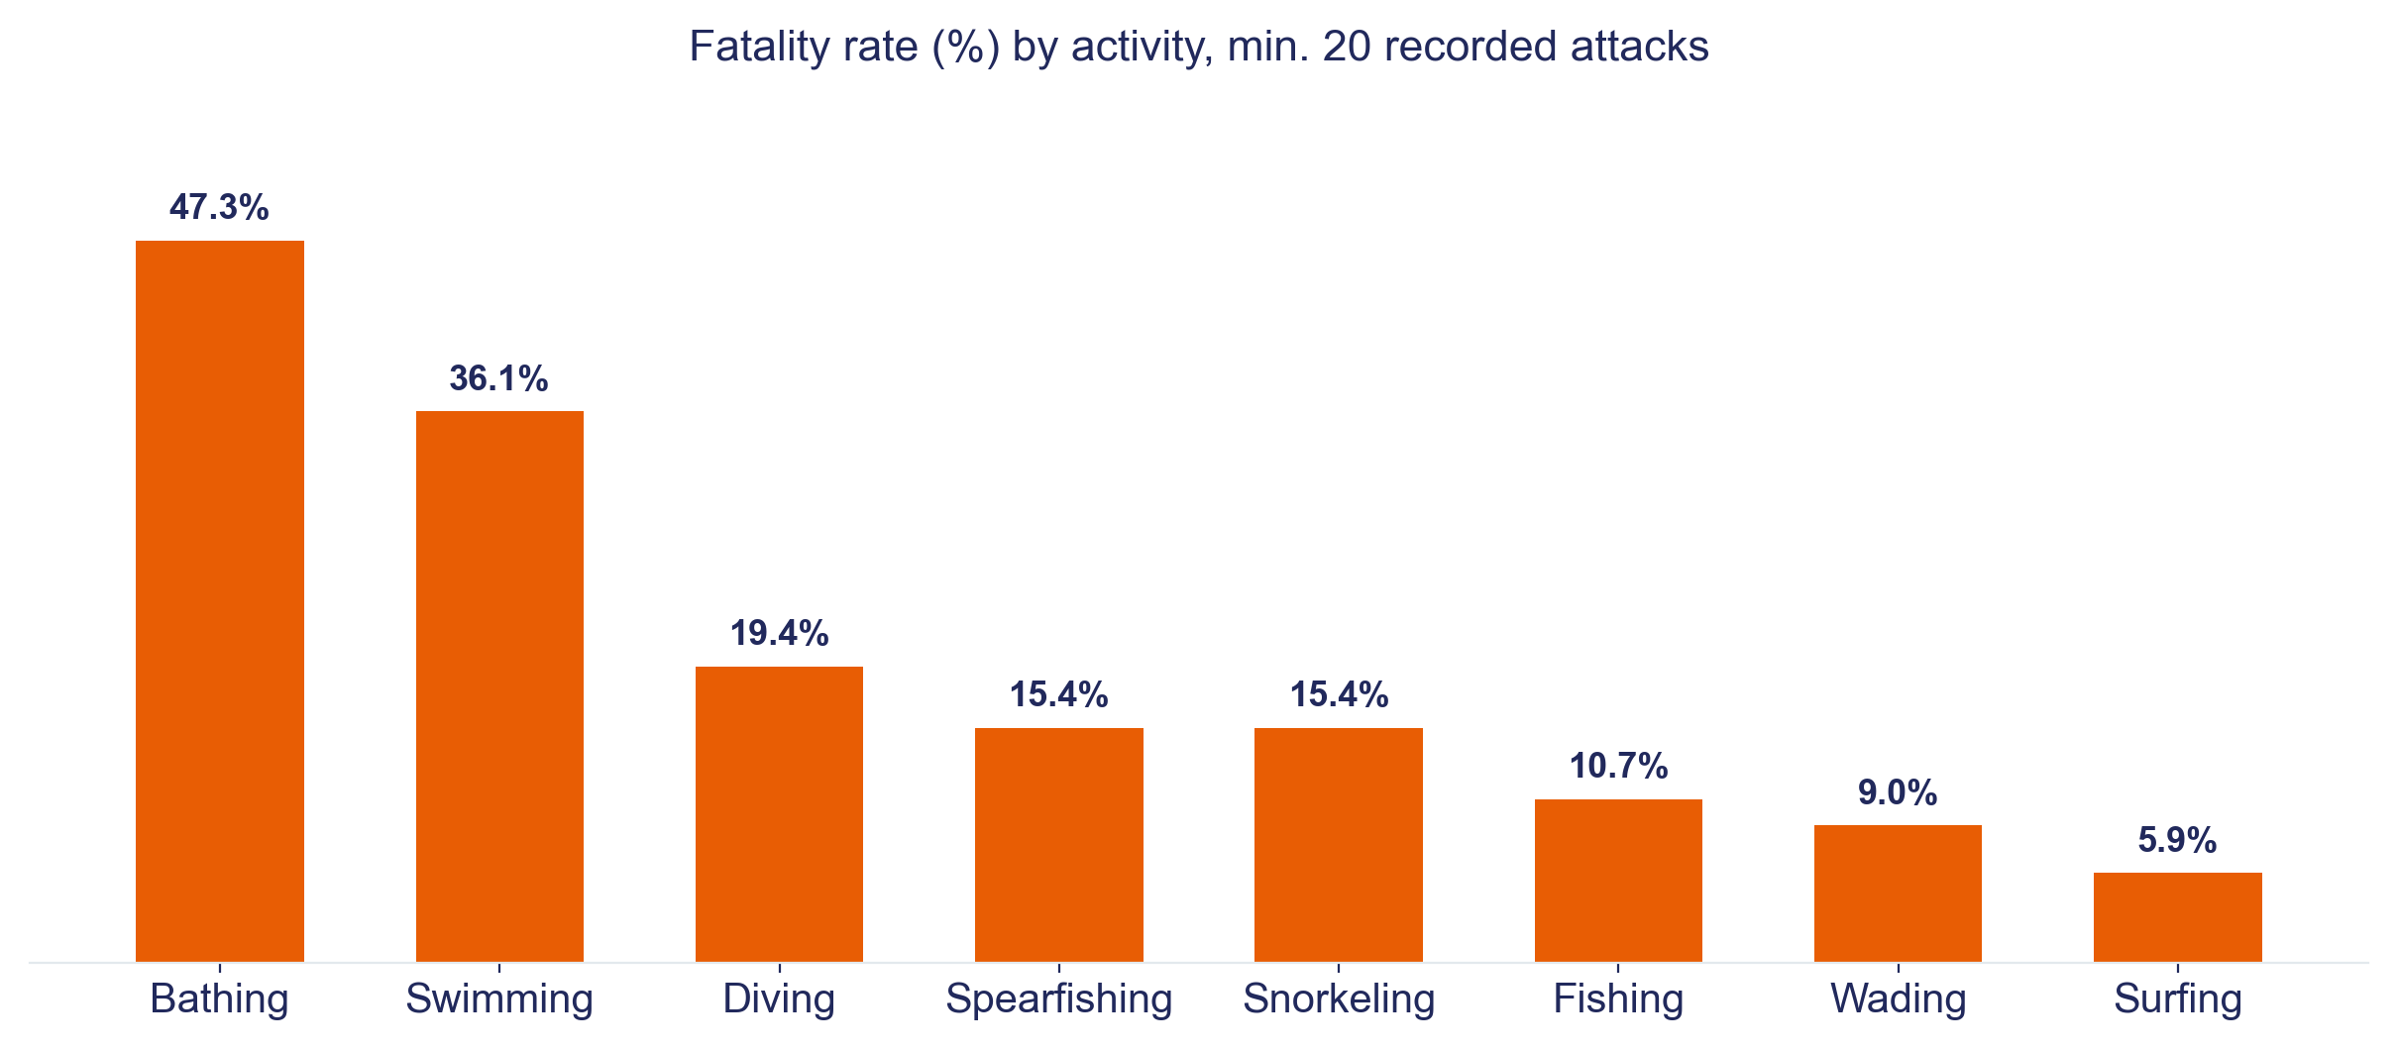
...But Which Are Actually the Most Fatal?
Shark Attacks — Data Cleaning Practice | 6

Slide 7

The Biggest Obstacle Wasn't Technical
Our first read of the data
What the fatality rate showed
1,158
5.9%
surfing attacks — the most of any activity.
Easy conclusion: "surfing is the riskiest activity."
of surfing attacks are fatal — the lowest of any common activity. Swimming (36%) and bathing (47%) are far more severe.
Lesson: "most attacks" and "most risk" are not the same metric — validating a hypothesis means picking the metric that actually answers the business question, not the first one the data hands you.

Slide 8

Conclusion & Insights
Hypothesis: supported, with a nuance — activity does predict risk, but "risk" means severity, not incident count.
For the insurer: a flat "water sports" rate overcharges surfers (high frequency, low severity) and undercharges swimmers/bathers (low frequency, high severity). Price by activity, not by category.
Also applies to: a surf/dive tour company deciding where and what to operate.
Limitations
~28% rows have a usable age
~85% of dates parsed
No real claim-cost data
Practice project, not a pricing model
Shark Attacks — Data Cleaning Practice | 8

Slide 9
Thank You
Shark Attacks: Pricing Risk by Activity
github.com/aroaxinping/shark-attack-risk-analysis
Aroa · Ironhack Data Analytics Bootcamp

