Slide 1


FIN PRINT
Pricing Shark-Attack Risk Where It Actually Pays Off
A Business Intelligence read of the Global Shark Attack File (GSAF)
Aroa · Ironhack Data Analytics Bootcamp — Week 2 Quest

Slide 2

The Business Question
A travel insurer wants a shark-attack coverage add-on. Where should it actually make money —
not just “where is it risky,” but where does the data show the biggest gap between
what travelers fear and what actually happens?
7,103
9
180+
recorded incidents
cleaning techniques applied
years of records, 254 countries
Data cleaned with 9 pandas techniques (junk-value mapping, regex age/date parsing, dedup) — full pipeline in cleaning.py.
Fin Print — Shark Attack Risk Pricing | 2

Slide 3

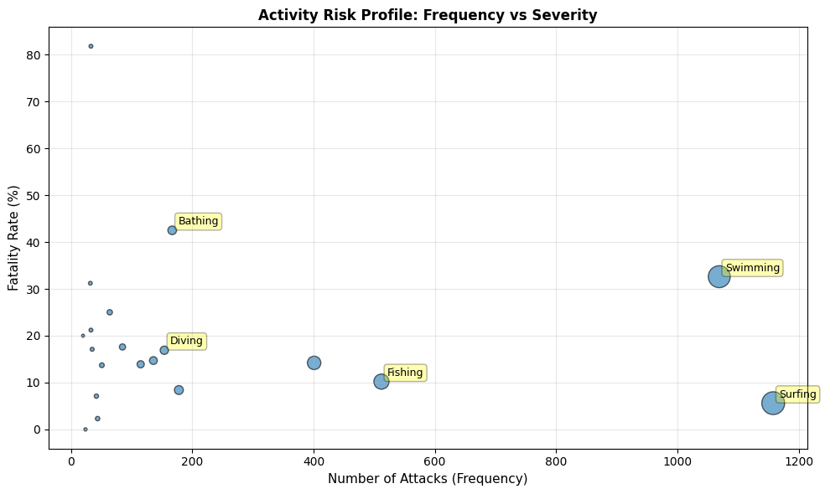
Finding 1: Surfing Looks Risky. It Isn't.
1,158
surfing attacks — the most of any activity
5.9%
of those are fatal — the lowest of any common activity
36–47%
fatality rate for swimming & bathing — far rarer, far deadlier
Fin Print — Shark Attack Risk Pricing | 3

Slide 4

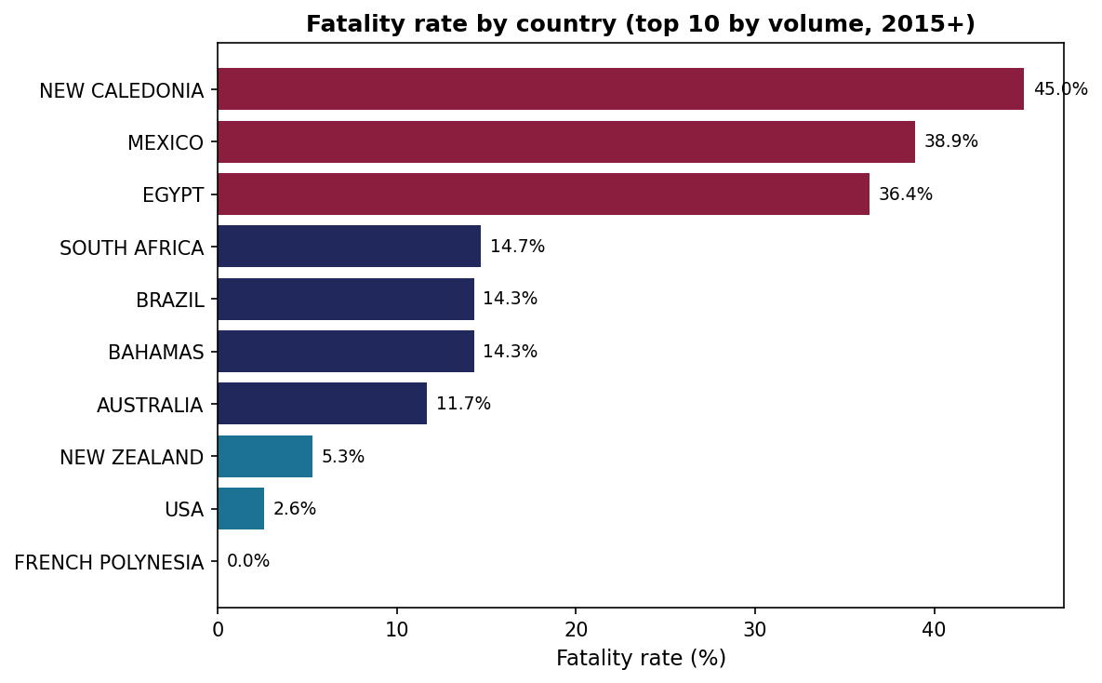
Finding 2: Geography Multiplies the Risk
USA
Highest volume (456 incidents), lowest fatality (2.6%) — the mass market.
Australia / Bahamas / South Africa / Brazil
11–15% fatality, meaningful volume — moderate uplift.
New Caledonia / Mexico
39–45% fatality, but tiny volume — priced up sharply, not subsidized.
Fin Print — Shark Attack Risk Pricing | 4

Slide 5
The Recommendation
One product: “Fin Print”
A shark-attack coverage add-on on top of existing travel policies — not a separate product per sport, country, or demographic.
MARKET TO
PRICE HONESTLY
VOLUME ENGINE
Surfers
Swim & bathe
USA & low-risk destinations
Highest perceived risk, lowest actual claims cost (5.9%). That gap is the margin.
Real fatality risk (36–47%) — priced at true cost, not the marketing focus.
Base rate, mass market. Small surcharge for high-severity outliers only.
add-on price = base rate x activity_risk_tier x country_price_multiplier
Fin Print — Shark Attack Risk Pricing | 5

Slide 6

Why Not One Product Per Sport (or Country, or Sex)
Early drafts of this analysis proposed separate pricing angles per activity, per country, and per traveler sex. None of them hold up as standalone products:
Fragmenting by sport
Multiplies operational complexity for no pricing gain — the tiering formula already captures activity risk in one product.
Fragmenting by sex
GSAF counts attacks, not participants — more male attacks could simply mean more men practice these sports. No exposure data means no individual risk claim can be made.
Fragmenting by country alone
Ignores that activity risk and country risk compound — the same formula handles both at once, no need for a country-only product.
Fin Print — Shark Attack Risk Pricing | 6

Slide 7

Limitations
Age: only ~28% of records have a usable numeric value
Dates: ~85% successfully parsed; older records lack full date info
Severity: fatal/non-fatal only — no real claim-cost (monetary) data
Exposure: no participation data — we see who was attacked, not who wasn't
This shows direction, not a finished rate card — the pricing formula is solid, but real premium numbers need exposure and claim-cost data that GSAF doesn't have. We chose to report that gap honestly instead of inventing numbers.
Fin Print — Shark Attack Risk Pricing | 7

Slide 8

Thank You
Fin Print — Pricing Shark-Attack Risk Where It Actually Pays Off
github.com/aroaxinping/shark-attack-risk-analysis
Aroa · Ironhack Data Analytics Bootcamp

