Slide 1
VANGUARD · CUSTOMER EXPERIENCE
Should the redesigned
process go live?
Evaluation of the A/B test run between 15 March and 20 June 2017
Aroa · Angélica - Vanguard Customer Experience Analytics
Notes:
Vanguard redesigned its online process and ran an A/B test on 50,000 clients. Our job is to say whether it should replace the current one, and why.

Slide 2
THE BUSINESS
Why this is not just a conversion question
Vanguard is owned by its own funds, which are owned by their investors — no outside shareholders. The company operates at cost: surpluses return to clients as lower fees.
So operating cost is not a saving for the company — it is a return for the client. Someone who cannot finish online and has to call is paying that cost themselves.
Vanguard business model and company profile, 2025.
Notes:
Frame the recommendation in Vanguard's own terms before showing any number.

Slide 3

HOW WE GOT THERE
Five questions, in order
1
Can we trust our data?
Quality, identifiers, what had to be decided
2
Can we trust our experiment?
Whether Control and Test are comparable
3
How should behaviour be measured?
Reconstructing journeys, defining the KPIs
4
What evidence supports our conclusions?
Statistical and practical significance
5
What should Vanguard do?
The recommendation, and what it rests on
Notes:
The table of contents. Each question depends on the previous being settled.

Slide 4
QUESTION 1
The log records events, not journeys
755,405
30%
28.8%
web events recorded across the experiment window
of visits contain more than one start event
of visits are a clean, linear run through the funnel
What we found and settled
10,764 duplicate events removed — the same step, client and second twice over.
20,109 clients were never randomised, and 49,548 appear with no profile. Both excluded.
No session exceeds 24 hours, so no duration trimming was needed — checked, not assumed.
Thirteen cleaning decisions, each documented next to the evidence that motivated it.
Analysis dataset: 317,135 events, 50,488 clients.
Notes:
The point is not that the data was dirty. It is that journeys have to be reconstructed under rules stated in advance.

Slide 5
QUESTION 2
The groups are comparable — and we can prove it
Every effect size
calls_6_mnth
below 0.02
p = 0.0005
Four of seven client characteristics are statistically significant. None is large enough to matter.
Looks like a finding until the effect size — 0.018 — says the groups are interchangeable.
With 25,000 clients per group, almost anything reaches significance. That is why every p-value in this analysis is reported next to an effect size.
The assignment itself is uneven — 53.4% Test against 46.6% Control — but it is unrelated to every client characteristic we can measure. We report it rather than correcting it.
Notes:
Never trust experimental metadata blindly. We checked before comparing anything.

Slide 6
QUESTION 3
One choice moved the answer by thirteen points
54.4%
67.4%
completion measured per visit
completion measured per client
Same data. We measure per client, because that is the unit the experiment randomised — measuring per visit would weight returning clients more heavily and undo the balance randomisation guarantees.
Six rules, fixed before any KPI was computed
A visit is one journey · the first start opens it · the first confirm closes it
Zero-duration visits count in rates, not in times
Backward movement is measured, not assumed to be an error
Notes:
Every team computes the same KPIs. What differs is the implementation. This is the choice that mattered most.

Slide 7
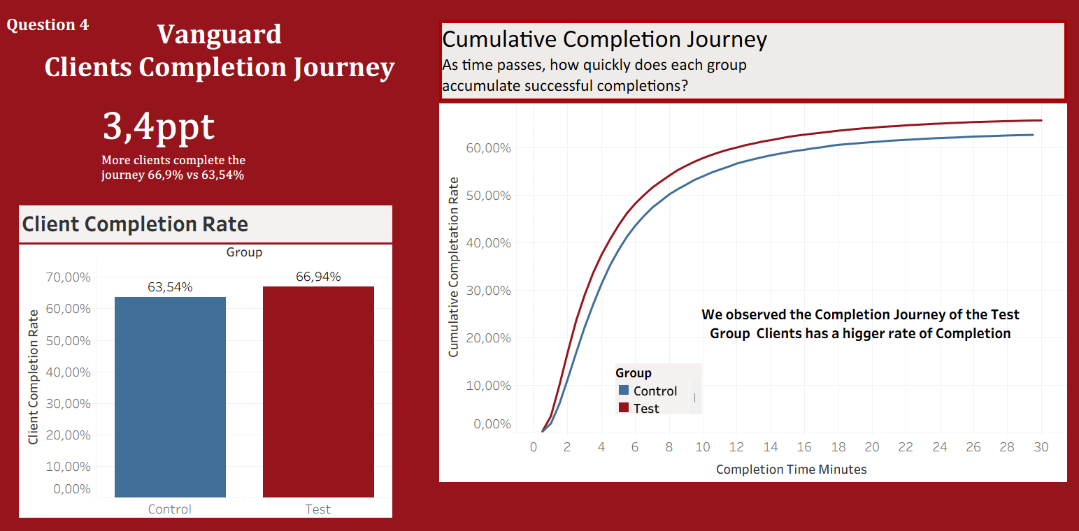
TABLEAU DASHBOARDS

Slide 8
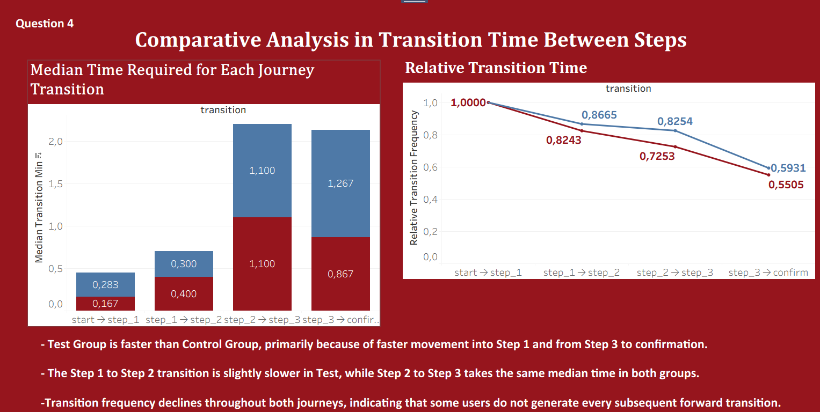

Slide 9
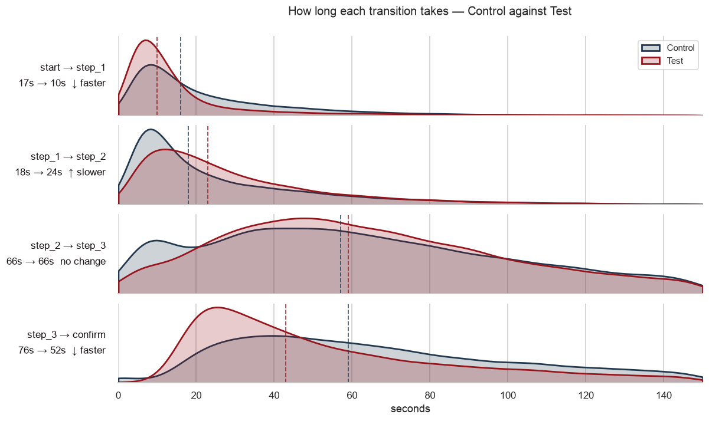
We got the same results in Python

Slide 10
QUESTION 4
So … More clients finish, and they finish faster
+3.4 pp
−34 s
−38 s
more clients complete the process
63.5% → 66.9%
faster to complete
272s → 238s, a 12.5% cut
less active working time
239s → 201s, a 15.9% cut
The completion gain is certain, so the 95% confidence interval runs from +2.6 to +4.2 points and never approaches zero. The speed improvement is the largest effect anywhere in the analysis.
Two-proportion z-test and Mann-Whitney, 49,858 clients. See 4.0-aroa-ab-testing. Results reproduced in Tableau 2.1-angelica.
Notes:
Roughly three clients in every hundred who would have abandoned now finish on their own, and everyone who finishes saves half a minute. End on the question and pause. Everything after this slide answers it — do not rush past it.

Slide 11
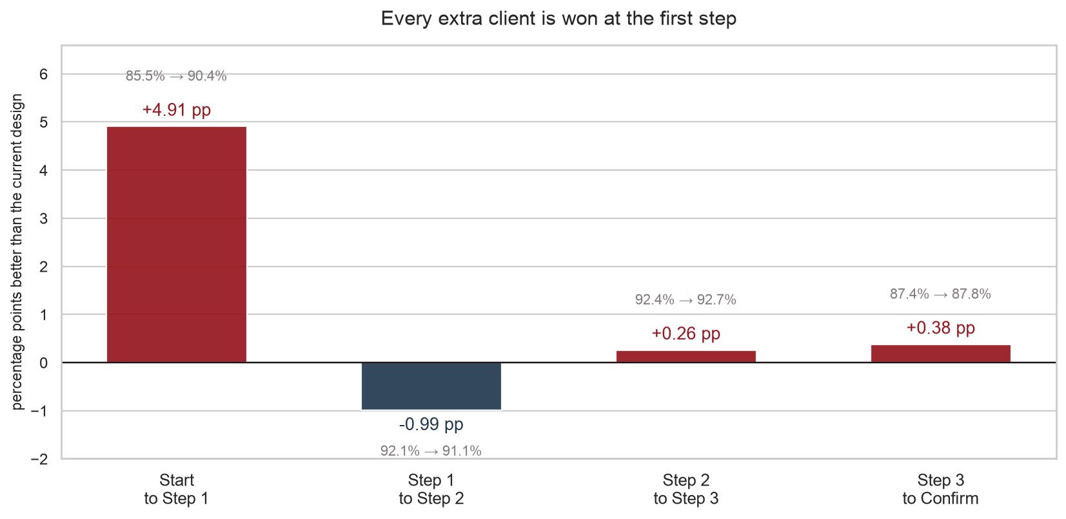
QUESTION 4
Every extra client is won at the first step
Where to invest next
90.4% of Test clients get past the opening step vs 85.5% of Control.
So the redesign did not make the process easier throughout. It removed one obstacle at the front door.
Notes:
This is the most actionable slide for the business. The opening step is where the value is, in this redesign and in the next one. Be honest about step 1 to step 2 being slightly worse — it is within noise, but volunteering it builds credibility. This slide is about CONVERSION. If asked where the 34 seconds come from, the answer is different: 7 seconds off the opening step and 24 off the final confirmation. step_1 to step_2 is the only transition that is worse on both conversion and time. See notebook 4.0.

Slide 12
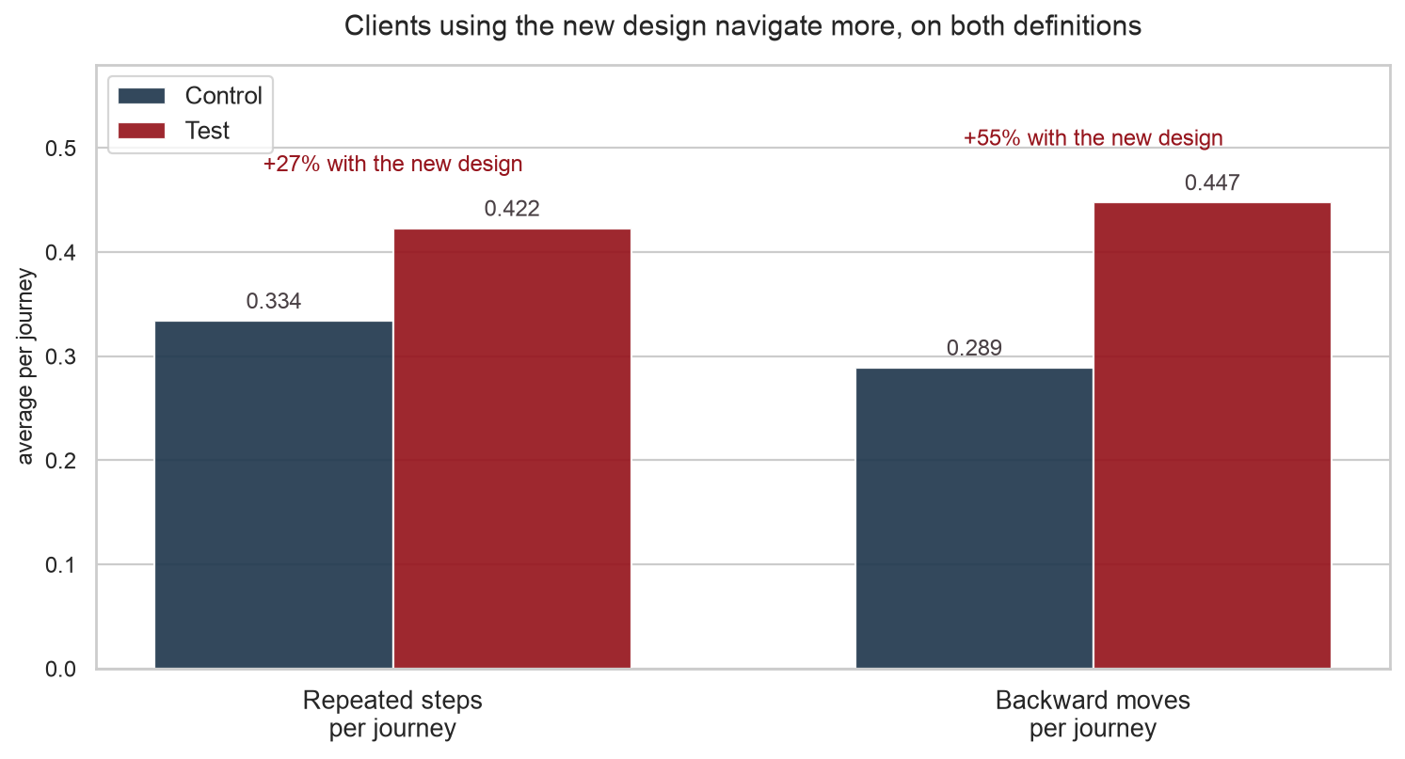
QUESTION 4
Clients navigate more — and that is a good sign
But it cannot be confusion.
Confused clients are slower and less likely to finish. These clients are faster and more likely to finish.
We defined this metric before seeing the result. If we had flagged backward movements as an error in advance, the redesign would have been penalised for being easy to navigate.
Notes:
This is the slide where the methodology pays off. Do not rush it.

Slide 13
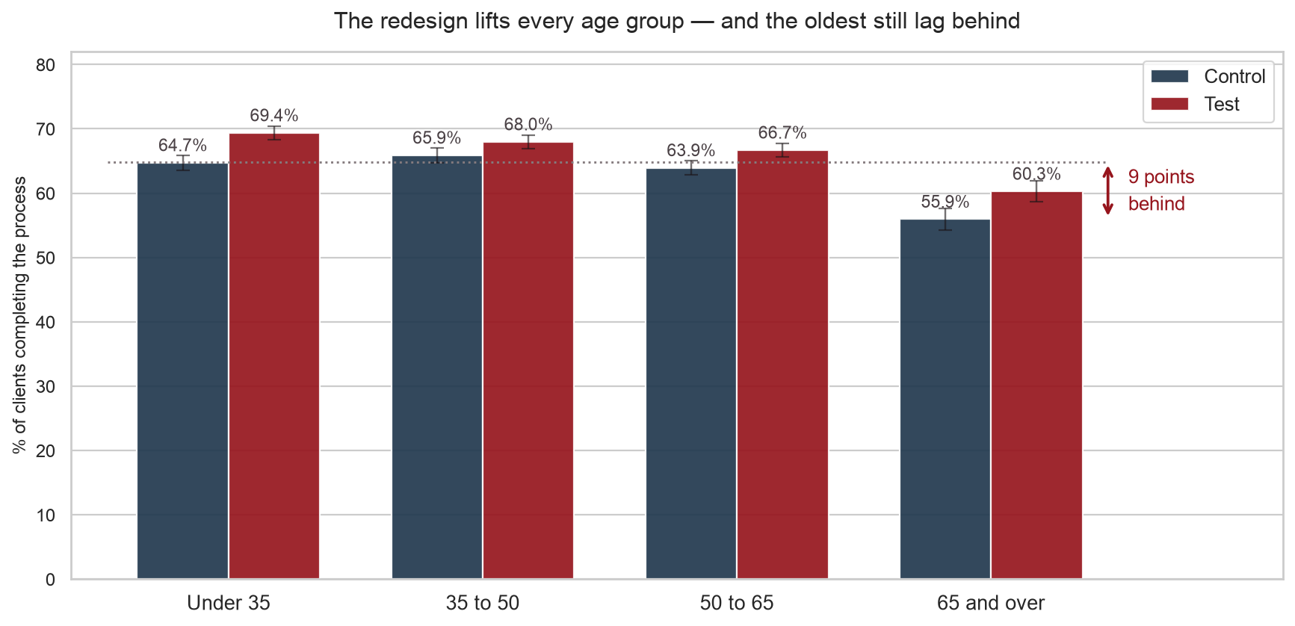
QUESTION 5
It lifts every age group — and one still lags
A nine-point gap, in both designs
The redesign helps every age group by a similar amount.
Less percent of completion!!
But clients aged 65 and over complete at 56%, against 64–66% for everyone else. That gap exists before the redesign and survives it.
Interaction tested by likelihood-ratio on nested logistic models. Per-segment confidence intervals .
Notes:
We deliberately do not claim the redesign favours older clients — the interaction is not significant. The real finding is the gap the redesign does not close.

Slide 14
QUESTION 5
What we recommend
Then open a second piece of work
Deploy it
Every outcome that matters moves in its favour, none moves against, and no group is harmed.
The oldest clients are nine points less likely to finish online. This redesign does not address that. We suggest a further analysis to address those clients in particular.
What we are not claiming
That the redesign works better for any particular age group — the interaction is not significant.
That these findings don’t describe every Vanguard client they are 69,657 clients who could not be analysed, some are excluded..
That a faster completion time proves a better process journey on its own — it is read alongside completion, never apart from it. We only took into account the complete journeys.
Notes:
State the limits before anyone asks. It is what makes the recommendation credible.

Slide 15
The redesign is worth shipping.
The nine points it leaves behind
are worth a project of their own.
Vanguard · Customer Experience Analytics
Notes:
The last thing they hear should be the finding, not the methodology. The nine points are the 65+ gap.

