Slide 1
It doesn’t work!
André Roberge
PyConAu 2021

Slide 2
You are a teacher or mentor

Slide 3
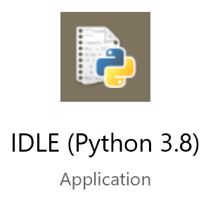
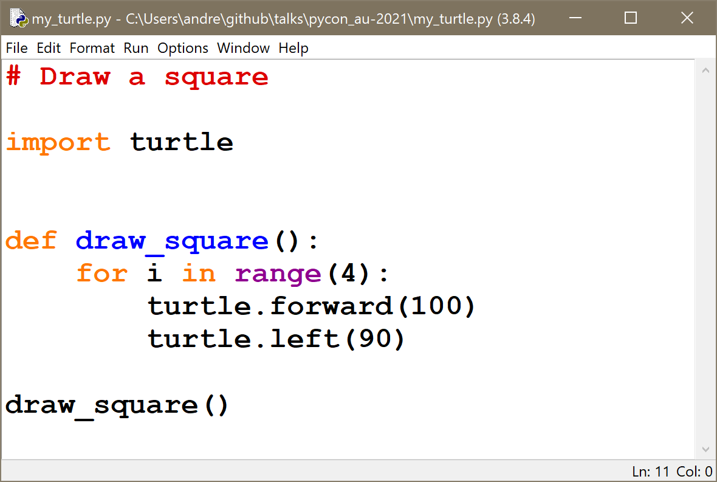
Example 1

Slide 4
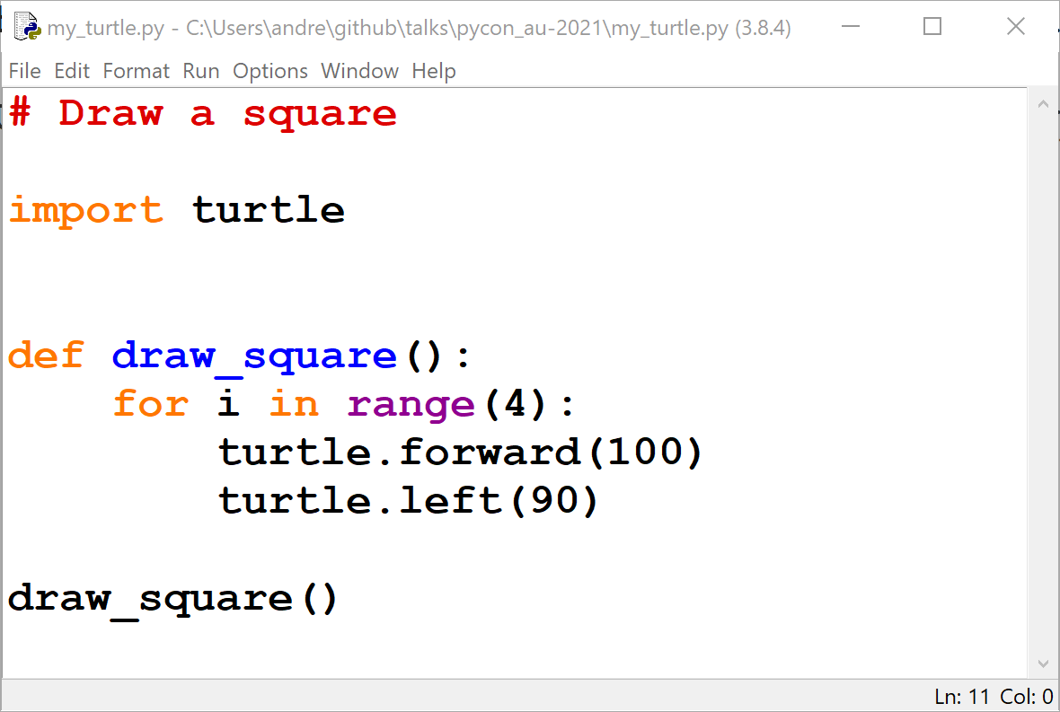
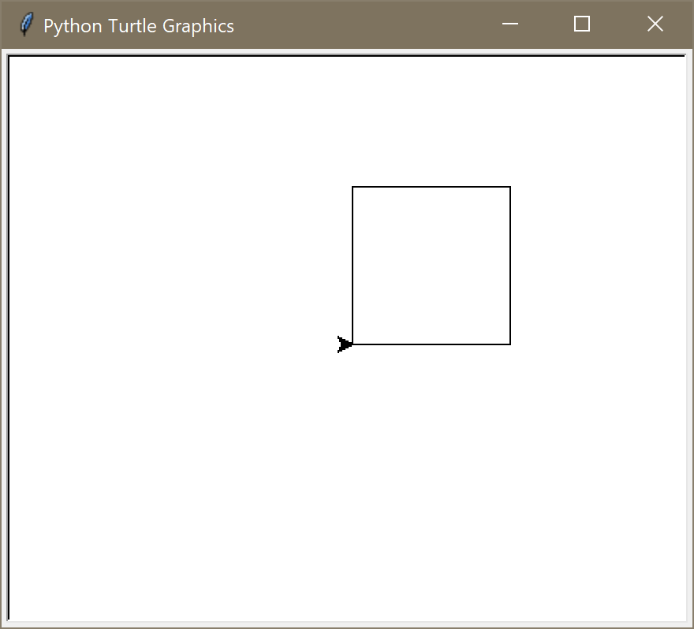
Example 1

Slide 5
A student tries to reproduce your example

Slide 6
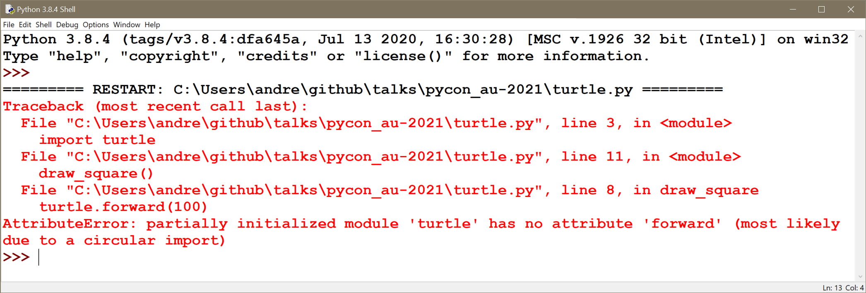
Example 1

Slide 7
Example 1
It doesn’t work!

Slide 8
It doesn’t work!
Too much red
Too much jargon
Traceback, AttributeError, partially initialized module, circular import, …

Slide 9
Could this be made more user-friendly?

Slide 10
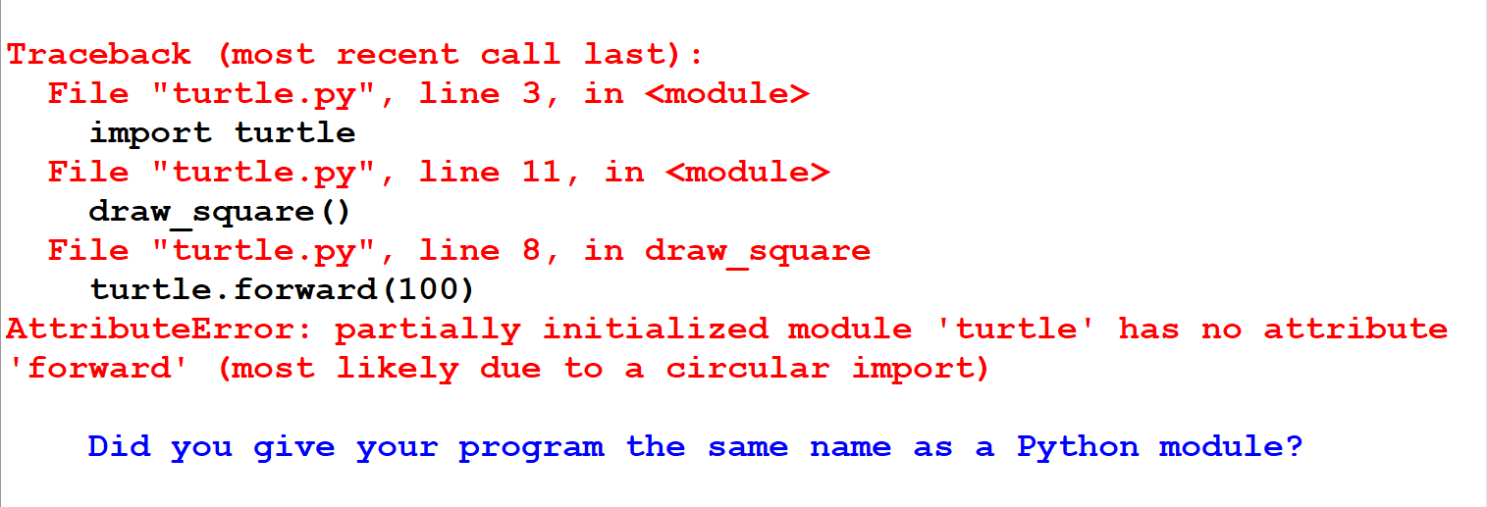
Could this be made more user-friendly?
Hint

Slide 11
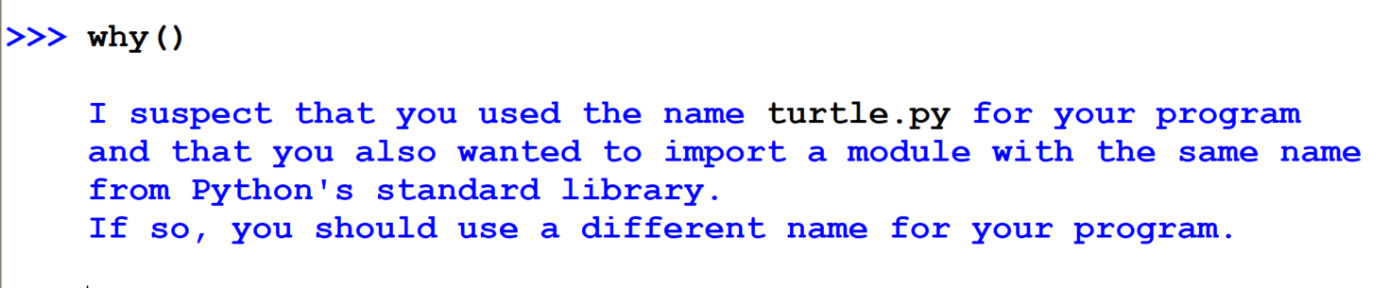
why()

Slide 12
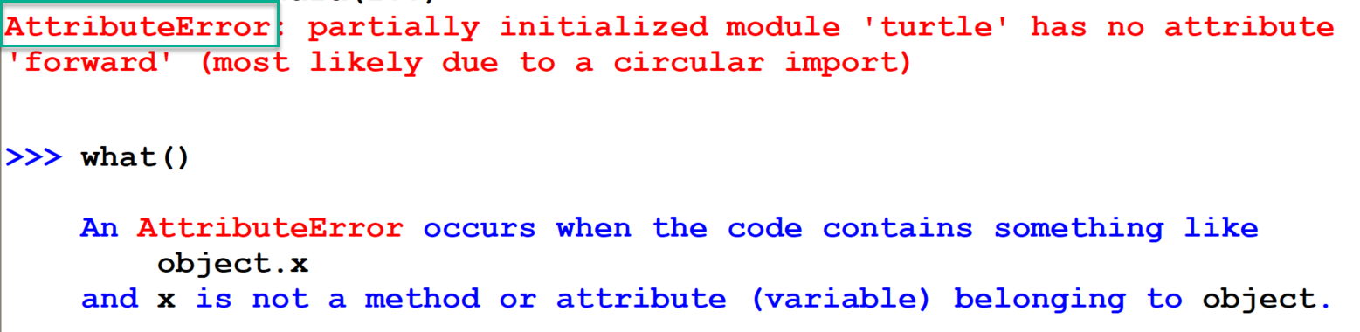
what()

Slide 13
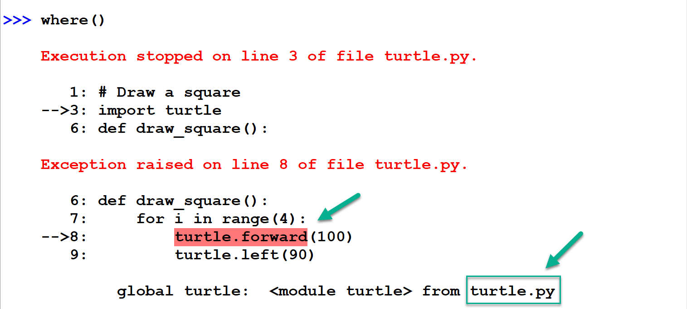
where()

Slide 14
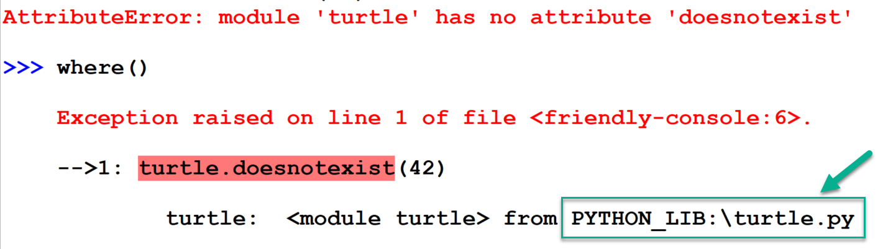
where()

Slide 15
This is possible using friendly
friendly
friendly_traceback

Slide 16
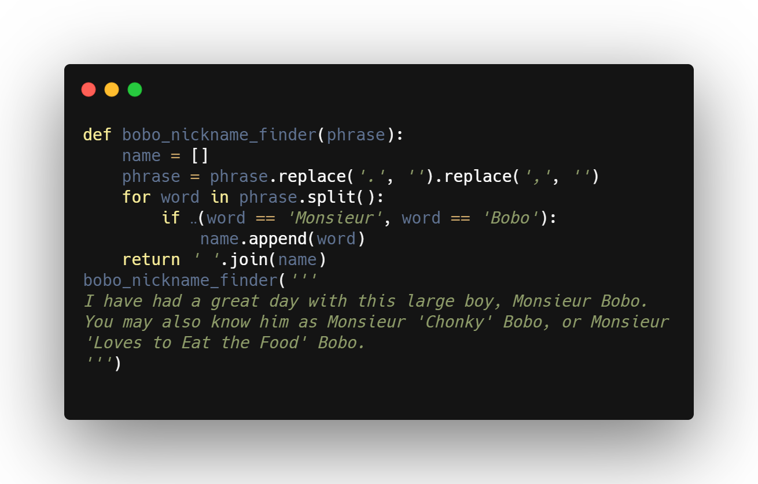
Example 2: flipfloperator

Slide 17
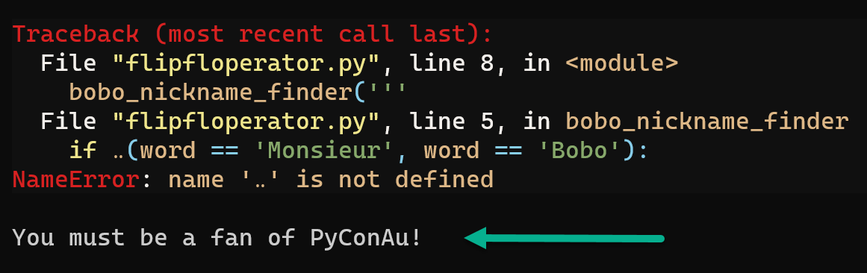
Example 2: flipfloperator

Slide 18
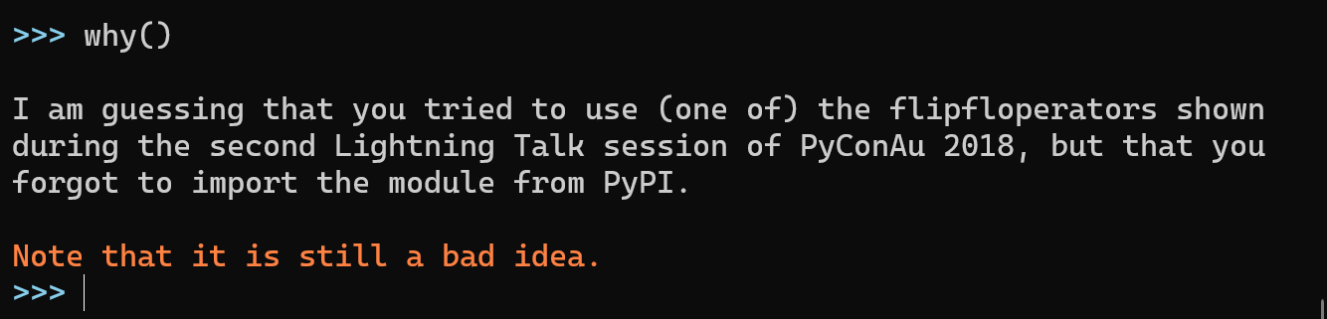
Example 2: flipfloperator

Slide 19
Purpose of this talk
Motivate you to use friendly with your students.
Encourage CS Education experts to critically evaluate friendly.
Motivate you to give me feedback to improve friendly.

Slide 20
Outline of the rest of this talk
Original purpose of friendly-traceback
Evolution of friendly/friendly-traceback
Suggestions made
Various examples
HackInScience site
Mu
Jupyter Notebooks
Justification after the fact

Slide 21
Original purpose of friendly-traceback
1. Provide accurate and easy to understand explanations for as many sources of Python exceptions as possible.
2. Translate these explanations in as many languages as possible.
This was in a submission following a Request for Proposals from the PSF Board Committee in Education – no money was requested, only public support for this project.

Slide 22
Suggestion from Julien Palard
Copy pasted text
Do it on HackInScience

Slide 23
Approach used: examples added one at a time
General
Did you give your program the same name as a Python module?
A few rare specialized cases
Using the flipfloperator … is still a bad idea
Version 0.4.0: approximately 300 individual cases of SyntaxError and various runtime errors.

Slide 24
https://friendly-traceback.github.io/docs/index.html

Slide 25
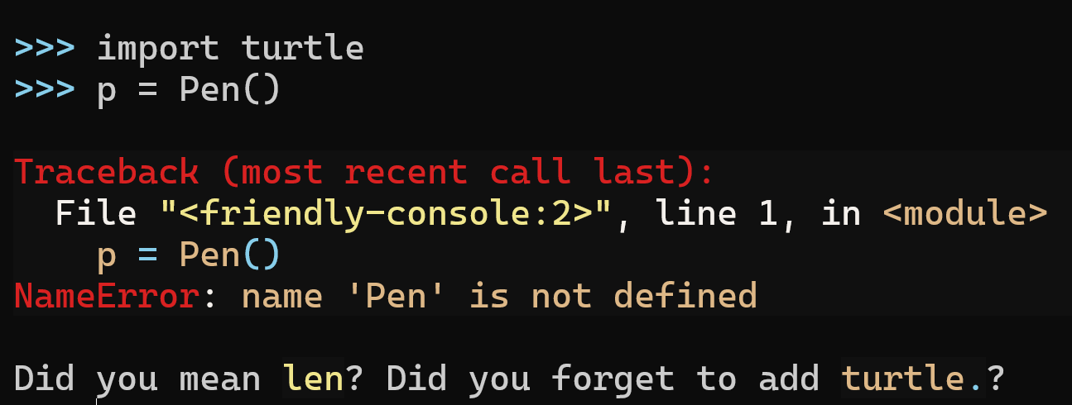
Do this example using Jupyter notebooks or Mu.

Slide 26
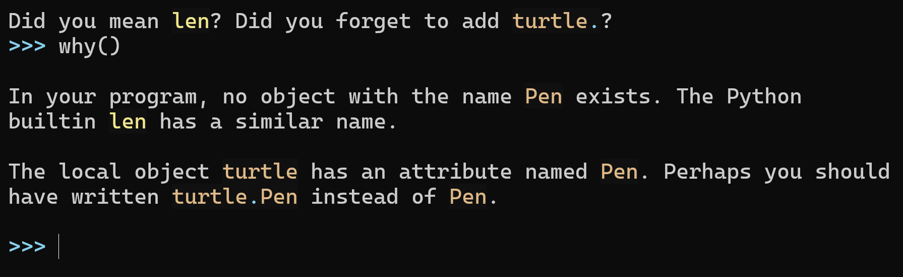

Slide 27
Mandering evolution I am just a hobbyist who has been developing a project based on suggestions from a few users and my own intuition of what was needed, without guidance from experts. Am I making the right choices?

Slide 28
Justification after the fact?
On Designing Programming Error Messages for Novices: Readability and its Constituent Factors
Paul Denny, Brett A. Becker, Catherine Mooney, John Homer, Zachary C. Albrecht, Gary B. Powell
CHI Conference on Human Factors in Computing Systems, May 2021.
https://www.youtube.com/watch?v=5-k9f3iFzXQ
https://dl.acm.org/doi/fullHtml/10.1145/3411764.3445696

Slide 29
Justification after the fact: a single paper
On Designing Programming Error Messages for Novices: Readability and its Constituent Factors
Paul Denny, Brett A. Becker, Catherine Mooney, John Homer, Zachary C. Albrecht, Gary B. Powell
CHI Conference on Human Factors in Computing Systems, May 2021.
“In educational contexts, the detrimental effects of cryptic error messages on novice programmers have been reported throughout the literature for decades…”

Slide 30
On Designing Programming Error Messages for Novices: Readability and its Constituent Factors
Important factors for readability: length and jargon

Slide 31
On Designing Programming Error Messages for Novices: Readability and its Constituent Factors
Important factors for readability: length and jargon
Remove jargon and acronyms
Write messages in complete sentences
Use simple vocabulary
Use an economy of words.

Slide 32
On Designing Programming Error Messages for Novices: Readability and its Constituent Factors
Important factors for readability: length and jargon
Remove jargon and acronyms
Write messages in complete sentences
Use simple vocabulary
Use an economy of words.
No mention of colour.

Slide 33
On Designing Programming Error Messages for Novices: Readability and its Constituent Factors
“We focus on readability which, we argue, is more fundamental [than usability] ”

Slide 34
On Designing Programming Error Messages for Novices: Readability and its Constituent Factors
“We focus on readability which, we argue, is more fundamental [than usability] ”
Usability: How actionable a message is?
Information about error locality
Message precision

Slide 35
On Designing Programming Error Messages for Novices: Readability and its Constituent Factors
Student evaluations of error messages from Java, C, Python.

Slide 36
On Designing Programming Error Messages for Novices: Readability and its Constituent Factors
Student evaluations of error messages from Java, C, Python.
Python was rated the worst.

Slide 37
On Designing Programming Error Messages for Novices: Readability and its Constituent Factors
Observation: Python 3.10 and upcoming 3.11 (PEP 657) include many improvements for message usability…

Slide 38
On Designing Programming Error Messages for Novices: Readability and its Constituent Factors
Python 3.6 and 3.7
AttributeError: module 'turtle' has no attribute 'forward’
Python 3.8+
AttributeError: partially initialized module 'turtle' has no attribute 'forward' (most likely due to a circular import)

Slide 39
On Designing Programming Error Messages for Novices: Readability and its Constituent Factors
Python + friendly
AttributeError: […] module 'turtle' has no attribute 'forward’ […]
Did you give your program the same name as a Python module?

Slide 40
Python friendly
Technical English
Intermediate to Advanced
Simple English
Simple French
etc.
Beginner to Intermediate
Opinion: Python should continue to strive first for usability, leaving it to projects like friendly to provide a bridge for absolute beginners.

Slide 41
Feedback wanted
Use it
Read the documentation
Design choices
Give feedback

Slide 42
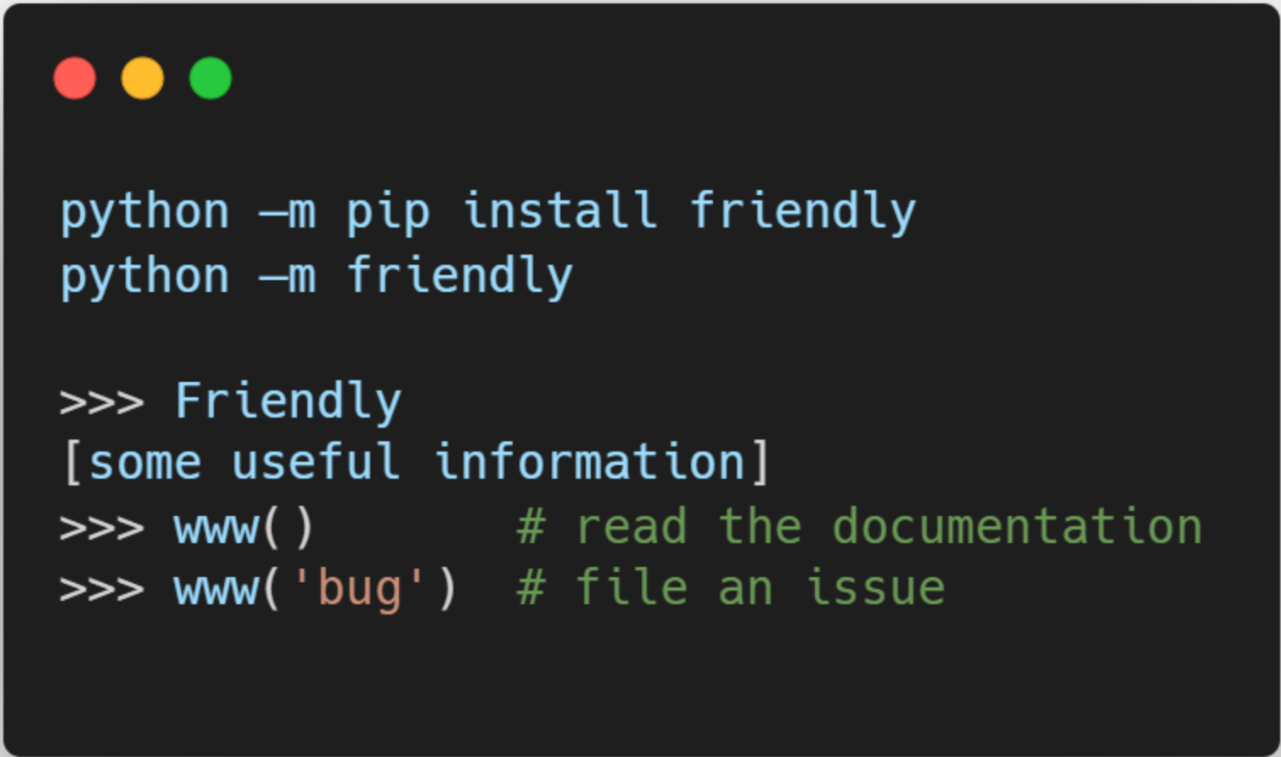
To find out more

