Slide 1
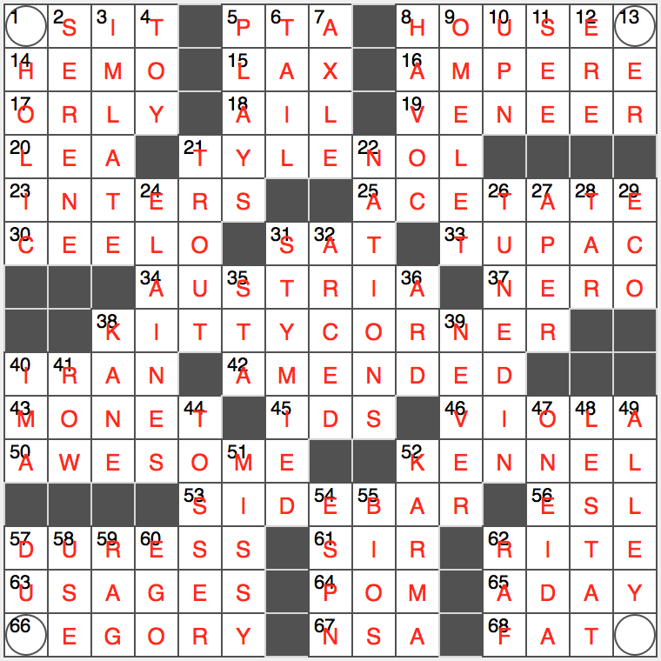
CAT
CAT
CAT
CAT

