Slide 1
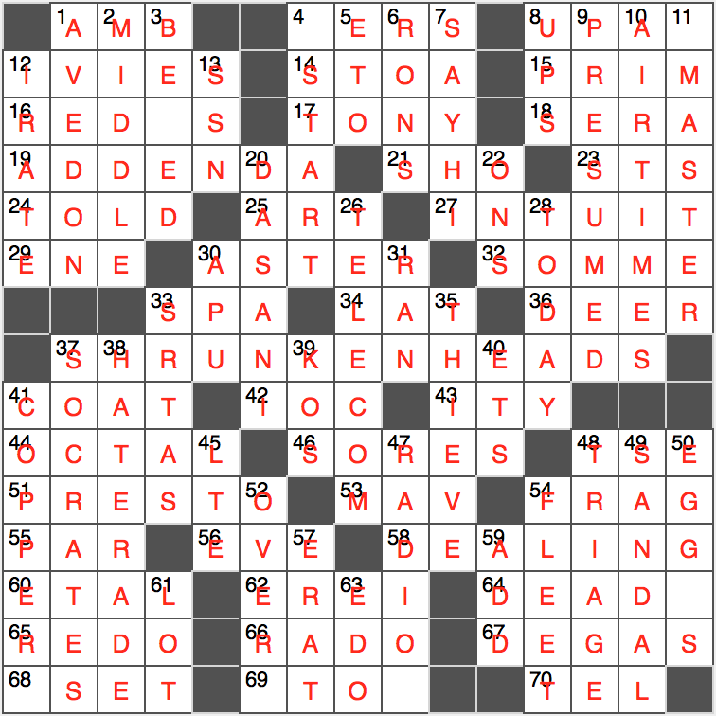
head
head
head
head
head
head
head

