Slide 1

Correspondence
ACDH & CH Internship 2020 / Q3
Walter Obweger
Instructor: Martin Anton Mueller
#wroACDHitp202003

Slide 2
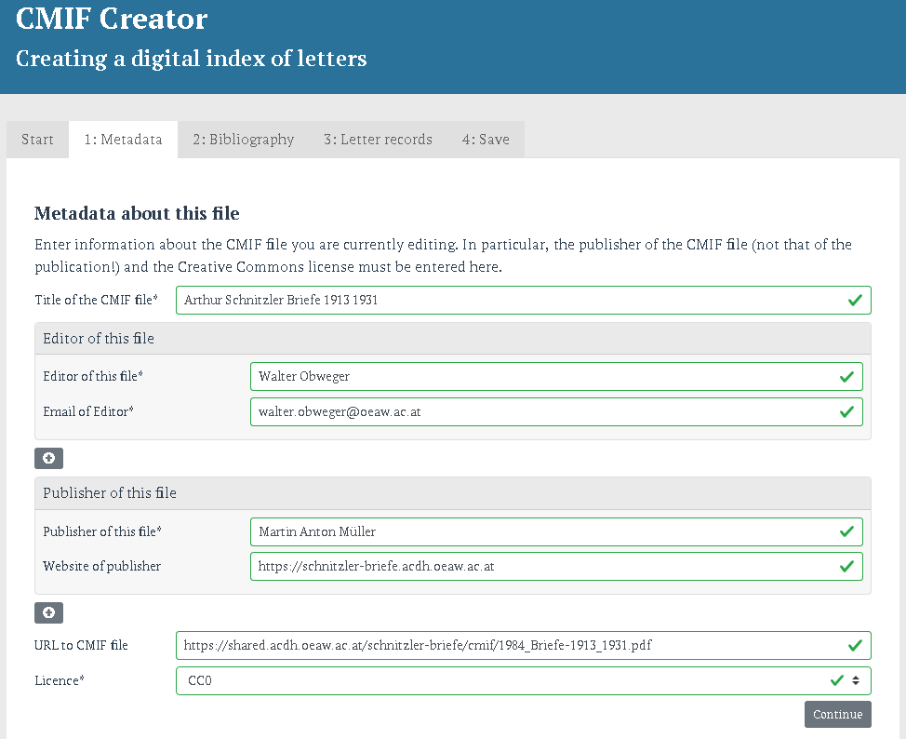
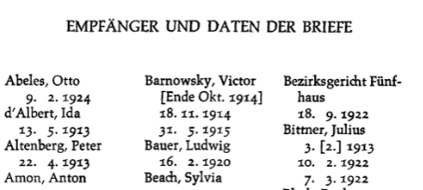
Correspondence Search
https://correspsearch.net/
TEI variation CMIF
CMIF Creator web
GND Gemeinsame
data letters in print

Slide 3
Arthur Schnitzler CorrespSearch, workflow
transkribus, text recognition 🙂😎
OpenRefine, working with messy data 🌞
Jupyter Notebook, semantic data validation, chronological dates
OpenRefine, final edit, format CMIF (json | xml)
released under MIT license, doc + src
Google Drive
public repo
https://github.com/wobweger/wroACDHitp202003
merci, thanks a lot, 💛lichsten Dank

