Slide 1



HAND GESTURE RECOGNITION AND TRANSLATION FOR INTERNATIONAL SIGN LANGUAGAE
B.E/B.Tech Viva-Voce Examination
Anna University, Chennai – 600 025
Presented By
ABDUL KATHAR J(310120243001)
AROCKIYA DASS A(310120243008)
NAVEEN RAJ D(310120243026)
Program: (B.Tech/ AI & DS)
Supervisor: Mr.R.SASIREKHA
Assistant Professor
Department of Artificial Intelligence & Data Science
Anand Institute of Higher Technology
Affiliated to Anna University
Chennai
BATCH NO: 15

Slide 2
Agenda
01
Objective
Modules Descripyion
09
Abstract
10
ISL
02
Literature Survey
11
Output Screenshot
03
Existing System
Condusion
04
12
Proposed System
13
References
05
System Requirement
06
07
System Architecture
08
Modules

Slide 3
Objective
To create a computer software and train a model using CNN
Which takes live hand gesture of International Sign Language and shows the output of the particular hand gesture in text format.
Then converts it into voice format and vice versa.
Our software employs to convert this information into audible voice.
This feature significantly enhances the accessibility and usability of our system.
Making it an effective communication tool not only for individuals.
Who use ISL but also for those who do not understand sign language.

Slide 4
Abstract
One of the earliest and most organic ways to communicate is through hand gestures, particularly for those who are hard of hearing or deaf.
Taking this into account, we have created a real-time neural network technique for hand gesture recognition based on International Sign Language (ISL).
The automatic identification of human gestures from camera images is a promising field for computer vision technology development.
We are using Convolutional Neural Network (CNN) approach to recognize hand gestures linked to human behaviors captured by live cameras.
The main goal is to identify and decipher hand movements used by people whose major form of communication is sign language.
Ultimately, using our approach, we were able to attain a 97.85% accuracy both with and without a clear background and in the right lighting.

Slide 5
Literature Survey
S.NO | Title, Author, Year | Technique used | Description | Remarks
1 | Enhancing Sign Language to Speech Conversion with Multimodal Data, E. Brown, F. Kim, 2022 | Multimodal Learning, Natural Language Processing | This study explores how integrating additional modalities like facial expressions and gestures can improve sign language translation. | Addresses the use of multimodal data in sign language translation.
2 | Recent Advances in Sign Language Translation Systems, A. Smith, B. Patel, 2022 | Deep Learning, Neural Networks | This paper reviews the most recent advances in sign language to speech translation systems. | Provides insights into state-of-the-art techniques.
3 | Deep Learning for Sign Language Recognition, C. Wang, D. Chen, 2019 | Multi-Stream CNN | Introduces a multi-stream CNN architecture for real-time sign language recognition. | Improved accuracy in dynamic signing.

Slide 6
Existing System
SignAll : Which is a pioneering company in the field of assistive technology.
They specifically focusing on communication barriers faced by the Deaf and Hard of Hearing community.
They have developed an innovative system that uses computer vision and machine learning to translate sign language into text.
Disadvantage:
Speech Conversion and Recommendations
Recommendations and Manipulation of words.

Slide 7
Proposed System
Our proposed system for sign language to speech aims to build upon existing technology while addressing some of the limitations currently faced.
The goal is to create a more portable, versatile, and bidirectional communication tool that can accurately translate sign language into speech and vice versa.
Algorithm used - Convolutional Neural Networks (CNNs).
Advantage :
Adequate lighting condition will be enough for the detection and classification of hand gestures.
Word Recommendation System.
Reverse Process.

Slide 8
System Requirement
Hardware Requirement :
Computer with Minimum i5 10th Gen Processor
Camera
Microphone
Speaker
Software Requirement :
Operating System: Windows 8 and Above
IDE: Visual Studio Code
Programming Language: Python 3.9 5
Python libraries: OpenCV, NumPy, Keras, MediaPipes, Tensorflow, Pillow, Speech Recognition, Tkinter

Slide 9
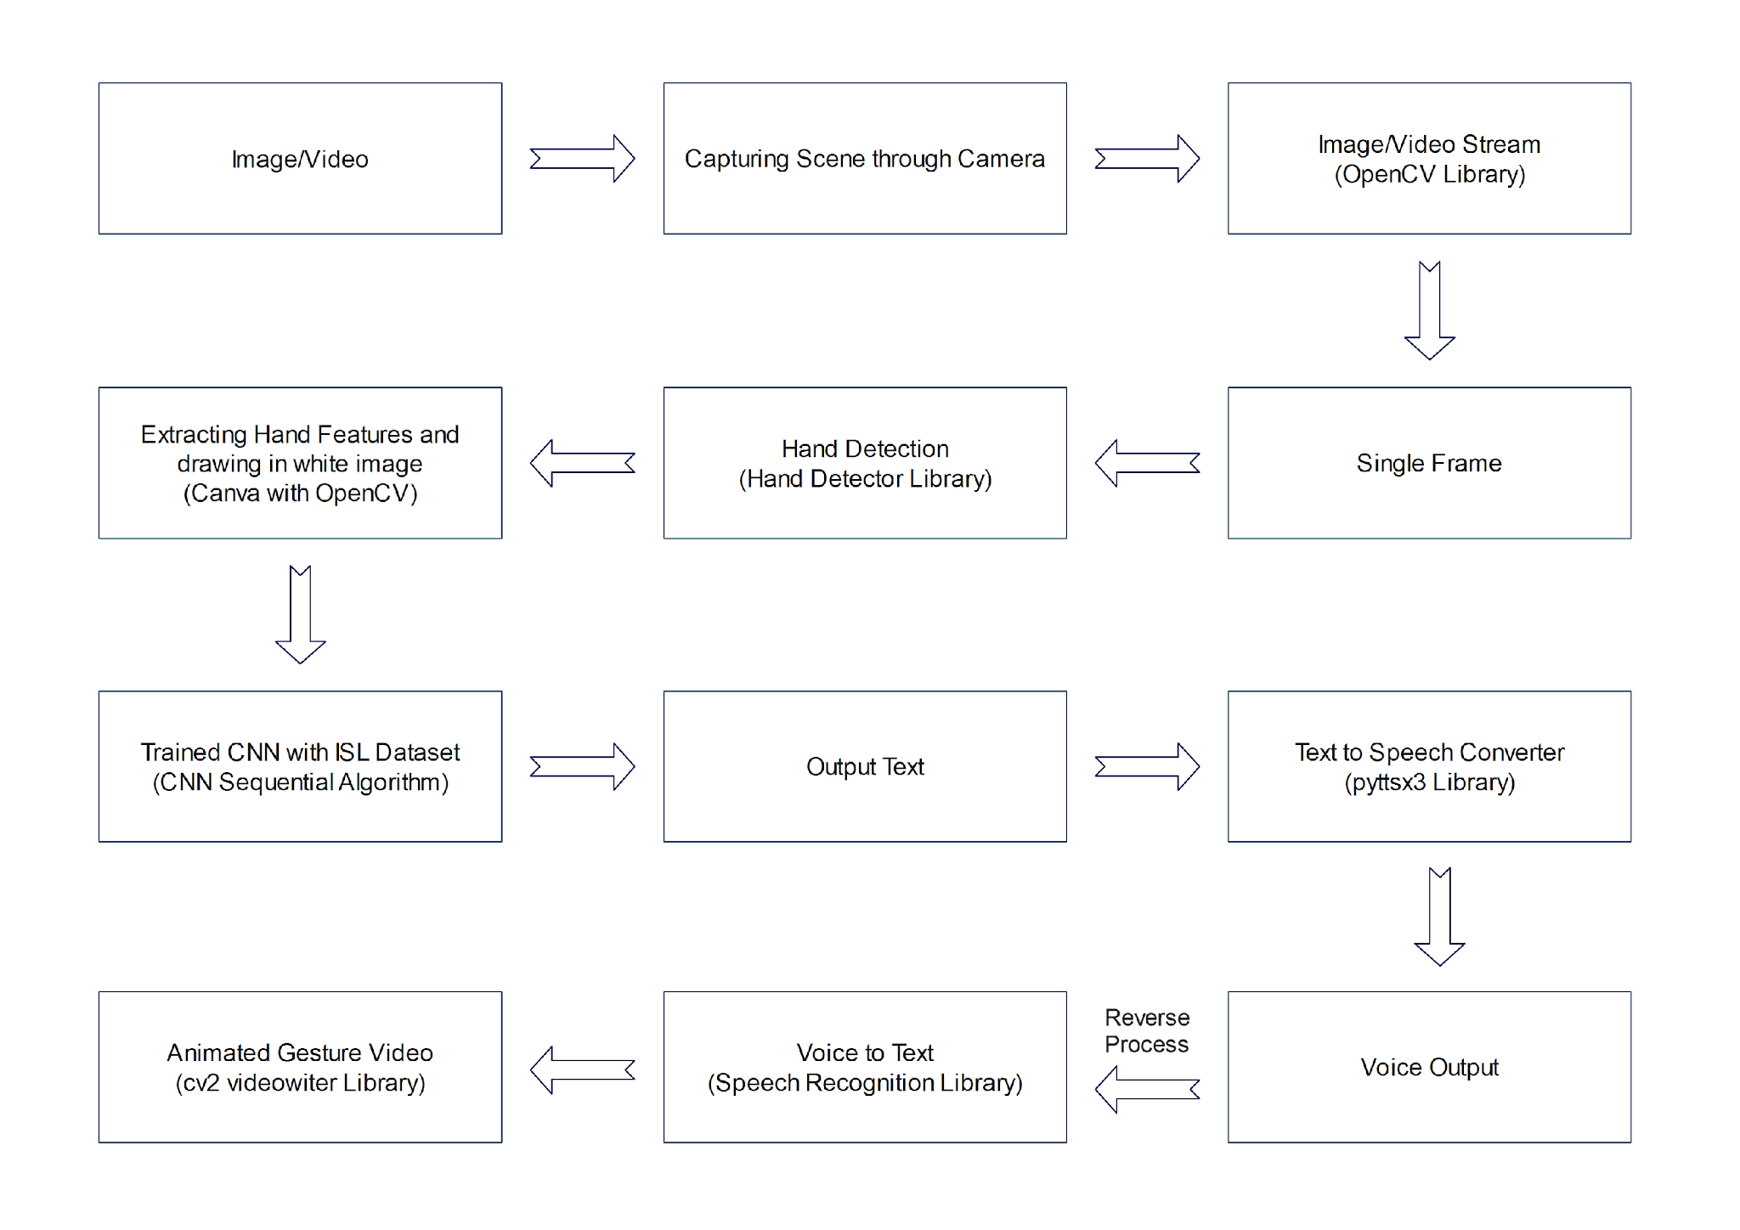
System Architecture

Slide 10
Modules
Data Procurement
Data Normalization and Feature Selection
Gesture Interpretation
Speech Synthesis
Reverse Process

Slide 11
Module Description
Data Procurement : Hand gesture data can be acquired through electromechanical devices like gloves, offering precise hand information but being costly and less user-friendly.
Alternatively, vision-based methods use webcams to observe hand/finger details, providing a cost-effective, device-free interaction between humans and computers.
Data Normalization and Feature Selection : Hand detection involves using the media pipe library to process webcam images, detecting hands and creating a region of interest (ROI).
After cropping and converting to a gray image with OpenCV, Gaussian blur is applied. Binary images are obtained using threshold methods.
However, limitations include the requirement for a clean background, proper lighting conditions, and challenges in real-world scenarios where these conditions may not be met.

Slide 12
Module Description(Cntd.,)
Gesture Interpretation : The initial convolutional layer deploys 32 filters with a 3x3 kernel size, resulting in the generation of feature maps.
Subsequent max-pooling strategically reduces spatial dimensions while preserving essential information.
This process iterates with 32 filters, yielding feature maps, followed by max pooling.
Continuing this pattern, two additional convolutional layers employ 16 filters each, complemented by further max pooling.
Speech Synthesis : The model translates known gestures into words.
We have used pyttsx3 library to convert the recognized words into the appropriate speech.
The text-to-speech output is a simple workaround, but it's a useful feature because it simulates a real-life dialogue.

Slide 13
Module Description(Cntd.,)
Reverse Process : The code converts voice input to text using speech_recognition, then processes the text to generate hand gesture animations via OpenCV.
Users initiate voice input, observe animated gestures, creating a seamless interaction bridging voice commands and visual representation.
The generated animations provide visual feedback, enhancing user understanding.
Additionally, error handling ensures robustness, gracefully managing potential issues during voice input and video generation processes, ensuring a smooth user experience

Slide 14
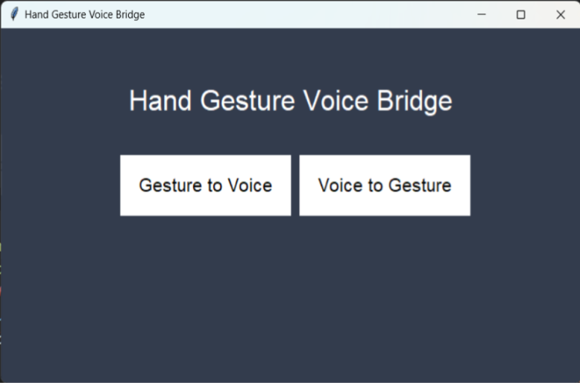
Output Screenshot

Slide 15
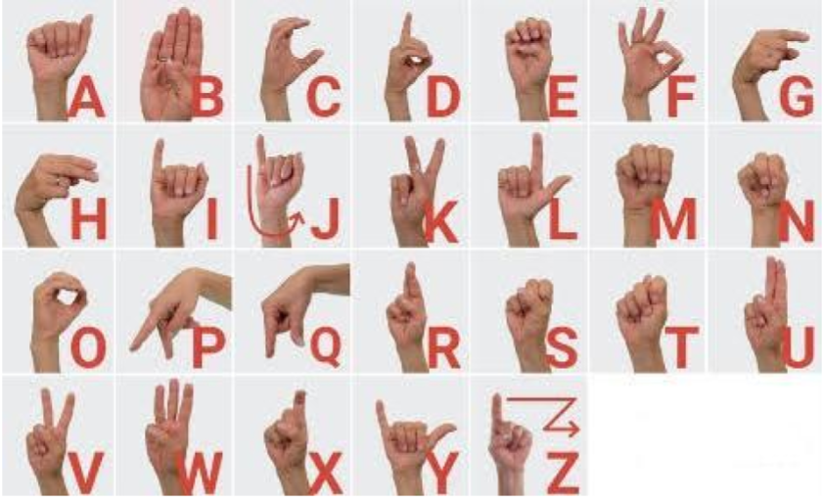
International Sign Language

Slide 16
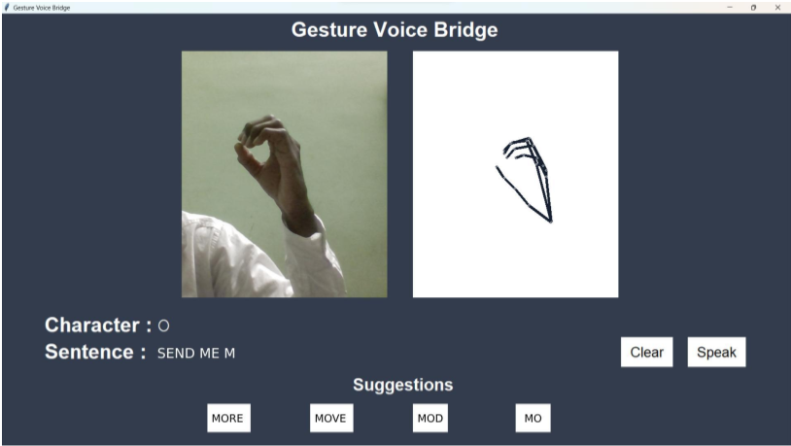
Output Screenshot

Slide 17
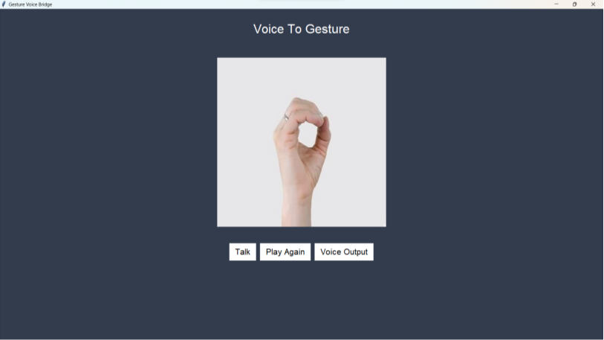
Output Screenshot

Slide 18
Conclusion and Future Enhancements
In this project, we have introduced a revolutionary system for real-time International Sign Language (ISL) gesture recognition and translation.
Leveraging the power of Convolutional Neural Networks (CNNs), our system excels in recognizing ISL gestures with remarkable accuracy, making it a reliable tool for individuals who use sign language as their primary mode of communication.
Beyond gesture recognition, our system transcends the visual medium by transforming recognized ISL gestures into audible voice, thus bridging communication gaps between the deaf and those who rely on spoken language.
This technology has the potential to create a more inclusive and communicative world, where language knows no boundaries.
The Future Enhancements are :
The Voice is available for Multiple Languages not only in English Language.
The Implementation of 2D or 3D Avatar in Reverse Process.
The Actions gesture like Hello, Thank You will be recognized by the gesture.

Slide 19
References
[1] Sunitha Nandhini, “Sign Language Recognition Using Convolutional Neural Network”, Shiva Roopan D, Shiyaam S, Yogesh S, May 2021.
[2] Siddhant Shivdikar, Juilee Thakur, Arnav Agarwal, “Hand Gesture Recognition and Translation Application ”, September 2022
[3] Yash Dhamecha, Rajat Pawar, Aditi Waghmare, Soma Ghosh, “Sign Language Conversion using Hand Gesture Recognition ”, April 2023
[4] Aditya Rathi, Sumanta Pasari, Sarita Sheoran, “Live Sign Language Recognition: Using Convolution Neural Networks ”, June 2022
[5] Heramba Limaye, Shraddha Shinde, Anurag Bapat, Nimish Samant, “Sign Language Recognition using Convolutional Neural Network with Customization ”, July 2022
[6] M Naveenkumar, S Srithar, G Ramesh Kalyan, E Vetrimani, S. Alagumuthukrishnan, “ Hand Sign Recognition using Deep Convolutional Neural Network ”, December 2022
[7] Dutta K. K. and Bellary S. A. S., “Machine Learning Techniques for Indian Sign Language Recognition,” 2017 International Conference on Current Trends in Computer, Electrical, Electronics and Communication (CTCEEC), 2017, pp.333-336, doi: 10.1109/CTCEEC.2017.8454988.

