Slide 1
Colossus
By Alexander Rodriguez

Slide 2
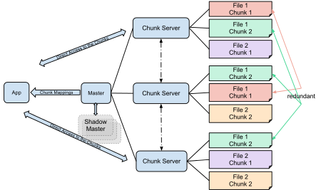
What is Colossus
Replaced GFS in 2010
Distributed File System
Google describes as “scalable storage system”
Backs all Google storage systems
GFS and Colossus operate similar way using clusters
Master node and Chunkservers
Exabytes of data (1 billion GB)

Slide 3
Why Colossus
GFS depended on single master node
Colossus uses multiple master nodes in one cluster
Single failure point not viable for things such as video
Reduces size of data chunks down to 1mb from 64mb

Slide 4
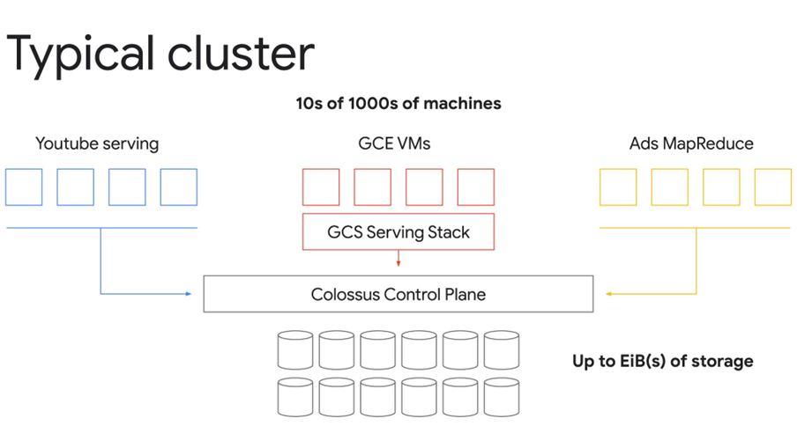
Colossus cont.
Failsafe programs called custodians
Colossus runs on a lot of hardware, failure expected
Custodians can use working drives to retrieve data from faulty one
Other maintenance and reliability tasks
Part of Colossus “Control Plane”
Colossus much more reliable and scalable than GFS

Slide 5
Sources
https://www.wired.com/2012/07/google-colossus/
https://siliconangle.com/2021/04/19/google-shares-technical-overview-exabyte-scale-colossus-file-system/
https://cloud.google.com/blog/products/storage-data-transfer/a-peek-behind-colossus-googles-file-system

