Slide 1
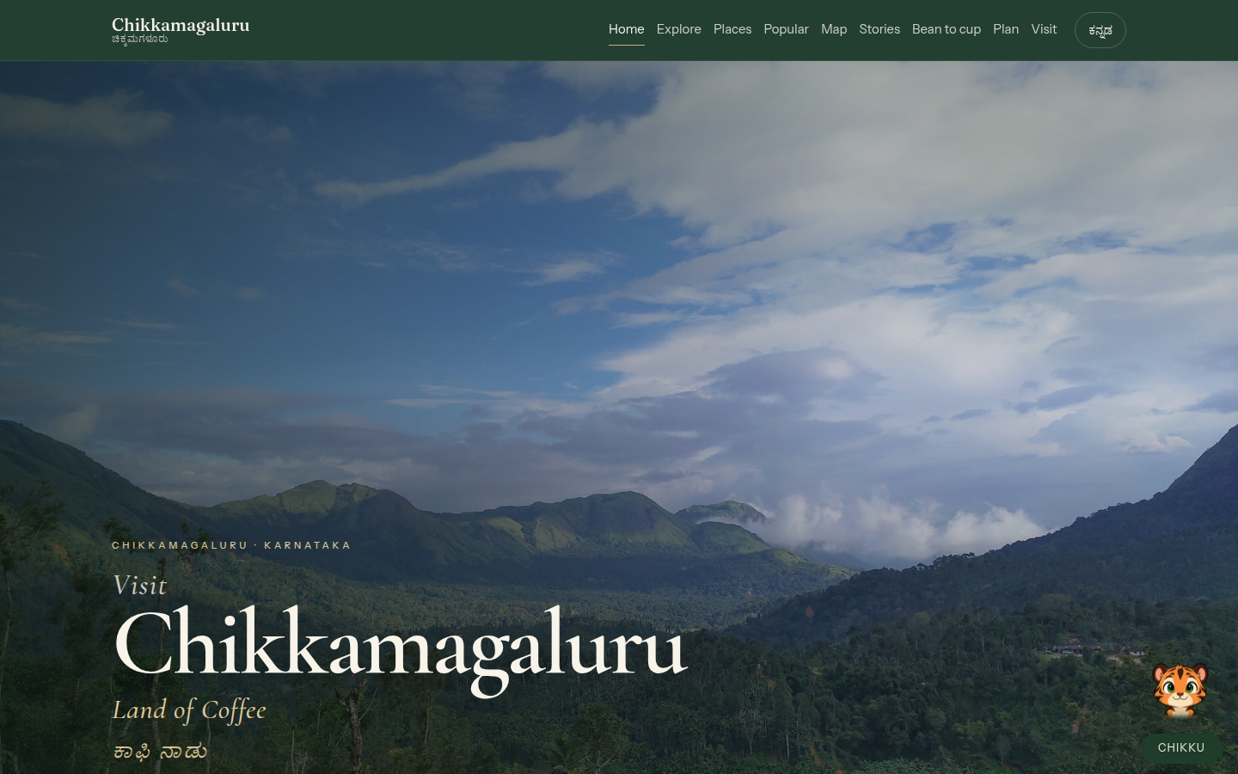
CONFIDENTIAL · DISTRICT COMPANION · 2026
Not another hotel list.
A companion for Chikkamagaluru.
Live product pitch for DTPC, coffee board, and destination partners.
chikkamagaluru-companion.vercel.app
List ₹9.9L · Close ₹8.5L · Walk-away ₹7.5L + GST
Chikkamagaluru Companion · Confidential pitch
01 / 23
Notes:
Open on the live URL. Do not start with price. Start with Nature, then the map, then Bean to Cup.

Slide 2
AGENDA
Forty minutes. Then a number.
01
The problem
Blogs, OTAs, and a missing district OS
02
Live product
Nature, map, popular, coffee, Chikku
03
Why it is unique
Eleven capabilities agencies do not ship
04
Market prices
What Bangalore / tourism agencies actually charge
05
The offer
₹8.5L close, extras, AMC, second district
06
Close
Objections, handover, who signs
Chikkamagaluru Companion · Confidential pitch
02 / 23

Slide 3
THE PROBLEM
The district is famous. The web is not useful.
OTA clones
Book-now buttons, fake availability, 18% take rates. A department cannot stand behind this.
Template tourism
Five sliders, 12 SEO pages, Instagram embed. No taluk, no permit, no season you can walk.
Pin salad maps
Google Map dumps mix Hassan, Kodagu, and this district. Visitors get lost on the ghat.
ChatGPT boxes
Generic bots invent homestays and jeep fees. Legal and forest-department risk.
Chikkamagaluru Companion · Confidential pitch
03 / 23

Slide 4
POSITIONING
Sell the companion. Not a marketplace.
This is
· A district OS for visitors
· English + Kannada
· Sourced hours, official links
· Coffee origin as brand film
· Mascot that stays on this map
This is not
· A booking engine
· A government gazette
· A hotel / homestay list
· A downloadable trip pack
· A generic ChatGPT widget
Why that wins
· Dept and mathas can endorse it
· No OTA scandal
· Forest permits stay theirs
· Coffee Board has a story
· Credibility on the hairpin
Chikkamagaluru Companion · Confidential pitch
04 / 23

Slide 5
THE 30-SECOND PITCH
Say this. Then open the URL.
Chikkamagaluru does not need another hotel list. It needs a companion a visitor can open on the hairpin: which taluk they are in, which peak or fall is actually in this district, when Hebbe is a jeep problem, that Kudremukh is a permit, and that coffee here is a story from seven Mocha seeds to filter coffee — not a café menu.
That companion is already live. English and Kannada. Nine taluks. Nature, heritage, food. A cinematic Bean-to-Cup walk. A tiger, Chikku, who only answers this district.
We do not book rooms. That is how you stay credible with the district, the forest department, and the mathas.
Chikkamagaluru Companion · Confidential pitch
05 / 23
Notes:
Memorise this paragraph. Do not read the whole deck. This is the spoken core.

Slide 6
LIVE PRODUCT
Not a mock. Production.
Hard-refresh if they saw an older hero overlay.
Home
chikkamagaluru-companion.vercel.app
Hero stills, map, Explore, popular, Bean to cup
Nature
/nature
Seasons you can walk, outdoor catalogue, forest care
Map
/map
Nine taluks, OSM, Kalasa & Ajjampura current
Bean to cup
/bean-to-cup
15-beat coffee walk, filter coffee close
Places
/places
Full catalogue by kind
Popular
/popular
30 recurring visitor stops + sourced hours
Chikkamagaluru Companion · Confidential pitch
06 / 23

Slide 7
SNIPPET · HOME
Editorial type on a still that moves every two seconds.
What to say
Five graded stills: Kudremukh, Mullayanagiri, Ayyanakere, Kemmanagundi sunset, Hebbe. Slow dissolve. No carnival overlay.
Cormorant display type. Chikkamagaluru stays on one line on a phone.
Reduced-motion visitors see the first still only.
Chikkamagaluru Companion · Confidential pitch
07 / 23

Slide 8
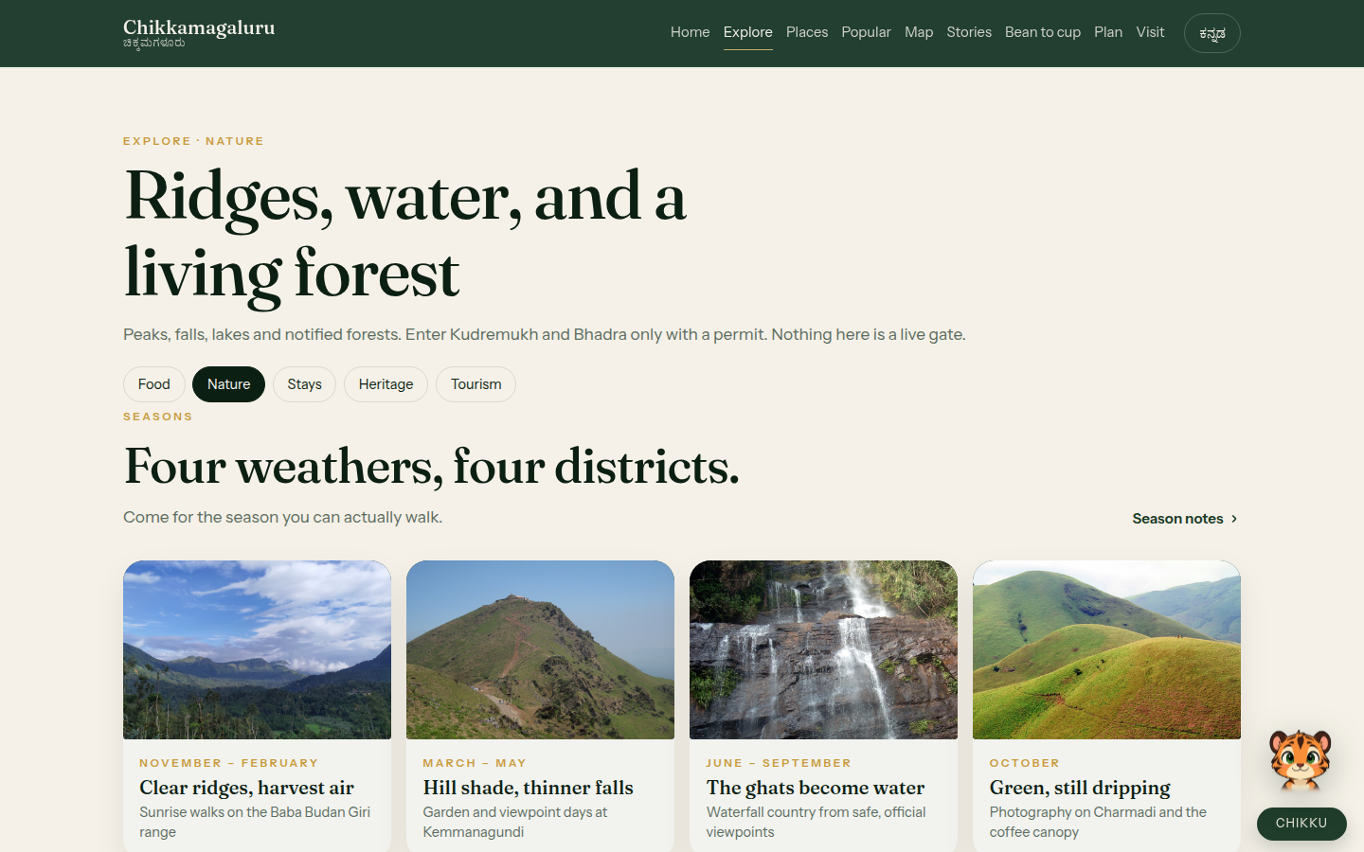
SNIPPET · NATURE
The page a monsoon visitor actually needs.
Show this first to forest / eco buyers.
Four seasons you can walk — not a weather widget.
Peaks, falls, lakes, notified forests grouped the way people search.
Kudremukh and Bhadra named as permit country. Nothing here is a live gate.
Field photographs + forest-care story in the same breath.
Chikkamagaluru Companion · Confidential pitch
08 / 23

Slide 9
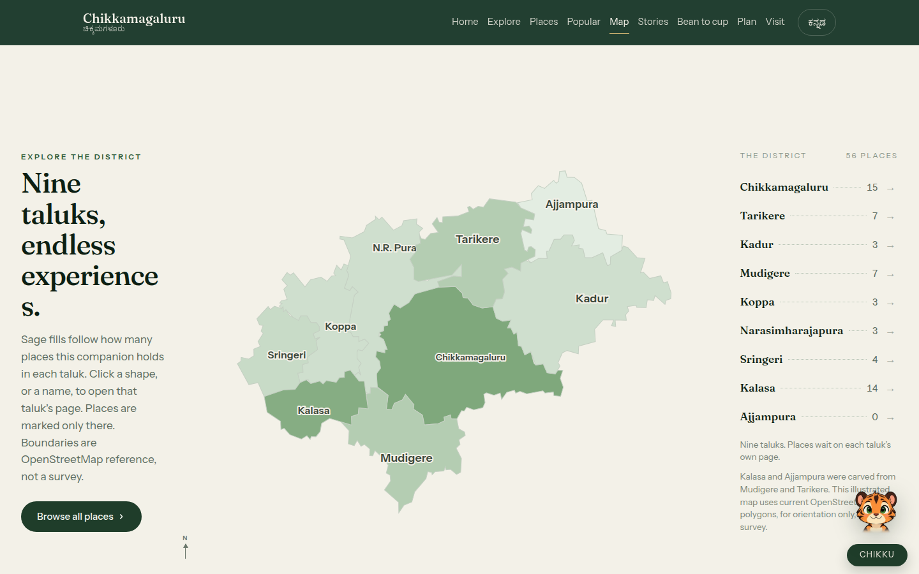
SNIPPET · MAP
Nine current taluks. Not a pin dump.
OSM choropleth
Home: taluks only. Click through: that taluk’s places.
Kalasa and Ajjampura shown as current units, not 1990s Mudigere/Tarikere.
Orientation only — not a survey. ODbL credited.
Chikkamagaluru Companion · Confidential pitch
09 / 23

Slide 10
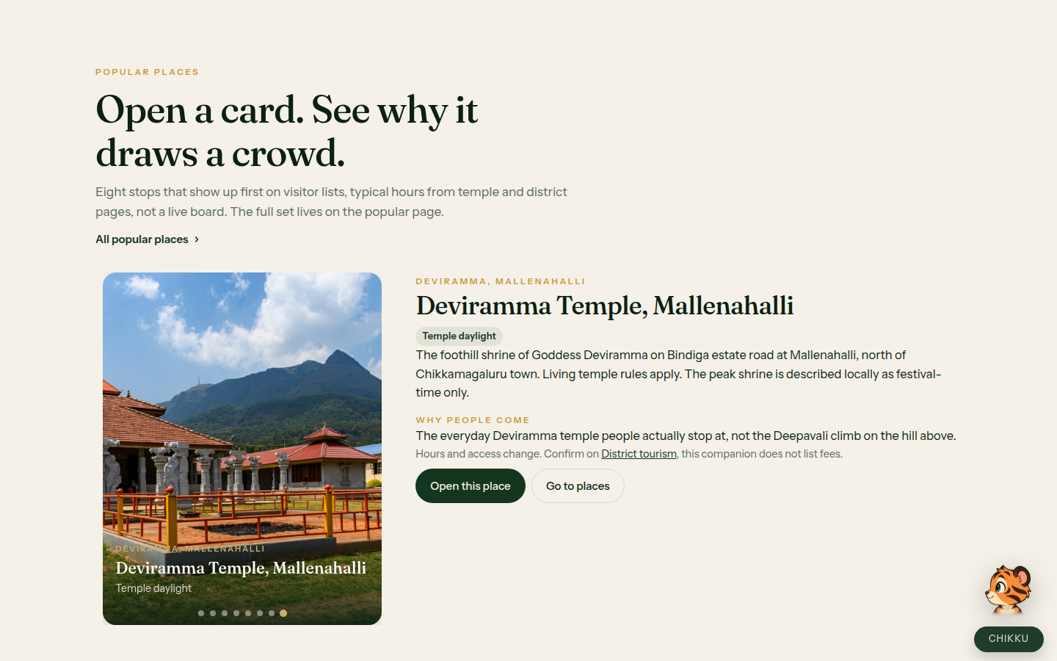
SNIPPET · POPULAR
Eight featured stops with why — not a dump.
Featured now
Deviramma Temple, Mallenahalli sits in the home carousel. Kalaseshwara stays on the full popular list.
Why people come + sourced hours (district, forest, matha).
Full popular page: ~30 in-district stops from Tripadvisor / district loops.
Chikkamagaluru Companion · Confidential pitch
10 / 23

Slide 11
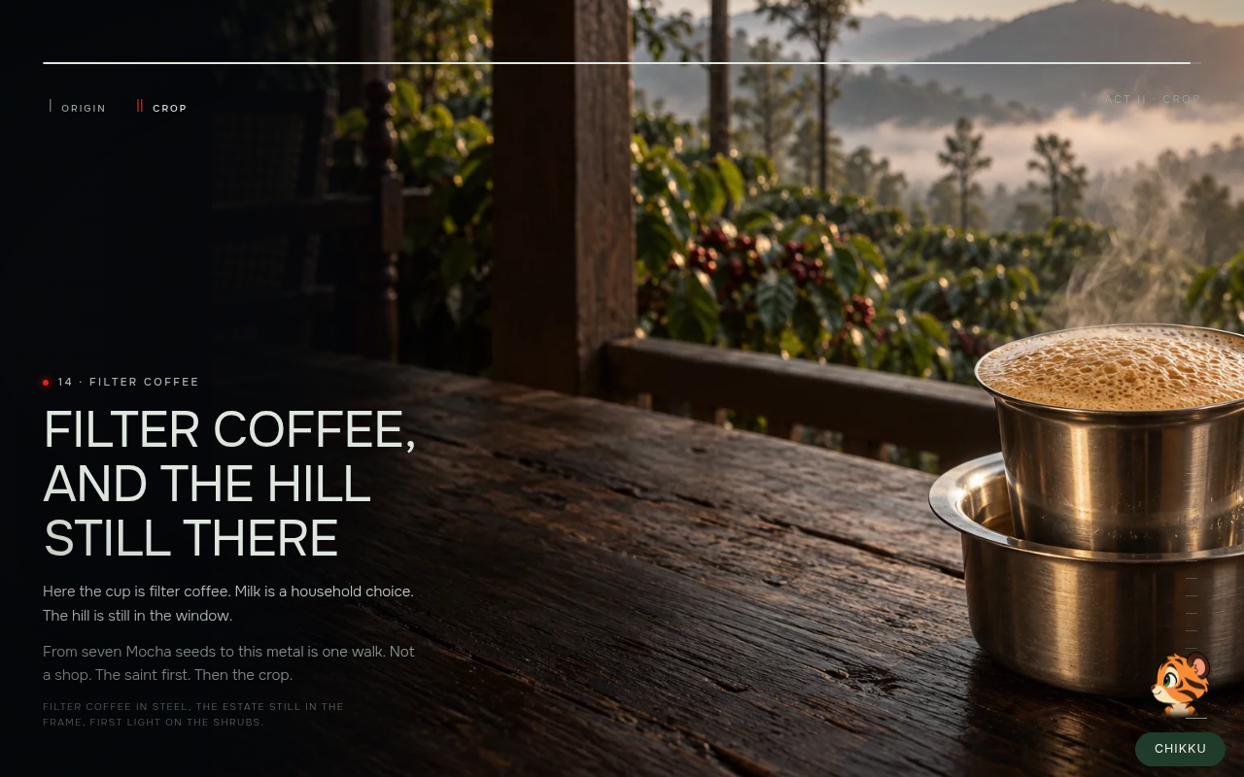
SNIPPET · BEAN TO CUP
The closer for Coffee Board and estates.
15 beats, one still at a time
Baba Budan → Mocha → courtyard → shade → cherry → roast → filter coffee.
Not a shop. Lore labelled lore.
Reduced-motion: same stills as a longread.
Chikkamagaluru Companion · Confidential pitch
11 / 23

Slide 12
UNIQUE NOW
Eleven things a ₹2L agency site will not include.
01 Honest scope
No rooms, carts, or fake Book now. Official links stay the authority.
02 Nine-taluk map
Current OSM units, places on the taluk page only.
03 Real catalogue
Peaks, falls, temples, lakes, wildlife, treks, coffee country.
04 Nature OS
Seasons, outdoor groups, forest care, field photos.
05 Bean to Cup
Brand film + encyclopedia for the crop.
06 Ask Chikku
District-only Q&A, 1–5 day sketches, iOS-safe, streams text.
07 EN + Kannada
Toggle on every shell.
08 Sourced popular
Hours from district, forest, Sringeri, Horanadu.
09 Tourism numbers
Published visits, seasonal planner, taluk counts.
10 Motion + restraint
Carousel, DriftWall, accordion; freeze on reduced-motion.
11 Licences
Commons / CC stills, named artists. Defensible in a legal review.
12 Phone first
Titles do not snap. Chikku survives the iOS keyboard.
Chikkamagaluru Companion · Confidential pitch
12 / 23

Slide 13
MARKET · INDIA 2025–26
What other agencies actually charge for tourism sites.
Blended quotes from typical Bangalore / Mysuru / national hospitality vendors. Not a tender scrape.
Tier | Typical vendor | What they ship | Fee (INR)
Freelance brochure | Fiverr, Justdial, 1–2 person shops | 5–8 WP pages, slider, form | ₹25k – ₹80k
Local digital agency | 5–15 person Bengaluru shops | 10–20 pages, enquiry, WhatsApp | ₹1.5L – ₹4L
Tourism boutique | Hotel / destination specialists | Custom UI, photo pack, MMT iframe | ₹4L – ₹8L
Premium studio | National creative + tech | Motion, CMS, multilingual campaign | ₹10L – ₹25L
DTPC / govt tender | Empanelled IT vendors | Portal, bilingual, AMC, often ugly | ₹8L – ₹40L
OTA / marketplace | Product companies | Inventory, payments, 10–18% take | ₹15L+ plus rev share
AMC in this market is usually 15–25% of build. Booking widgets look cheap until legal and chargebacks arrive.
Chikkamagaluru Companion · Confidential pitch
13 / 23

Slide 14
WHERE THIS SITS
Boutique depth, studio craft, tender honesty — without the OTA.
Rebuild from scratch at a mid-agency blended rate (₹10–15k/day, two people, 16–20 weeks) is ₹12–20 lakh. You are buying finished inventory, not a kickoff.
vs ₹80k brochure
They get a template. You get a taluk map, catalogue, coffee film, mascot that will not invent a homestay.
vs ₹3L agency
They get 15 pages and a form. You get 15+ surfaces, bilingual, sourced hours, Nature as a product.
vs ₹12L studio
They start in month four. You are live on a phone in the ghats this week. Brand pass is 14 days.
vs ₹20L tender portal
They ship CMS + ugliness. You ship editorial OS the department can actually show a minister.
Chikkamagaluru Companion · Confidential pitch
14 / 23

Slide 15
SCOPE COMPARISON
Same meeting, three quotes.
Capability | ₹3L agency | ₹10L studio | This companion
Bilingual EN + Kannada | Often English only | Paid extra | In every shell
Taluk map (current 9) | Google iframe | Custom if scoped | OSM choropleth, live
Place catalogue depth | 12–20 SEO pages | CMS empty until content | District set, sourced
Sourced temple/forest hours | Rare | If content team hired | Yes, with links
Coffee origin film-walk | No | Campaign extra ₹3–6L | Bean to Cup 00–14
Grounded mascot Q&A | Tawk.to / GPT | Custom bot extra | Chikku, district-only
No fake booking | Usually Book now | Depends | By design
Nature season logic | Gallery | Microsite extra | Own hub
Time to useful URL | 8–14 weeks | 16–24 weeks | 14-day brand handover
Indicative fee | ₹1.5–4L | ₹10–25L | Close ₹8.5L + GST
Chikkamagaluru Companion · Confidential pitch
15 / 23

Slide 16
COMMERCIALS
One number to close. Three numbers to remember.
LIST
₹9.9 lakh
Open the meeting here. Turnkey district OS on their domain.
CLOSE
₹8.5 lakh
Target. Light brand, 90-day hypercare, this district.
WALK-AWAY
₹7.5 lakh
As-live handover. Below this you are selling a brochure.
FLOOR
₹5.0 lakh
Do not. It trains the buyer to treat this as freelance hours.
Included in the close · GST extra
Domain + Vercel production · wordmark / colour pass in 14 days · 90-day hypercare · featured-eight and Chikku line edits · bilingual as shipped · training (1 session).
AMC ₹1.8 lakh / year · copy, photos, Chikku answers, stats, small UX. Typical market AMC on an ₹8.5L build would be ₹1.3–2.1L (15–25%).
Chikkamagaluru Companion · Confidential pitch
16 / 23

Slide 17
EXTRAS · SECOND INVOICE
Do not bundle these into ₹8.5L.
Extra | Buyer reason | Add (INR)
Live LLM Chikku, still grounded | Ask anything without leaving the district | ₹1.5 – 2.5L
CMS for hours / closures / festivals | Dept updates without a developer | ₹2.0 – 2.5L
Hero film + stills production | 3–5s clips, licensed crew | ₹1.5 – 4.0L
Second district (Kodagu, Hassan…) | Same OS, new map + catalogue | 60–70% of first (~₹5–7L)
Hindi or Tulu layer | Statewide tourism | ₹0.8 – 1.2L / language
WhatsApp / voice Chikku | Drivers and pilgrims | ₹2.0 – 3.0L
Analytics + monthly PDF | What opened: Hebbe, Sringeri… | ₹0.6L + ₹25k/mo
Bean-to-Cup studio (passworded) | They tweak the coffee walk | ₹0.8L
A11y + performance report | Tender checkbox | ₹0.4L
Chikkamagaluru Companion · Confidential pitch
17 / 23

Slide 18
WHO THIS IS FOR
One product, three buyers, three proofs.
DTPC / district / Karnataka Tourism
Proof: Nature + map + sourced hours. Close ₹12–16L tender-shaped (GST, training, year-1 AMC).
Do not lead with Bean to Cup.
Coffee Board / estate association
Proof: Bean to Cup → filter coffee. Close ₹8.5L private.
Do not offer booking.
Private DMO / responsible operator
Proof: Chikku 2-day sketch + popular hours. Close ₹8.5L.
If they demand OTA, walk.
Chikkamagaluru Companion · Confidential pitch
18 / 23

Slide 19
ROOM SCRIPT
40 minutes. URL on the table.
1:30
Home hero
Not a booking site. A companion.
2:00
Map → taluk
This is the district, not a pin salad.
2:00
Nature
The page a monsoon visitor needs.
2:00
Popular → Deviramma
Featured stops with why.
3:00
Bean to Cup beat 14
Coffee-board buyer is done.
1:00
Chikku: Hebbe / 2 days
Show off-topic refusal.
3:00
Price slide
₹9.9 list / ₹8.5 close / ₹1.8 AMC.
1:00
Ask
If we put your wordmark on this URL in 14 days, who signs?
Chikkamagaluru Companion · Confidential pitch
19 / 23

Slide 20
OBJECTIONS
Answer once. Then wait.
We can get a site for ₹80,000.
You can get a brochure. You cannot get a taluk map, a sourced catalogue, a coffee film, and a mascot that will not invent a homestay.
Can it book rooms?
No. That is the point. A booking engine is a second product and a second legal stack.
Udupi Tourism looks free.
That is a department site. You are buying the editorial + product layer they still do not have.
We need changes.
Brand, domain, featured eight, Chikku lines: inside ₹8.5L. CMS, LLM, film, second district: rate card.
Send a PDF.
The demo is the PDF. One-pager and 14-day checklist after you confirm the close number.
Our nephew does websites.
Ask him to ship nine current taluks, Bean to Cup, and a bot that refuses Coorg. Then compare.
Chikkamagaluru Companion · Confidential pitch
20 / 23

Slide 21
14-DAY HANDOVER
They own a live URL, not a Figma.
Day 1–2
Access, domain, wordmark, colour tokens.
Day 3–7
Header, featured eight, Chikku greeting, footer legal line.
Day 8–10
Training: update flow, what not to add (bookings).
Day 11–14
Go-live on their domain, 90-day hypercare clock starts.
Day 30
First stats + broken-link pass.
Day 90
Handover review. Convert to AMC ₹1.8L.
Chikkamagaluru Companion · Confidential pitch
21 / 23

Slide 22
THE ASK
Put your wordmark on this URL in 14 days.
CLOSE
₹8.5 lakh + GST
CARE
₹1.8 lakh / year
NEXT DISTRICT
~60% of year one
Who signs? · chikkamagaluru-companion.vercel.app · Not for sale as rooms. For sale as a companion.
Chikkamagaluru Companion · Confidential pitch
22 / 23
Notes:
If we put your wordmark on this URL in 14 days, who signs? Then silence.

Slide 23
APPENDIX
One-pager after they confirm the number.
Product · Chikkamagaluru Companion (live)
Handover · domain, Vercel, wordmark, 14-day brand pass, 90-day hypercare
Investment · ₹8,50,000 + GST
Care · ₹1,80,000 / year
Next district · quoted separately, ~60% of year-one
Not included · booking, live LLM, film production, CMS
Nature · chikkamagaluru-companion.vercel.app/nature
Chikkamagaluru Companion · Confidential pitch
23 / 23

