Slide 1
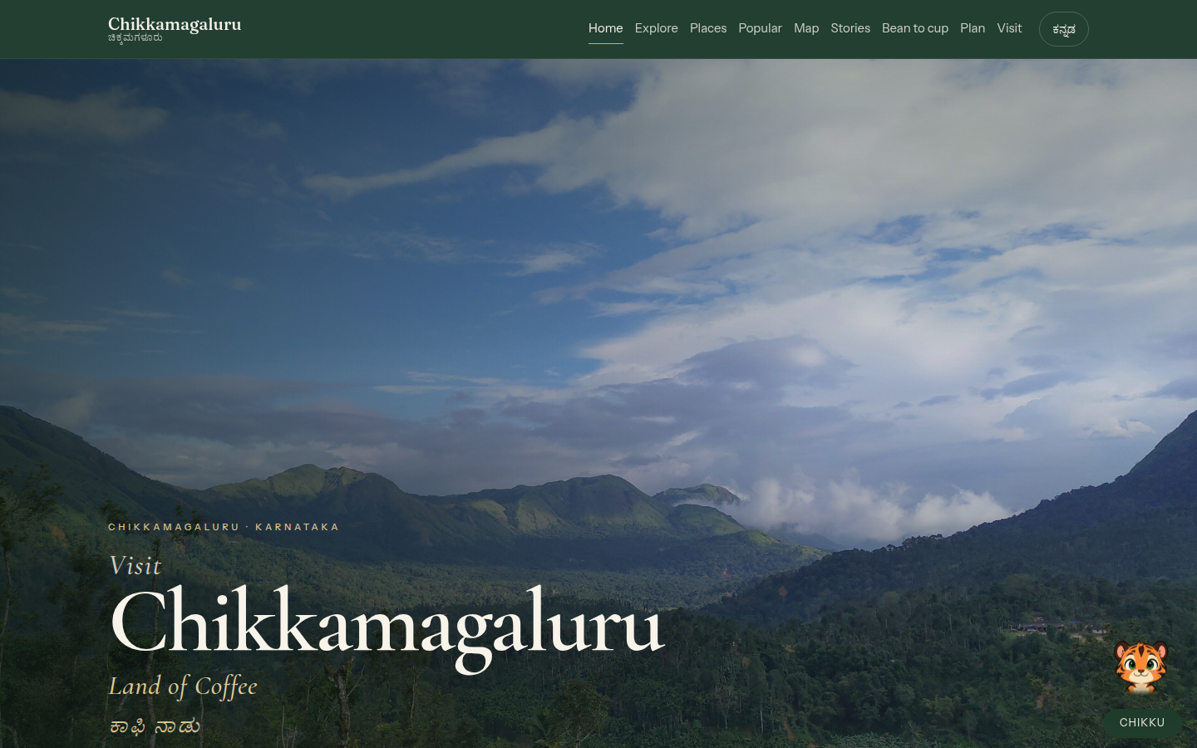
LIVE DISTRICT OS · NOT A BOOKING SITE
A companion for Chikkamagaluru.
Map, nature, coffee walk, grounded mascot. Already live.
chikkamagaluru-companion.vercel.app
Close ₹8.5L + GST AMC ₹1.8L / year
Chikkamagaluru Companion · Pitch
1 / 6

Slide 2
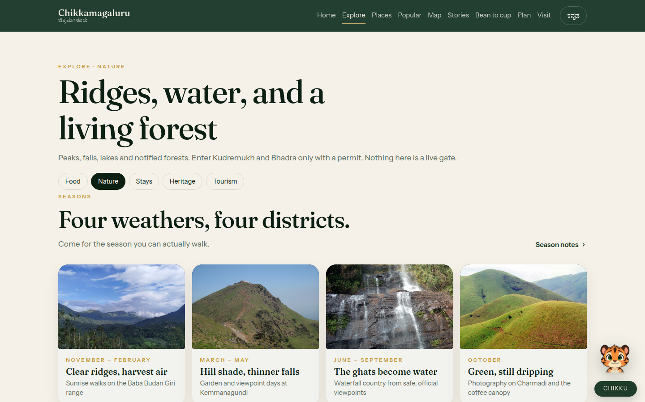
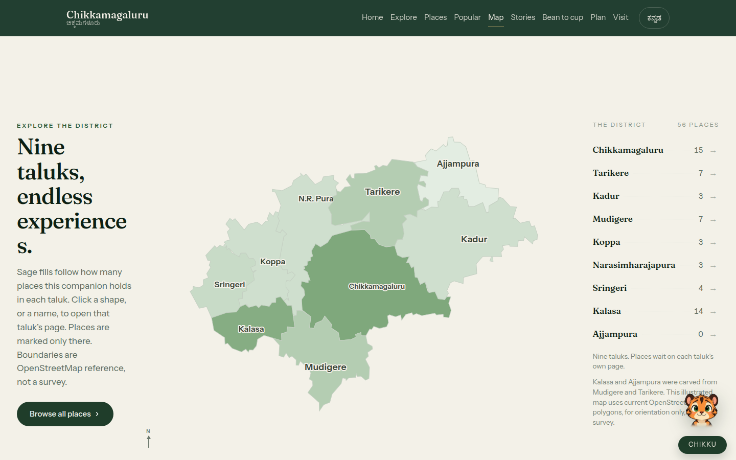
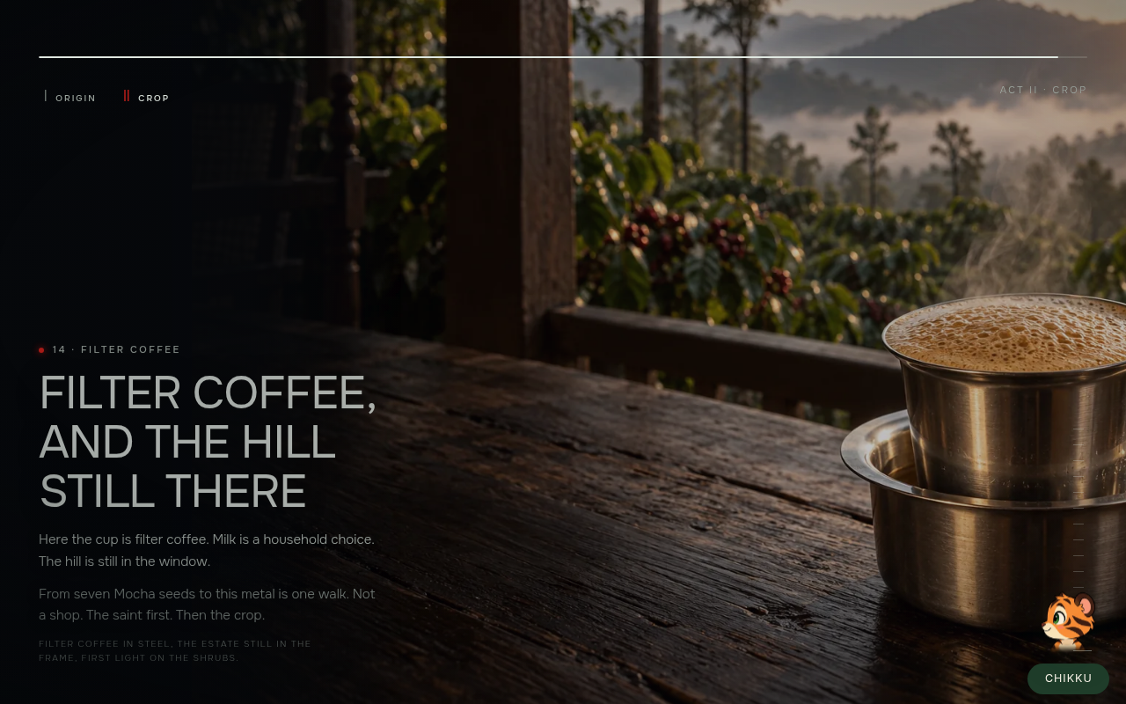
01 · LIVE PRODUCT
Open these. The deck is the demo.
Home
Five stills, editorial type
Nature
Seasons you can walk
Map
Nine current taluks
Bean to cup
Filter coffee close
Also: popular carousel (Deviramma Temple, Mallenahalli) · Ask Chikku (district-only, 1–5 day sketches, iOS-safe) · EN + Kannada · no rooms, no fake Book now.
Chikkamagaluru Companion · Pitch
2 / 6

Slide 3
02 · WHY THIS IS NOT A ₹3L BROCHURE
Already built. Agencies charge extra for each row.
Taluk map
Nine current OSM taluks. Places open on the taluk page, not a pin salad.
Nature hub
Seasons, ridges, water, permit forests. Kudremukh / Bhadra are not a live gate.
Bean to Cup
15-beat walk: Baba Budan → Mocha → shade → filter coffee. Not a shop.
Ask Chikku
Tiger mascot. Stays on this district. Refuses off-topic. Streams answers.
Sourced hours
District, forest, Sringeri, Horanadu links. Fees stay on their pages.
Bilingual + licences
EN / Kannada. Commons stills with named artists. Defensible in review.
Chikkamagaluru Companion · Pitch
3 / 6

Slide 4
03 · INDIA MARKET 2025–26
What other agencies charge vs this live OS.
Tier | What they ship | Typical fee | Time
Freelance WordPress | 5–8 pages, slider, contact form | ₹25k – ₹80k | 2–4 weeks
Local Bengaluru agency | 10–20 pages, enquiry, WhatsApp | ₹1.5L – ₹4L | 8–14 weeks
Tourism boutique | Custom UI + booking iframe | ₹4L – ₹8L | 10–16 weeks
Premium studio | Motion, CMS, campaign site | ₹10L – ₹25L | 16–24 weeks
DTPC / govt tender | Portal, bilingual, AMC, often ugly | ₹8L – ₹40L | Tender cycle
This companion | Map, catalogue, coffee walk, Chikku, EN+KN | Close ₹8.5L + GST | 14-day handover
Rebuild from scratch at ₹10–15k/day × 2 people × 16–20 weeks is ₹12–20L. You are buying finished inventory. AMC in this market is 15–25% of build (here: ₹1.8L).
Chikkamagaluru Companion · Pitch
4 / 6

Slide 5
04 · THE OFFER
One number to close. Extras on a second invoice.
LIST
₹9.9L
Open here
CLOSE
₹8.5L
Target + GST
WALK-AWAY
₹7.5L
As-live only
AMC
₹1.8L/yr
Copy, Chikku, stats
In the close: domain, Vercel, 14-day wordmark pass, featured eight + Chikku lines, 90-day hypercare, one training session. Floor ₹5L — do not.
Live LLM Chikku
₹1.5–2.5L
Hours CMS
₹2–2.5L
Film / stills
₹1.5–4L
Second district
~60% of first
Hindi / Tulu
₹0.8–1.2L each
WhatsApp Chikku
₹2–3L
Chikkamagaluru Companion · Pitch
5 / 6

Slide 6
05 · THE ASK
If we put your wordmark on this URL in 14 days, who signs?
Private / coffee / DMO
Close ₹8.5L + GST. Proof: Bean to Cup, then Chikku “2-day sketch”.
DTPC / tender
Shape as ₹12–16L all-in (GST, training, year-1 AMC). Proof: Nature + map.
Do not sell
Booking engine, fake fees, OTA clone. That is a different product.
Then stop talking. · chikkamagaluru-companion.vercel.app/nature
Chikkamagaluru Companion · Pitch
6 / 6

