Slide 1

Note: The data and information in this document is reflective of a hypothetical situation and client. This document is to be used for KPMG Virtual Internship purposes only.
Sprocket Central Pty Ltd
Data analytics approach
[Division Name] - [Engagement Manager], [Senior Consultant], [Junior Consultant]

Slide 2
Note: The data and information in this document is reflective of a hypothetical situation and client. This document is to be used for KPMG Virtual Internship purposes only.
Agenda
Introduction
Data Exploration
Model Development
Interpretation

Slide 3
Note: The data and information in this document is reflective of a hypothetical situation and client. This document is to be used for KPMG Virtual Internship purposes only.
Introduction
Following Demographics are being explored in follow report
Exploration – Age Demographics
Development – Gender Demographics
Interpretation – Job Industry and Wealth Segments

Slide 4
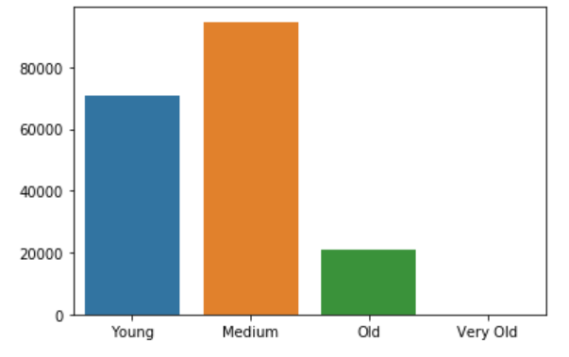
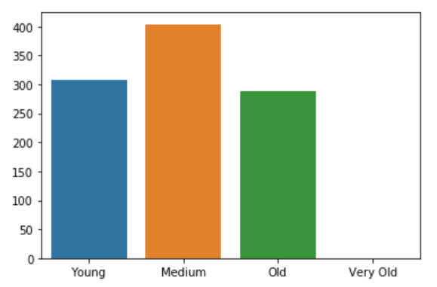
Note: The data and information in this document is reflective of a hypothetical situation and client. This document is to be used for KPMG Virtual Internship purposes only.
Data Exploration
Customer Demographics - Age
Most customers are medium aged that is they come from demography of age 40-60 years.
In recent years while the ratio of young to medium aged customers has been the same, there has been an increase in percentage of old customers (60-90 years) which is a positive sign

Slide 5
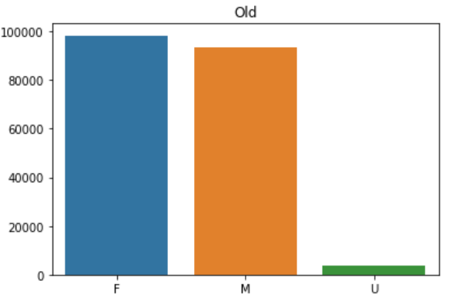
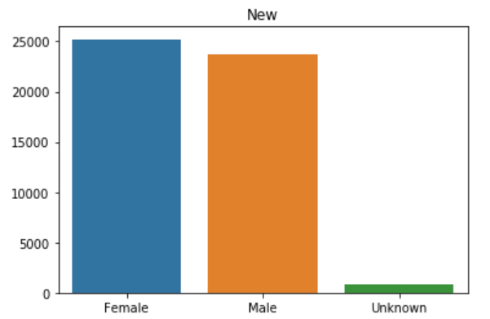
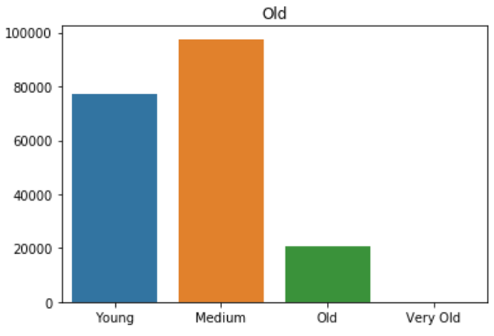
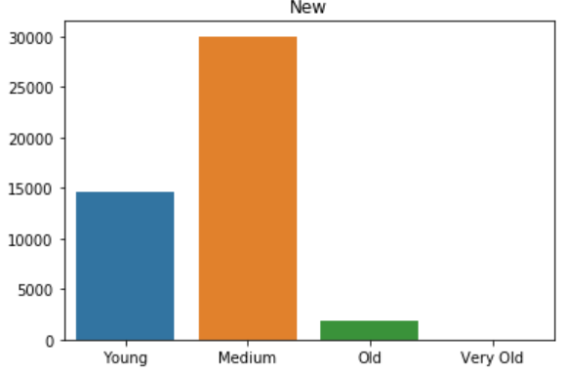
Note: The data and information in this document is reflective of a hypothetical situation and client. This document is to be used for KPMG Virtual Internship purposes only.
Model Development
Total Bike Sales
Gender distribution for each bike purchase remains almost the same. Female purchase highest amount of bikes
In terms of age, market share of young people has reduced – they must be targeted to make up for their market share

Slide 6
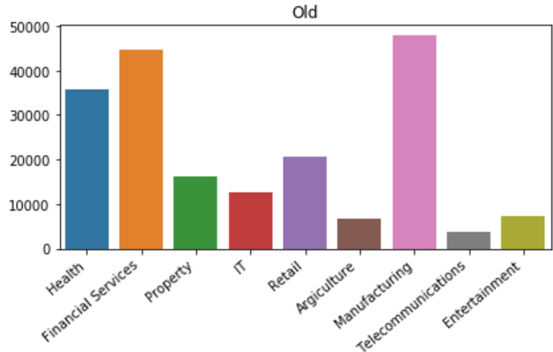
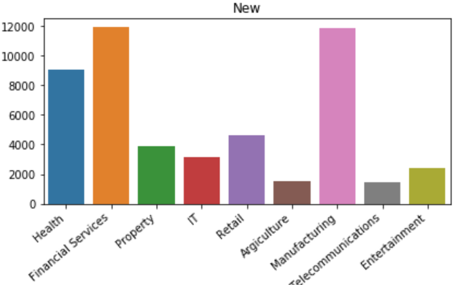
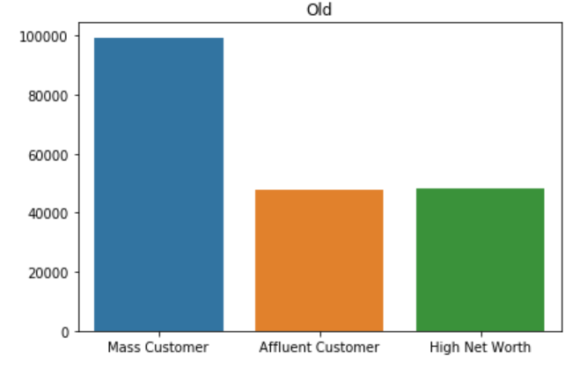
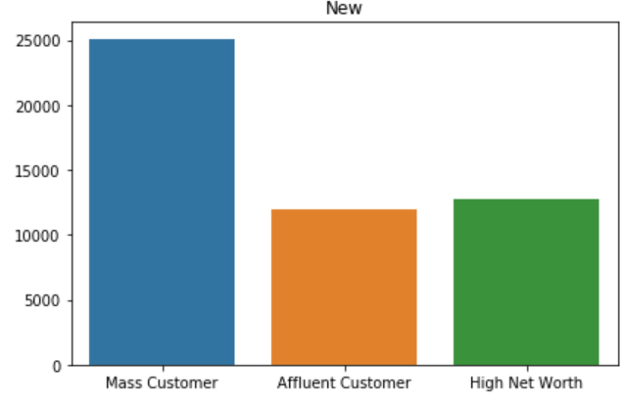
Note: The data and information in this document is reflective of a hypothetical situation and client. This document is to be used for KPMG Virtual Internship purposes only.
Interpretation
Job Industry and
Wealth Segments
Financial and Manufacturing services should be given priority as they constitute highest customer group
The wealth segment has remained unchanged with Mass Customers having nearly twice the demand of Affluent customers and High net worth customers

Slide 7
Note: The data and information in this document is reflective of a hypothetical situation and client. This document is to be used for KPMG Virtual Internship purposes only.
Appendix

