Slide 1
Dr. S. & S.S. Ghandhy Government Engineering College, Surat
Department of Electronics & Communication Engineering
Helixo AI
AI-Based Helmet Detection & Engine Safety Lock System
Proactive Edge-Computing for Real-Time Helmet Compliance & Ignition Interlock Control
Global Innovation Hackathon 2026 – Build for a Better Future | SSIP Supported
Team Leader: Arohanjan
Arohanjan (ECE)
arohanjan001@gmail.com | +91 9023836708
1

Slide 2
THE PROBLEM
Why This Project Matters
▸ India has one of the highest road accident fatality rates globally
▸ Over 1.5 lakh deaths annually — ~40% are two-wheeler riders
▸ Helmet compliance among two-wheeler riders remains critically low
▸ Current system is penalty-based — fines imposed AFTER violation
▸ No real-time prevention mechanism exists to stop unsafe riding
▸ Riders are fined ₹1,000 under MV Act, yet violations continue
▸ Rural areas have minimal traffic enforcement coverage
The Core Problem
▸ Reactive System: Penalty after accident/violation
▸ No Prevention: Engine starts regardless of helmet
▸ Human Dependency: Relies on police presence
▸ Zero Automation: No technology-driven enforcement
Our Approach: Reactive → Preventive
Integrate AI-based helmet detection directly into the vehicle to prevent ignition without helmet usage. Works with ANY standard helmet — no RFID, Bluetooth, or custom tags.
2

Slide 3
OBJECTIVES
What We Aim to Achieve
🎯 Primary Objective
📷 Real-Time Detection
Develop an AI-based system that ensures helmet usage by preventing motorcycle ignition without a helmet and monitoring rider safety in real-time.
Use camera-based detection with YOLOv8-nano AI model to identify helmet presence with 99.87% precision using sliding window confidence analysis.
⚙️ Ignition Control
🔄 Continuous Monitoring
Implement relay-based ignition control that blocks engine start when helmet is not detected (≥70% confidence threshold over 50 frames).
Monitor helmet usage during the ride with gradual speed reduction and controlled stop if helmet is removed mid-ride.
🚨 Emergency Override
📉 Under ₹2,000 Cost
Provide time-limited, internally logged emergency bypass for critical situations without compromising overall safety.
Direct ESP32-S3 embedded system deployment at ₹1,900–₹2,200 manufacturing cost per unit — affordable for mass adoption.
3

Slide 4
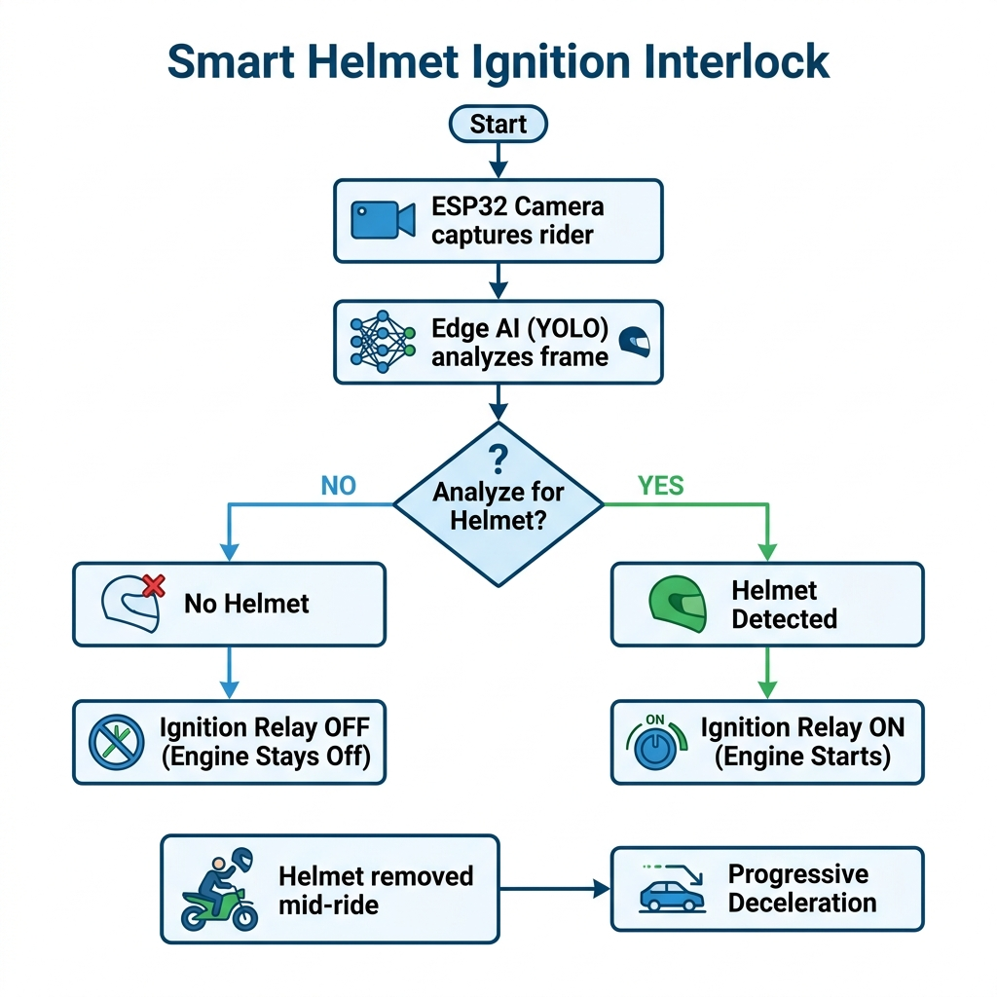
SOLUTION
From Reactive Fines to Proactive Prevention
How Helixo AI Works
▸ OV2640/OV3660 camera mounts on instrument cluster
▸ ESP32-S3 runs YOLOv8-nano AI model locally (offline)
▸ 50-frame sliding window (10 sec) analyzes helmet confidence
▸ If confidence ≥ 70%: Relay ON → Engine starts ✔
▸ If confidence < 70%: Relay OFF → Engine blocked ✘
▸ Works with ANY standard helmet — no tags needed
▸ Zero internet connectivity required
▸ Buzzer + LED provide audio-visual feedback
99.87%
97.50%
<300ms
₹2,000
Precision
mAP@50
Inference
Unit Cost
4

Slide 5
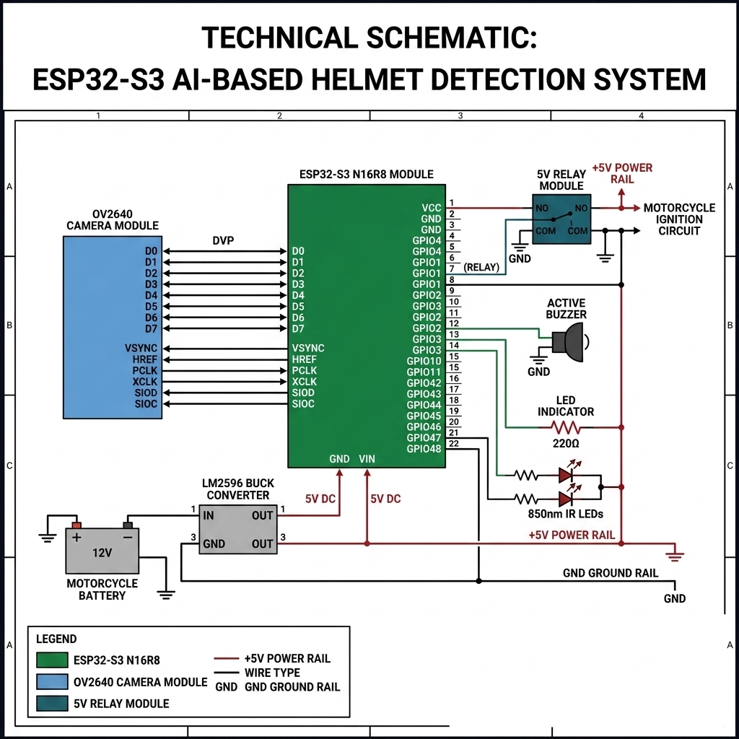
HARDWARE
Circuit Design & Hardware Architecture
Key Components & Wiring Specifications
▸ ESP32-S3 N16R8 MCU
16MB Flash, 8MB PSRAM — executes YOLOv8-nano TFLite model
▸ OV2640/OV3660 Camera
DVP interface camera capturing real-time 5-15 FPS frames
▸ 5V Relay Module
Opto-isolated relay connected in series with bike ignition coil
▸ LM2596 Buck Converter
Step-down converter (12V bike battery → regulated 5V DC)
▸ Active Buzzer & LEDs
Green (ignition ON), Red (blocked), Buzzer audio alert
▸ 850nm IR LEDs
Infrared illumination array for night-vision helmet detection
▸ Emergency Push Button
Tactile switch for time-limited, logged emergency override
⚡ Signal Flow: 12V Battery → LM2596 (5V) → ESP32-S3 → Camera (DVP) → AI Inference → GPIO 5 → Opto Relay → Ignition Coil
5

Slide 6
AI & TECHNOLOGY
AI Detection Pipeline & Technology Stack
Detection Pipeline
Technology Stack & Metrics
▸ Camera captures frames at 5–15 FPS continuously
▸ YOLOv8-nano model processes each frame on ESP32-S3
▸ Custom dataset: 6,000+ Indian rider images (12,198 augmented)
▸ Sliding Window (10-sec / 50 frames) for decision stability
▸ Confidence% = (Helmet frames ÷ Total frames) × 100
▸ ≥ 70% → SAFE (Green LED) | < 70% → UNSAFE (Red LED)
⚡ Hardware Stack
ESP32-S3 N16R8 (16MB Flash, 8MB PSRAM) • OV2640/OV3660 Camera • 5V Relay • LM2596 Converter • IR LEDs (Total: ~₹2,000)
🤖 AI & Software Stack
YOLOv8-nano → ONNX → TFLite INT8 (~1 MB) • C++/MicroPython firmware • OpenCV preprocessing • 50-frame sliding window
Training Configuration
Parameter | Phase 1 (Base) | Phase 2 (Fine-tune)
Epochs | 100 | 15
Input Size | 224×224 | 224×224
Batch Size | 16 | 16
Optimizer | SGD | Adam
Learning Rate | Cosine decay | 1×10⁻³
✅ Final Model Performance (115 Epochs)
Precision:
99.87%
Cls Loss:
0.528
Recall:
97.96%
Inference (Browser):
<300 ms
mAP@50:
97.50%
Model Size (ONNX):
~12 MB
Box Loss:
0.719
Model Size (TFLite):
~1 MB
6

Slide 7
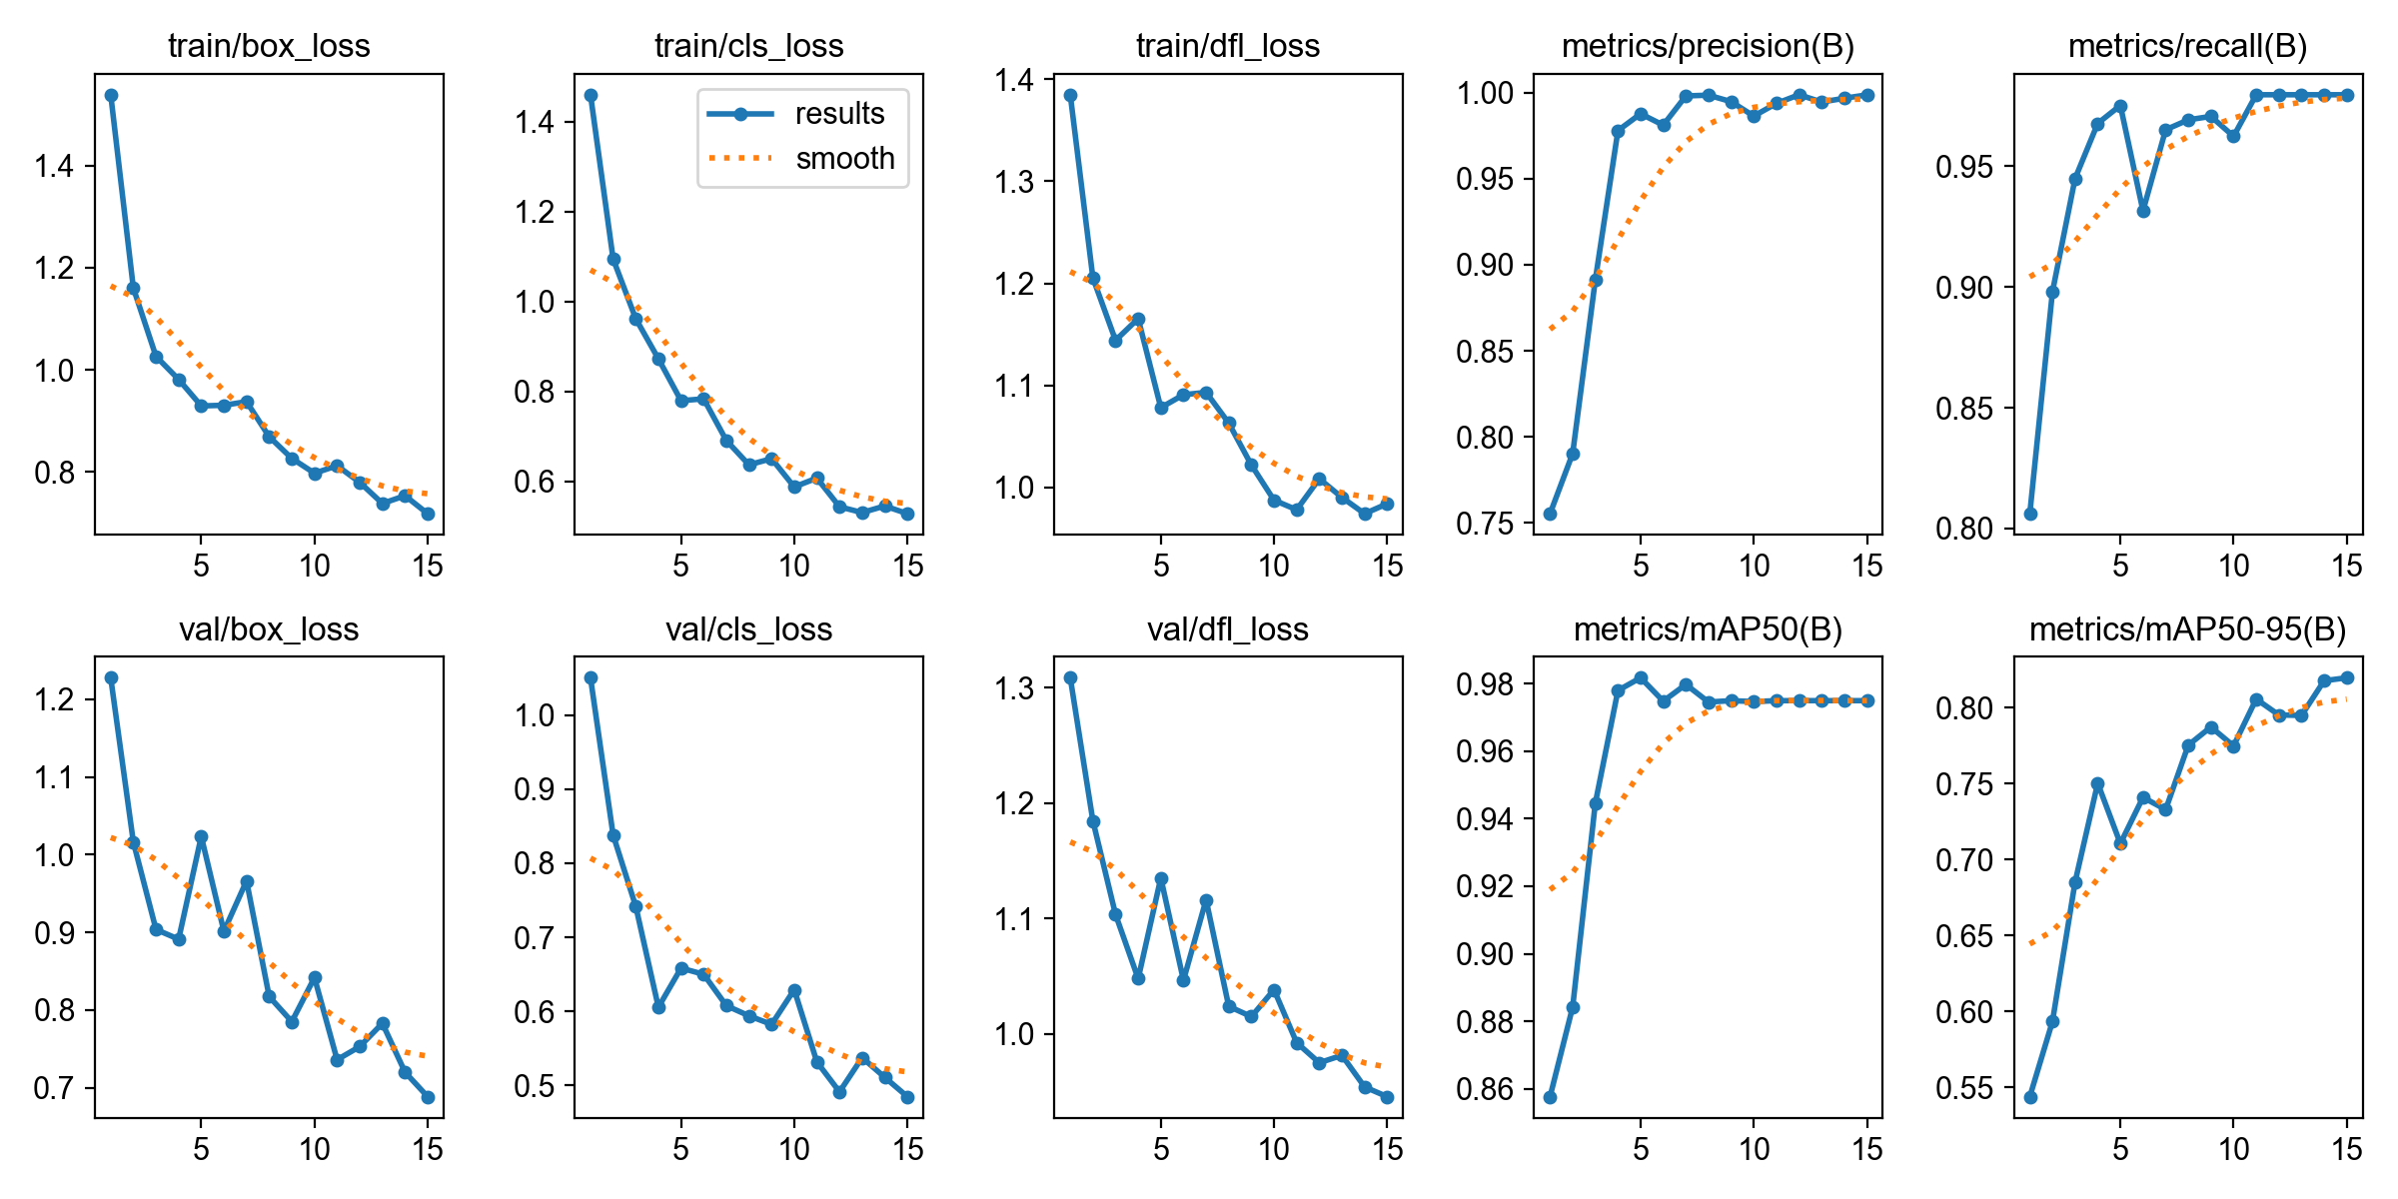

AI RESULTS
Training Convergence & Model Validation
YOLOv8-nano — Custom trained on 6,000+ images (12,198 augmented) for Indian road conditions
Fig 1: Training loss curves (Box loss: 0.719, Cls loss: 0.528) over fine-tuning epochs
Fig 2: Normalized Confusion Matrix on Validation Set
📈 High Accuracy Convergence: Box loss dropped to 0.719 and Cls loss to 0.528 over 115 total epochs, demonstrating stable learning without overfitting.
🎯 99.87% Precision Benchmark: Confusion matrix confirms 99.87% precision for helmet detection — critical for an interlock system to prevent false blocks.
7

Slide 8
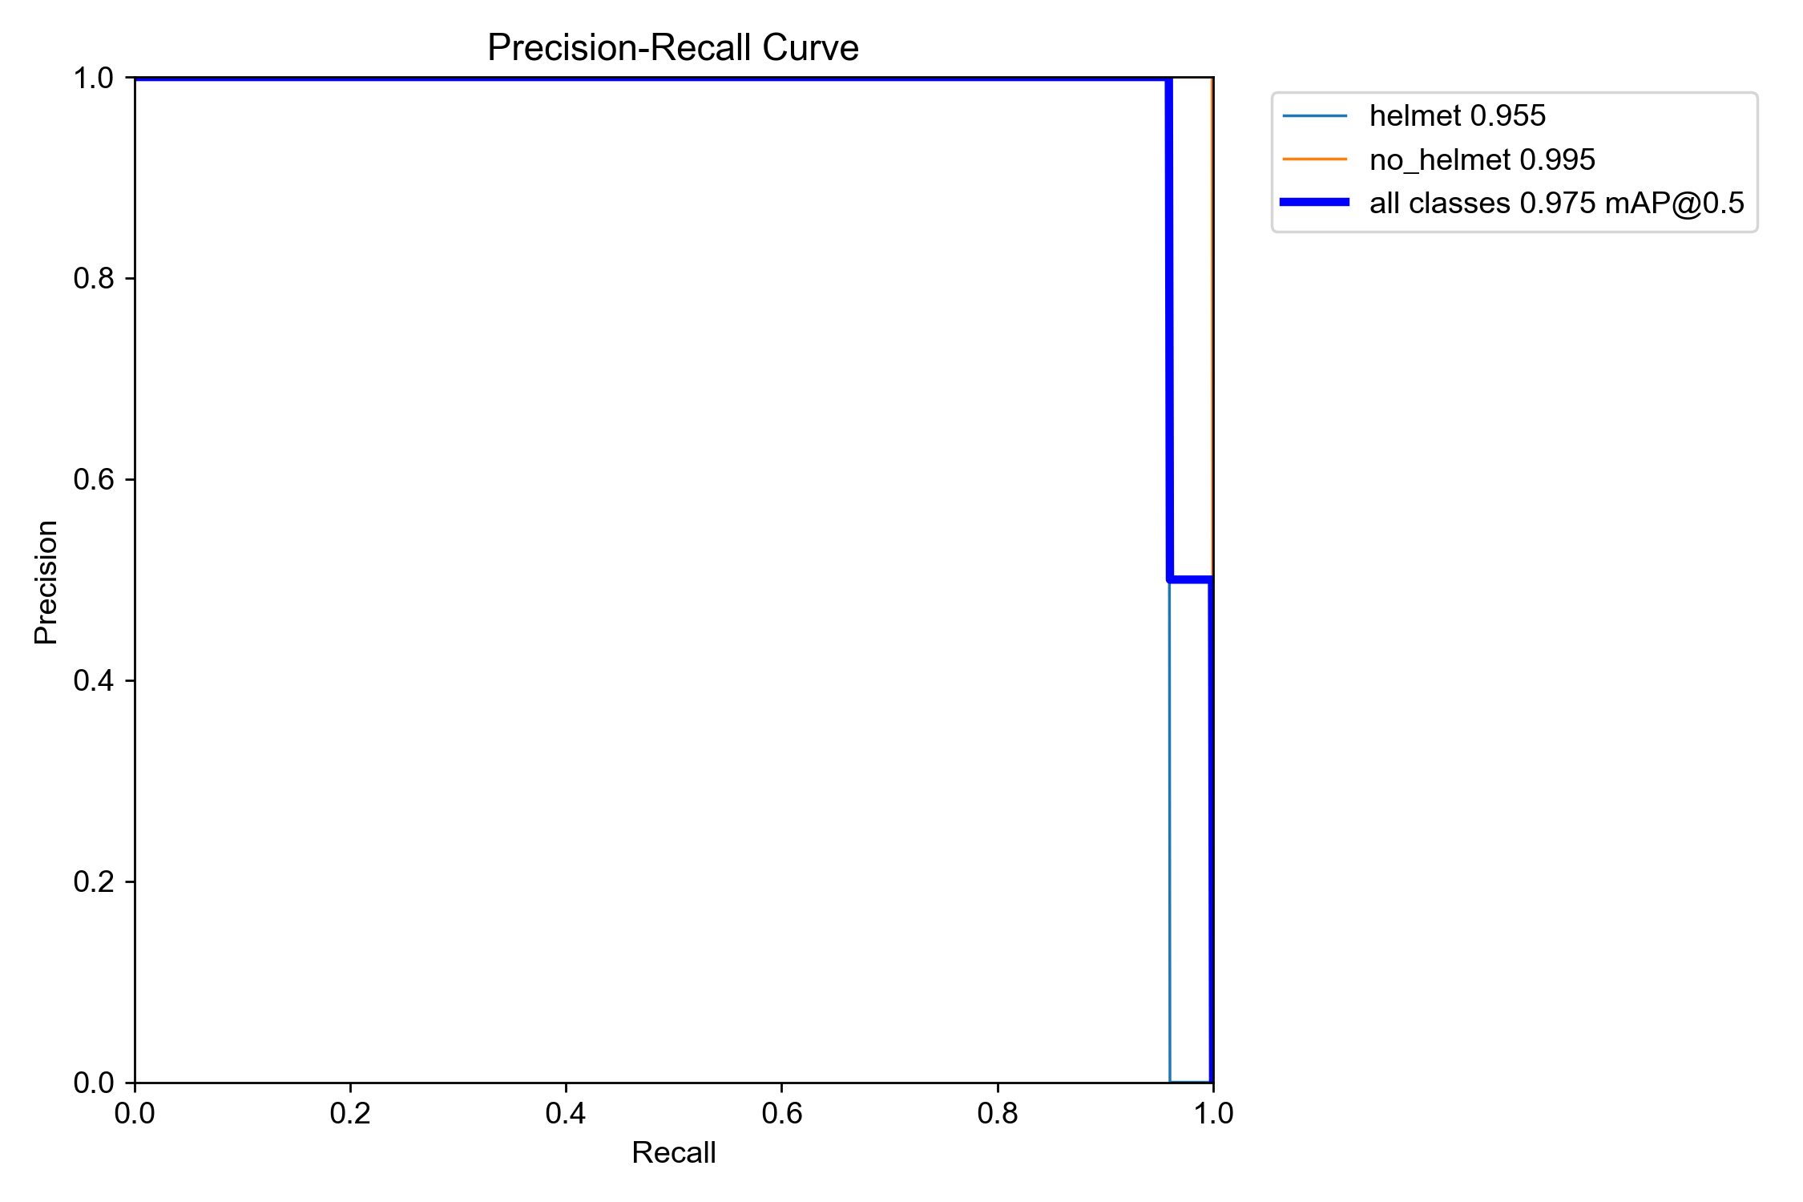
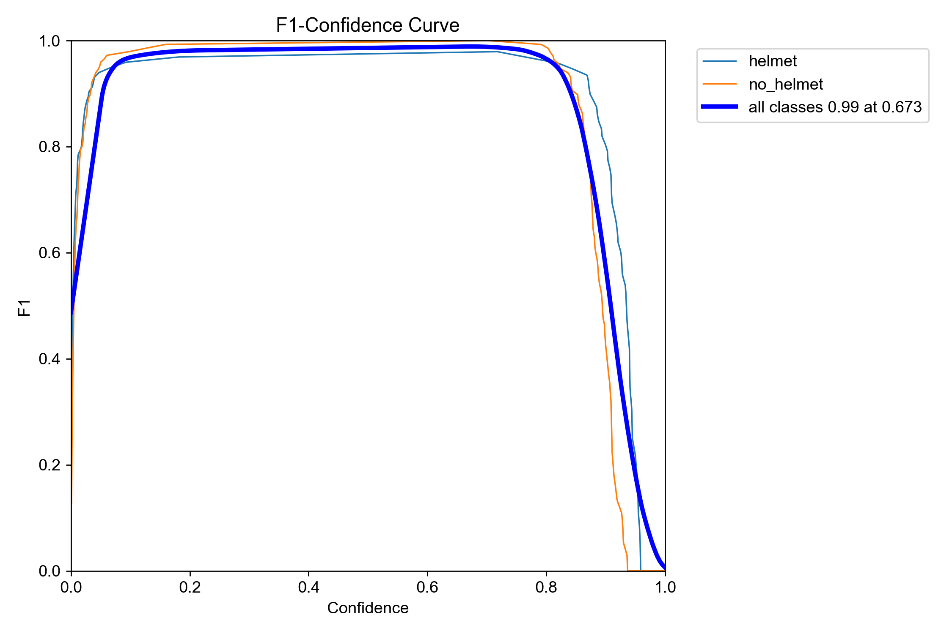
VALIDATION
Precision-Recall & F1-Score Analysis
Precision-Recall Curve (mAP@50 = 97.50%)
F1-Score Curve — Optimal operating threshold
Accuracy Across Lighting Conditions
Condition | Precision | Recall | F1-Score
Daylight (Clear) | 0.98 | 0.97 | 0.975
Dusk / Dawn | 0.93 | 0.91 | 0.920
Night (IR-assist) | 0.88 | 0.85 | 0.865
💡 Zero False Positive Tolerance
99.87% precision means virtually zero false positive triggers — preventing unnecessary ignition blocks for safe riders, which is critical for real-world user adoption.
8

Slide 9
SAFETY SYSTEM
Real-Time Monitoring & Progressive Safety Response
Phase 1: Pre-Start Check (10 seconds)
Phase 2: Continuous Monitoring (during ride)
▸ Camera scans rider before ignition (50 frames)
▸ ≥70% helmet confidence → Engine starts
▸ <70% → Engine blocked + buzzer alert
▸ Every second: update 10-sec sliding window
▸ If helmet removed → Progressive response triggers
▸ Gradual — never sudden engine cutoff
⚡ Step 1: Warning
⚡ Step 2: Deceleration
⚡ Step 3: Controlled Stop
Audio buzzer + Red LED alert
(0–15 seconds grace period)
Gradual intermittent relay cuts
causing engine speed reduction (15–45s)
Complete relay disconnect
Safe vehicle stop — NOT sudden cutoff (>45s)
🚨 Emergency Override Feature
Time-limited bypass (logged internally) for critical situations. Override events stored with timestamp for audit trail. Prevents misuse while ensuring real-world flexibility.
9

Slide 10
COST ANALYSIS
Bill of Materials — ESP32 Embedded System
Direct ESP32-S3 deployment — production-ready embedded system under ₹2,000
# | Component | Specification | Cost (₹)
1 | ESP32-S3 N16R8 | 16MB Flash, 8MB PSRAM MCU | 800–1,000
2 | OV3660 NoIR Camera | 3MP, DVP, IR removed | 400–600
3 | IR LED Module (850nm) | 2–3 units for night vision | 50–80
4 | 5V Relay Module | Opto-isolated, 1-ch, 10A/250V | 60
5 | LM2596 Buck Converter | 12V → 5V, 3A step-down | 100
6 | Active Buzzer (5V) | Warning sound indicator | 20
7 | LEDs (Green + Red) + 220Ω | Status indicators | 15
8 | Push Button (Momentary) | Emergency bypass switch | 10
9 | Waterproof Enclosure | ABS, IP-rated casing | 150
10 | Fuse Holder + Wiring | 2A inline fuse + harness | 105
 | TOTAL PER UNIT |  | ₹1,900 – ₹2,200
💰 Under ₹2,000 Cost Target
• Manufacturing: ₹1,900 – ₹2,200/unit
• Target Price: ₹2,500 – ₹3,500
• High profit margin at mass scale
• Compact & vehicle-mountable
• No OS — instant boot
• Waterproof IP-rated enclosure
🔑 Why Direct ESP32?
• No high-cost single-board computer
• Firmware-based — runs directly on MCU
• Quantized TFLite INT8 model (~1 MB)
• Instant boot time upon ignition key
🏆 SSIP Grant Secured
INR ₹16,000 prototype grant awarded by Student Startup & Innovation Policy (SSIP), Gujarat
10

Slide 11
INNOVATION
Innovation & Uniqueness
Existing Approaches vs. Helixo AI
Approach | Method | Limitation | Helixo AI Advantage
Traffic Cameras (Roadside CNN) | Surveillance camera detection | Post-facto fines only; fixed infrastructure | Proactive: Prevents ignition before ride starts
RFID Smart Helmets | Embedded passive tags + vehicle reader | Requires custom ₹3K+ tagged helmets | Works with ANY standard off-the-shelf helmet
Bluetooth Helmets | BLE proximity pairing | Pairing dependency; battery drain | Zero connectivity needed; fully offline AI
Heavy CNN Models (Roadside GPU) | Server-side GPU inference | Accuracy drops in low-light; costly GPU | Lightweight YOLOv8-nano on ₹2K edge hardware
Single Most Novel Element
Shift from "Reactive Surveillance" to "Proactive Interlock" using offline edge computing.
The entire system processes visually ON the motorcycle via a ₹2,000 microcontroller, requiring zero cloud connectivity, making it foolproof and universally accessible. This has the potential to become a mandatory factory-standard safety accessory — similar to how seatbelt interlocks and ABS evolved in 4-wheelers.
11

Slide 12
IMPACT
Expected Impact & Scaling Strategy
🏍️ For the Rider
🏛️ For the Government
Physically prevents fatal head injuries before the ride begins. No reliance on external enforcement.
Enforces 100% permanent helmet compliance without expensive police deployments or camera infrastructure.
👥 For the Masses
🏭 For Industry
Protects low-income demographics by keeping safety affordable — uses any standard helmet they already own.
Designed to become mandatory factory-standard safety accessory for two-wheeler manufacturers.
🚀 Scaling Roadmap
📍 GPS Integration
💸 Insurance Discounts
🏙️ Smart City
Location tracking & geo-fenced enforcement zones
Compliance data for premium reduction
Feed safety data to traffic management systems
📱 Mobile App
🔧 OEM Integration
🤖 Advanced AI
Ride history, safety score, real-time alerts
Partner with Hero, TVS, Bajaj for factory integration
Face recognition, multi-rider detection, helmet type classification
12

Slide 13

LIVE DEMO
Try Helixo AI Live — Scan QR Code
Scan the QR code below using your smartphone camera to test our real-time AI helmet detection model
📱 Interactive AI Web Demonstration
Test real-time helmet detection directly in your mobile browser with live confidence scoring.
URL: https://imaginative-kitsune-6e83b9.netlify.app/
⚡ Real-Time ONNX Model Inference
Model runs 100% client-side using ONNX Runtime Web with WebGL acceleration for sub-300ms latency on any smartphone or laptop.
🔒 100% Client-Side Privacy Guarantee
Zero cloud image uploads — camera feed is processed entirely locally on your browser for complete data privacy and security.
🎯 Try Live Test Scenarios
Test with full-face helmets, visors up/down, caps, bandanas, or bare heads to observe live confidence percentages and ignition interlock decision logic.
📲 Scan to Launch Live Web Demo
https://imaginative-kitsune-6e83b9.netlify.app/
14

Slide 14
Thank You
Questions & Answers
Helixo AI — AI-Based Helmet Detection & Engine Safety Lock System
Dr. S. & S.S. Ghandhy Government Engineering College, Surat
Department of Electronics & Communication Engineering
Team Leader: Arohanjan
Team: Arohanjan (ECE)
arohanjan001@gmail.com | +91 9023836708
15

