Slide 1



aruna
View in Power BI
Last data refresh:
6/3/2024 8:57:30 AM UTC
Downloaded at:
6/3/2024 9:17:41 AM UTC

Slide 2
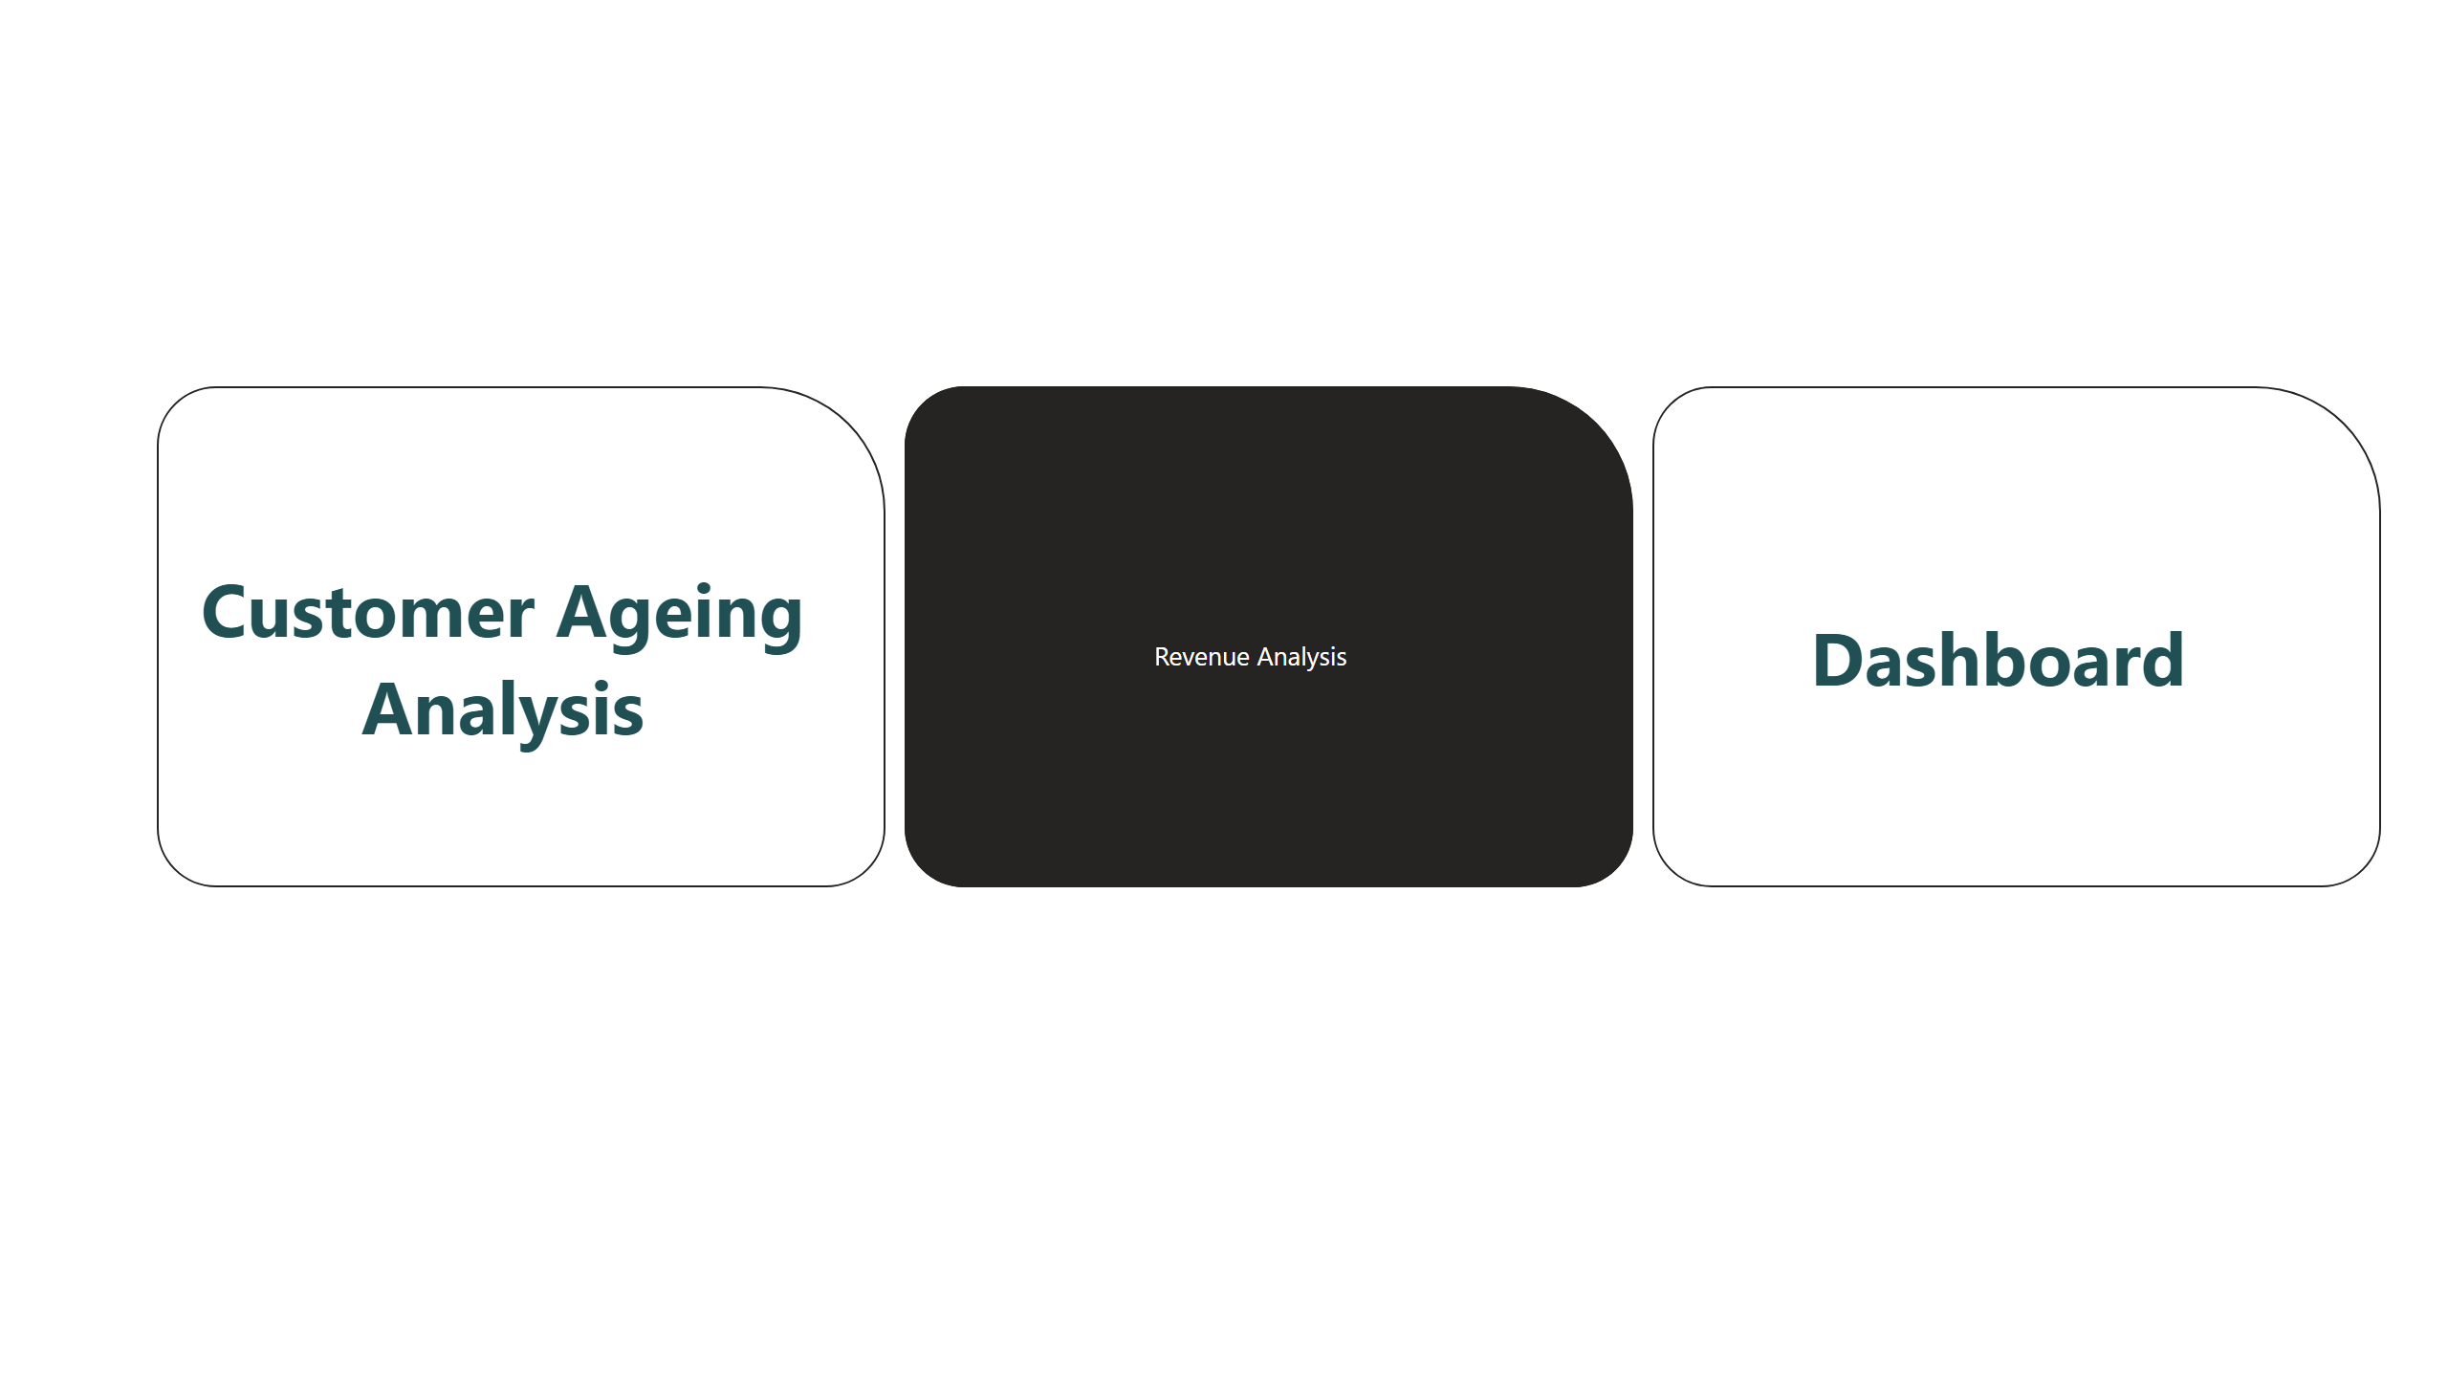
Dashboard
Notes:
bookmarkNavigator
No alt text provided

Slide 3
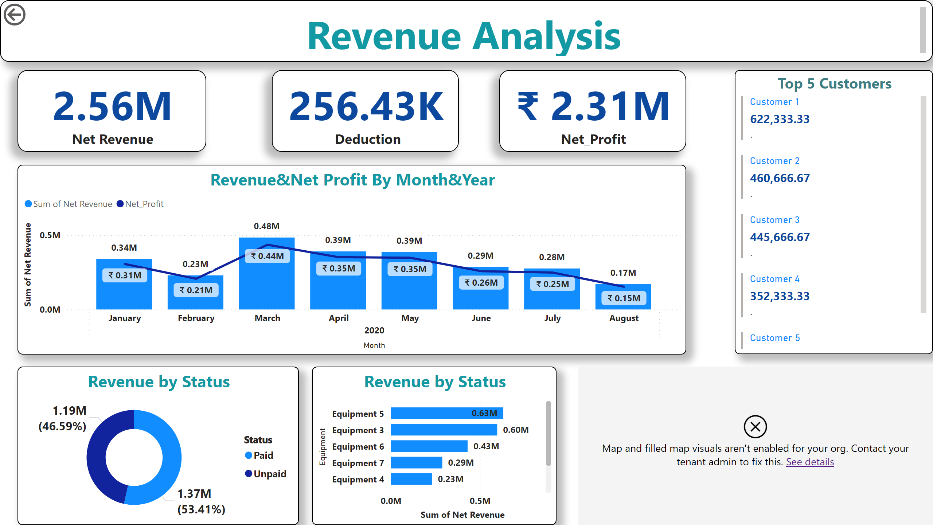
Revenue Analysis
Notes:
textbox
No alt text provided
card
No alt text provided
card
No alt text provided
card
No alt text provided
Top 5 Customers
No alt text provided
Revenue&Net Profit By Month&Year
No alt text provided
Revenue by Status
No alt text provided
Revenue by Status
No alt text provided
map
No alt text provided
actionButton
No alt text provided

Slide 4
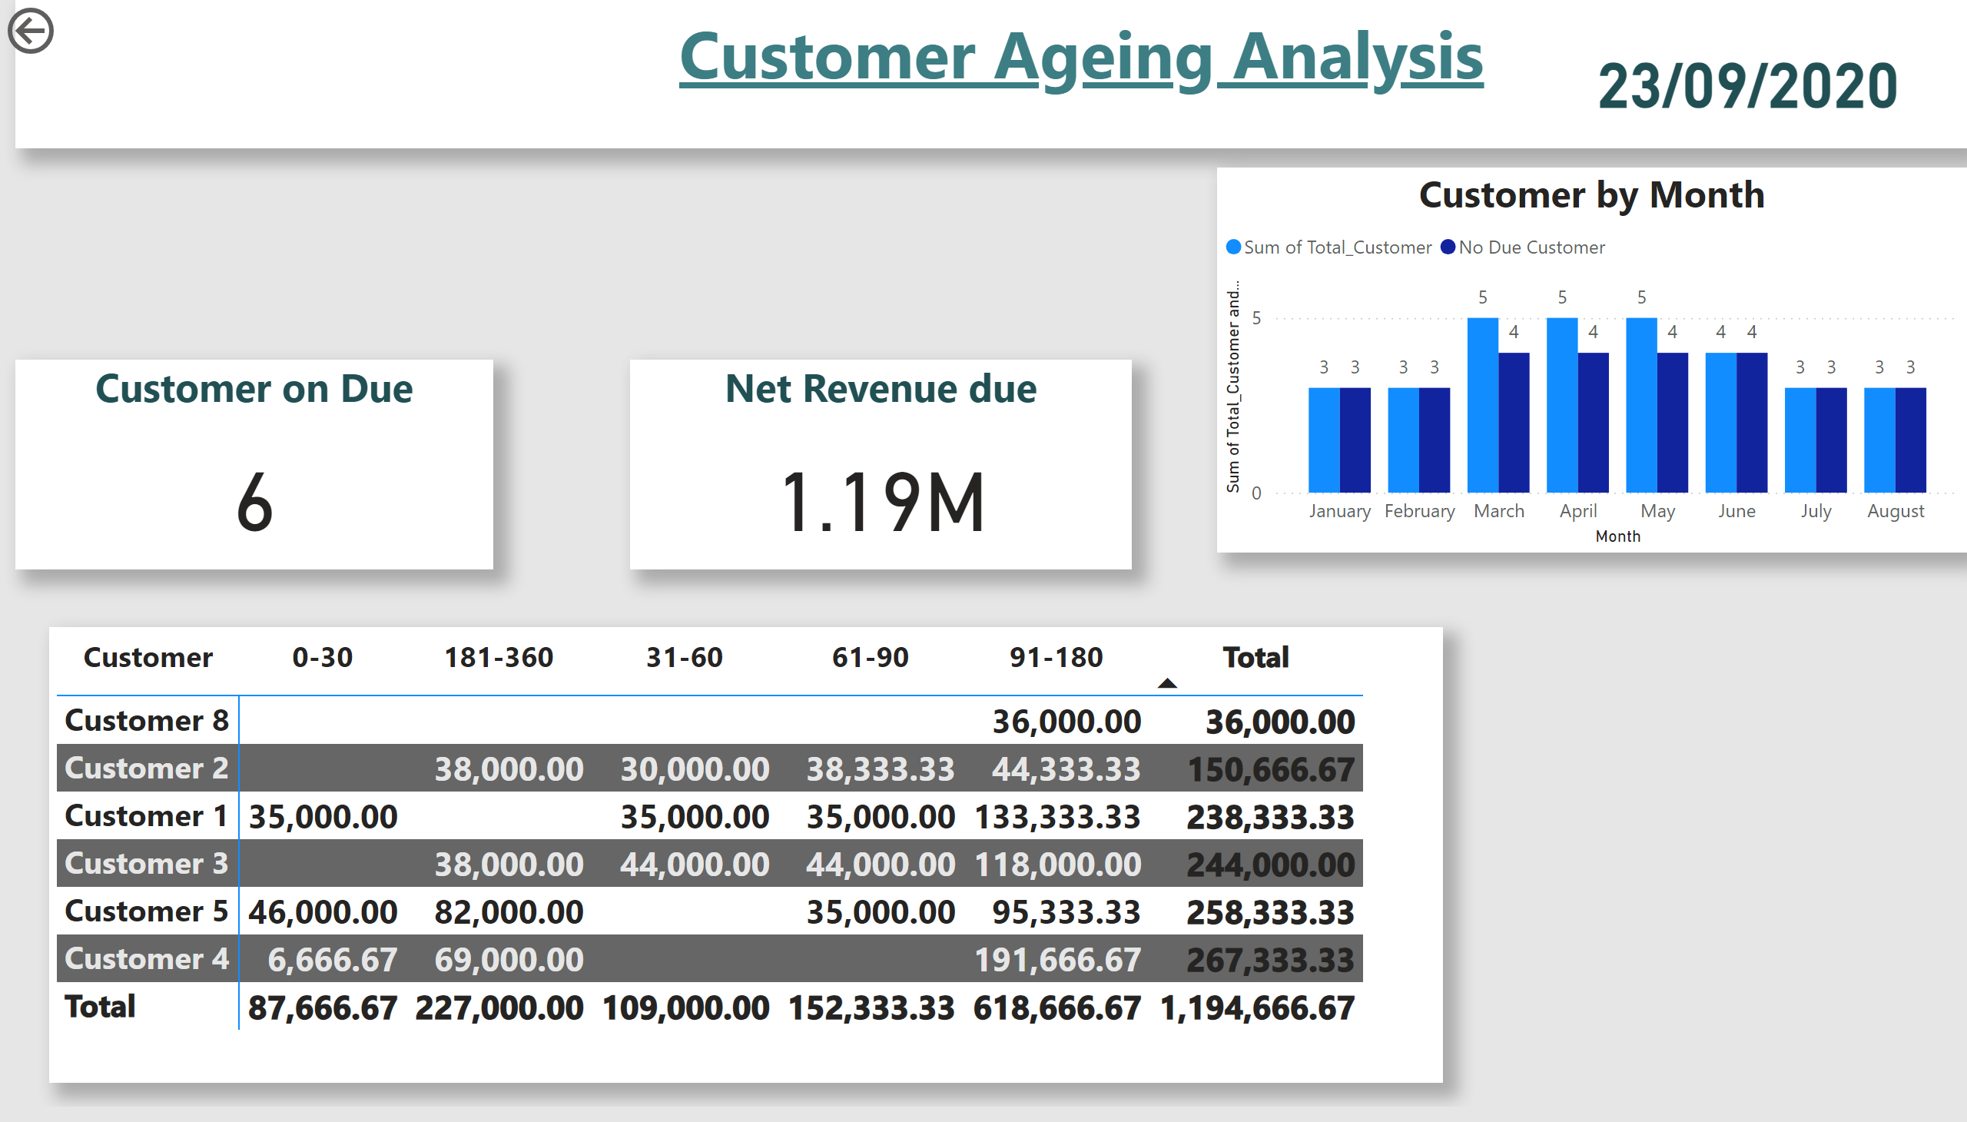
Customer Ageing Analysis
Notes:
textbox
No alt text provided
Customer on Due
No alt text provided
pivotTable
No alt text provided
Customer by Month
No alt text provided
Net Revenue due
No alt text provided
card
No alt text provided
actionButton
No alt text provided

