Slide 1


Correlation of Coronavirus vs Stock Market by Sector
Team: Nicky, David and Ram

Slide 2



Project Charter & Hypothesis
Project Charter
We have seen that coronavirus has had an impact on stock market, our project takes this further by analyzing which sectors were the most impacted by the virus that will help the general public to make better choices with their investments
Hypothesis
H_{null} = There is no impact to the Financial, Technology and Healthcare sector. There will be impact to Retail and Travel industries.
H_{a} = There will be impact to all industries resulting in a negative correlation.
Notes:
Nicky

Slide 3

























Sectors
We decided to create our selection of stocks in each sector
HealthCare
Travel
Retail
Financial
Technology
Notes:
Nicky

Slide 4

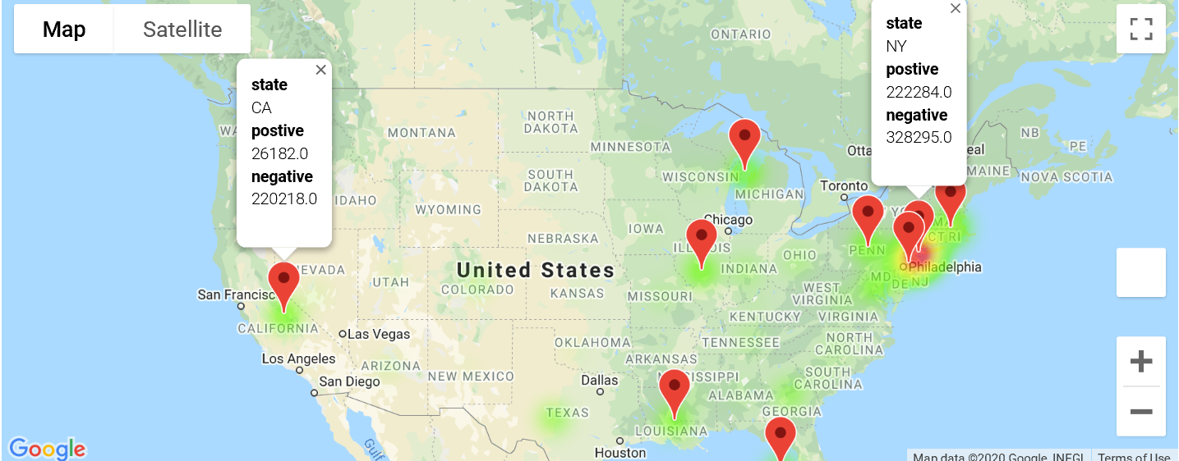

Coronavirus Cases in the US
The above heat-map shows the number of cases across the US
Most impacted are the north east regions, with more hotspots emerging in the Midwest
Notes:
Ram

Slide 5

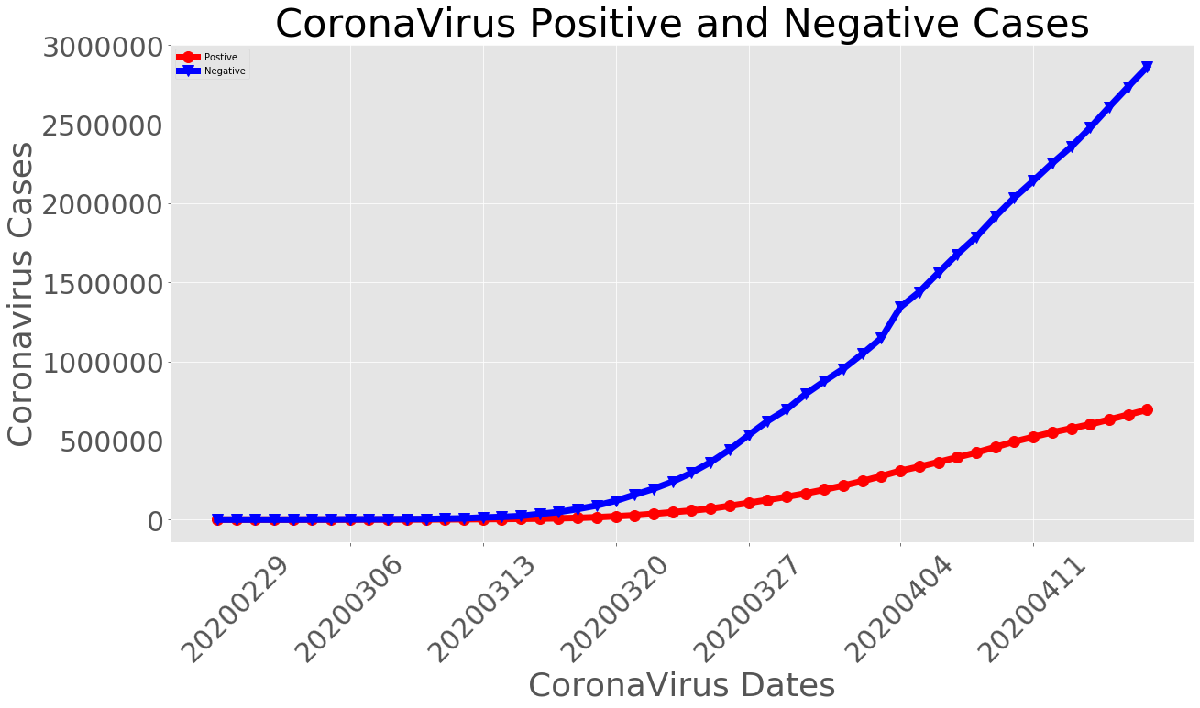
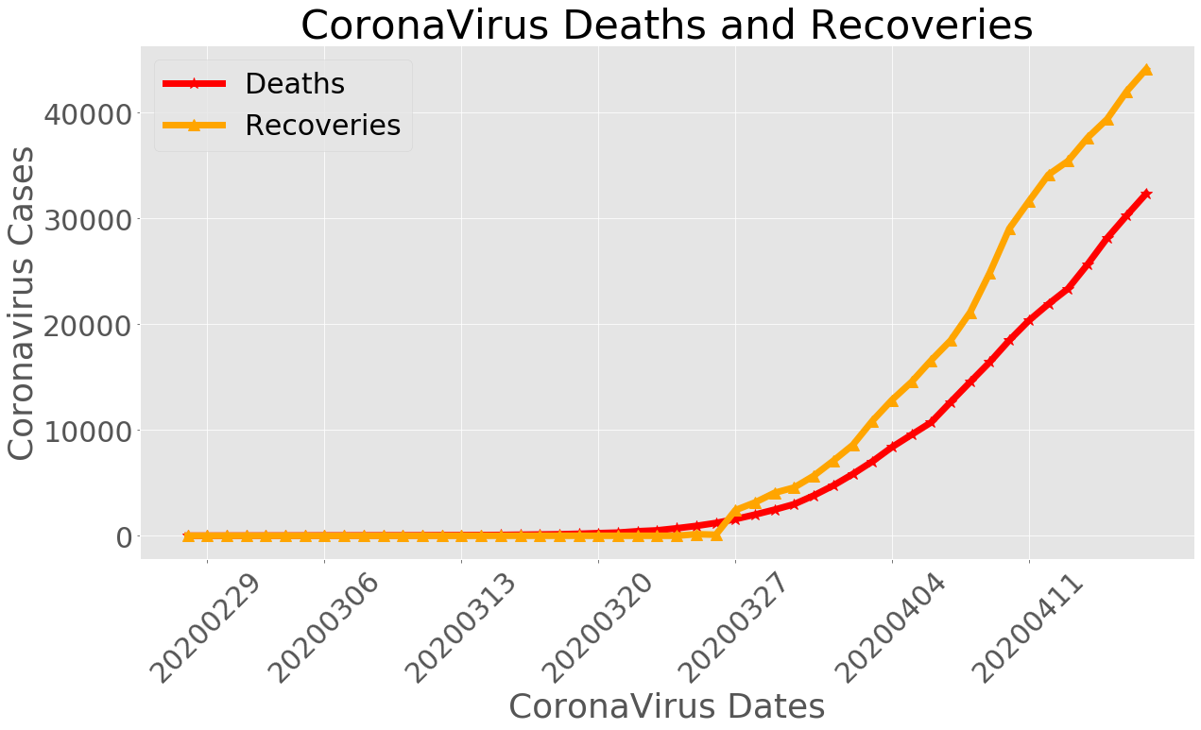
Coronavirus Statistics
Notes:
Ram

Slide 6
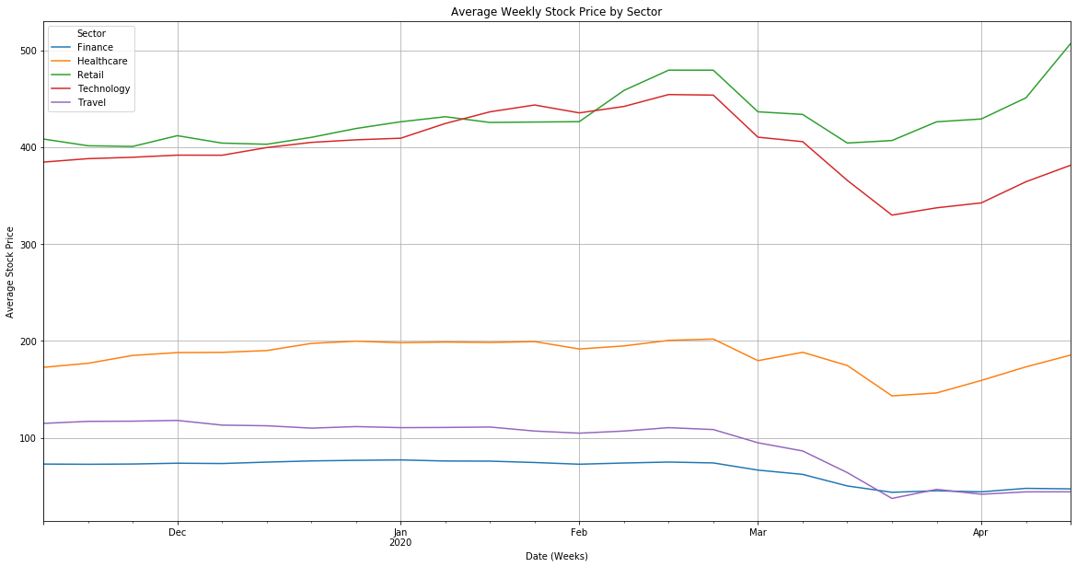
Stock Price Movement by Sectors
Feb 24th :
1.25B ask from Congress for Coronavirus response
Mar 25th :
The White House and Senate leaders reach an agreement on a $2 trillion stimulus deal
Jan 20nd : First Case in the US
Jan 31nd : US stops travel from China
Feb 29th :
US records first death due to Coronavirus
Mar 20th :
All 52 States with Cases, Total Cases at 18,000+, US shuts down
Notes:
David
https://www.nytimes.com/article/coronavirus-timeline.html

Slide 7

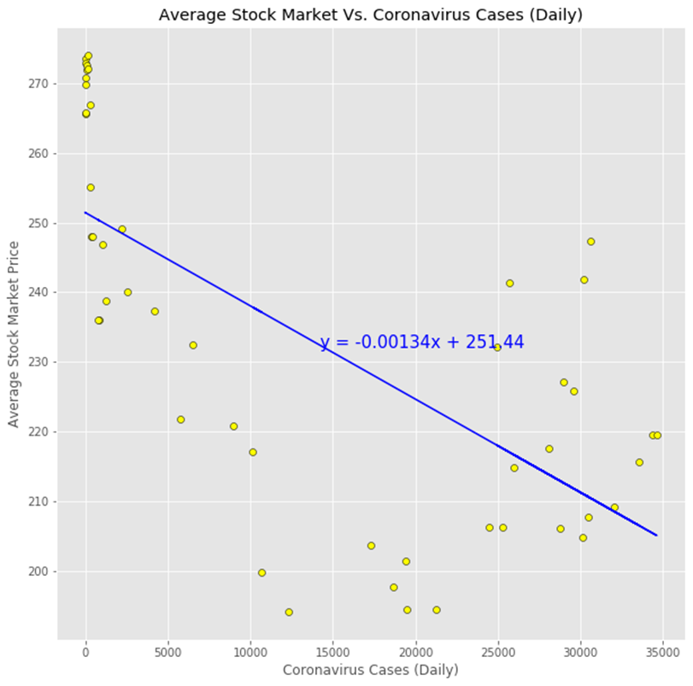
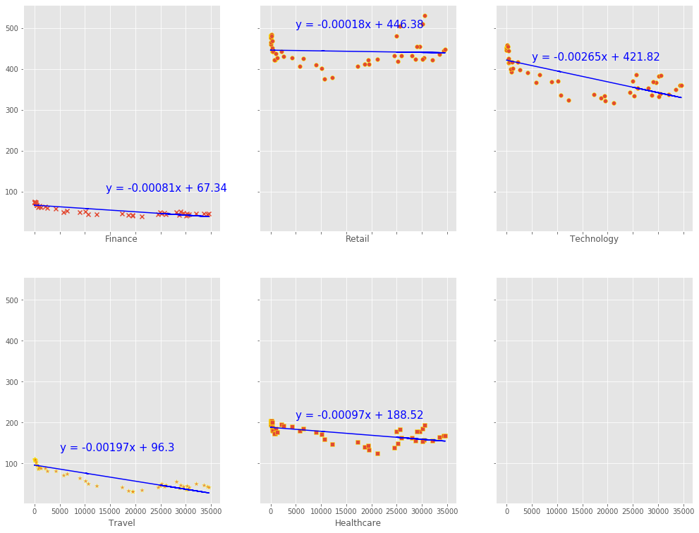
Correlation
The Stock Market is negatively correlated to coronavirus:
When the number of coronavirus cases increases the stock market declines, correlation coefficient is -0.68
By Sector:
Travel:
Correlation vs Coronavirus : strongest negative correlation -0.89, as expected per H-null
Finance:
Correlation vs Coronavirus: second strongest negative correlation -0.85, not expected per H-null
Technology:
Correlation vs Coronavirus : third strongest negative correlation -0.76, not expected per H-null
Healthcare:
Correlation vs Coronavirus : fourth strongest negative correlation -0.61, not expected per H-null
Retail:
Correlation vs Coronavirus : lowest negative correlation -0.07, not expected per H-null
Correlation Coefficient:
Finance Sector : -0.85
Retail Sector: -0.07
Technology Sector: -0.76
Travel Sector: -0.89
HealthCare Sector: -0.61
Notes:
David
*For Travel and Retail we are decreasing the expected values by $1 & $3.

Slide 8
Chi-sq & P-value Test
By Sector: observed vs. the expected prices
Critical Value: 65.17
Travel:
Chi-sq: 128.0
P-value: 3.3 e-9, less than 0.05, this indicates that expected stock prices decline which we were expecting to go down by $1.75/day, actually declined at a pace less than that
Finance:
Chi-sq: 324.9
P-value: 8.8 e-43 less than 0.05, this indicates that the observed stock prices did not remain constant and rather declined
Technology:
Chi-sq: 155.3
P-value: 3. e13 less than 0.05, this indicates that the observed stock prices did not remain constant and rather declined
Healthcare:
Chi-sq: 239.2
P-value: 3.4e-27 less than 0.05, this indicates that the observed stock prices did not remain constant and rather declined
Retail:
Chi-sq: 836.2
P-value: 2.1 e-144 less than 0.05 this indicates that expected stock prices decline which we were expecting to go down by $3/day, actually did not decline as expected
Notes:
Nicky
Did the sectors we expected to decline, actually decline?
*For Travel and Retail we are decreasing the expected values by $1 & $3.

Slide 9


Conclusion
We were able to reject our null hypothesis and keep our alternative hypothesis based on the correlations we saw
Margin of error
Sample Selection & Size
Our Sector data was hand-picked and not representative of the sector
Time Range
Our time range was small, ideally, a few months data before and after the crises beginning would have given us a better picture
Our data stops at 4/16/2020
More Focused Sector Selection
Eg. Brick & Mortar Retail vs. E-commerce Retail, or, Grocery Retail vs. Apparel Retail
Notes:
Nicky

Slide 10
Learnings
Initially we wanted to pull the S&P 500 Sector information
Challenge – couldn’t find the right data set in the given amount of time/ resources
Our Sources
https://alphavantage.co
https://covidtracking.com/api
Our Code
https://github.com/arohipant/WolfGang-Project-1
Please refer to the Final folder in the project for evaluation
The graphs, correlations and critical values may vary depending the date of the run of the code for evaluation as the presentation slides were prepared as of April 16th 2020.
Notes:
Nicky

