Slide 1
Online Dating
And Falsified Heights
Azalea Rohr and Angelo Amato

Slide 2
—Pew Research Center
3 in 10 US Adults say they have used a dating app, and about 50% of those under 30 report they have used a dating site or app
Notes:
Azalea

Slide 3


27% of men say they
add 2 extra inches (in height)
Notes:
Angleo A GQ Modern Love survey of 604 men (ages 16–44) found that 27% misreported their height, with majority adding about two inches.

Slide 4
On dating platforms where self-reported height is often inflated, how can we use images to produce more accurate height estimates?

Slide 5
Approach
Mean Baseline
Simple baseline predictor
Simple CNN
Basic Network
Untrained DinoV2 model
Off the shelf
Fine-tuned DinoV2 model
Training on specific task
Data Augmentation
with Fine-tuned DinoV2
Incorporating image complexities

Slide 6
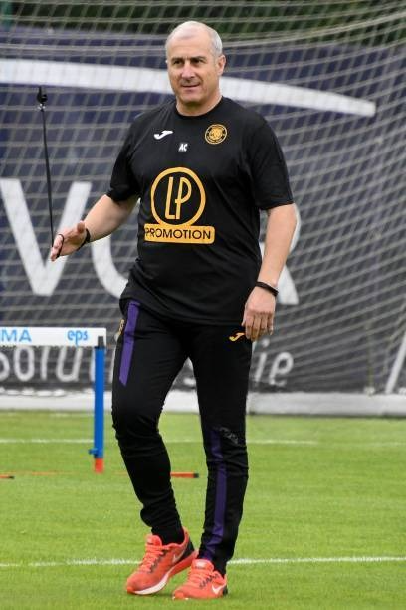
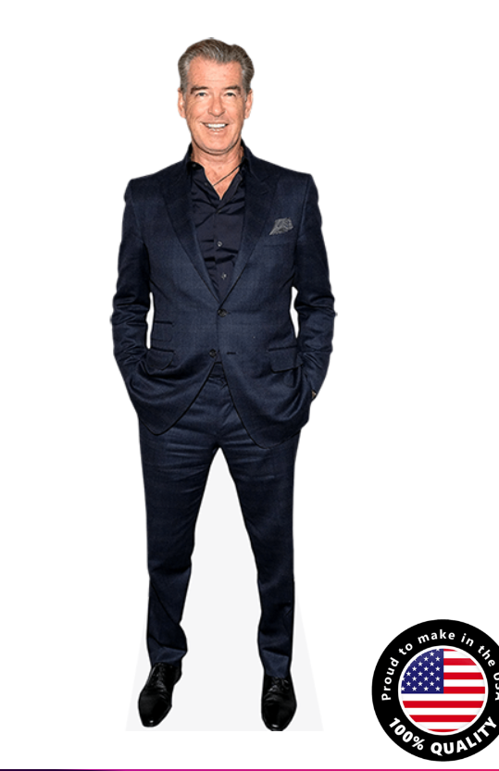
Dataset: Celeb-FBI
Contains 7,211 images of worldwide celebrity images in a standing front-facing position, including the four attributes:
Height: (4 feet 8 inches to 6 feet 5 inches)
Weight: (41 to 110 kg)
Age: (21 to 80 years)
Gender: (Male and Female)
Later used for fine tuning
5.10h_77w_male_62a
6.2h_88w_male_70a

Slide 7
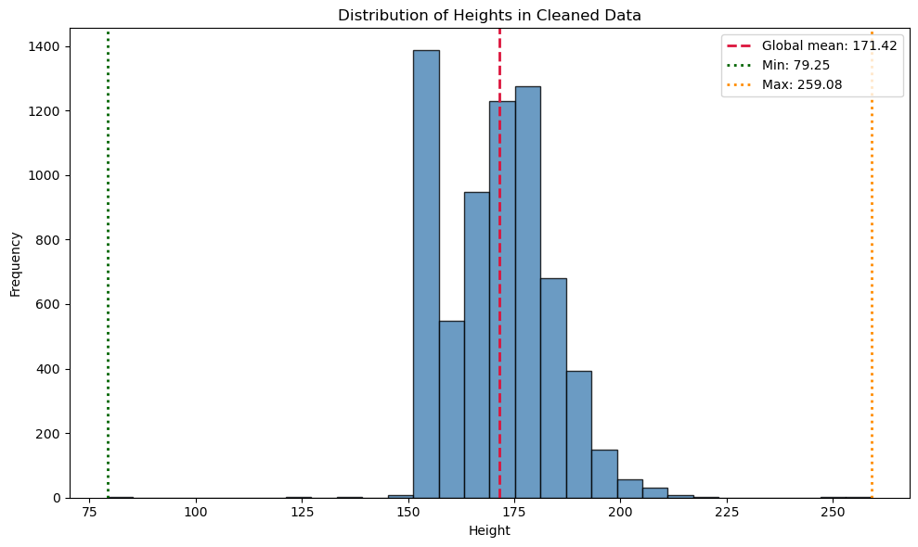
Mean Baseline
Average height: 171.42 cm
Train MSE: 150.69
Validation MSE: 164.16
Test MSE: 141.11
Global MSE: 150.94
Notes:
Azalea

Slide 8
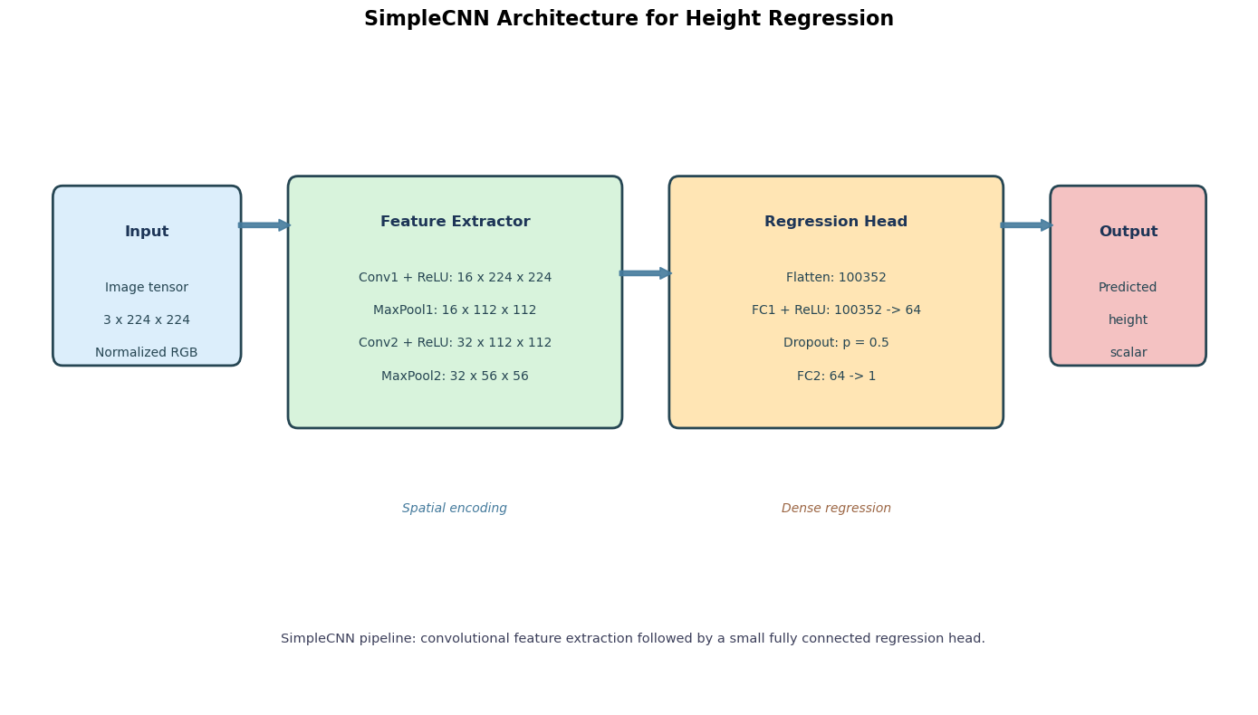
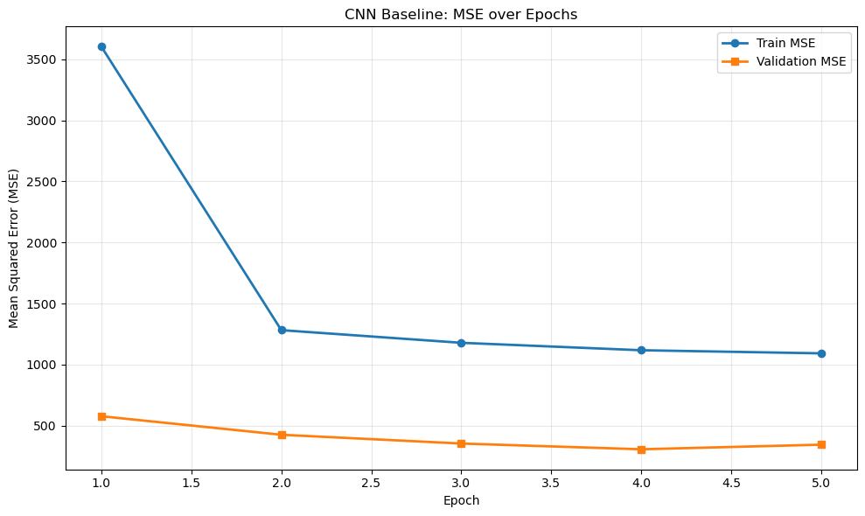
Convolutional NN
Created a simple CNN from scratch, which lets us see if there is substantial improvement from adding complexity from a pre trained models like DINOv2.
Test MSE: 287.43
Notes:
Azalea FC1 means the first fully connected layer
FC1: learns a weighted combination of all extracted image features.
FC2: output 1 | 64 -> 1
This is the final fully connected layer.
It takes the 64 values from the previous layer and combines them into a single number.
FC2 converts that representation into one final height prediction

Slide 9
Dino V2: Base
What is DinoV2
How it was trained
Pretrained vision model by Meta
Turns images into numerical feature vectors (embeddings)
Trained to understand shapes, body structure, and visual patterns
Works as a feature extractor (not a final predictor)
Uses self-supervised learning
Trained on millions of images
Learns by comparing different views of the same image
Forces model to learn consistent visual representations
Why we choose it
We don’t have a huge labeled dataset
DINOv2 already understands human body proportions
Gives strong features → better predictions than CNN
Easy to add a regression head for height

Slide 10
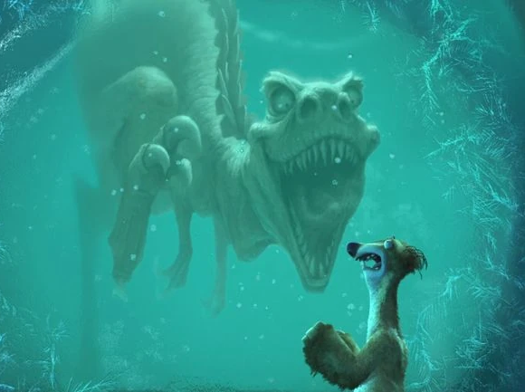
DinoV2: Fine-tuned
Once we had the regression head, we unfrose the DinoV2 weights
Trained for 5 epochs
3 epochs had the lowest Validation MSE
Test MSE (3 epochs fine-tuning): 134.64

Slide 11
DinoV2: Fine-tuned +Data Augmentation
Not all images are full body images
How do we account for someone half hidden (behind a counter, mirror selfie, etc.)
Blacked out portions of the image from the bottom half down
Test MSE: 127.84

Slide 12
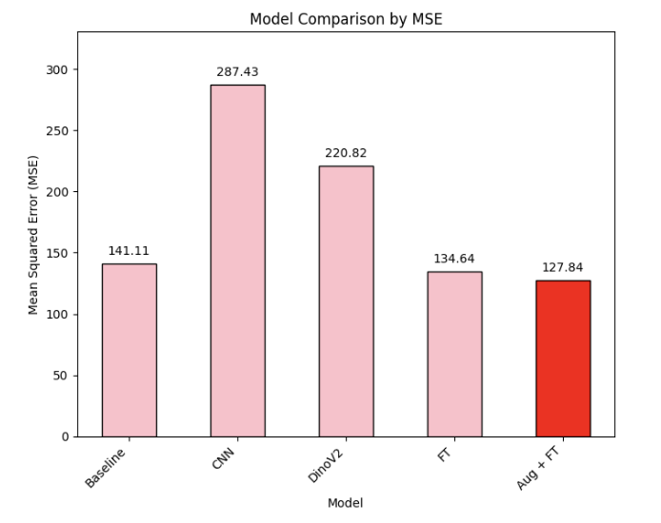
Final Performance

Slide 13
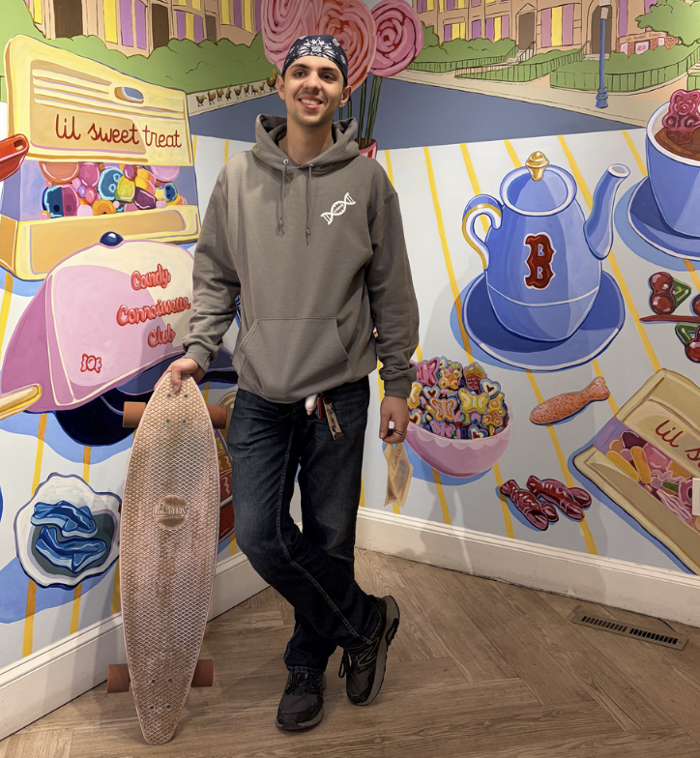
Case Study: S. Maurer
Angelo’s Boyfriend (Met on Hinge)
Drivers Liscence Height: 180.34cm (5’11’’)
Actual Height: 177.8cm (5’10’’)

Slide 14
Thank You
Any Questions?

Slide 15
