Slide 1
Adventures in computational reproducible research for ribosomal based community profiling
Dave Beck
dacb@uw.edu
http://faculty.washington.edu/~dacb

Slide 2
Background
Methane (CH₄) is a greenhouse gas
85x more potent than CO₂
Atmospheric [CH₄] have increased 150% / 200 years

Slide 3
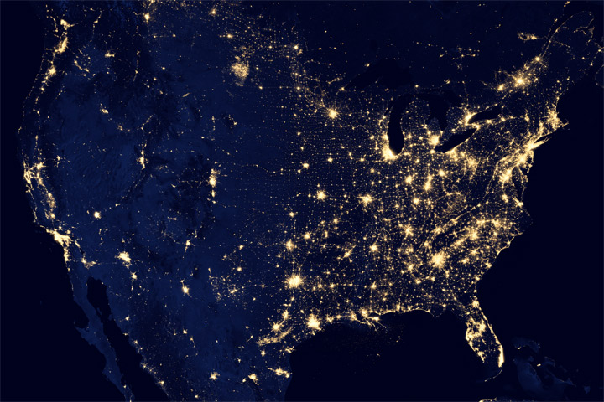
Bakken Shale (CH₄ flares)
Minneapolis – St. Paul
Chicago

Slide 4
Background
Methane (CH₄) is a greenhouse gas
85x more potent than CO₂
Atmospheric [CH₄] have increased 150% / 200 years
Methane has been present on the planet since life began 3.6 billion years ago
Something must have evolved to consume methane
Evidence of this in bacterial record from 2.73 billion years ago
Can we identify who the modern day bacteria are that consume methane?
Can they be engineered to consume more?

Slide 5
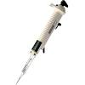

Strategy
Collect env. samples that metabolize CH₄
Enrich the communities for CH₄ utilizers
Extract DNA from samples
Sequence the 16S region of each sample (454)
Extract, transform, load & clean
39 samples w/ 100,000s reads
Perform sequence clustering
Naïve Bayes taxonomy classification of seqs.
Classical correspondence analysis of taxonomy abundance data
Understand how patterns of species originate from their metabolic interactions to utilize CH₄
Publish

Slide 6
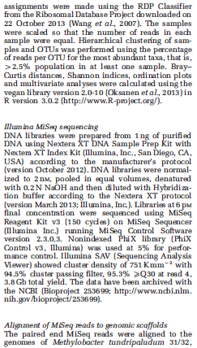
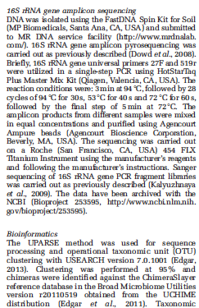
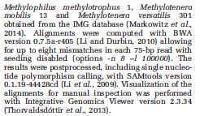
Methods section

Slide 7
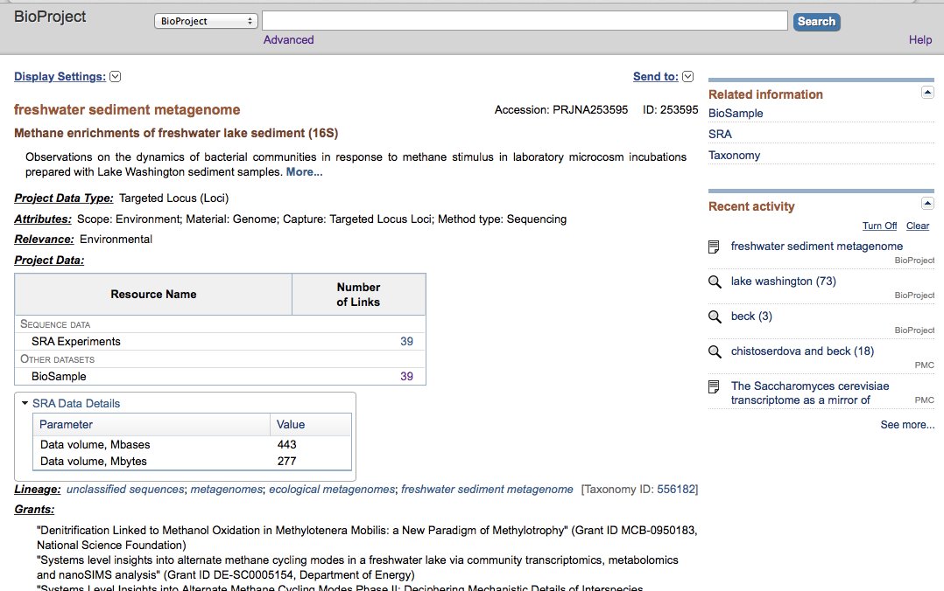
Deposit raw data
Put the raw data into NCBI BioProject with metadata for the study

Slide 8
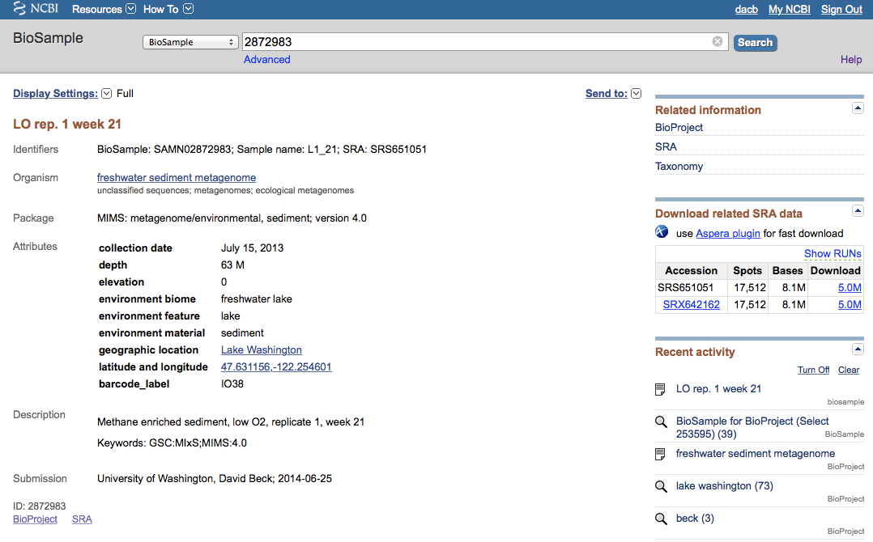
Deposit raw data
Including sample metadata such as collection date, GPS coordinates and sequencing methodology / protocol

Slide 9
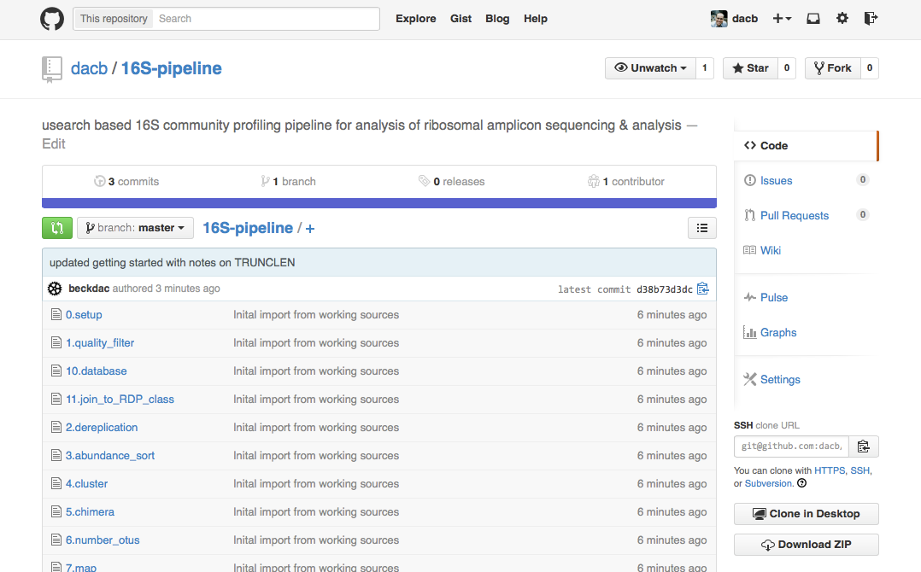
Deposit source code
Transferred code from a local SVN repo to github.com

Slide 10
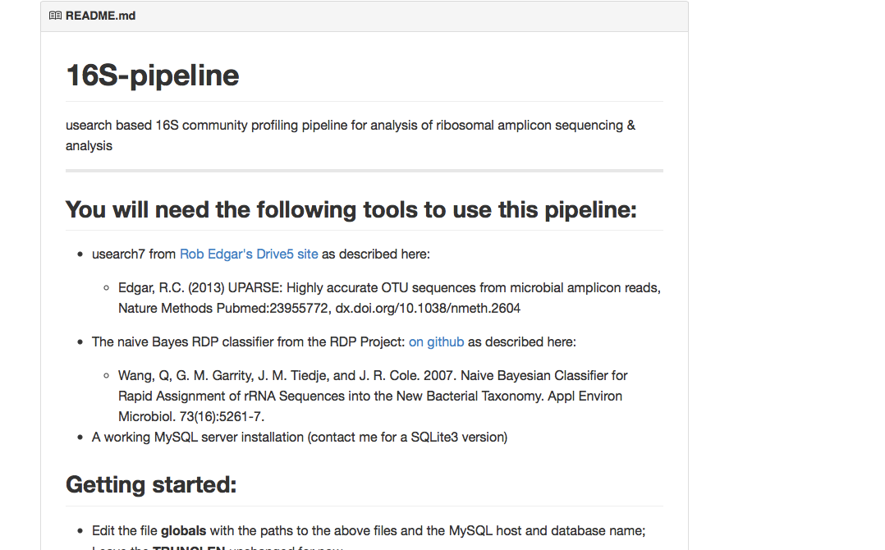
Deposit source code
Added some documentation on pipeline requirements and basic usage

Slide 11
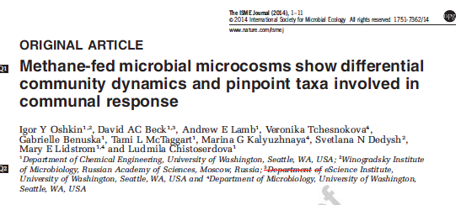
Publish (ISME Journal)

Slide 12
How did we do?
http://uwescience.github.io/reproducible/guidelines.html
Version control
Replicable computations
Data & code provenance, sharing & archiving
Data
Code
Replicable environment
Requirements documentation
Virtual machine
+
?
-

Slide 13
How did we do?
http://uwescience.github.io/reproducible/guidelines.html
Version control
Transitioned from local SVN to Git after paper written
+

Slide 14
How did we do?
http://uwescience.github.io/reproducible/guidelines.html
Version control
Replicable computations
Used scripts for steps and to run the pipeline
Final figures tweaked by hand
+
+
-

Slide 15
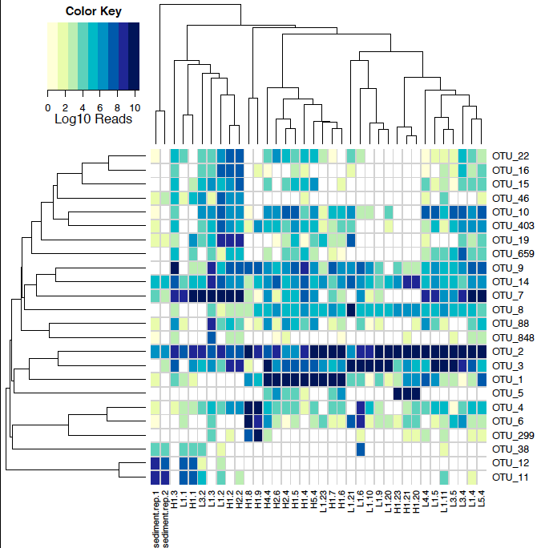
Generated figure

Slide 16
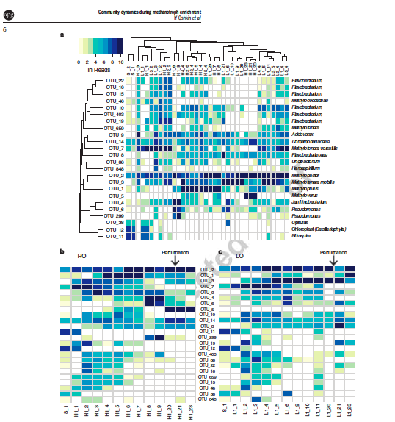
Final figure

Slide 17
How did we do?
http://uwescience.github.io/reproducible/guidelines.html
Version control
Replicable computations
Data & code provenance, sharing & archiving
Data
Code
+
+/-
+
+

Slide 18
How did we do?
http://uwescience.github.io/reproducible/guidelines.html
Version control
Replicable computations
Data & code provenance, sharing & archiving
Data
Code
Replicable environment
Requirements documentation
Virtual machine
+
+/-
+
+
+

Slide 19
How did we do?
http://uwescience.github.io/reproducible/guidelines.html
Version control
Replicable computations
Data & code provenance, sharing & archiving
Data
Code
Replicable environment
Requirements documentation
Virtual machine
Can’t! The usearch tool used by the pipeline license forbids
+
+/-
+
+
+
+
-

Slide 20
How did we do?
http://uwescience.github.io/reproducible/guidelines.html
Version control
Replicable computations
Data & code provenance, sharing & archiving
Data
Code
Replicable environment
Requirements documentation
Virtual machine
+
+/-
+
+
+
+/-
+
-

Slide 21
Lessons
Use the same version control system from start to finish
Waiting until the paper is accepted means the code DOI has to go in during proof stage
Final figures in scripts can be hard but is worth the effort

