Slide 1
Guidelines For Reproducible Research
Joseph L. Hellerstein
Senior Data Science Fellow
eScience Institute
University of Washington

Slide 2
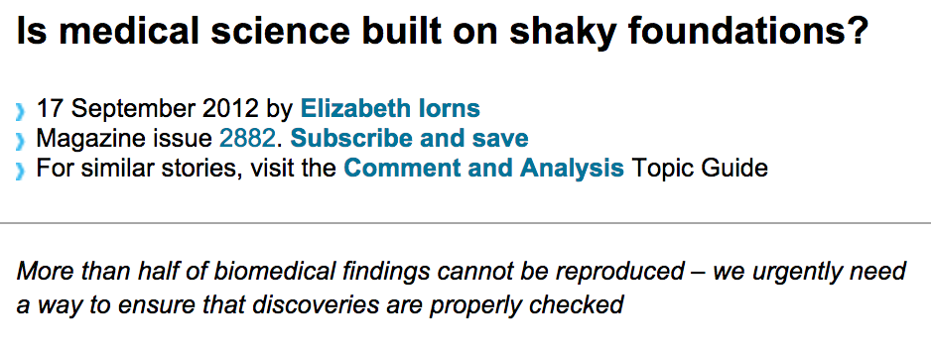

Background
(New Scientist)
(Reuters)

Slide 3
Reproducibility is a foundation of science.
Reproducibility is the ability of an entire experiment or study to be reproduced, either by the researcher or by someone else working independently. (Wikipedia)

Slide 4
What Causes Irreproducibility of Computational Results?
Lack of sharing
Data, code, computational environment
Changes in
Data, code computational environment
Manual steps

Slide 5
Guidelines
Detail practices that promote reproducibility
Version control
Replicable computations (use scripts)
Data and code provenance and sharing
Replicable environment
http://uwescience.github.io/reproducible/guidelines.html

