Slide 1
Detecting Adhesion through AFM Force Curves
Sahil Arora
Alan Liu
9.17.2019

Slide 2
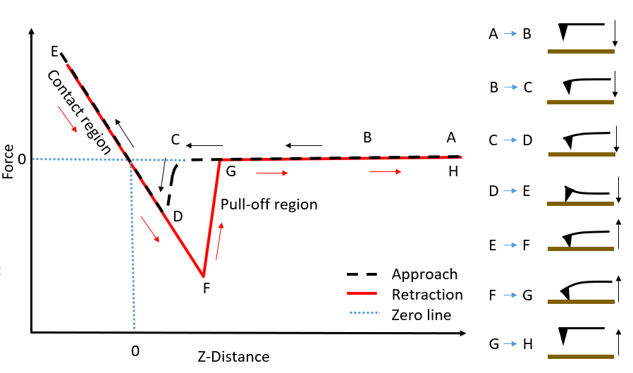
Purpose
Objectives
Create a reliable, consistent, automated method to detect regions of binding for when an atomic force microscopy probe binds with the surface it is scanning
Develop an algorithm that isolates this binding region and measures the force interaction
Applications
There is potential for this method to be generalized such that it can detect and measure binding of other bodies, such as cell-cell or particle-antibody interactions

Slide 3
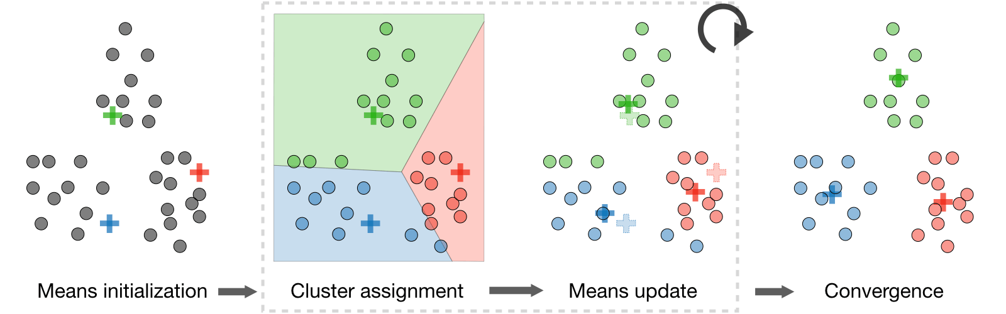
Unsupervised Learning
Machine learning approach where we group our data points such that there is high intra-cluster similarity (within one cluster) and low inter-cluster similarity (across clusters)
K-Means is one of the most popular algorithms, where k centers are randomly chosen, which then assign its nearest neighbors and iteratively updates the center until a convergence is reached

Slide 4
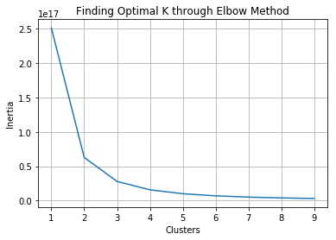
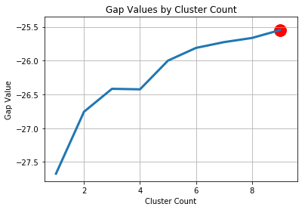
Choosing K
K Means is simple and intuitive, but we must choose our k beforehand
Minimize the distance of all points from their cluster centers without overfitting (i.e. making every point a cluster)
Elbow method measures the inertia (or total sum squared error of points over all centroids) and then chooses the “elbow”, where returns from adding a cluster become marginal
Gap Statistics is a more advanced method that selects the clustering with the largest gap between a clustering and just selecting from a normal distribution

Slide 5
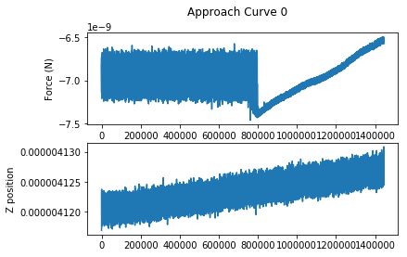
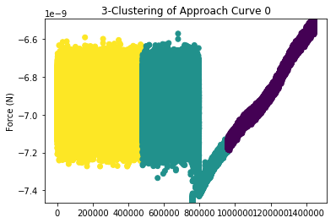
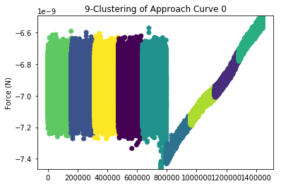
K Means on Noisy Approach Curve
3-clustering is promising, with binding occurring in one region
9-clustering leaves many indifferentiable clusters and splits binding region

Slide 6
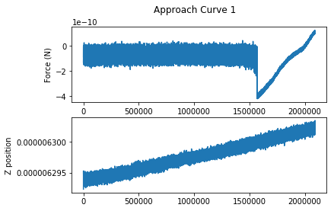
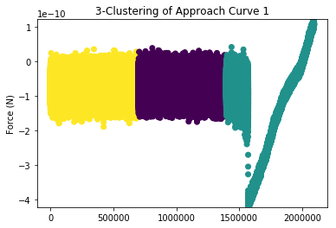
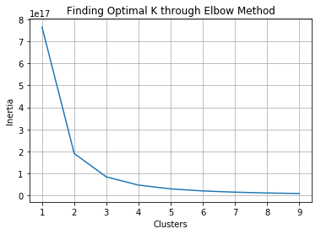
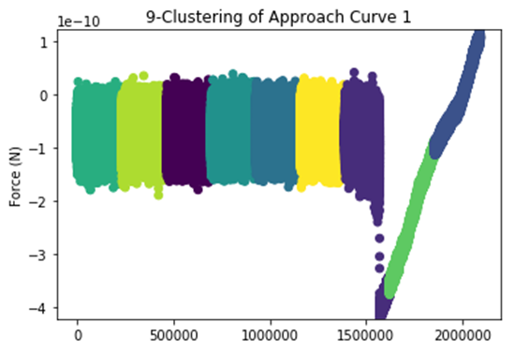
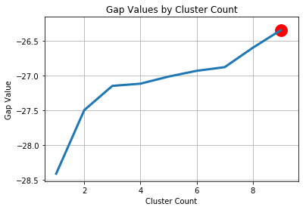
K Means on Approach Curve with Clear Binding
3-clustering has binding occur in one region, but not splitting in the same way as the previous dataset
9-clustering leaves many indifferentiable clusters but captures the binding region

Slide 7
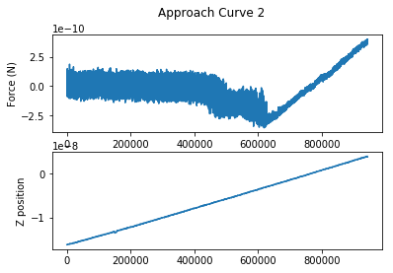
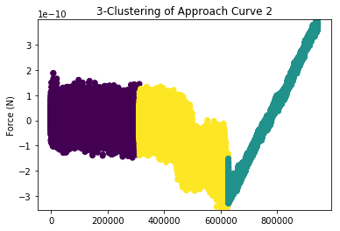
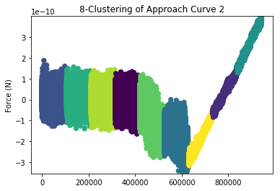
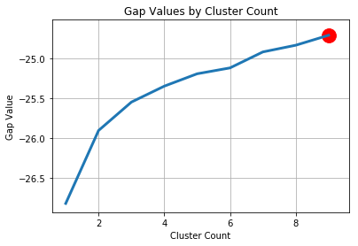
K Means on Approach Curve with Multiple Binding Sites
Elbow method suggests 3 clusters when ideally, we should have separate clusters for each binding region
9-clustering separates both binding regions but leaves many “meaningless clusters”
9

Slide 8
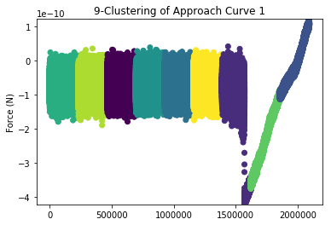
Takeaway: 9 is excessive and 3 is inconsistent

Slide 9
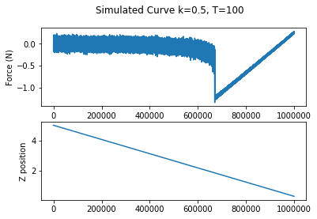
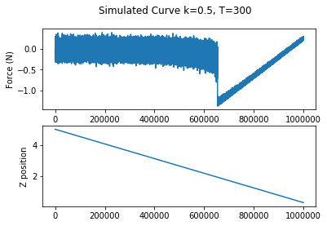
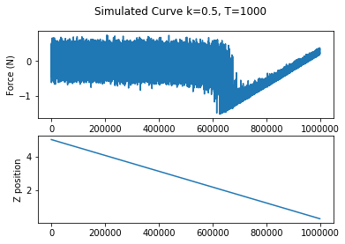
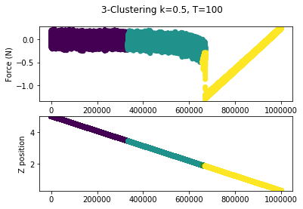
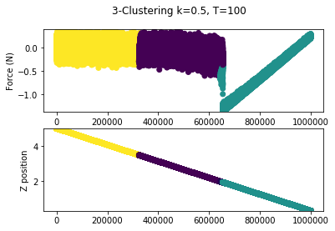
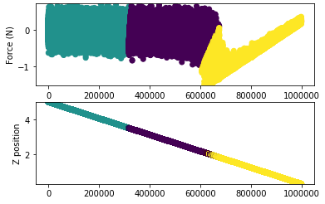
Simulated data is more consistent but still imperfect as it is not isolating the binding region perfectly

Slide 10
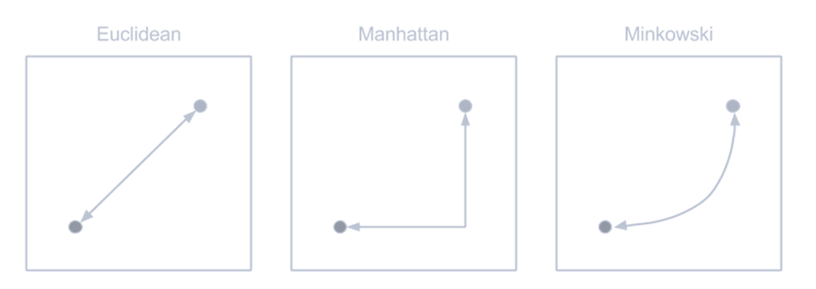
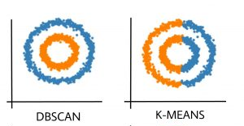
Future Directions
Tweak existing k-means with different distance metrics
Explore k-means clustering based on aggregate statistics (averages, kurtosis, percentile above mean) instead of the data points directly
Explore different clustering methods such as hierarchical and density-based clustering

