Slide 1
Execution Sequences & BIT
Software
Presenter: J. Meyers

Slide 2
Execution Sequence
Capabilities & Design

Slide 3
Table-Driven Design (Why? What Does That Mean?)
FIRMWARE
  Table-driven design is an approach to software development engineering that is aimed at simplifying and generalizing applications by separating the program control variables and parameters (rules) from the code and placing those in separate external tables
  The main objective is to decouple the program control data from the application logic and to put emphasis on modularity to ease change management
  Tables have the following benefits:
    They provide concise and orderly specifications of the business goal or challenge during the analysis phase
    They can be implemented directly and easily from the specifications, which also provide a very close link between theory and application during the design and development phase
    Tables can be shared to allow for single and centralized changes for quick turnarounds with minimal risk to the existing code during the maintenance and enhancement phase

Slide 4
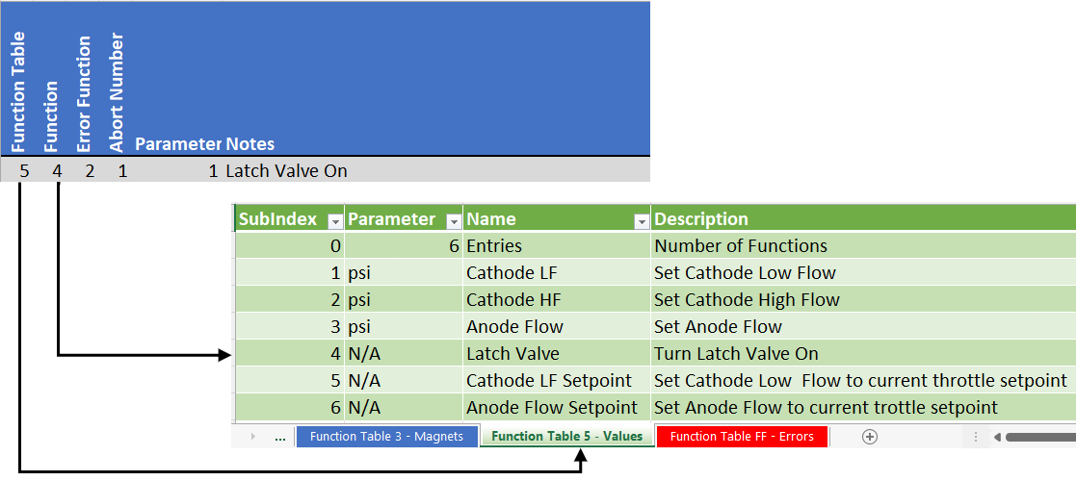
Execution Sequence
FIRMWARE
  List of functions and parameters
  Each step in the table is executed in order
  Each step consists of:
    Function Table
    Function Number in the Function Table
    Error Function
    Abort Code
    Parameter
      32 Bits (4 byte) Integer (No floats)
      Each function has a different parameter definition
      Float values usually multiplied by 1000
  No branching, no jumps, no flow control
  If a function fails the sequence stops and fails
  If an abort event is detected the sequence is aborted

Slide 5
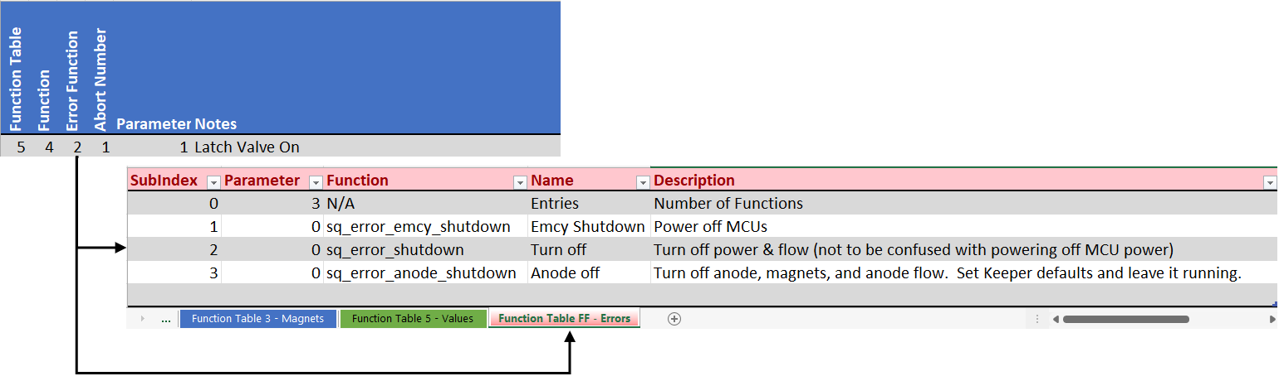
Error Functions
FIRMWARE
  There is an error function table which contains a list of error functions
  Each step has an error function assigned to it
  If the function called during that step fails:
    The specified error function is called
    Execution stops
    The sequence fails

Slide 6
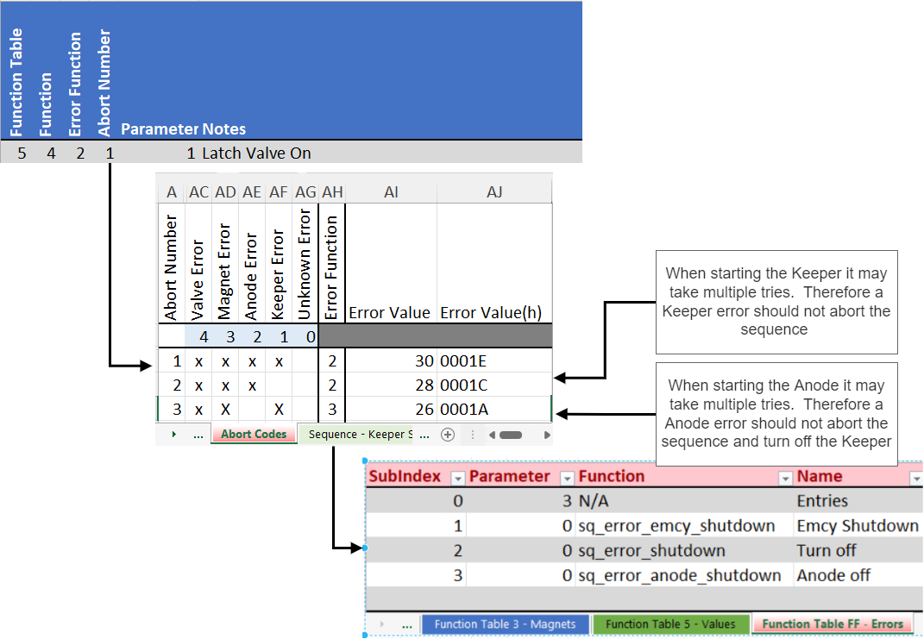
Abort Codes and Functions
FIRMWARE
  Each step has an Abort Number
  Abort Numbers correspond to an Abort Code
  The Abort Code is a bit mask of Abort Events
  Each Abort Event specifies an Error Function to call if the Abort Event is detect
  The Sequence will abort if:
    The Abort Event is detected during the step
    The corresponding bit is set in Abort Code
  When an Abort Event is detected
    The Sequence is aborted
    The Sequence fails
    The Error Function called

Slide 7
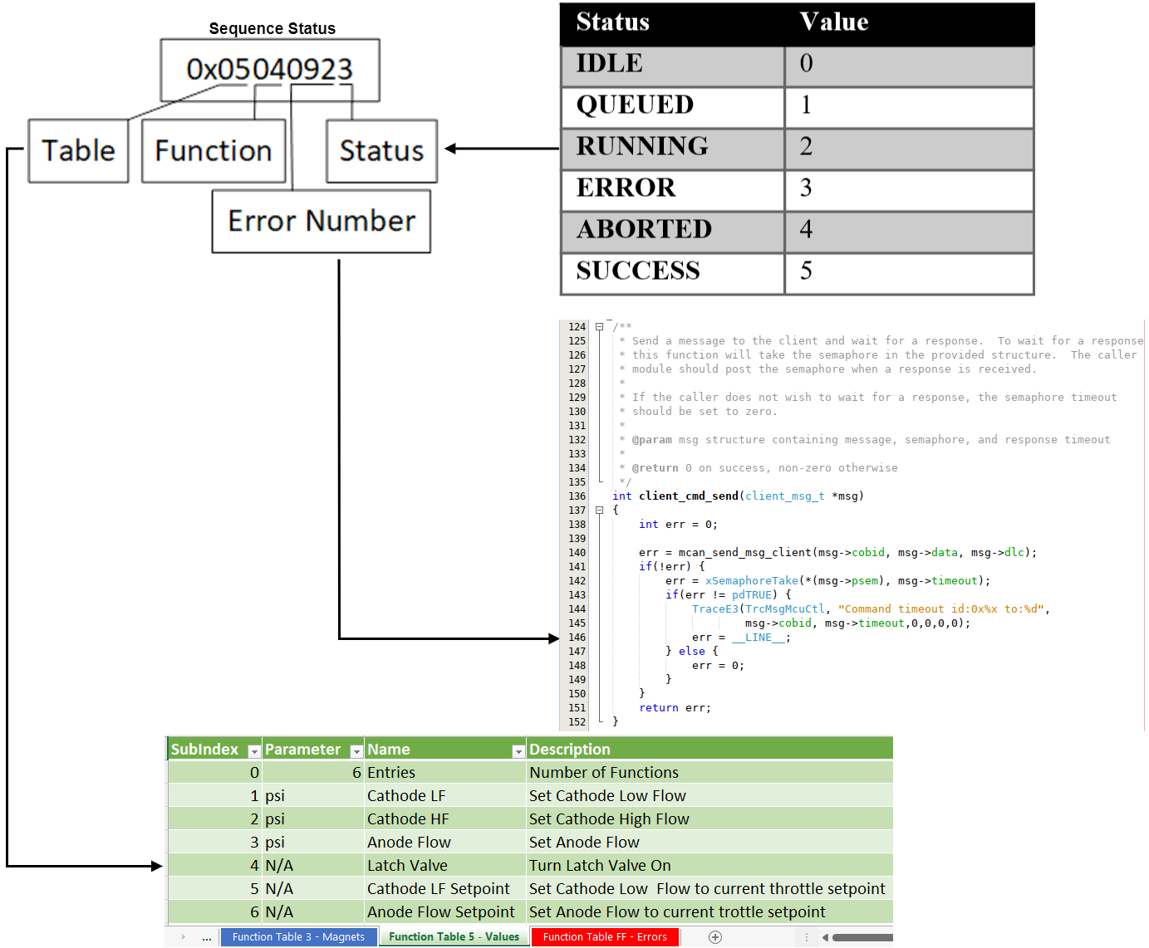
Sequence Status
FIRMWARE
  Each Sequence has an associated status
  The status is a 32 bit (4 Byte) integer
  The status represents:
    0 if the sequence has not been executed
    Current state if it is running
    Result of the last execution otherwise
  The status contains:
    Function Table
    Function Number
    Error Code (usually a line number)
    Sequence status
0x092 = 146
The sequence above failed when it tried to open the latch valve and the valve card did not respond

Slide 8
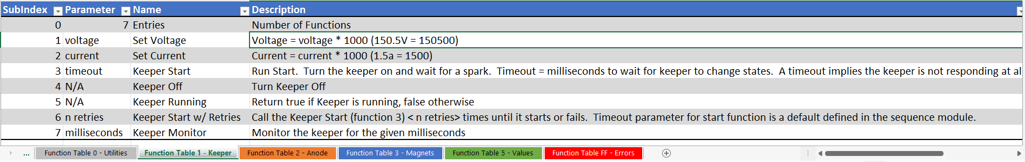
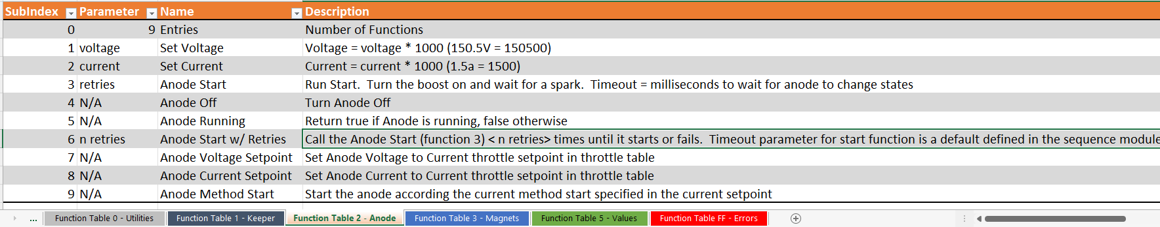
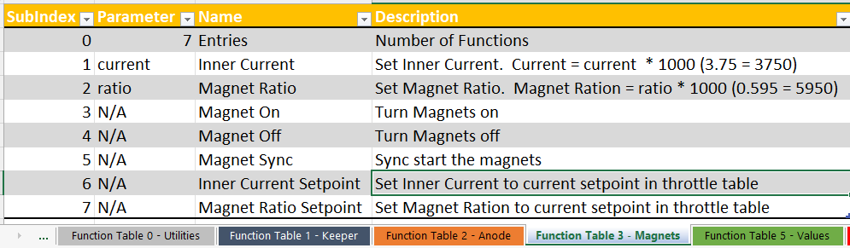
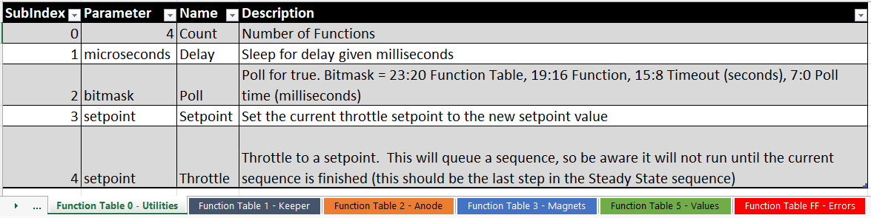
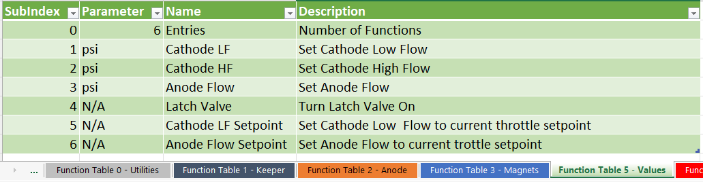
Function Tables
FIRMWARE
One table for each component
  Keeper
  Anode
  Magnets
  Values
Error Function Table
  Specifies error reactions
Utility Table
  General purpose functions
    Delay
    Set a thrust setpoint
    Throttle to a setpoint

Slide 9
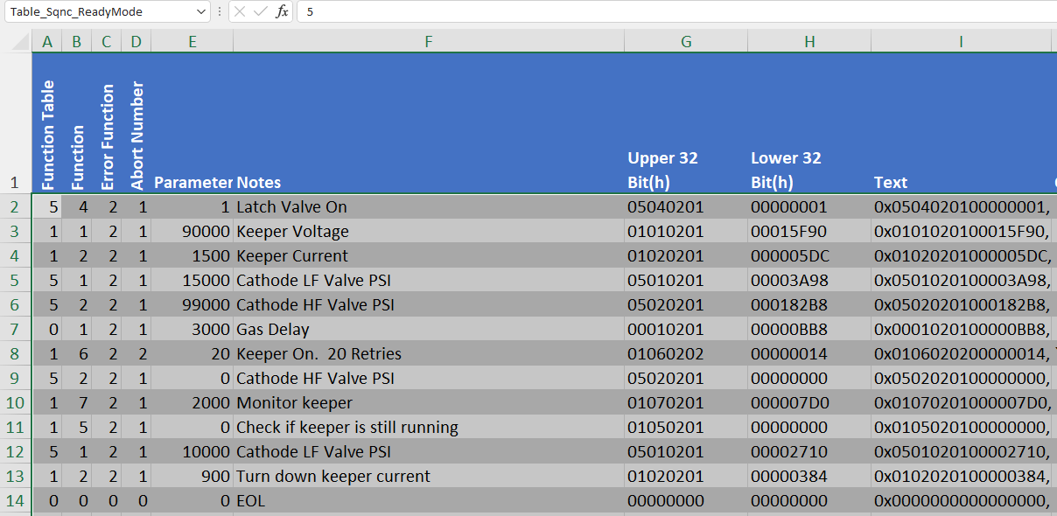
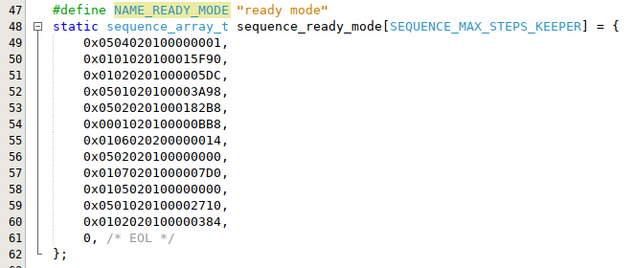
Sequence Uploading
FIRMWARE
Sequences can be uploaded at runtime
Each step is represented by a 64 Bit (8 byte) hexadecimal number
  Upper 32 bits represent the step information
  Lower 32 bits represent the parameter
Each sequence has a table name (e.g. Table_Sqnc_ReadyMode)
Sequences are set to the system by Table Name & Step Number
Uploaded sequences are not saved permanently (they set back to default on reset/power cycle)
Sequences must be terminated with zero value step number
(Also C code is generated in the Text column for copy/paste to code)
C Code

Slide 10
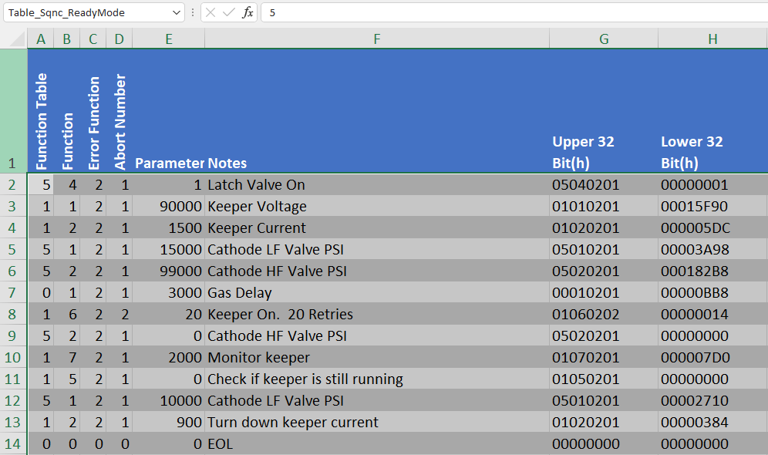
Sequence Upload Script
FIRMWARE
The throttle_upload.py program uploads sequence from a spreadsheet
Prompts for a spreadsheet file name
Sequences are listed by table name (e.g. Table_Sqnc_ReadyMode)
Selecting the table uploads the sequence to the system
============= ExoTerra Thruster Command & Control =============
============= ExoTerra Thruster Command Help Menu =============
0 - Exit : [Exits the Program]
1 - Help : [Displays the help Menu]
2 - Upload Throttle xlsx. : [Upload the Throttle xlsx file.]
3 - Query Throttle Table. : [Upload the Throttle xlsx file.]
4 - Upload Sequence Table. : [Upload the Sequence xlsx file.]
> 4
Upload Sequence Table.
Select file from ./excel_sheets or type back to exit
[0] - ./excel_sheets/ExecutionSequences_ThrusterSimCopy.xlsx
[1] - ./excel_sheets/ExecutionSequences.xlsx
> 1
Selected ./excel_sheets/ExecutionSequences.xlsx
Select the Table:
[1] - {'table_name': 'Table_Sqnc_ReadyMode', 'table_range': 'A1:I18', 'sheet': <Worksheet "Sequence - Ready Mode">}
> 1
Selected {'table_name': 'Table_Sqnc_ReadyMode', 'table_range': 'A2:I15', 'sheet': <Worksheet "Sequence - Ready Mode">}
table: Table_Sqnc_ReadyMode table data read: packed_h: b'05040201' packed_l: b'00000000'
table: Table_Sqnc_ReadyMode table data read: packed_h: b’01010201' packed_l: b’00015F90’
….
table: Table_Sqnc_ReadyMode table data read: packed_h: b'00000000' packed_l: b'00000000'

Slide 11
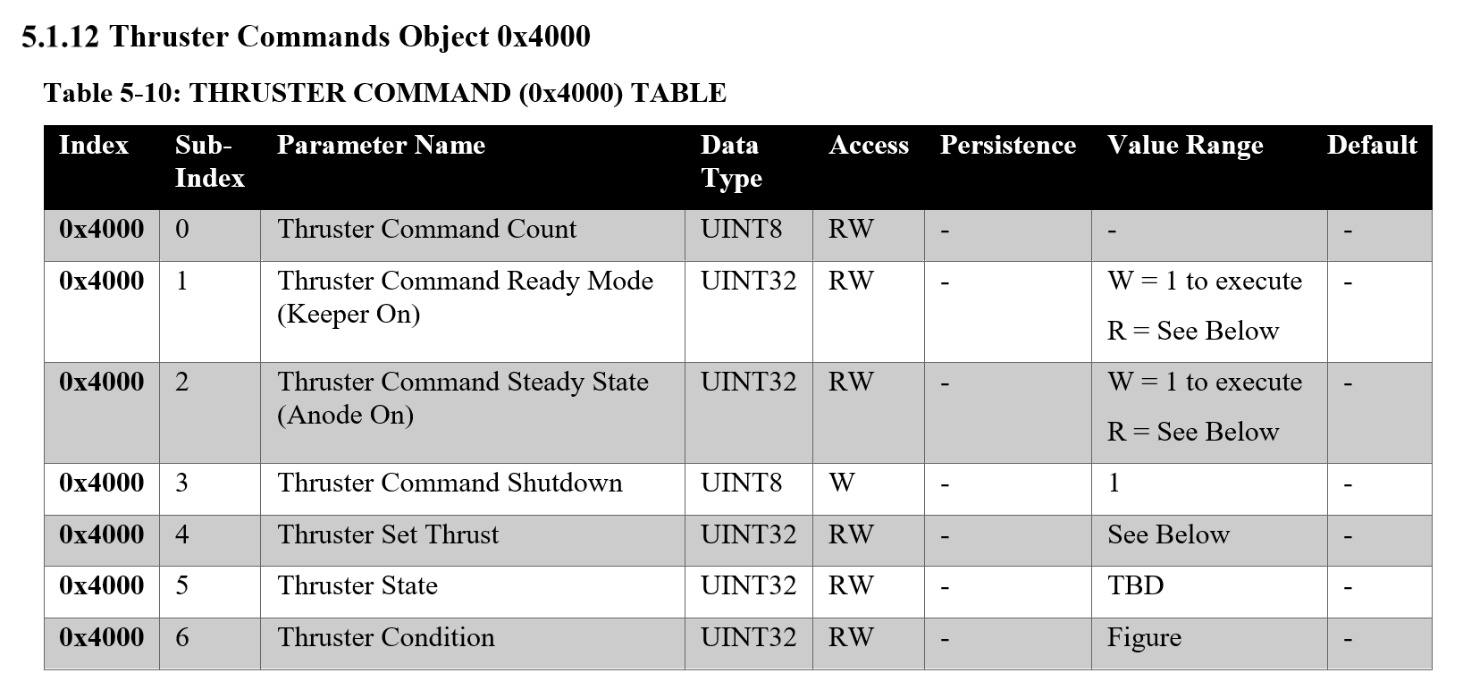
Sequence Execution
FIRMWARE
Sequences are executed by writing ‘1’ to the appropriate Index/Sub-Index
Sequence status is read by reading the same Index/Sub-Index
Example
  Execute the Ready Mode Sequence by writing a ‘1’ to Index/Sub-Index 0x4000/0x1
  Read 0x4000/0x1 to get status
$ ./thruster_command.py /dev/ttyUSB0 0x22 --hsi 192.168.120.110
============= ExoTerra Thruster Command & Control =============
============= ExoTerra Thruster Command Help Menu =============
0 - Exit : [Exits the Program]
…
5 - Run Ready Mode : [Writes a UINT-32 to the Thruster Ready Mode.]
6 - Run Steady State : [Writes a UINT-32 to the Thruster Steady State.]
…
[rm:0x0:ss:0x0:ts:0x8]> 5
Run Ready Mode
{'Wrote:0x4000-0x1: 0x01000000'}
[rm:0x0:ss:0x0:ts:0x8]> Updated State: Operational
[rm:0x1060002:ss:0x0:ts:0x9]> Updated State: Operational
[rm:0x1020005:ss:0x0:ts:0xa]> 6
Run Steady State
{'Wrote:0x4000-0x2: 0x01000000'}

Slide 12
Built In Test (BIT)
BIT Test Capability

