Slide 1
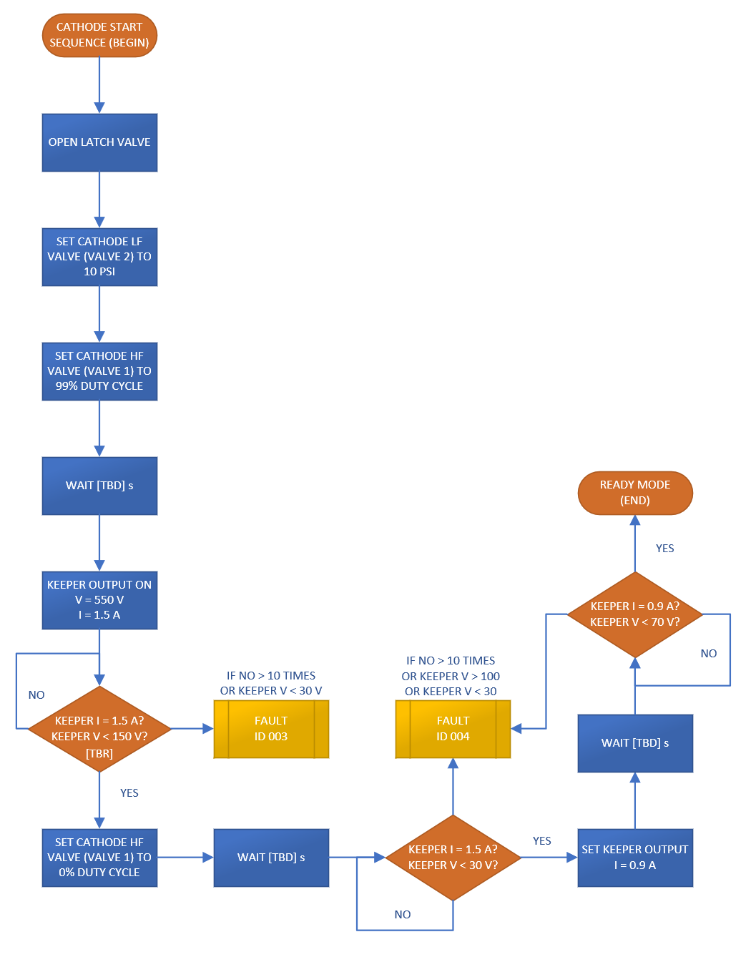
Halo – Cathode Start (Ready Mode)

Slide 2
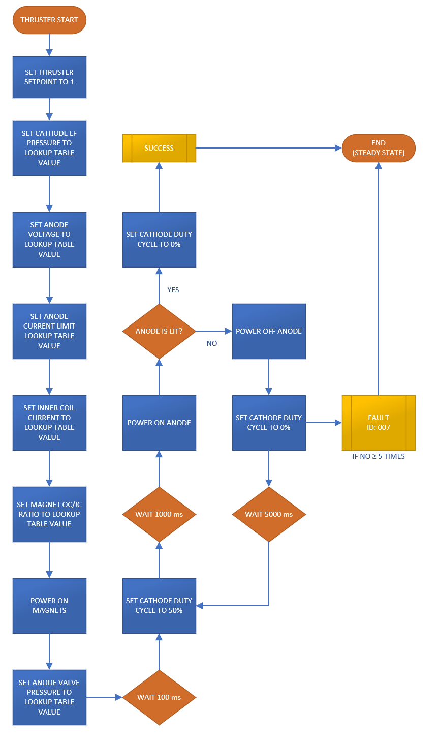
Halo – Thruster Start (Steady State)

Slide 3
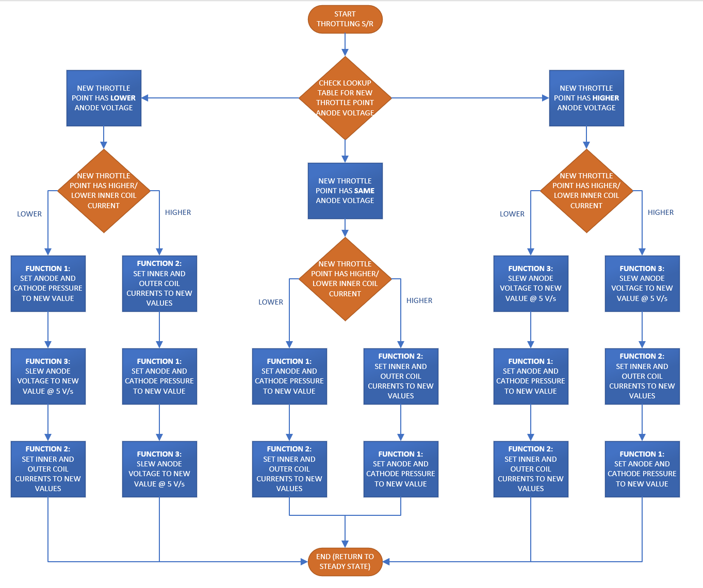
Halo – Throttling

Slide 4
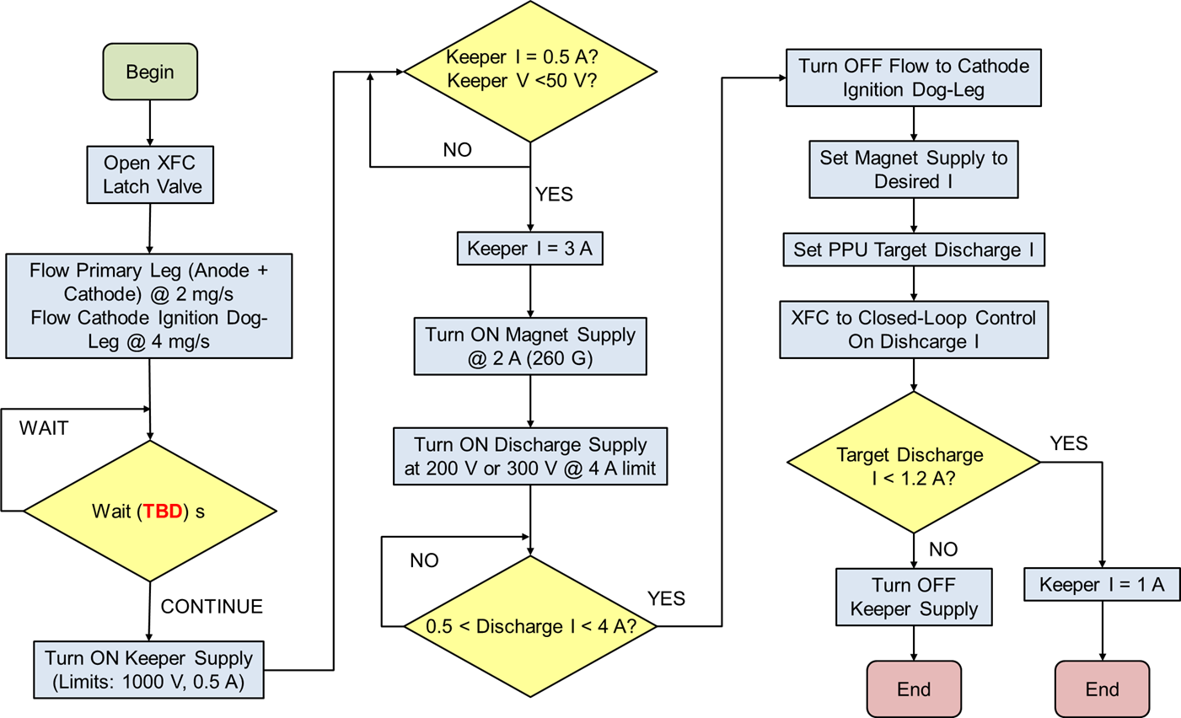
Halo12 - Ignition

Slide 5
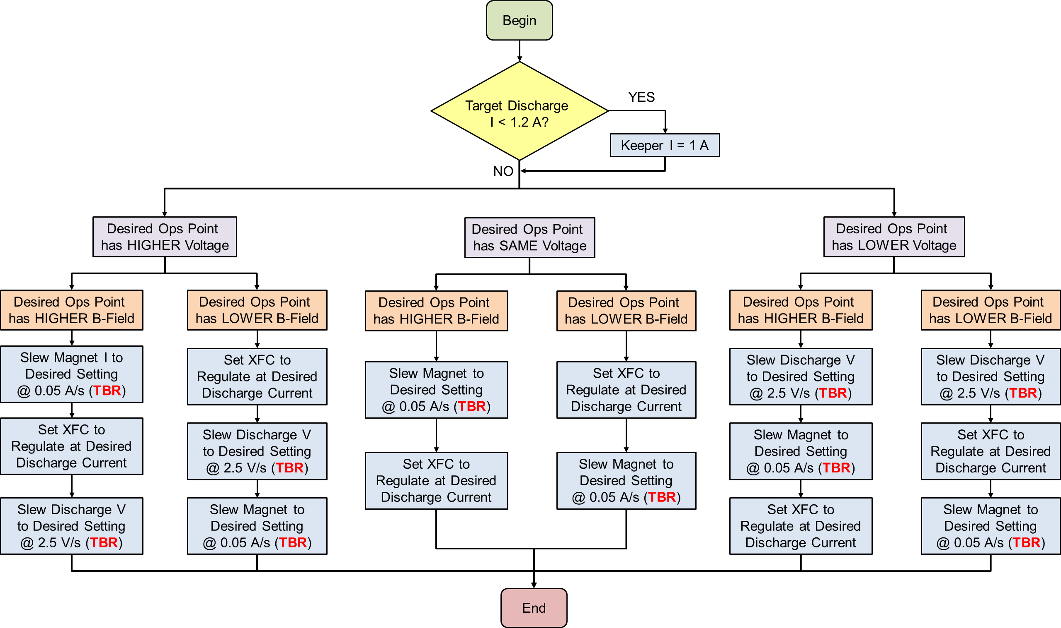
Halo12 - Throttling

