Slide 1
Halo 12 Memory Layout Change
Changes from PDR

Slide 2
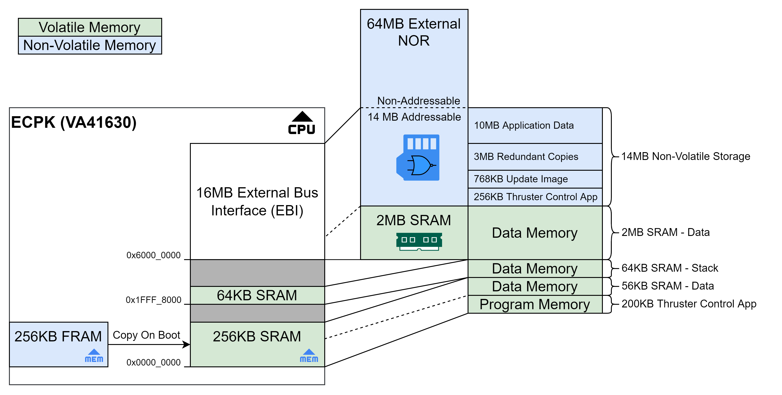
Original Memory Layout
Non-Volatile FRAM – 256KB
Stores application binary
Processor copies contents into SRAM on boot
Internal SRAM – 256KB for Program Memory
Application execution area
Extra room can be used for data memory
200KB for Thruster Control Application
56KB for Data – Trace Message Buffer
Internal SRAM – 64KB for Data Memory
Used for Thruster Control Application stack
External SRAM – 2MB for Data Memory
Thruster Control Application data memory
External NOR Flash – 64MB
14MB for Application data
Addition space can be utilized with a custom driver
14MB Application Data Area
Layout of Thruster Control App, Update Image and Redundant copies is legacy carryover of Halo 6 which used rad-tolerant chips
This was a safety measure in the event an area of memory got corrupted, then there would be backups
VA41630 and the External NOR are rad-hard and can benefit from another strategy

Slide 3
New Memory Layout
Files Changed
Storage_memory_layout.h
Storage_memory_file_map.c
Component_keys.h
Va416xx_linker_freertos.ld
Va416xx_linker_baremetal.ld
SW Update
Region (1M)
2MB ext SRAM
Data Region (1M)
0x60E00000
14MB ext Addressable
NOR Flash
(64MB device)
Application Configuration
Region is 65kB
Store configuration data required by app that must persist after power cycle
0x60200000
App Configuration Region
Image Backup Region 2
0x60000000
Software Update Backups
Regions are 1MB each
Store images and headers for all three devices; ECPK, MVCP, ACP
App stores state for each region in the Application Data area
0x60100000
Image Backup Region 1
0x1FFF8000
64k int SRAM
RTT (2k)
0x60000000
256k FRAM
256k int SRAM
SRAM2 (30k)
0x00000000
SRAM1 (32k)

Slide 4
Software Update Binary
Update Binary Contains Image For Each Device
Typically the same image is deployed on each device and resistor population options determine behavior
This structure allows different versions to be deployed
Also allows dedicated firmware for each device
If one image is to be deployed to all three devices then only one image is included and all headers point to this image
Update Image Header
First 256B of Update Binary
Metadata about the whole region
Encompasses the image headers
CRC is for the whole region
Device Headers
Each one is 64B
Metadata about the Image
CRC is for the image
ACP Image
256kB
MVCP Image
256kB
Target Magic Number
Offset within the update binary
Size of the image (region or actual)
Device ID (ECPK, MVCP, or ACP)
Firmware Major Version
Firmware Minor Version
Firmware Patch Version
Git SHA
Image CRC
ECPK Image
256kB
Padding
ACP Header
256B
MVCP Header
ECPK Header
Update Image Header
Update Magic Number
Size of the update binary
Number of images (always 3)
ECPK Header
MVCP Header
ACP Header
Header Region CRC

Slide 5
ECPK Software Update Process
EBI SRAM (volatile)
EBI NOR Flash (non-volatile)
Upload from FCP
Index = 0x5500
Sub-index = 0x01
Write update image to update binary region of SRAM
Check CRC’s when complete
Update Binary Region
Verify Upload (w)
Index = 0x5500
Sub-index = 0x02
Decrypt (future)
Verify CRC’s
Read Result (r)
Index = 0x5500
Sub-index = 0x02
Update Binary Region
Install
Index = 0x5500
Sub-index = 0x03
Write the update image to NOR Flash
Write ECPK image to FRAM
Send the MVCP image to the MVCP device
Send the ACP image to the ACP device
Update Binary Region
Enable
Index = 0x5500
Sub-index = 0x04
Resets all devices
Causes FRAM images to be read into program memory
&*^& Image
ACP Image
*@%^ Image
MVCP Image
%&#@ Image
ECPK Image
Application Data Region
Header
Header
Update Binary
Update Binary
0x60F00000
Application Data Region
Application Data Region
0x60E00000
Question
If installing without a valid image in SRAM, do we copy the active or stale backup region?
Doing stale allows to go back to a previous release.
Doing active just reloads the image currently in FRAM.
Application Data - TBD
Application Data - TBD
EBI NOR Flash
Image Backup Region 2
Image Backup Region 1
ACP Image
0x60200000
MVCP Image
Image Backup Region 2
Image Backup Region 2
ECPK Image
0x60100000
Header
Image Backup Region 1
Image Backup Region 1
Update Binary
0x60000000
FRAM
FRAM
FRAM
ECPK Image
0x00000000

Slide 6
ECPK Software Update Process Detail
Image Backup Regions
Two regions to store images for each of the three devices (ECPK, MVCP, ACP).
Each region is 1MB = 16 sectors (smallest erase is a 65kB sector)
Each region has two states; stale and active
Active = has been written to FRAM. Only one region can be active at a time, the other must be stale
When an update is received it is validated as it is transferred to the stale backup region
Once the full update image is transferred it remains stale until user sends Install command
The user sends a Install command to make the update active and copy it to FRAM
The user can use the Install command to switch back and forth between the latest and the previous versions
Initialize both regions as stale. If someone attempts to install we will fail
Verify Upload (w)
Index = 0x5500
Sub-index = 0x02
Region 1 State?
Stale
Write Image to Region 1
End
Active
Write Image to Region 2
Region 2 = stale
1
Fail
Always check region 1 first
Upload an update
Install
Index = 0x5500
Sub-index = 0x03
No
Region 1 State?
Stale
Check Region 1 CRC
Pass?
Yes
Copy Region 1 image to FRAM
Send Region 1 Images to Clients
Region 1 = Active
Region 2 = Stale
End
Active
Installs what is in a stale region and makes it active, IF, there is a valid image in the stale region.
2
Check Region 2 CRC
Pass?
Yes
Copy Region 2 image to FRAM
Send Region 2 Images to Clients
Region 1 = Stale
Region 2 = Active
No
Upload an update
Fail

