Slide 1
Model Context Protocol
Giving AI Agents Hands
Agentic AI Course | Week 19

Slide 2
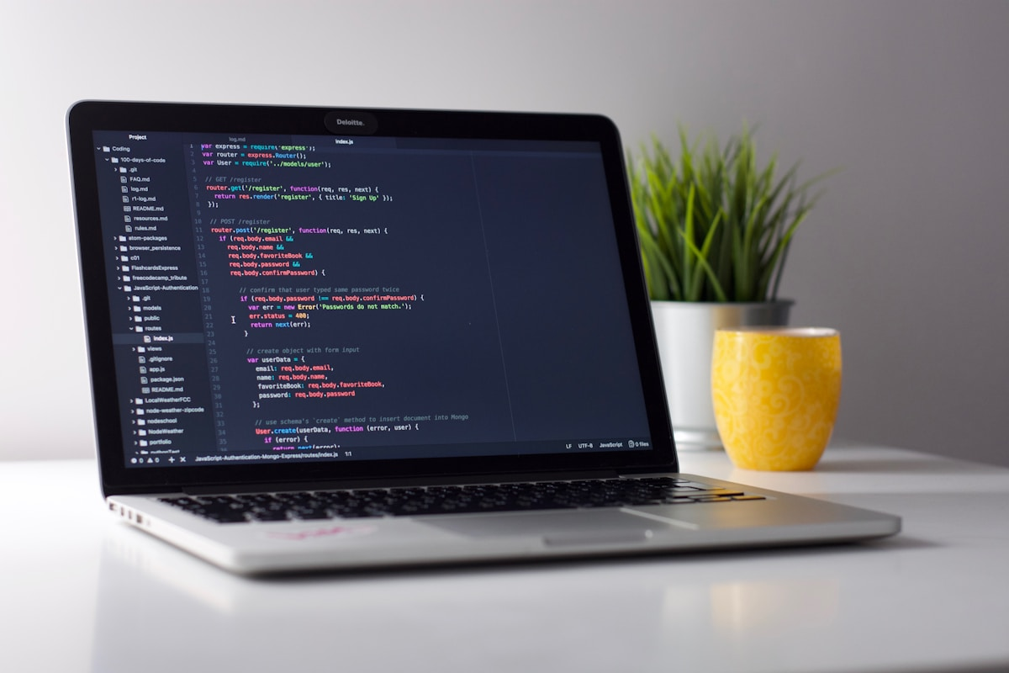
The Problem: Without MCP
❌ Code duplication across agents
❌ Inconsistent implementations
❌ Updates scattered everywhere
Every agent rewrites the same tools:
• read_file()
• write_file()
• search()
Finding a bug? Fix it in 3 places.

Slide 3

The Solution: With MCP
✅ One source of truth
✅ Reusable across agents
✅ Update once, benefit everywhere
Write tools once. Connect any agent.
Agent code never changes when you add tools.

Slide 4
What is MCP?
Model Context Protocol: A standard protocol for connecting external tools to Claude.
Key Idea:
• Tools live on a separate server
• Your agent's client connects to it
• Claude decides when to use tools
Like USB for AI agents.

Slide 5
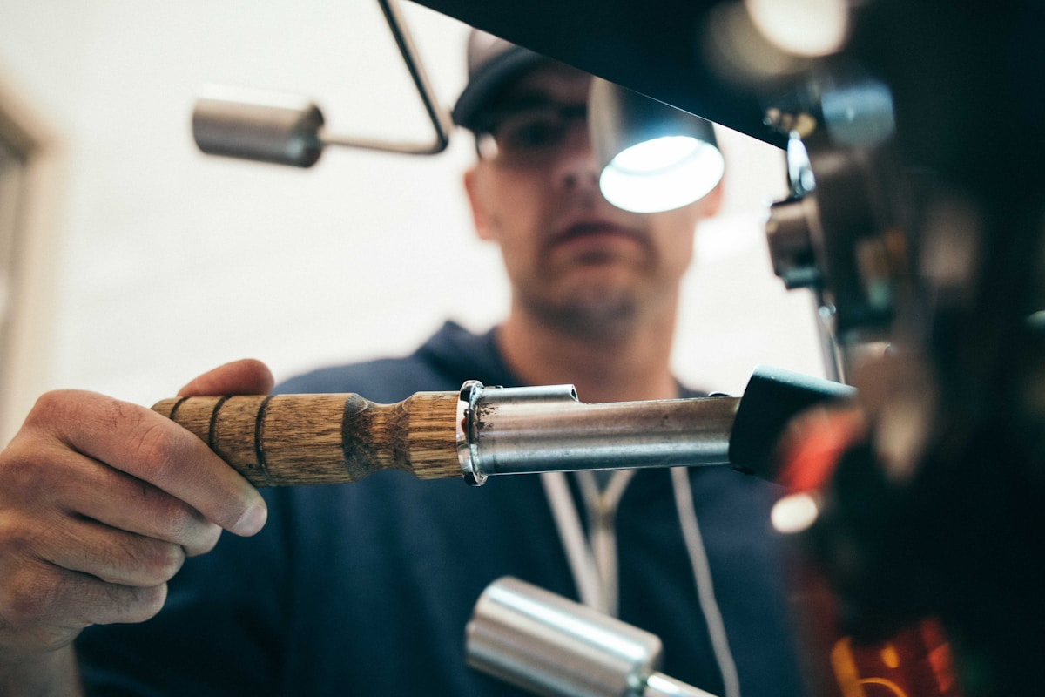
MCP Architecture
Three components:
1. Host (Your Application)
• Holds the MCP client
2. MCP Client (in your agent)
• Talks to the server
• Fetches available tools
3. MCP Server (separate process)
• Defines and executes tools
• Returns results

Slide 6
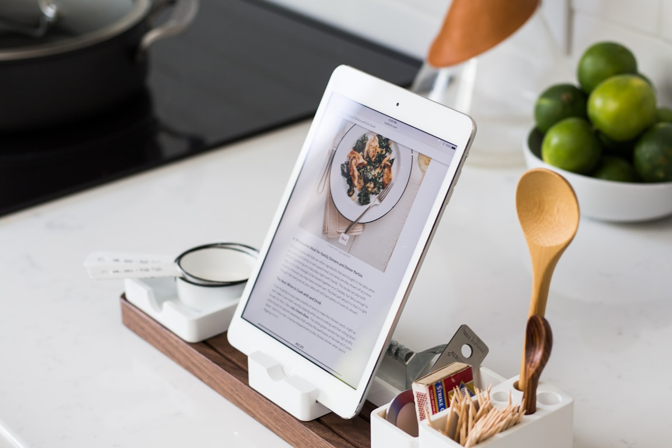
The Restaurant Analogy
Customer (Claude): Places an order
↓
Waiter (MCP Client): Takes the order
↓
Kitchen (MCP Server): Makes the food
↓
Waiter (MCP Client): Brings it back
↓
Customer (Claude): Enjoys the meal
Key: Customer never goes to the kitchen.

Slide 7
Demo Time
Watch what happens:
1. I'll run an MCP server
2. Connect Claude via the SDK
3. Ask Claude a question
4. Claude autonomously uses the server
Don't worry about details yet. Just watch.

Slide 8

What Just Happened
The autonomous flow:
1. User asks question
2. Claude identifies need for tool
3. Client asks server for tools
4. Server sends tool list
5. Claude chooses appropriate tool
6. Client executes on server
7. Server returns result
8. Claude uses result
✅ All autonomous. No manual steps.

Slide 9
Building an MCP Server
Two essential methods:
1. list_tools()
→ Tell Claude what tools you have
2. call_tool(name, arguments)
→ Execute the tool
That's the whole server.
Inside call_tool(): check the name, do the work, return result.

Slide 10
Connecting Your Agent
Three steps:
1. Initialize client connection
2. Fetch tool list from server
3. Pass tools to Claude
Claude sees the tools and uses them autonomously.
Agent code stays simple. Loose coupling.

Slide 11
The Agentic Loop
How MCP powers autonomous agents:
1. Claude thinks: What can I do?
2. Client fetches tool list
3. Claude decides: I'll use this tool
4. Client calls server
5. Server executes, returns result
6. Claude uses result in reasoning
7. Loop until task complete
Without MCP: Claude can think but can't act.

Slide 12
Real-World: Drawing Room
Orchestrator connects to multiple MCP servers:
📁 FileSystem Server
• read_file()
• write_file()
📚 LMS Server
• get_submissions()
• post_assignments()
🎬 Video Tools Server
• transcode()
• extract_audio()
Each team manages their own server.

Slide 13
Transport: Stdio vs SSE
Two ways to communicate:
📍 Stdio (Local)
• Server is a local process
• Talk via stdin/stdout
• Simple, no network
☁️ SSE (Remote)
• Server runs in the cloud
• Talk via HTTP
• Good for resource-heavy tools
Today: We use stdio.

Slide 14
Live Build: Let's Code
We're building a minimal MCP server together.
You'll see:
1. Tool definition
2. Tool execution
3. Connection to Claude
Watch first. You'll build in the assignment.

Slide 15
Step 1: Define the Tool
In list_tools():
name: 'get_today'
description: 'Returns today's date'
inputSchema: {empty}
This tells Claude: I have a tool called get_today.

Slide 16
Step 2: Execute the Tool
In call_tool():
if name == 'get_today':
return today's date
When Claude calls it, this code runs.

Slide 17
Step 3: Start Server
asyncio.run(stdio_server(server))
Server is now running.
Listening for client requests.
Waiting for Claude to connect.

Slide 18
Step 4: Connect Claude
Client connects to server.
Passes tools to Claude.
Asks: 'What's today's date?'
Claude autonomously:
• Sees the tool
• Decides to use it
• Gets the result

Slide 19
Step 5: The Loop in Action
User: 'What's today's date?'
Claude: 'I'll use get_today'
Server: 'Today is [date]'
Claude: 'Today is [date]'
Autonomous. No manual steps.

Slide 20
Your Turn: The Assignment
Add a search_files(keyword) tool:
✓ Accept keyword argument
✓ Search files in workspace
✓ Return matching filenames
✓ Return 'No matches' if none
You have 15 minutes.
Instructor is here to help.

Slide 21
Assignment Tips
1. Define in list_tools()
name, description, inputSchema
2. Implement in call_tool()
Add if-branch for search_files
3. Test it
Run server, ask Claude to search
You've got this. Same pattern as demo.

Slide 22
Stretch Goal
Add summarise_file(filename):
✓ Takes filename
✓ Reads the file
✓ Calls Claude for 1-paragraph summary
✓ Returns summary
Hint: Use anthropic.Anthropic() from within the tool.

Slide 23
Debrief Discussion
Think about these:
1. How much agent code changed when you added the tool?
(Answer: Zero)
2. What if two agents connected to this server?
(Answer: Both see same tools)
3. What MCP server would you build for Drawing Room?
(Brainstorm...)

Slide 24
Why MCP Matters
Without MCP:
❌ Duplication, tight coupling, no sharing
With MCP:
✅ One source of truth
✅ Loose coupling
✅ Independent updates
✅ Team collaboration
MCP is how you build scalable, maintainable agents.

Slide 25
Drawing Room: From Signals to Assets
Orchestrator workflow:
📖 Read signal_backlog
📋 Plan content
📝 Write content map
📚 Generate learner packs
🎬 Video processing
📤 Publish assets
MCP is the glue. It's how the orchestrator touches the real world.

Slide 26
Key Takeaways
✅ MCP is a protocol for tools
✅ Servers expose, clients connect
✅ Claude decides autonomously
✅ You can build MCP servers
✅ MCP scales across agents
✅ Drawing Room uses MCP
You can build this. You just did.

Slide 27
Resources & Next Steps
📚 Official Docs:
modelcontextprotocol.io
💻 Examples:
github.com/anthropics/mcp
🏗️ Try at Home:
Build your own MCP server
🚀 Next Session:
Deployment, multi-server architectures

Slide 28
Questions?
Ask anything:
• About MCP?
• About the assignment?
• About Drawing Room?
• About agents?
No question is too small.
Let's discuss.

Slide 29
You Just Learned MCP
You came in asking 'What's MCP?'
You're leaving knowing:
✅ What it is • ✅ How it works • ✅ How to build
✅ How to connect • ✅ Why it matters
You're ready to build with MCP.
See you next week!

