Slide 1
Systems Evaluations
Knowing When Your Agent is Good
Agentic AI Course | Week 20

Slide 2

The Problem
You've built an agent.
Claude can reason and act.
But: How do you know it's good?
❌ No clear standard
❌ Hard to measure quality
❌ Can't compare agents
❌ No early warning for problems

Slide 3
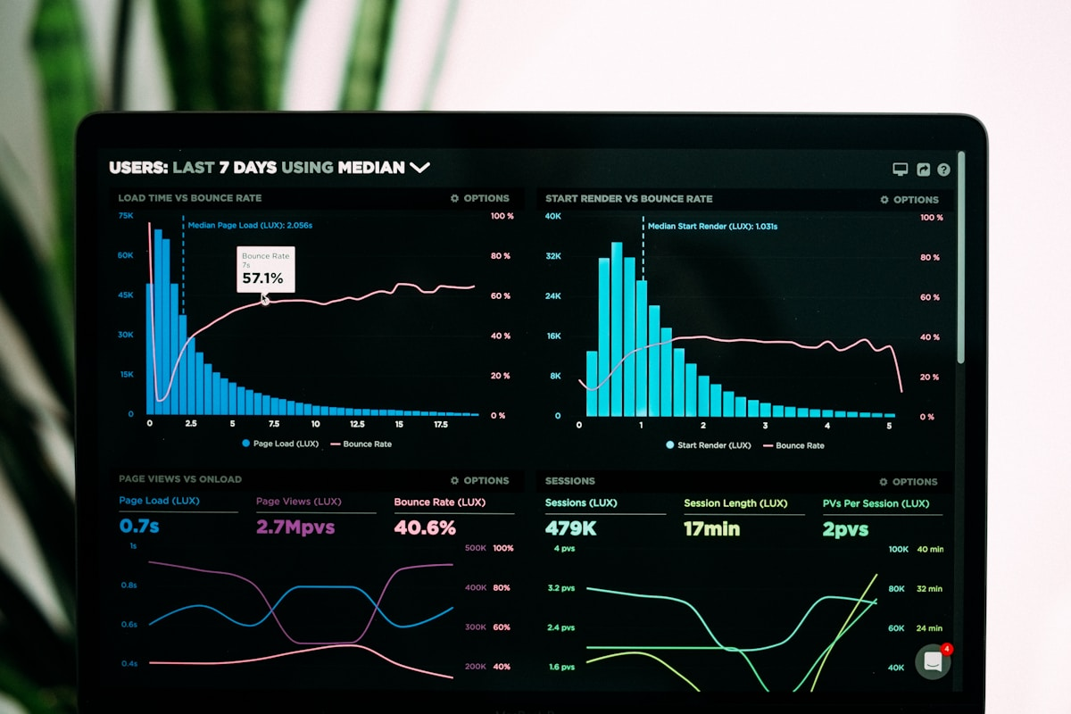
The Solution: Evaluation
Systematic measurement of agent quality.
Three types:
1. Metrics (numbers)
2. Automated checks (pass/fail)
3. Human evaluation (expert judgment)
Run continuously.
Use results to improve.

Slide 4
What is Evaluation?
Quality control for agents.
You ask:
• Does it work?
• Does it meet standards?
• Where does it fail?
• How do you improve it?
Evaluation answers these.
Unlike testing: evaluation measures goals achieved, not just code working.

Slide 5
Three Types of Evaluation
Metrics (quantitative):
Numbers: accuracy, latency, cost
Automated Checks (binary):
Pass/fail: glossary has 5+ terms?
Human Evaluation (qualitative):
Expert judgment: clarity? Rate 1-5
Use all three together.

Slide 6
The MEASURE Framework
M: Measure what matters
E: Explore failures
A: Assess root causes
S: Sum up health
U: Unblock improvements
R: Repeat
This loop never stops.
Continuous evaluation drives improvement.

Slide 7

Demo Time
Watch what happens:
1. I'll show an agent output
2. Ask: Is this good? How do I know?
3. Walk through evaluation
4. Show metrics and rubric
5. Make a decision
Don't worry about code yet.
Just watch the process.

Slide 8
Example: Pass Rate Metric
Definition:
pass_rate = (tests passed) / (total tests)
Example:
18 tests passed, 2 failed
pass_rate = 18/20 = 90%
Why it matters:
Tracks agent reliability
Watch for regressions

Slide 9

Example: Automated Check
Rule: Glossary must have 5+ terms
Logic:
if len(glossary) < 5:
fail
else:
pass
Why it matters:
Gate before publishing
Prevent incomplete content

Slide 10

Example: Human Evaluation Rubric
Dimension: Clarity
poor (1): Hard to understand
fair (2): Understandable, some confusion
good (3): Clear, easy to follow
excellent (4): Very clear, well-structured
Evaluator rates each output.
Average score = quality metric.

Slide 11
Building a Test Suite
Create test cases:
Test 1: Glossary generation
Input: recording transcript
Expected: 5+ terms with definitions
Test 2: Assignment creation
Input: learning outcomes
Expected: rubric with 3+ dimensions
Run all tests, collect results.

Slide 12
Real-World: Drawing Room Evaluation
Orchestrator metrics:
• % sessions pass QA gate
• Avg glossary size
• Assignment rubric completeness
• Publishing error rate
Checks:
• Output files exist
• No PII in content
• Metadata valid
Human: Review flagged items weekly

Slide 13

What Do Metrics Tell You?
Good news:
Metrics dropped -> problem signal
Bad news:
Metrics can mislead
Example: 95% accuracy but users unhappy
Always validate metrics against:
Human judgment
User feedback
Real-world impact

Slide 14
Live Build: Evaluator Setup
Create evaluation class.
Load agent output.
Prepare test data.
We'll build this together.

Slide 15
Step 1: Define Metrics
Pick 3 metrics:
1. pass_rate
2. avg_response_time
3. content_completeness
Define calculations for each.

Slide 16
Step 2: Write Checks
Write pass/fail rules:
1. Output not empty
2. No forbidden words
3. Matches expected schema
Each rule = safety check

Slide 17
Step 3: Build Test Suite
Create TestCase objects.
Define inputs + expected outputs.
Run each test.
Collect results.

Slide 18
Step 4: Run Evaluation
Calculate metrics from results.
Compare against baselines.
Identify failures.
Automated process.

Slide 19
Step 5: Interpret Results
Read metrics.
Compare vs threshold.
Make decision:
Pass? Deploy.
Fail? Investigate.

Slide 20
Your Turn: Design Evaluation
Scenario: Explanation Simplifier Agent
Your job:
1. Identify 3 metrics
2. Write 3 automated checks
3. Design human eval rubric
4. Set acceptance criteria
You have 15 minutes.
Instructor is here to help.

Slide 21
Tips for Design Success
1. Start with human judgment
Ask: What does good look like?
2. Derive metrics from that
What would good outputs share?
3. Write checks for obvious failures
What must never happen?
4. Set realistic thresholds
When is 'good enough' good enough?

Slide 22
The Improvement Loop
Week 1: Establish baseline metrics
Week 2: Improve prompts -> metrics go up
Week 3: New edge case found -> metrics drop
Week 4: Fix edge case -> metrics recover
This is healthy iteration.
Evaluation drives improvement.

Slide 23
Debrief Discussion
Think about:
1. How would you collect data for your metrics?
2. What's the hardest thing to measure?
3. What happens if a metric disagrees with human judgment?

Slide 24
Why Evaluation Matters
Without evaluation:
Flying blind, shipping broken agents
With evaluation:
Early problem detection
Data-driven improvement
Confidence in quality
Continuous iteration
Evaluation = how you ship good agents.

Slide 25
Drawing Room: Evaluation in Action
1. Orchestrator processes session
2. Evaluation suite runs
3. Metrics calculated
4. Checks verified
5. Human review gate
6. Decision: keep/rebuild/kill
7. Feedback loop improves next cycle

Slide 26

Key Takeaways
Evaluation measures agent quality
Use metrics + checks + human judgment
Run evaluation continuously
Use results to improve
Evaluation is how you ship good agents
You can evaluate your agents.
You just learned how.

Slide 27
Resources & Next Steps
Read:
Anthropic evaluation guide
Industry best practices
Try:
Build evaluation for your agent
Measure quality metrics
Act on results
Next: Deploy with confidence

Slide 28
Questions?
Ask anything:
• About evaluation?
• About your assignment?
• About Drawing Room?
• About metrics?
No question is too small.

Slide 29
You Just Learned Evaluation
You came in asking 'How do I know if my agent is good?'
You're leaving knowing:
✓ How to measure quality
✓ How to design evaluation
✓ How to improve systematically
You're ready to ship good agents.
See you next week!

