Slide 1
Development of an end-to-end demand forecasting pipeline for retail
Input DQ check
Шуб Сергей Алексеевич

Slide 2
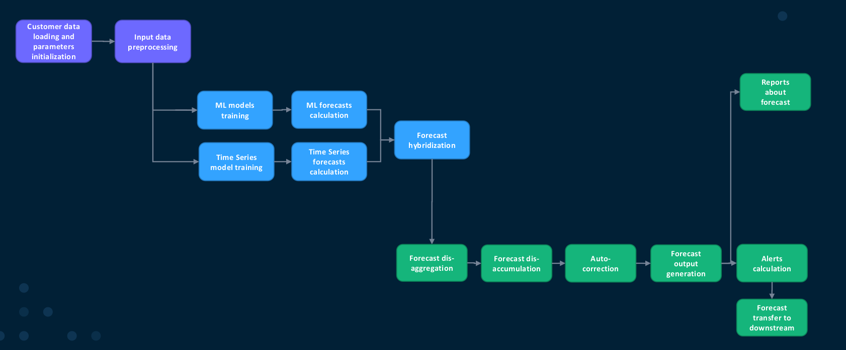
end-to-end demand forecasting process
What it does and why:
Check that required tables exist
Validate values are non-negative
Cross-check keys
Temporal cross-check
Why it’s needed: to prevent “broken” data from going further in the pipeline

Slide 3
Input data for the step
Set of tables
Numeric metrics
Keys and calendar
Client DDS tables in the IN_.(DPS_) format, which we validate for data quality
SALES_QTY, STOCK_QTY, SELL_IN_QTY, SELL_OUT_QTY, PRICE, PROMO_PRICE - non-negativity checks
PRODUCT_ID, LOCATION_ID, CUSTOMER_ID, DISTR_CHANNEL_ID, PERIOD_DT are the basis for cross-checks across relationships and time gaps.

Slide 4
Output data for the step
DATA_QUALITY_OUTPUT
PRODUCT_LVL_ID – идентификатор продукта, где найдена ошибка
LOCATION_LVL_ID – идентификатор локации (магазин/склад)
CUSTOMER_LVL_ID – идентификатор клиента (если применимо)
DISTR_CHANNEL_LVL_ID – идентификатор канала дистрибуции
PRODUCT_LVL / LOCATION_LVL / CUSTOMER_LVL / DISTR_CHANNEL_LVL – уровень иерархии, на котором зафиксирована ошибка
PERIOD_DT – дата или период, к которому относится ошибка
INPUT_TABLE – исходная таблица, из которой пришла проблемная строка
INPUT_COLUMN – столбец, в котором обнаружена проблема
INPUT_VALUE – проблемное значение или составной ключ
WARNING_TYPE – тип ошибки (например, NEGATIVE_VALUE, MISSING_KEY, TIME_CROSS_MISSING)
WARNING – краткое текстовое описание проблемы (для человека)

Slide 5
Live Demo

Slide 6
Conclusion
Conclusions: Implemented a DQ validation module for incoming DDS tables that automatically detects negative values, inconsistent keys, and temporal gaps between facts. Built a single consolidated output report, DATA_QUALITY_OUTPUT, where each row represents a specific issue with the object, period, table, and error type. Validated it on synthetic and real data; built aggregates and visualizations that show the distribution of issues by table and type and allow a quick “health check” of the dataset before model training.
How to improve the result: Add business-level DQ rules (thresholds for sales/prices, anomalous spike values). Move all thresholds and settings into a configuration table (DQ_PARAMETERS) and make the step fully configurable without code changes.

Slide 7
Development of an end-to-end demand forecasting pipeline for retail
Disaccumulation
Шуб Сергей Алексеевич

Slide 8
end-to-end demand forecasting process
What it does and why: Checks whether the current forecast time granularity differs from the target one. If it differs, splits intervals into days or weeks. Redistributes forecast values proportionally to the number of days in each new interval, preserving the total volume.
Why it’s needed: To produce a forecast at the time resolution required by downstream steps, without losing or distorting the original forecast volume.

Slide 9
Input data for the step
AGG_HYB_FCS…
Параметр конфигурации
Keys
time: PERIOD_DT–PERIOD_END_DT interval (usually a month)
forecast values: VF_FORECAST_VALUE, ML_FORECAST_VALUE, HYBRID_FORECAST_VALUE
DAY or WEEK.2, which defines the target time granularity

Slide 10
Output data for the step
ACC_AGG_HYBRID_FORECAST
PRODUCT_ID – product identifier for which the forecast is calculated LOCATION_ID – location identifier (store / warehouse) CUSTOMER_ID – customer identifier (if used in the mart) DISTR_CHANNEL_ID – distribution channel identifier PERIOD_DT – start of the interval in the target time granularity (DAY / WEEK.2) PERIOD_END_DT – end of the interval (for DAY it matches PERIOD_DT; for WEEK.2 it is the week end) VF_FORECAST_VALUE – disaggregated VF forecast volume for this interval ML_FORECAST_VALUE – disaggregated ML forecast volume for this interval HYBRID_FORECAST_VALUE – disaggregated hybrid forecast volume for this interval

Slide 11
Live Demo

Slide 12
Conclusion
Conclusions: Implemented a forecast disaggregation module that converts an aggregated forecast into the target time granularity (DAY / WEEK.2). Ensured correct allocation of values across days/weeks while preserving the total volume for each PRODUCT_ID–LOCATION_ID–… combination. Validated the module on synthetic data and built “before/after” visualizations demonstrating the correctness of the disaggregation.
How to improve the result: Add support for other time levels (e.g., 10-day periods, client financial weeks) and more flexible allocation logic (not only uniform by days, but also demand-weighted).

Slide 13
Link to github:
https://github.com/aromanenko/DFP/tree/Shub_Sergey_dqcheak%2Bdisaccumulation

