Slide 1
Digital Portfolio
STUDENT NAME: I.Aron Beautisha
REGISTER NO AND NMID: 222402329
DEPARTMENT: COMPUTER SCIENCE
COLLEGE:ST.JOSEPH’S COLLEGE(ARTS&SCIENCE)/
UNIVERSITY OF MADRAS

Slide 2
PROJECT TITLE
DIGITAL PORTFOLIO

Slide 3


AGENDA
Problem Statement
Project Overview
End Users
Tools and Technologies
Portfolio design and Layout
Features and Functionality
Results and Screenshots
Conclusion
Github Link
3/21/2024 Annual Review

Slide 4

PROBLEM STATEMENT
As a student, I face difficulty in presenting my skills, strengths, and achievements effectively through a traditional resume. There is no proper platform to showcase my technical knowledge, creativity, and personal qualities. I need a digital portfolio to represent my profile in a professional and interactive way.

Slide 5

PROJECT OVERVIEW
This project develops a student portfolio website that displays personal details, skills, strengths, and contact information in a structured and interactive way. It highlights expertise in web development, programming, and teamwork, while creating a professional digital identity.

Slide 6

WHO ARE THE END USERS?
1. Recruiters & Employers – To quickly evaluate skills, personality, and contact details
2. Peers/Team Members – To collaborate on projects by knowing expertise areas
3. Teachers & Mentors – To assess student’s progress and profile.

Slide 7

TOOLS AND TECHNIQUES
HTML : structure the webpage content
CSS : style the webpage( color , layout, buttons)
JAVASCRIPT :Interactive(navigation menu, animations)

Slide 8
POTFOLIO DESIGN AND LAYOUT
SECTIONS INCLUDED:
PROFILEIMAGE
ABOUT ME
SKILLS
STRENGHTS
WEEKNESS
CONTACT
8

Slide 9
FEATURES AND FUNCTIONALITY
Dark/Light Mode Toggle → improves user experience with switching themes
Navigation Buttons → Smooth scrolling to different sections (Skills, Strengths & Weaknesses, Contact).
Responsive Design → Adjusts for different screen sizes (desktop, laptop, mobile).
Clickable Contact Links → Phone (click to copy) and Email (direct email link).
User-Friendly Layout → Simple and professional look for recruiters.

Slide 10
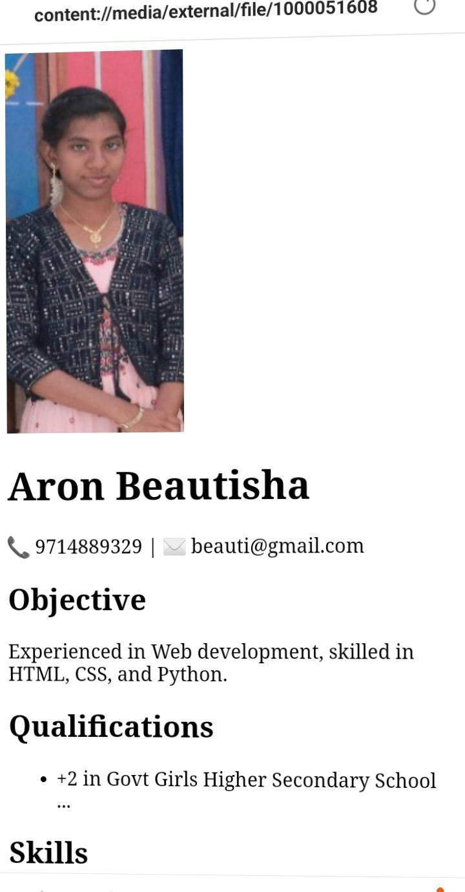

RESULTS AND SCREENSHOTS
3/21/2024 Annual Review
10

Slide 11
CONCLUSION
This portfolio highlights my learning, skills, and growth. I am confident that these experiences will guide me in achieving my future goals.
11

