Slide 1

My favorite app

Slide 2
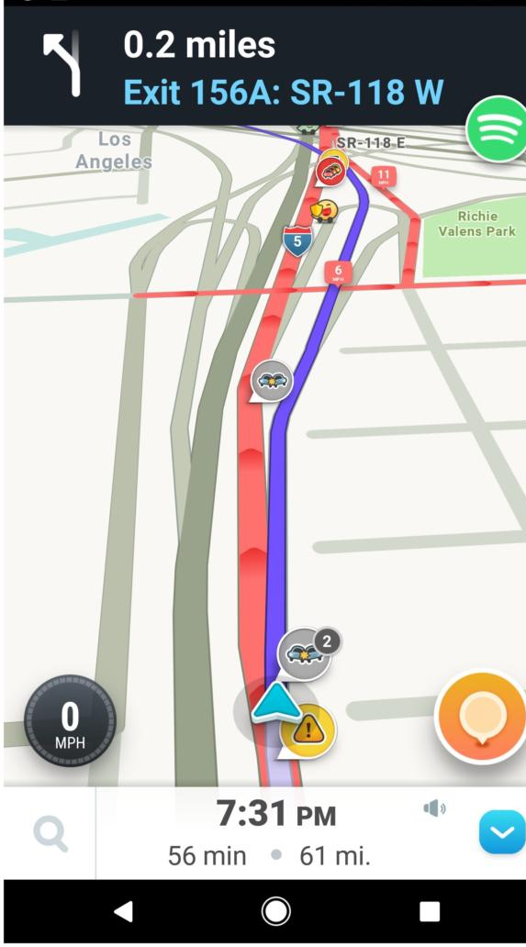
https://images.techhive.com/images/article/2017/04/waze-navigation-100718398-large.jpg

Slide 3
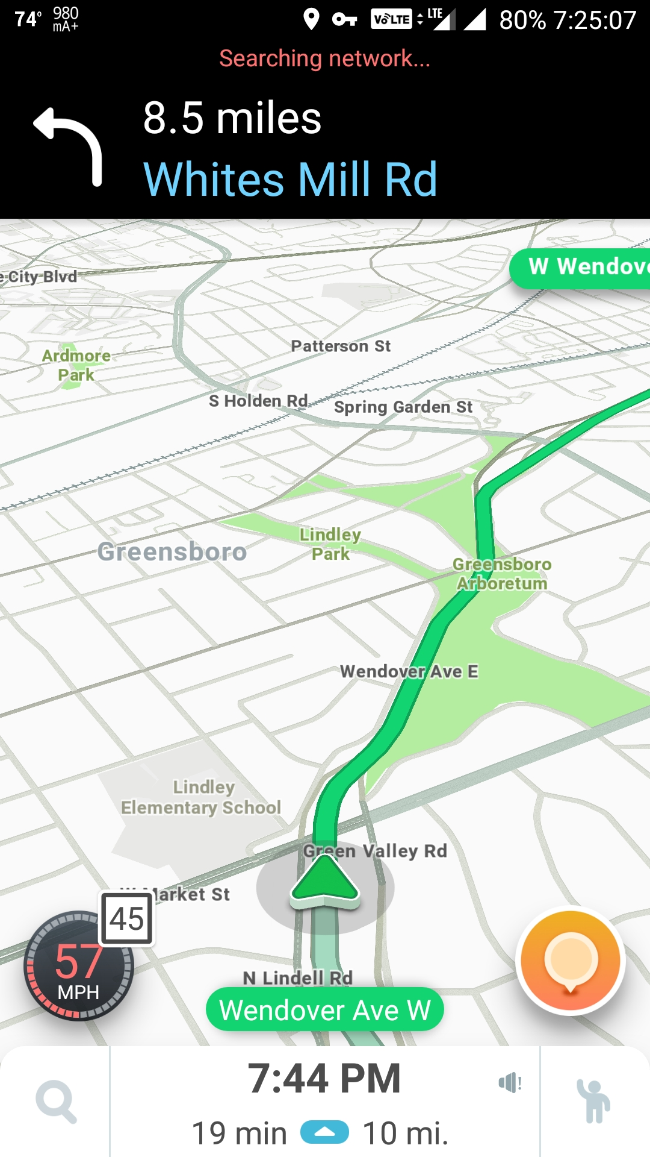
https://i.imgur.com/FWs3Zpl.jpg

Slide 4
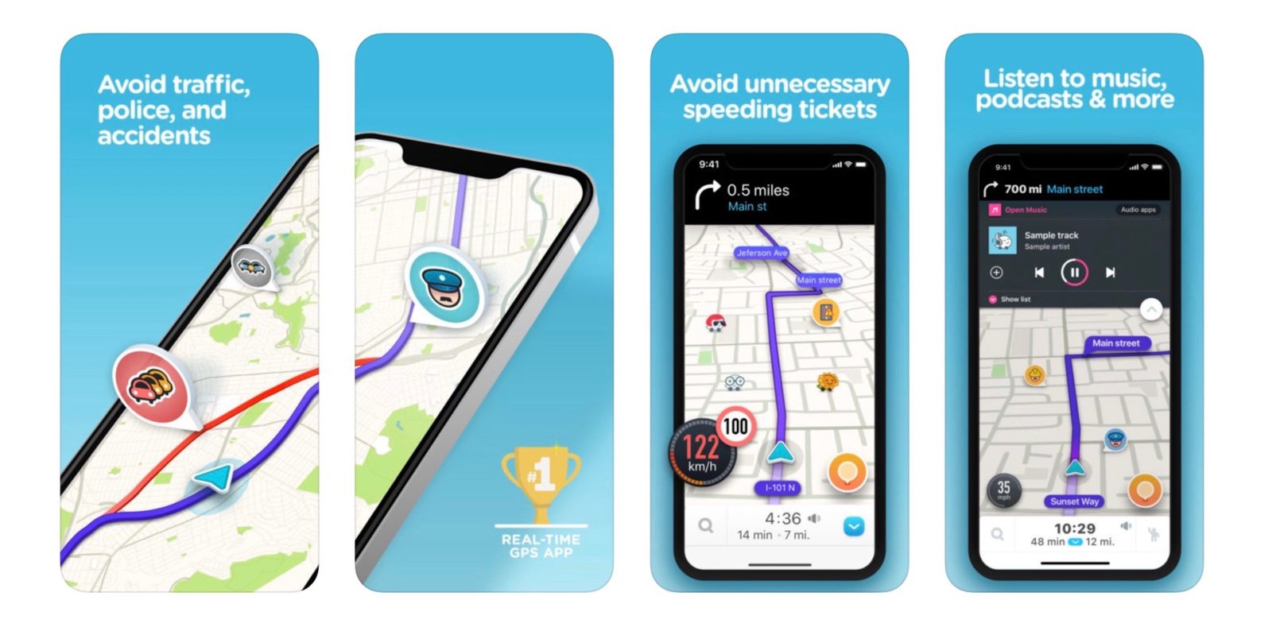
I like it because…
https://9to5mac.com/wp-content/uploads/sites/6/2019/02/waze-ios-app.jpeg?quality=82&strip=all&w=1600

Slide 5
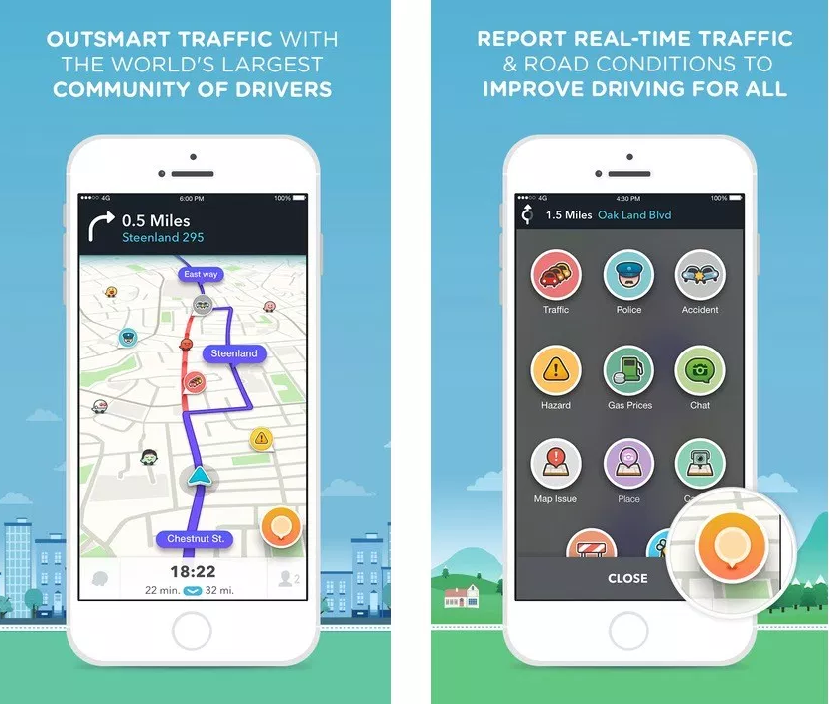
https://i1.wp.com/geoawesomeness.com/wp-content/uploads/2015/10/Waze-4.0-iOS-Geoawesomeness.jpg?ssl=1

Slide 6
My favorite app is Waze, I like it because it’s easy to use and it’s very helpful whenever I go to places that I haven’t been through. You can also use this app to see the traffic of the road that you will be taking before leaving your house and it will work even though you lost your internet connection while traveling. It estimates the time travel according to your speed and the distance of your destination.
I’ve been using this app since I learned how to drive, it’s almost 2 years. I’m still using it until now because it has features like police report, if there’s any that you will encounter, traffic reports, accident reports, and many more. These traffic conditions are reported by other users. You can also see other fast food chain that you will pass, so this will help you to foresee the conditions ahead of you.

