Slide 1


Java – Logic Day 01
Ver. 0.1

Slide 2
Day 01
1
What is JSP

Slide 3
What is JSP
JSP technology is used to create web application just like Servlet technology. It can be thought of as an extension to Servlet because it provides more functionality than servlet such as expression language, JSTL, etc.
A JSP page consists of HTML tags and JSP tags. The JSP pages are easier to maintain than Servlet because we can separate designing and development. It provides some additional features such as Expression Language, Custom Tags, etc.

Slide 4
Advantages of JSP over Servlet
There are many advantages of JSP over the Servlet. They are as follows :
1) Extension to Servlet
JSP technology is the extension to Servlet technology. We can use all the features of the Servlet in JSP. In addition to, we can use implicit objects, predefined tags, expression language and Custom tags in JSP, that makes JSP development easy.
2) Easy to maintain
JSP can be easily managed because we can easily separate our business logic with presentation logic. In Servlet technology, we mix our business logic with the presentation logic.
3) Fast Development: No need to recompile and redeploy
If JSP page is modified, we don't need to recompile and redeploy the project. The Servlet code needs to be updated and recompiled if we have to change the look and feel of the application.
4) Less code than Servlet
In JSP, we can use many tags such as action tags, JSTL, custom tags, etc. that reduces the code. Moreover, we can use EL, implicit objects, etc.

Slide 5
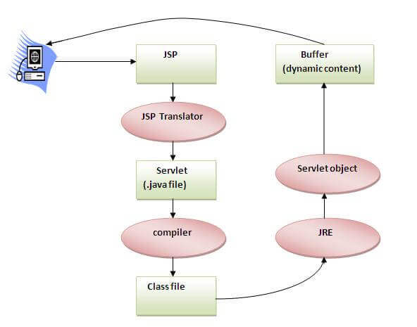
The Lifecycle of a JSP Page
The JSP pages follow these phases:
Translation of JSP Page
Compilation of JSP Page
Classloading (the classloader loads class file)
Instantiation (Object of the Generated Servlet is created).
Initialization ( the container invokes jspInit() method).
Request processing ( the container invokes _jspService() method).
Destroy ( the container invokes jspDestroy() method).

Slide 6
Day 01
2
Creating New JSP

Slide 7
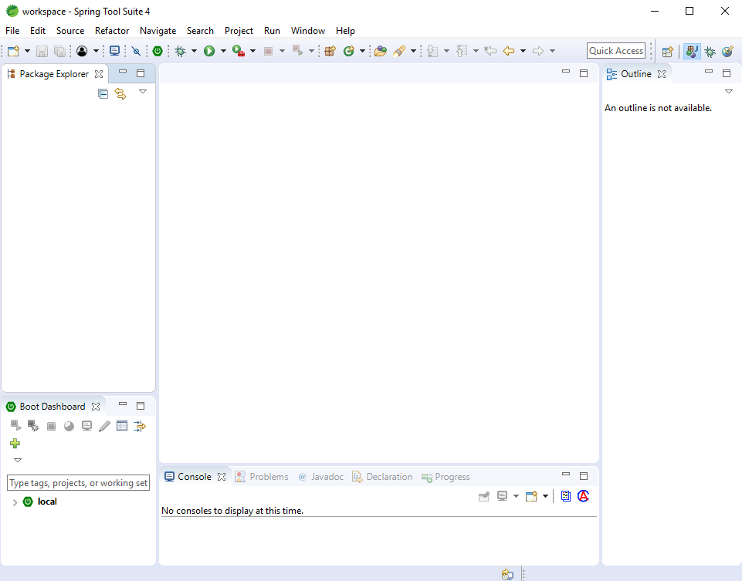
Open STS

Slide 8
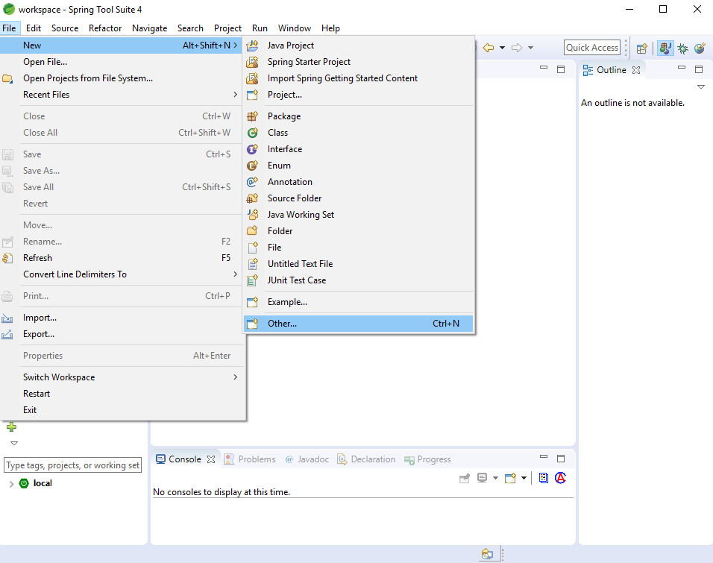
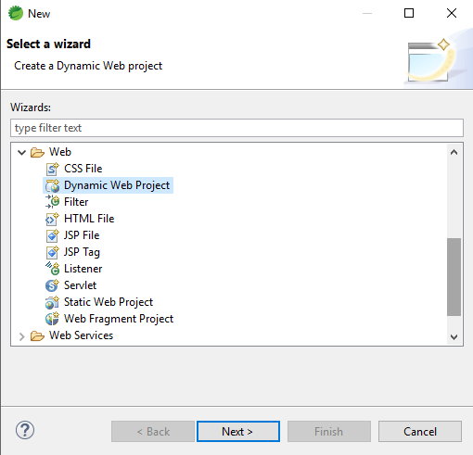
New Project
File -> New -> Other

Slide 9
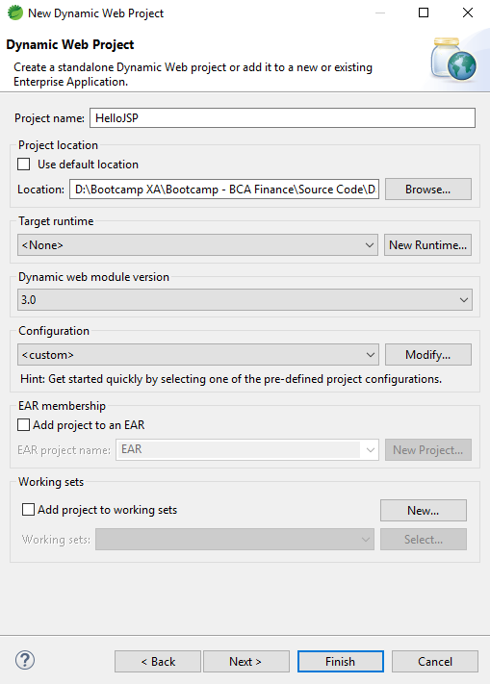
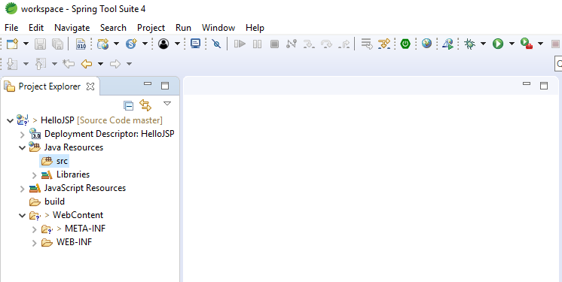
New Project
Create Project HelloJSP, and create new folder with name HelloJSP at custome location in your drives

Slide 10
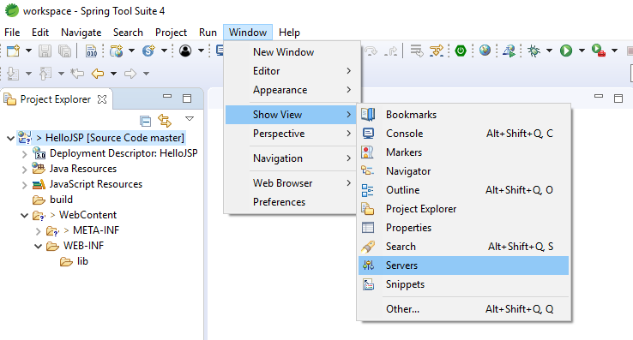
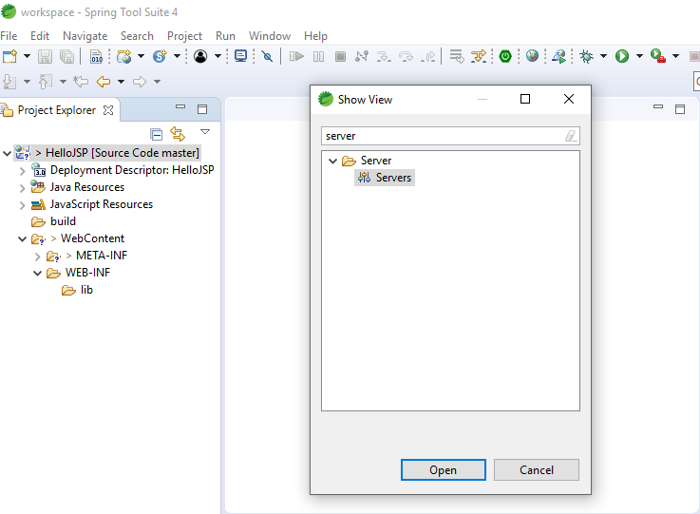
Setting Server
Window -> Show View -> Server
Window -> Show View -> Other -> Server

Slide 11
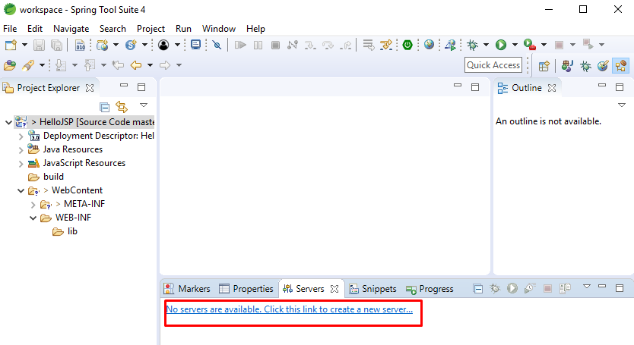
Setting Server
Click Server

Slide 12
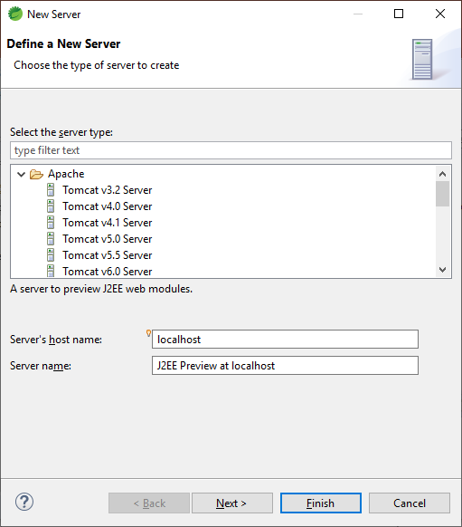
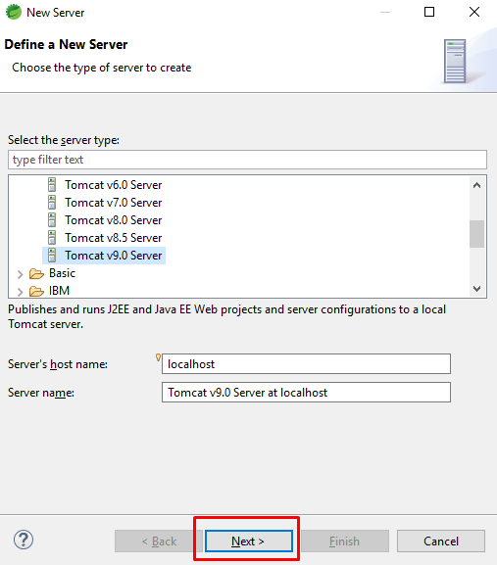
Setting Server
Select Server on New Server Dialog

Slide 13
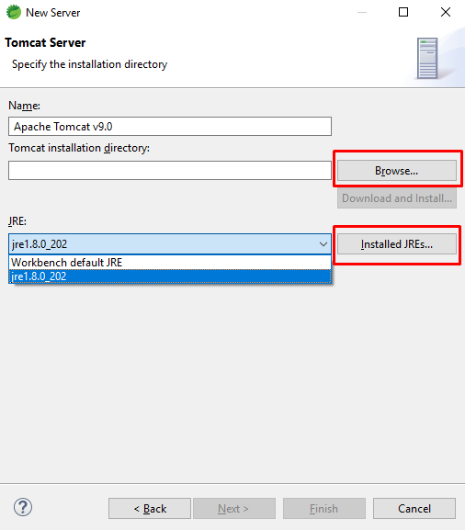
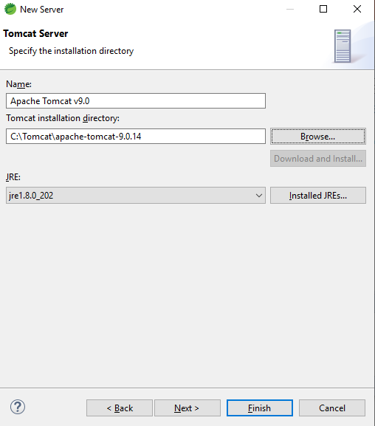
Setting Server
Select tomcat server :

Slide 14
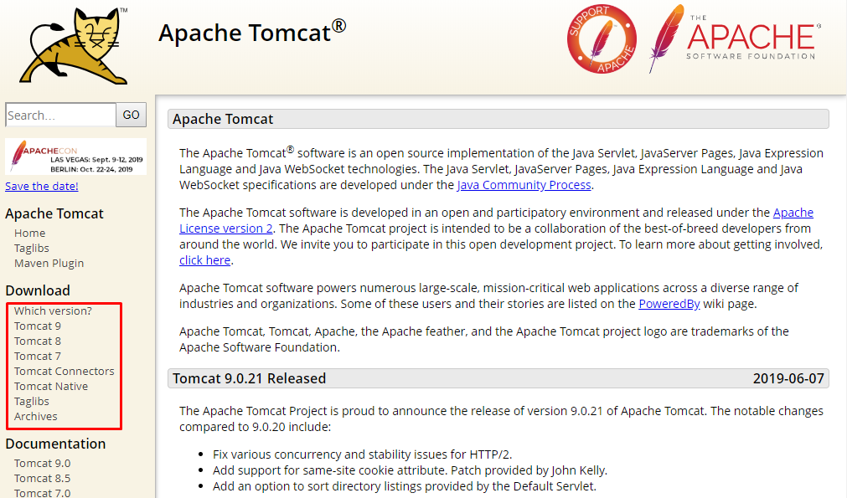
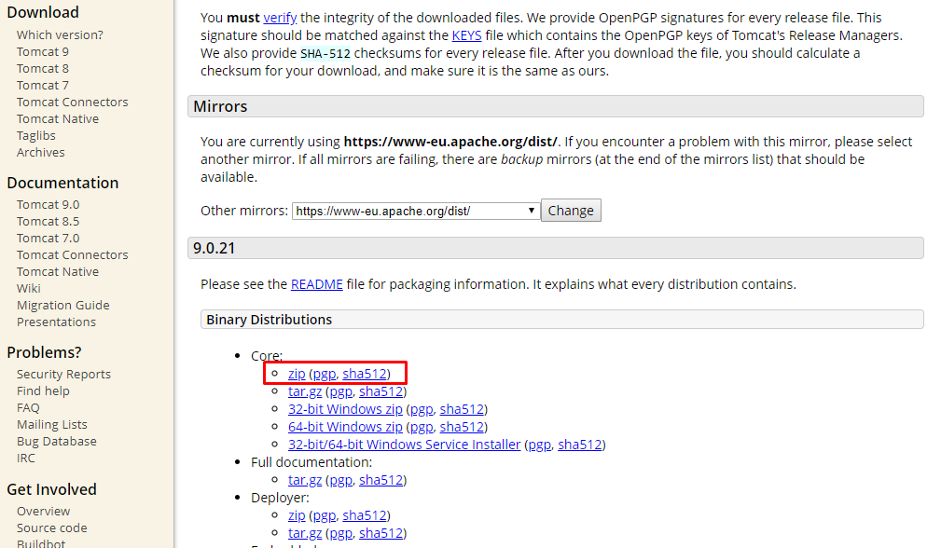
Download Tomcat Server
https://tomcat.apache.org/download-90.cgi

Slide 15
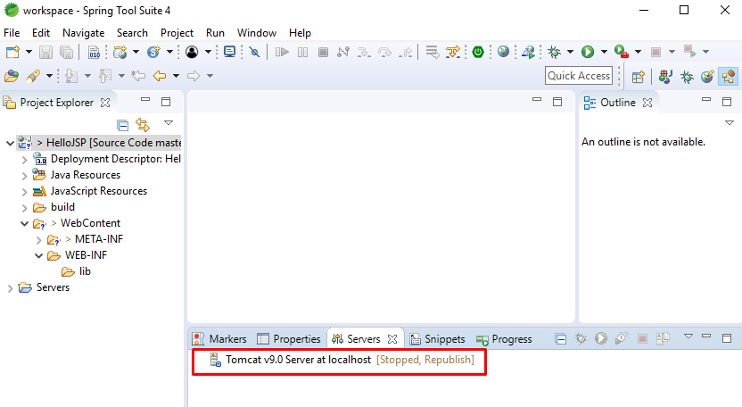
Setting Server

Slide 16
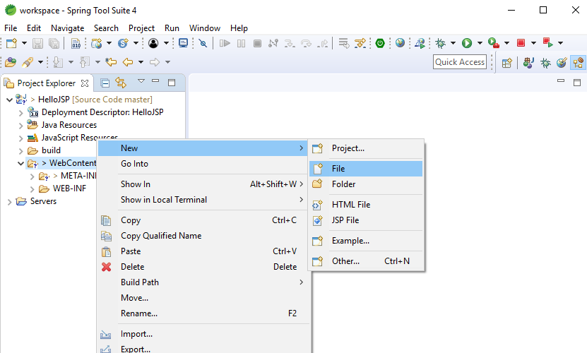
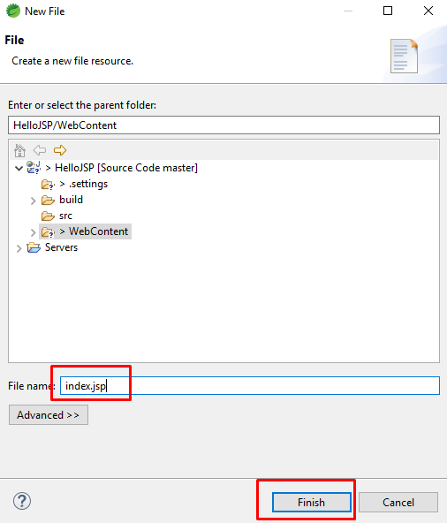
Creating New JSP
Folder WebContent -> Righ Click -> New -> File
Index.jsp

Slide 17
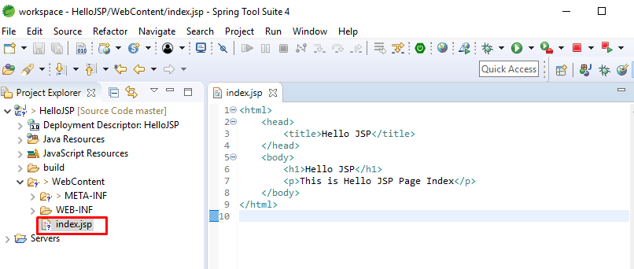
Creating New JSP
Create web page using html

Slide 18
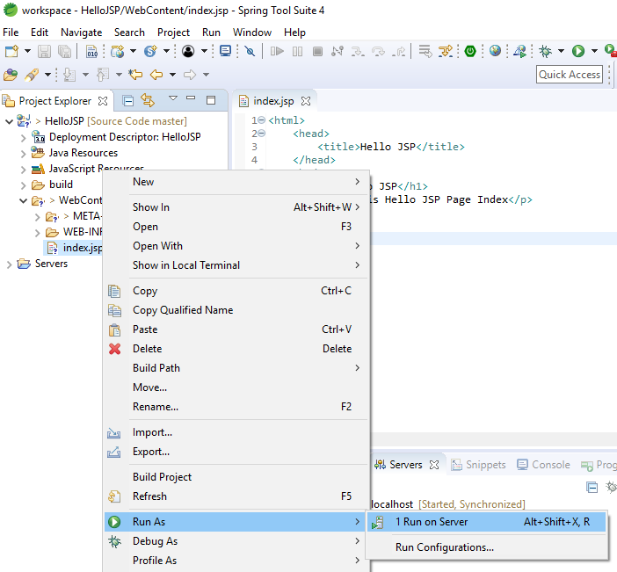
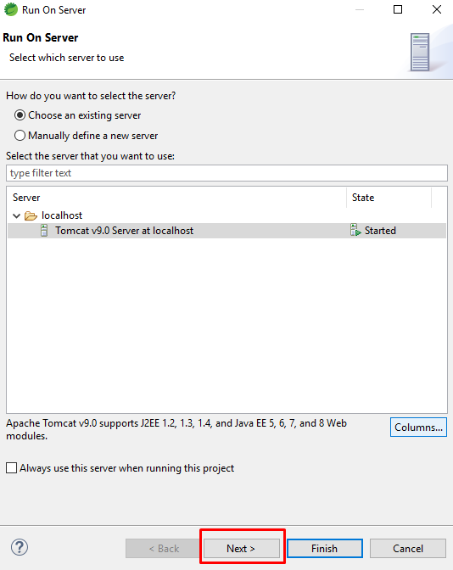
Running JSP on Server
Right click on index.jsp -> Run As -> Run On Server

Slide 19
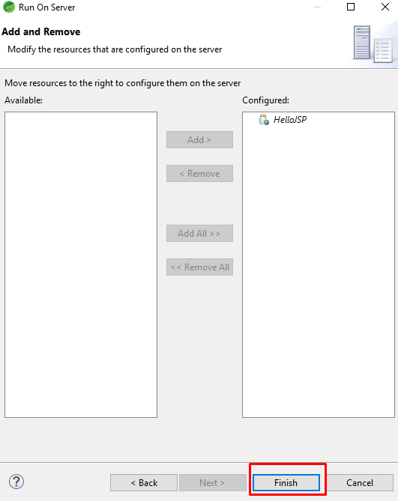
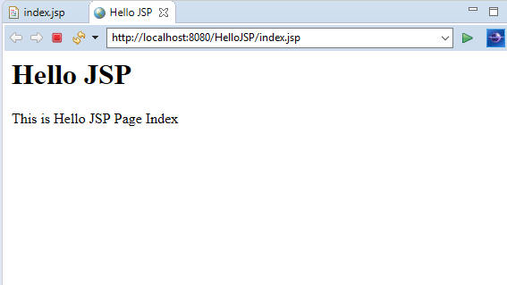
Running JSP on Server
Finish to show web page
Web Page

Slide 20
Day 01
3
JSP Scripting elements

Slide 21
JSP Scripting elements
The scripting elements provides the ability to insert java code inside the jsp. There are three types of scripting elements:
scriptlet tag
expression tag
declaration tag
Scriptlet tag
Expression tag
Declaration Tag

Slide 22
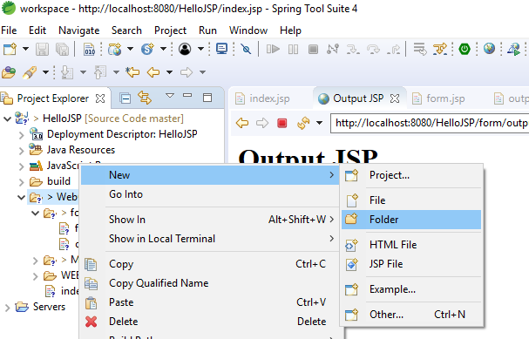
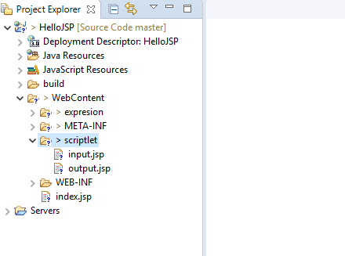
Scriptlet Tag
Right Click -> New -> Folder
WebContext -> scriptlet

Slide 23
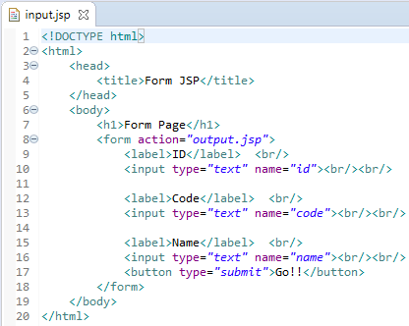
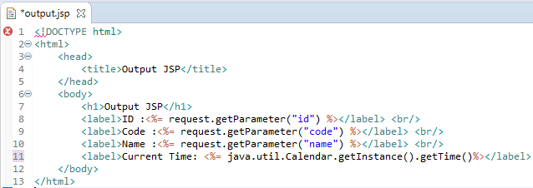
Scriptlet Tag
Script HTML input.jsp
Script HTML output.jsp

Slide 24
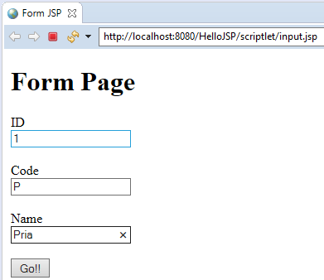
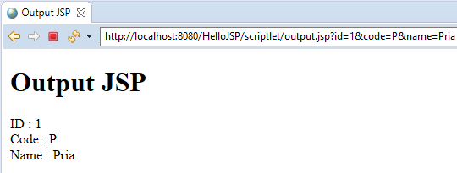
Scriptlet Tag
Web Page input.jsp
Web Page output.jsp

Slide 25
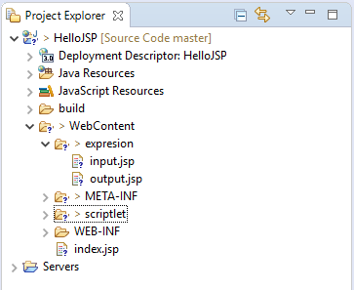
Expression Tag
Right Click -> New -> Folder
WebContext -> expression

Slide 26
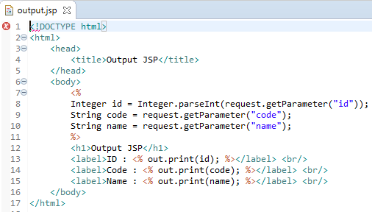
Expression Tag
Script HTML input.jsp
Script HTML output.jsp

Slide 27
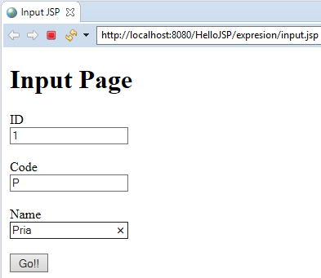
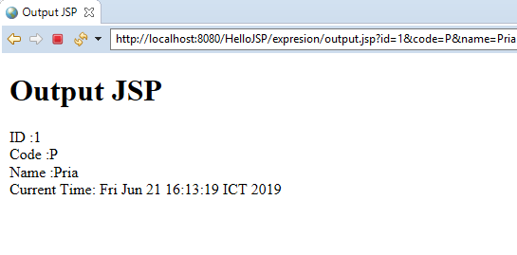
Expression Tag
Web Page input.jsp
Web Page output.jsp

Slide 28
Declaration Tag
The JSP declaration tag is used to declare fields and methods.
The code written inside the jsp declaration tag is placed outside the service() method of auto generated servlet.
So it doesn't get memory at each request.
Declaration Tag vs. Scriptlet Tag
Sciptlet Tag
The jsp scriptlet tag can only declare variables not methods.
The declaration of scriptlet tag is placed inside the _jspService() method.
Declaration Tag
The jsp declaration tag can declare variables as well as methods.
The declaration of jsp declaration tag is placed outside the _jspService() method.

Slide 29
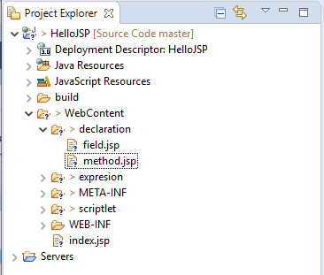
Declaration Tag
Right Click -> New -> Folder
WebContext -> declaration

Slide 30
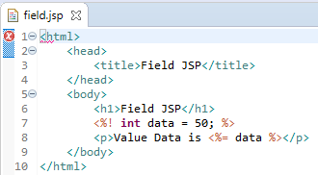
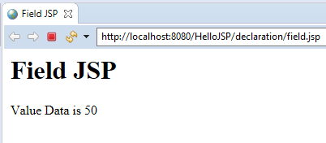
Declaration Tag
Script HTML field.jsp
Web page field.jsp

Slide 31
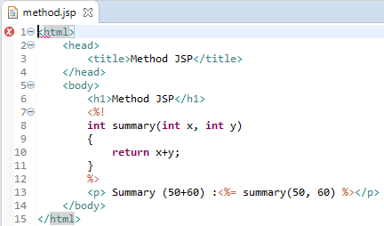
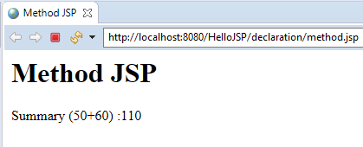
Declaration Tag
Script HTML method.jsp
Web page method.jsp

Slide 32
Day 01
4
HTML Practice

Slide 33
w3schools
To improve your skill about HTML, please visit this web.
www.w3schools.com/html

Slide 34
Day 01
5
HTML Practice

Slide 35
JSP request implicit object
The JSP request is an implicit object of type HttpServletRequest i.e. created for each jsp request by the web container. It can be used to get request information such as parameter, header information, remote address, server name, server port, content type, character encoding etc.
It can also be used to set, get and remove attributes from the jsp request scope.
Let's see the simple example of request implicit object where we are printing the name of the user with welcome message.

Slide 36
Sample Request
Input.jsp
Output.jsp

Slide 37
GOOD LUCK!

Slide 38
THANKS!
Any questions?
Contact Your Trainer

