Slide 1


Java – Logic Day 01
Ver. 0.1

Slide 2
Day 01
1
What is JSP

Slide 3
What is JSP
JSP technology is used to create web application just like Servlet technology. It can be thought of as an extension to Servlet because it provides more functionality than servlet such as expression language, JSTL, etc.
A JSP page consists of HTML tags and JSP tags. The JSP pages are easier to maintain than Servlet because we can separate designing and development. It provides some additional features such as Expression Language, Custom Tags, etc.

Slide 4
Advantages of JSP over Servlet
There are many advantages of JSP over the Servlet. They are as follows :
1) Extension to Servlet
JSP technology is the extension to Servlet technology. We can use all the features of the Servlet in JSP. In addition to, we can use implicit objects, predefined tags, expression language and Custom tags in JSP, that makes JSP development easy.
2) Easy to maintain
JSP can be easily managed because we can easily separate our business logic with presentation logic. In Servlet technology, we mix our business logic with the presentation logic.
3) Fast Development: No need to recompile and redeploy
If JSP page is modified, we don't need to recompile and redeploy the project. The Servlet code needs to be updated and recompiled if we have to change the look and feel of the application.
4) Less code than Servlet
In JSP, we can use many tags such as action tags, JSTL, custom tags, etc. that reduces the code. Moreover, we can use EL, implicit objects, etc.

Slide 5
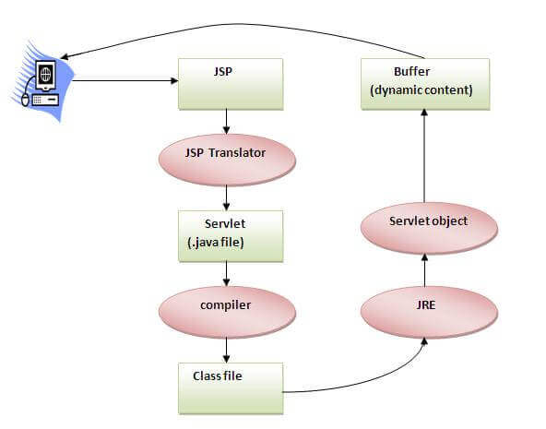
The Lifecycle of a JSP Page
The JSP pages follow these phases:
Translation of JSP Page
Compilation of JSP Page
Classloading (the classloader loads class file)
Instantiation (Object of the Generated Servlet is created).
Initialization ( the container invokes jspInit() method).
Request processing ( the container invokes _jspService() method).
Destroy ( the container invokes jspDestroy() method).

Slide 6
Java Platforms / Editions
1) Java SE (Java Standard Edition)
It is a Java programming platform. It includes Java programming APIs such as java.lang, java.io, java.net, java.util, java.sql, java.math etc. It includes core topics like OOPs, String, Regex, Exception, Inner classes, Multithreading, I/O Stream, Networking, AWT, Swing, Reflection, Collection, etc.
2) Java EE (Java Enterprise Edition)
It is an enterprise platform which is mainly used to develop web and enterprise applications. It is built on the top of the Java SE platform. It includes topics like Servlet, JSP, Web Services, EJB, JPA, etc.
3) Java ME (Java Micro Edition)
It is a micro platform which is mainly used to develop mobile applications.
4) JavaFX
It is used to develop rich internet applications. It uses a light-weight user interface API.

Slide 7
Day 01
2
Features of Java

Slide 8
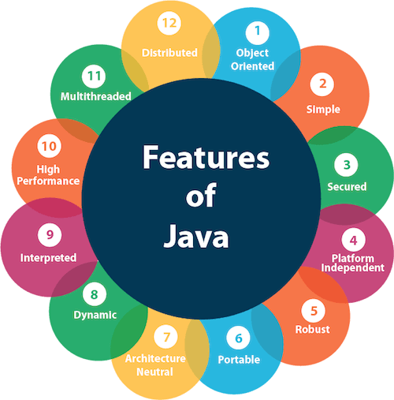
Features of Java
The primary objective of Java programming language creation was to make it portable, simple and secure programming language. Apart from this, there are also some excellent features which play an important role in the popularity of this language. The features of Java are also known as java buzzwords.

Slide 9
Feature Of Java
Simple
Java is very easy to learn, and its syntax is simple, clean and easy to understand. According to Sun, Java language is a simple programming language because:
Java syntax is based on C++ (so easier for programmers to learn it after C++).
Java has removed many complicated and rarely-used features, for example, explicit pointers, operator overloading, etc.
There is no need to remove unreferenced objects because there is an Automatic Garbage Collection in Java.

Slide 10
Feature Of Java
Object-oriented
Java is an object-oriented programming language. Everything in Java is an object. Object-oriented means we organize our software as a combination of different types of objects that incorporates both data and behavior.
Object-oriented programming (OOPs) is a methodology that simplifies software development and maintenance by providing some rules.
Basic concepts of OOPs are:
Object
Class
Inheritance
Polymorphism
Abstraction
Encapsulation

Slide 11
Feature Of Java
Platform Independent
Java is platform independent because it is different from other languages like C, C++, etc. which are compiled into platform specific machines while Java is a write once, run anywhere language. A platform is the hardware or software environment in which a program runs.
There are two types of platforms software-based and hardware-based. Java provides a software-based platform.
The Java platform differs from most other platforms in the sense that it is a software-based platform that runs on the top of other hardware-based platforms. It has two components:
Runtime Environment
API(Application Programming Interface)
Java code can be run on multiple platforms, for example, Windows, Linux, Sun Solaris, Mac/OS, etc. Java code is compiled by the compiler and converted into bytecode. This bytecode is a platform-independent code because it can be run on multiple platforms, i.e., Write Once and Run Anywhere(WORA).

Slide 12
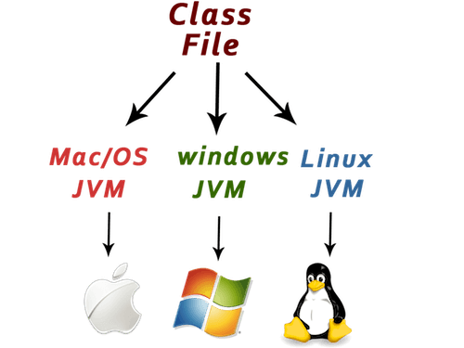
Feature Of Java

Slide 13
Feature Of Java
Secured
Java is best known for its security. With Java, we can develop virus-free systems. Java is secured because:
No explicit pointer
Java Programs run inside a virtual machine sandbox
Classloader: Classloader in Java is a part of the Java Runtime Environment(JRE) which is used to load Java classes into the Java Virtual Machine dynamically. It adds security by separating the package for the classes of the local file system from those that are imported from network sources.
Bytecode Verifier: It checks the code fragments for illegal code that can violate access right to objects.
Security Manager: It determines what resources a class can access such as reading and writing to the local disk.
Java language provides these securities by default. Some security can also be provided by an application developer explicitly through SSL, JAAS, Cryptography, etc.

Slide 14
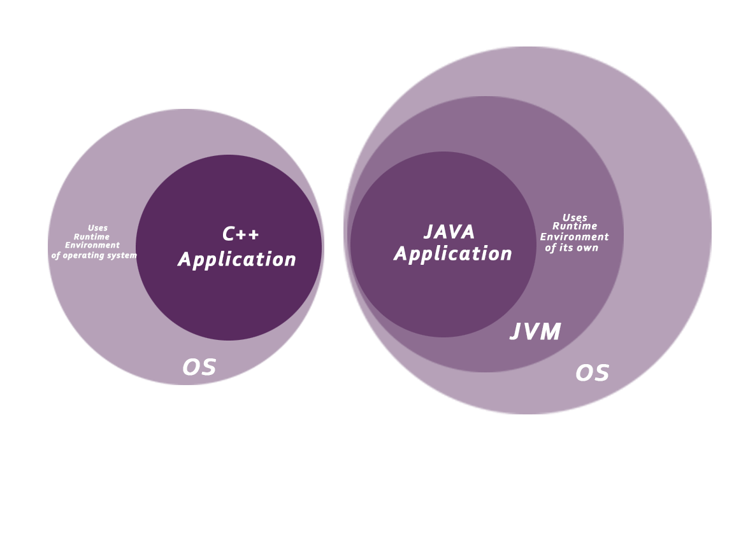
Feature Of Java

Slide 15
Feature Of Java
Robust
Robust simply means strong. Java is robust because:
It uses strong memory management.
There is a lack of pointers that avoids security problems.
There is automatic garbage collection in java which runs on the Java Virtual Machine to get rid of objects which are not being used by a Java application anymore.
There are exception handling and the type checking mechanism in Java. All these points make Java robust.

Slide 16
Feature Of Java
Architecture-neutral
Java is architecture neutral because there are no implementation dependent features, for example, the size of primitive types is fixed.
In C programming, int data type occupies 2 bytes of memory for 32-bit architecture and 4 bytes of memory for 64-bit architecture. However, it occupies 4 bytes of memory for both 32 and 64-bit architectures in Java.
Portable
Java is portable because it facilitates you to carry the Java bytecode to any platform. It doesn't require any implementation.
High-performance
Java is faster than other traditional interpreted programming languages because Java bytecode is "close" to native code. It is still a little bit slower than a compiled language (e.g., C++). Java is an interpreted language that is why it is slower than compiled languages, e.g., C, C++, etc.

Slide 17
Feature Of Java
Distributed
Java is distributed because it facilitates users to create distributed applications in Java. RMI and EJB are used for creating distributed applications. This feature of Java makes us able to access files by calling the methods from any machine on the internet.
Multi-threaded
A thread is like a separate program, executing concurrently. We can write Java programs that deal with many tasks at once by defining multiple threads. The main advantage of multi-threading is that it doesn't occupy memory for each thread. It shares a common memory area. Threads are important for multi-media, Web applications, etc.
Dynamic
Java is a dynamic language. It supports dynamic loading of classes. It means classes are loaded on demand. It also supports functions from its native languages, i.e., C and C++.
Java supports dynamic compilation and automatic memory management (garbage collection).

Slide 18
Day 01
3
JDK, JRE, and JVM

Slide 19
JVM
JVM (Java Virtual Machine) is an abstract machine. It is called a virtual machine because it doesn't physically exist. It is a specification that provides a runtime environment in which Java bytecode can be executed. It can also run those programs which are written in other languages and compiled to Java bytecode.
JVMs are available for many hardware and software platforms. JVM, JRE, and JDK are platform dependent because the configuration of each OS is different from each other. However, Java is platform independent. There are three notions of the JVM: specification, implementation, and instance.
The JVM performs the following main tasks:
Loads code
Verifies code
Executes code
Provides runtime environment

Slide 20
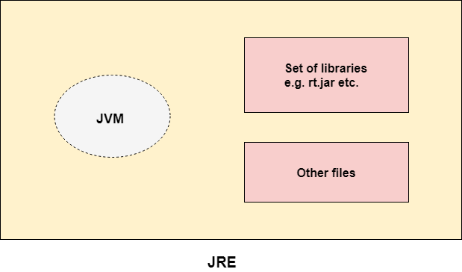
JRE
JRE is an acronym for Java Runtime Environment. It is also written as Java RTE. The Java Runtime Environment is a set of software tools which are used for developing Java applications. It is used to provide the runtime environment. It is the implementation of JVM. It physically exists. It contains a set of libraries + other files that JVM uses at runtime.
The implementation of JVM is also actively released by other companies besides Sun Micro Systems.

Slide 21
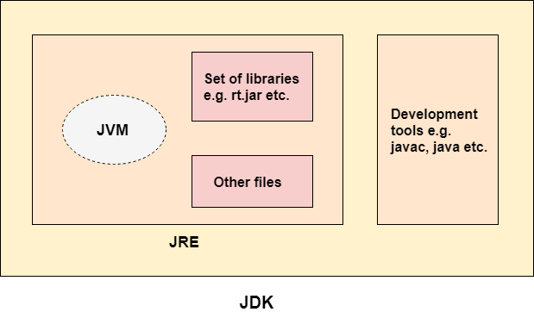
JDK
JDK is an acronym for Java Development Kit. The Java Development Kit (JDK) is a software development environment which is used to develop Java applications and applets. It physically exists. It contains JRE + development tools.
JDK is an implementation of any one of the below given Java Platforms released by Oracle Corporation:
Standard Edition Java Platform
Enterprise Edition Java Platform
Micro Edition Java Platform
The JDK contains a private Java Virtual Machine (JVM) and a few other resources such as an interpreter/loader (java), a compiler (javac), an archiver (jar), a documentation generator (Javadoc), etc. to complete the development of a Java Application

Slide 22
Day 01
4
Hello World

Slide 23
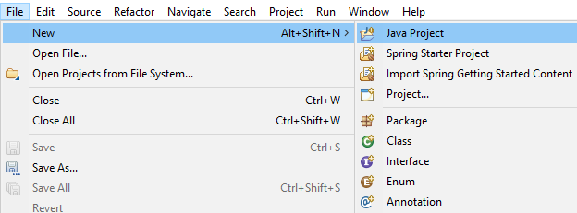
Create New Project
Open STS or Eclipse, then create new project,
File -> New -> Java Project

Slide 24
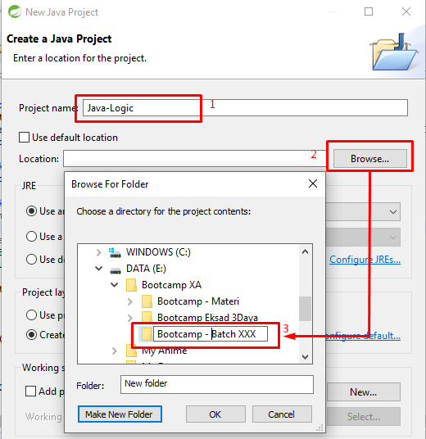
Create New Project
1. Fill then name project “Java Logic”
2. Find your location to put your java project
3. Create folder or directory
4. Clik OK.

Slide 25
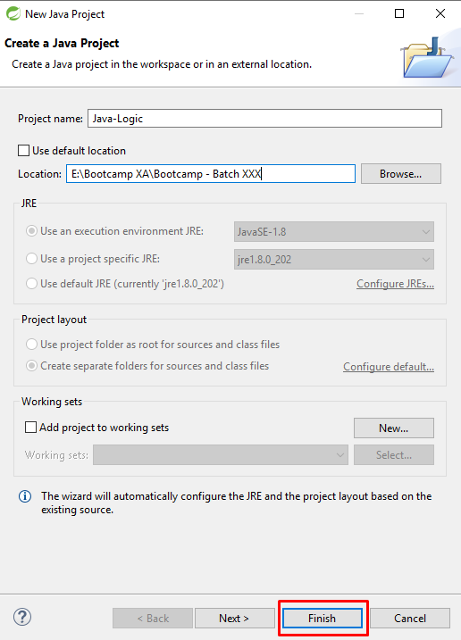
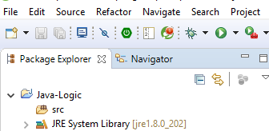
Create New Project

Slide 26
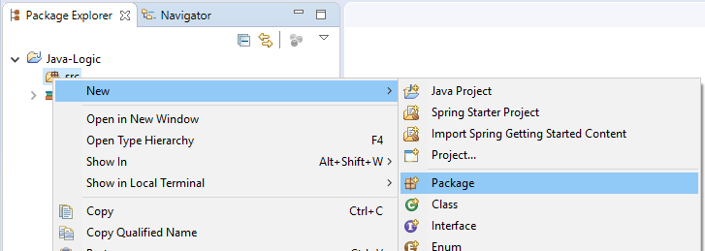
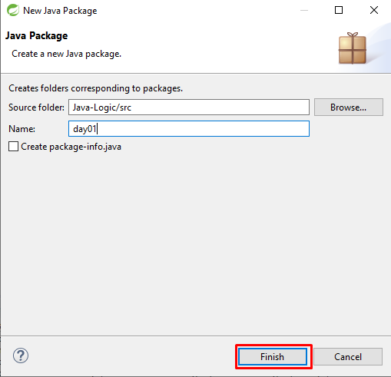
New Package
Righ Click on src -> New -> Package
Create Package day01

Slide 27
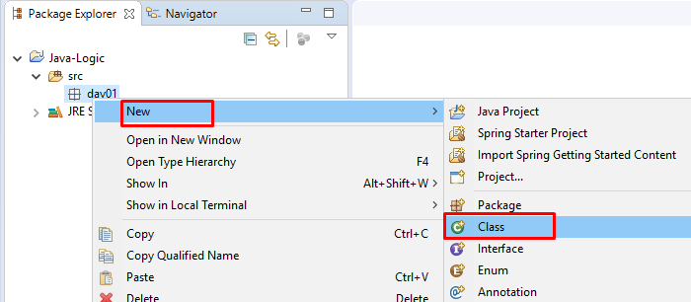
Create New Class
Right Click on package day01 -> new -> class

Slide 28
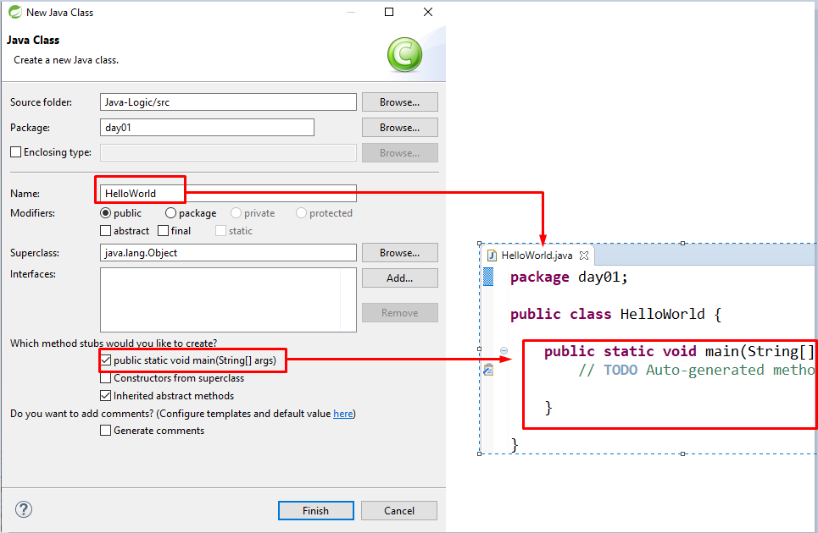
Create New Class
Create class name HelloWorld

Slide 29
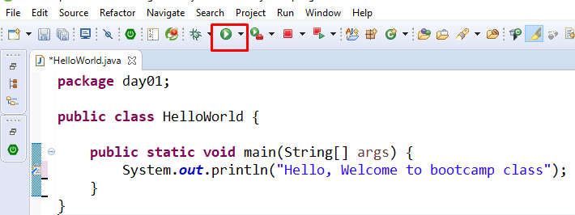
Create Hello World
Type source code below on your editor and then run your code with click read mark.

Slide 30
Day 01
5
Basic Syntax

Slide 31
Java – Basic Syntax
Case Sensitivity − Java is case sensitive.
Class Names − For all class names the first letter should be in Upper Case. If several words are used to form a name of the class, each inner word's first letter should be in Upper Case.
Method Names − All method names should start with a Lower Case letter. If several words are used to form the name of the method, then each inner word's first letter should be in Upper Case.
Program File Name − Name of the program file should exactly match the class name.
public static void main(String args[]) − Java program processing starts from the main() method which is a mandatory part of every Java program.

Slide 32
Java – Identifier
Names used for classes, variables, and methods are called identifiers.
Rule of identifier :
All identifiers should begin with a letter (A to Z or a to z), currency character ($) or an underscore (_).
After the first character, identifiers can have any combination of characters.
A key word cannot be used as an identifier.
Most importantly, identifiers are case sensitive.
Examples of legal identifiers: age, $salary, _value, __1_value.
Examples of illegal identifiers: 123abc, -salary.

Slide 33
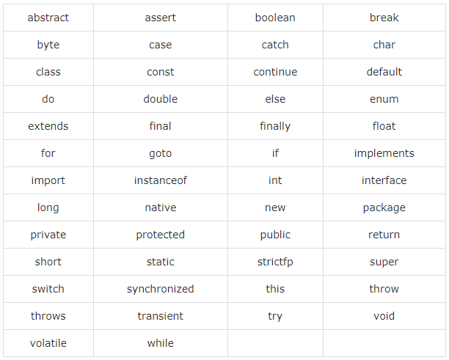
Java - Keyword

Slide 34
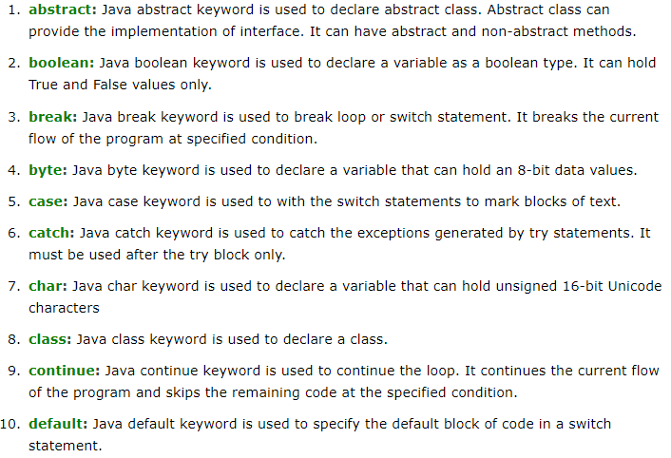
Java - Keyword

Slide 35
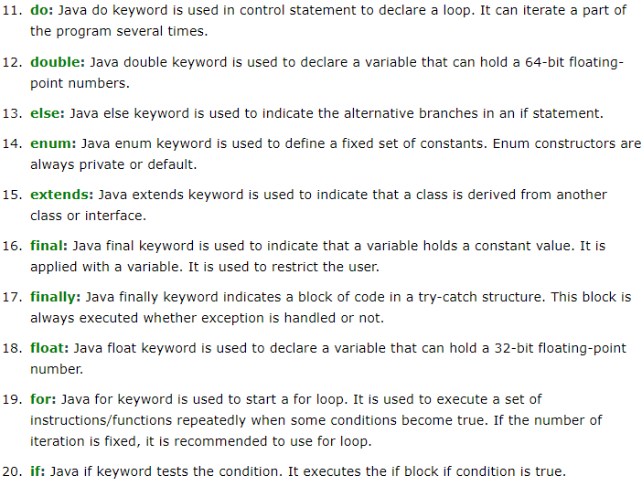
Java - Keyword

Slide 36
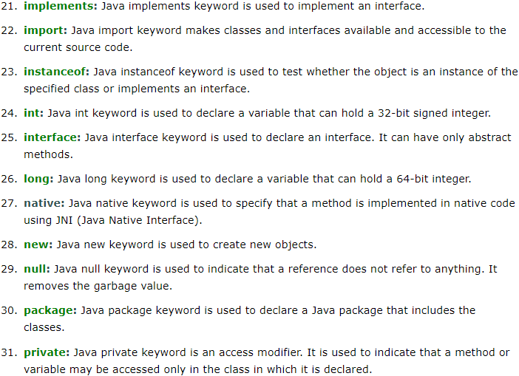
Java - Keyword

Slide 37
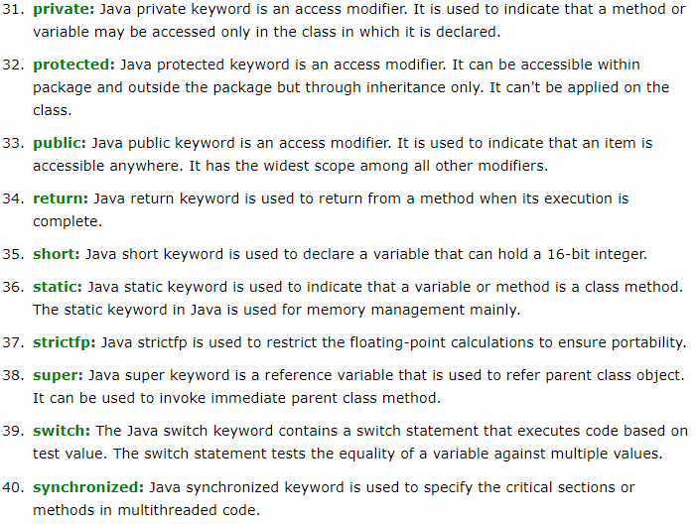
Java - Keyword

Slide 38
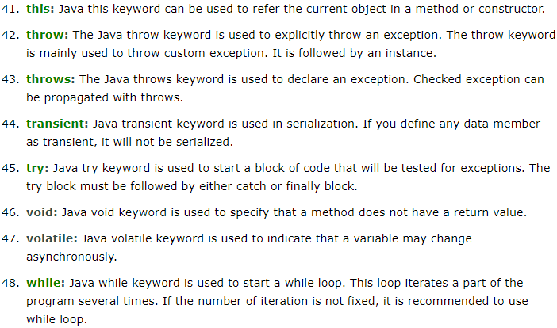
Java - Keyword

Slide 39
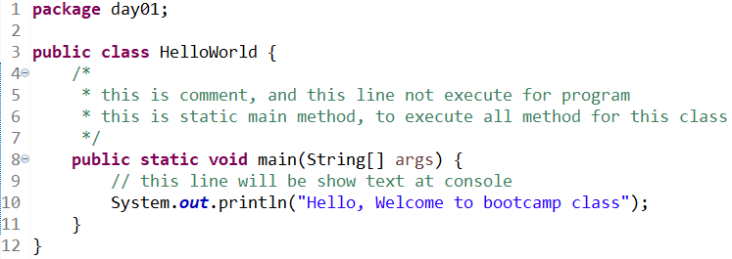
Java - Comment
Java supports single-line and multi-line comments very similar to C and C++. All characters available inside any comment are ignored by Java compiler.

Slide 40
Day 01
6
Java Variable

Slide 41
Variable
Variable is name of reserved area allocated in memory. In other words, it is a name of memory location. It is a combination of "vary + able" that means its value can be changed.

Slide 42
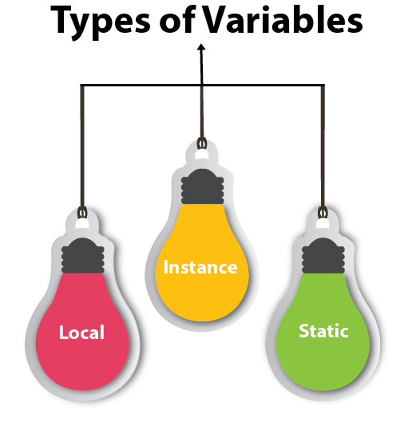
Types of Variables
There are three types of variables in java:
local variable
instance variable
static variable

Slide 43
Types of Variables
1) Local Variable
A variable declared inside the body of the method is called local variable. You can use this variable only within that method and the other methods in the class aren't even aware that the variable exists.
A local variable cannot be defined with "static" keyword.
2) Instance Variable
A variable declared inside the class but outside the body of the method, is called instance variable. It is not declared as static.
It is called instance variable because its value is instance specific and is not shared among instances.
3) Static variable
A variable which is declared as static is called static variable. It cannot be local. You can create a single copy of static variable and share among all the instances of the class. Memory allocation for static variable happens only once when the class is loaded in the memory.

Slide 44
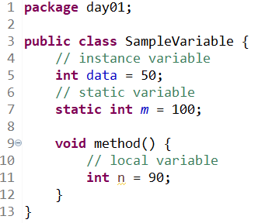
Types of Variables

Slide 45
Day 01
7
Data Types in Java

Slide 46
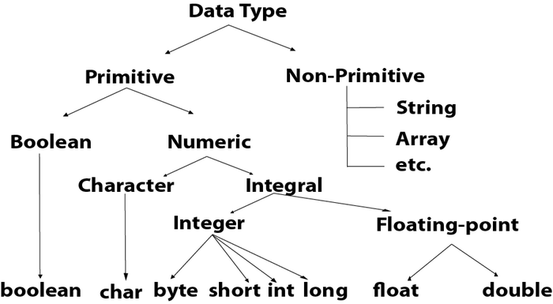
Data Type in Java
Data types specify the different sizes and values that can be stored in the variable. There are two types of data types in Java:
Primitive data types: The primitive data types include boolean, char, byte, short, int, long, float and double.
Non-primitive or Reference data types: The non-primitive data types include Classes, Interfaces, and Arrays

Slide 47
Java Primitive Data Types
In Java language, primitive data types are the building blocks of data manipulation. These are the most basic data types available in Java language.
There are 8 types of primitive data types:
boolean data type
byte data type
char data type
short data type
int data type
long data type
float data type
double data type

Slide 48
Java Primitive Data Types
Boolean
The Boolean data type is used to store only two possible values: true and false. This data type is used for simple flags that track true/false conditions.
The Boolean data type specifies one bit of information, but its "size" can't be defined precisely.
Example: Boolean one = false
Byte
The byte data type is an example of primitive data type. It isan 8-bit signed two's complement integer. Its value-range lies between -128 to 127 (inclusive). Its minimum value is -128 and maximum value is 127. Its default value is 0.
The byte data type is used to save memory in large arrays where the memory savings is most required. It saves space because a byte is 4 times smaller than an integer. It can also be used in place of "int" data type.
Example: byte a = 10, byte b = -20

Slide 49
Java Primitive Data Types
Short
The short data type is a 16-bit signed two's complement integer. Its value-range lies between -32,768 to 32,767 (inclusive). Its minimum value is -32,768 and maximum value is 32,767. Its default value is 0.
The short data type can also be used to save memory just like byte data type. A short data type is 2 times smaller than an integer.
Example: short s = 10000, short r = -5000
Int
The int data type is a 32-bit signed two's complement integer. Its value-range lies between - 2,147,483,648 (-2^31) to 2,147,483,647 (2^31 -1) (inclusive). Its minimum value is - 2,147,483,648and maximum value is 2,147,483,647. Its default value is 0.
The int data type is generally used as a default data type for integral values unless if there is no problem about memory.
Example: int a = 100000, int b = -200000

Slide 50
Java Primitive Data Types
Long
The long data type is a 64-bit two's complement integer. Its value-range lies between -9,223,372,036,854,775,808(-2^63) to 9,223,372,036,854,775,807(2^63 -1)(inclusive). Its minimum value is - 9,223,372,036,854,775,808and maximum value is 9,223,372,036,854,775,807. Its default value is 0. The long data type is used when you need a range of values more than those provided by int.
Example: long a = 100000L, long b = -200000L
Float
The float data type is a single-precision 32-bit IEEE 754 floating point.Its value range is unlimited. It is recommended to use a float (instead of double) if you need to save memory in large arrays of floating point numbers. The float data type should never be used for precise values, such as currency. Its default value is 0.0F.
Example: float f1 = 234.5f

Slide 51
Java Primitive Data Types
Double
The double data type is a double-precision 64-bit IEEE 754 floating point. Its value range is unlimited. The double data type is generally used for decimal values just like float. The double data type also should never be used for precise values, such as currency. Its default value is 0.0d.
Example: double d1 = 12.3
Char
The char data type is a single 16-bit Unicode character. Its value-range lies between ‘\u0000' (or 0) to ‘\uffff' (or 65,535 inclusive).The char data type is used to store characters.
Example: char letterA = 'A'

Slide 52
Java Reference Data Type
Reference variables are created using defined constructors of the classes. They are used to access objects. These variables are declared to be of a specific type that cannot be changed. For example, Employee, Puppy, etc.
Class objects and various type of array variables come under reference datatype.
Default value of any reference variable is null.
A reference variable can be used to refer any object of the declared type or any compatible type.
Example: Animal animal = new Animal("giraffe");

Slide 53
Day 01
8
Java Operator

Slide 54
Java Operator
Java provides a rich set of operators to manipulate variables. We can divide all the Java operators into the following groups :
Arithmetic Operators
Relational Operators
Bitwise Operators
Logical Operators
Assignment Operators
Misc Operators

Slide 55
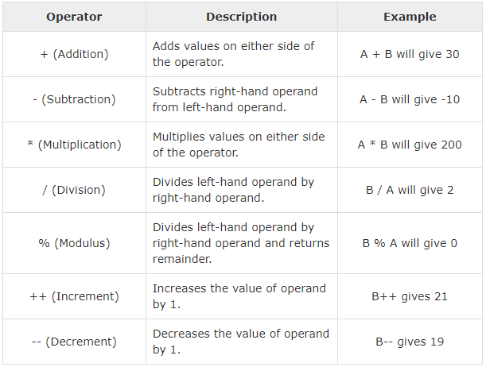
The Arithmetic Operators
Arithmetic operators are used in mathematical expressions in the same way that they are used in algebra. The following table lists the arithmetic operators

Slide 56
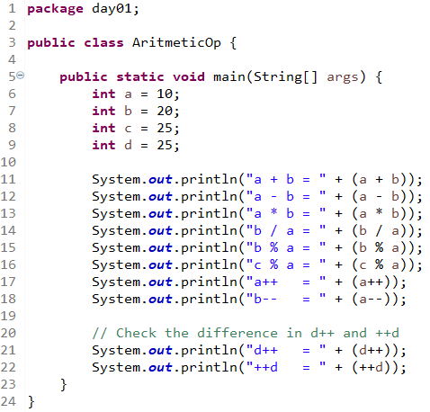
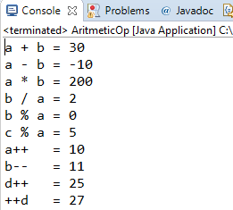
The Arithmetic Operators
Example
Output :

Slide 57
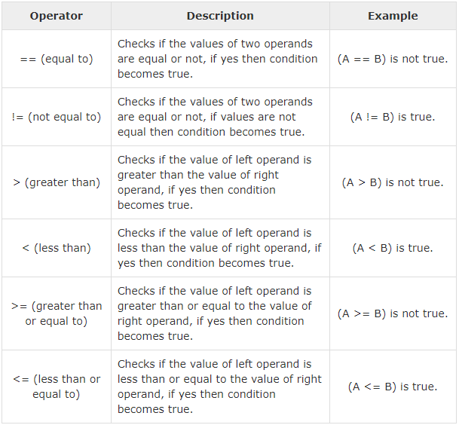
The Relational Operators
There are following relational operators supported by Java language.

Slide 58
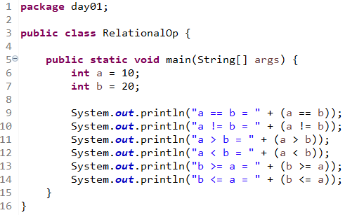
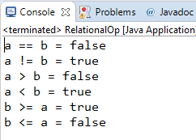
The Relational Operators
Example :
Output :

Slide 59
The Bitwise Operators
Java defines several bitwise operators, which can be applied to the integer types, long, int, short, char, and byte.
Bitwise operator works on bits and performs bit-by-bit operation. Assume if a = 60 and b = 13; now in binary format they will be as follows
a = 0011 1100
b = 0000 1101
-----------------
a&b = 0000 1100
a|b = 0011 1101
a^b = 0011 0001
~a = 1100 0011

Slide 60
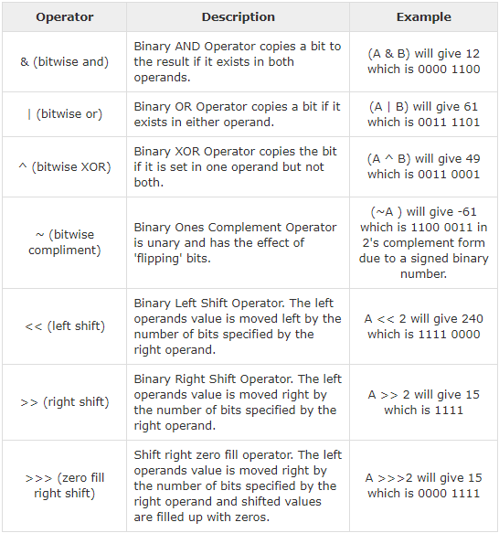
The Bitwise Operators

Slide 61
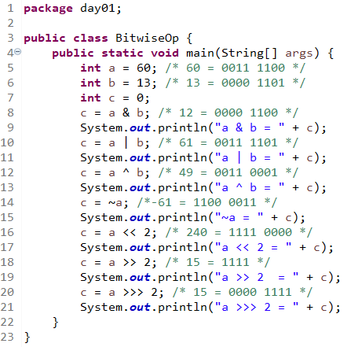
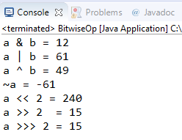
The Bitwise Operators
Example :
Output :

Slide 62
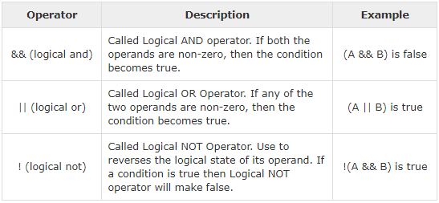
The Logical Operators
The following table lists the logical operators −
Assume Boolean variables A holds true and variable B holds false

Slide 63
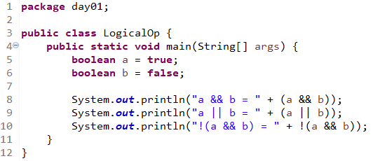
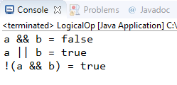
The Logical Operators
Example :
Output :

Slide 64
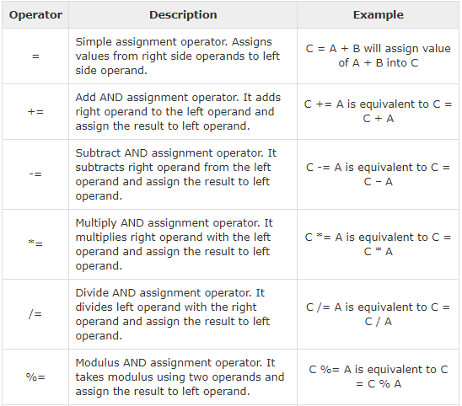
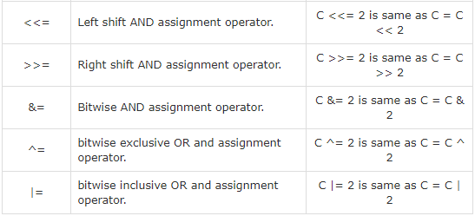
The Assignment Operators

Slide 65
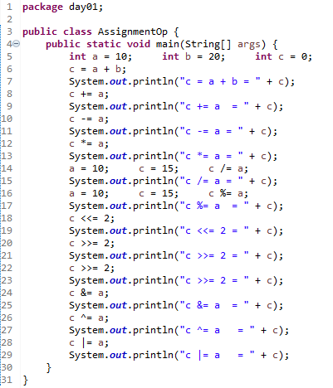
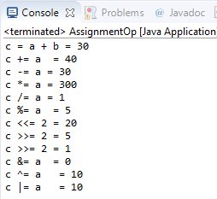
The Assignment Operators
Example :
Output :

Slide 66
Precedence of Java Operators
Operator precedence determines the grouping of terms in an expression. This affects how an expression is evaluated. Certain operators have higher precedence than others; for example, the multiplication operator has higher precedence than the addition operator −
For example, x = 7 + 3 * 2; here x is assigned 13, not 20 because operator * has higher precedence than +, so it first gets multiplied with 3 * 2 and then adds into 7.
Here, operators with the highest precedence appear at the top of the table, those with the lowest appear at the bottom. Within an expression, higher precedence operators will be evaluated first.

Slide 67
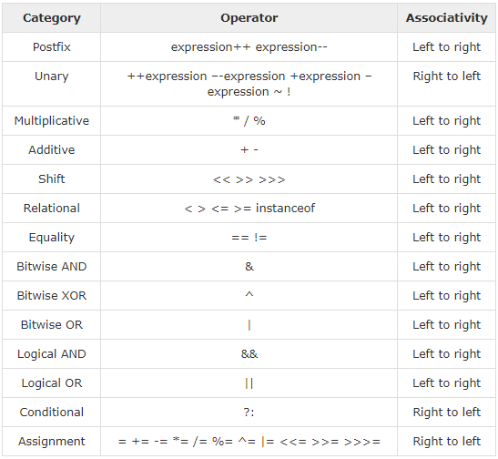
Precedence of Java Operators

Slide 68
Day 01
9
Looping

Slide 69
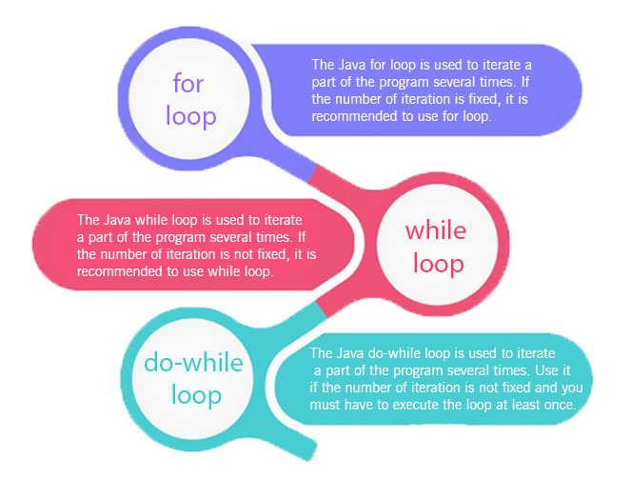
Java - Loop
In programming languages, loops are used to execute a set of instructions/functions repeatedly when some conditions become true. There are three types of loops in java.
for loop
while loop
do-while loop

Slide 70
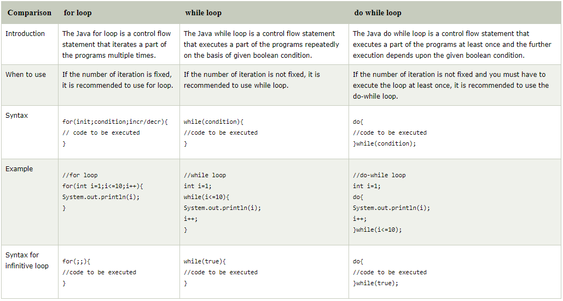
For Loop vs While Loop vs Do While Loop

Slide 71
Java For Loop
The Java for loop is used to iterate a part of the program several times. If the number of iteration is fixed, it is recommended to use for loop.
There are three types of for loops in java.
Simple For Loop
For-each or Enhanced For Loop
Labeled For Loop
Java Simple For Loop
A simple for loop is the same as C/C++. We can initialize the variable, check condition and increment/decrement value. It consists of four parts:
Initialization: It is the initial condition which is executed once when the loop starts. Here, we can initialize the variable, or we can use an already initialized variable. It is an optional condition.
Condition: It is the second condition which is executed each time to test the condition of the loop. It continues execution until the condition is false. It must return boolean value either true or false. It is an optional condition.
Statement: The statement of the loop is executed each time until the second condition is false.
Increment/Decrement: It increments or decrements the variable value. It is an optional condition.

Slide 72

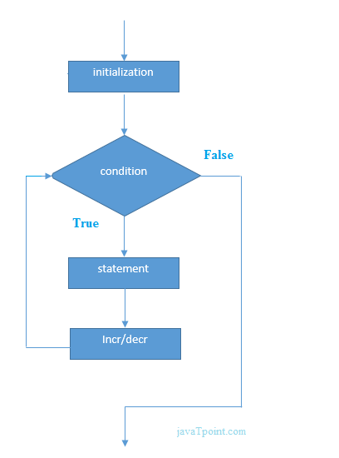
Java Simple For Loop
A simple for loop is the same as C/C++. We can initialize the variable, check condition and increment/decrement value. It consists of four parts:
Initialization: It is the initial condition which is executed once when the loop starts. Here, we can initialize the variable, or we can use an already initialized variable. It is an optional condition.
Condition: It is the second condition which is executed each time to test the condition of the loop. It continues execution until the condition is false. It must return boolean value either true or false. It is an optional condition.
Statement: The statement of the loop is executed each time until the second condition is false.
Increment/Decrement: It increments or decrements the variable value. It is an optional condition.
Syntax :

Slide 73
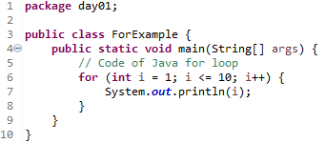
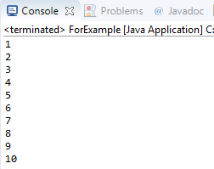
Java Simple For Loop
Example :
Output :

Slide 74

Java for-each Loop
The for-each loop is used to traverse array or collection in java. It is easier to use than simple for loop because we don't need to increment value and use subscript notation.
It works on elements basis not index. It returns element one by one in the defined variable.
Syntax :

Slide 75
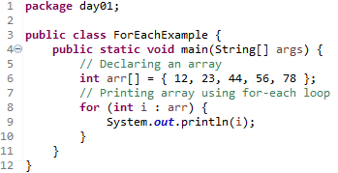
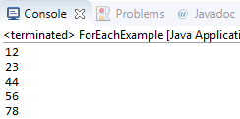
Java for-each Loop
Example :
Output :

Slide 76

Java Labeled For Loop
We can have a name of each Java for loop. To do so, we use label before the for loop. It is useful if we have nested for loop so that we can break/continue specific for loop.
Usually, break and continue keywords breaks/continues the innermost for loop only.
Syntax :

Slide 77
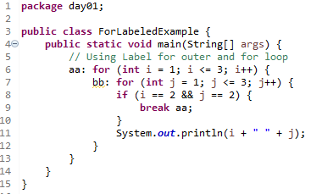

Java Labeled For Loop
Example :
Output :

Slide 78


Java Labeled For Loop
If you use break bb;, it will break inner loop only which is the default behavior of any loop.
Example :
Output :

Slide 79



Java Infinitive For Loop
If you use two semicolons ;; in the for loop, it will be infinitive for loop.
Syntax :
Example :
Output :

Slide 80


Java While Loop
The Java while loop is used to iterate a part of the program several times. If the number of iteration is not fixed, it is recommended to use while loop.
Syntax :

Slide 81


Java While Loop
Example :
Output :

Slide 82



Java Infinitive While Loop
If you pass true in the while loop, it will be infinitive while loop.
Syntax :
Example :
Output :

Slide 83



Java do-while Loop
The Java do-while loop is used to iterate a part of the program several times. If the number of iteration is not fixed and you must have to execute the loop at least once, it is recommended to use do-while loop.
The Java do-while loop is executed at least once because condition is checked after loop body.
Syntax :
Example :
Output :

Slide 84



Java Infinitive do-while Loop
If you pass true in the do-while loop, it will be infinitive do-while loop.
Syntax :
Example :
Output :

Slide 85


Java Break Statement
When a break statement is encountered inside a loop, the loop is immediately terminated and the program control resumes at the next statement following the loop.
The Java break is used to break loop or switch statement. It breaks the current flow of the program at specified condition. In case of inner loop, it breaks only inner loop.
We can use Java break statement in all types of loops such as for loop, while loop and do-while loop.
Syntax :

Slide 86


Java Break Statement
Example :
Output :

Slide 87


Java Break Statement with Inner Loop
It breaks inner loop only if you use break statement inside the inner loop.
Example :
Output :

Slide 88


Java Break Statement with Labeled For Loop
We can use break statement with a label. This feature is introduced since JDK 1.5. So, we can break any loop in Java now whether it is outer loop or inner.
Example :
Output :

Slide 89


Java Break Statement in while loop
Example :
Ouput :

Slide 90


Java Break Statement in do-while loop
Example :
Ouput :

Slide 91
Day 01
10
Study Case – Logic 01

Slide 92

Case Study – Logic 01

Slide 93


Logic 01 Soal 01
Source Code :
Output :

Slide 94


Logic 01 Soal 02
Source Code :
Output :

Slide 95
GOOD LUCK!

Slide 96
THANKS!
Any questions?
Contact Your Trainer

