Slide 1


Java – Logic Day 07
Ver. 0.1

Slide 2
Day 07
1
Goal Material

Slide 3
Goal Material
Abstract Class
Interface
Nested Interface
Abstract vs Interface
Package
Access Modifier
Encaptulation

Slide 4
Day 07
2
Abstract Class

Slide 5
Abstraction
Abstraction is a process of hiding the implementation details and showing only functionality to the user.
Another way, it shows only essential things to the user and hides the internal details, for example, sending SMS where you type the text and send the message. You don't know the internal processing about the message delivery.
Abstraction lets you focus on what the object does instead of how it does it.
Ways to achieve Abstraction
There are two ways to achieve abstraction in java :
Abstract class (0 to 100%)
Interface (100%)

Slide 6
Abstract class in Java
A class which is declared as abstract is known as an abstract class. It can have abstract and non-abstract methods. It needs to be extended and its method implemented. It cannot be instantiated.

Slide 7
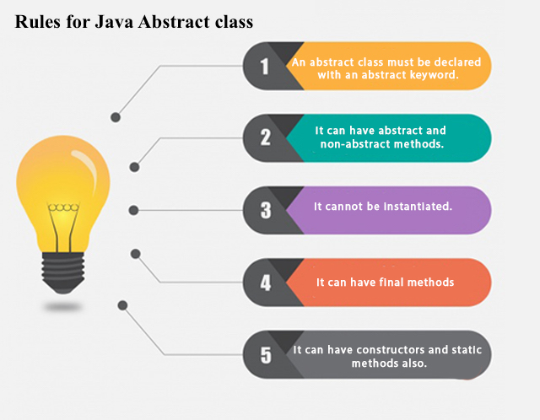
Points to Remember
An abstract class must be declared with an abstract keyword.
It can have abstract and non-abstract methods.
It cannot be instantiated.
It can have constructors and static methods also.
It can have final methods which will force the subclass not to change the body of the method.

Slide 8
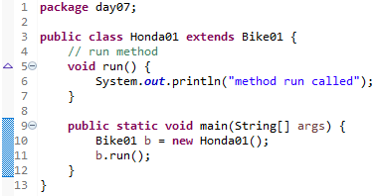

Abstract Method in Java
A method which is declared as abstract and does not have implementation is known as an abstract method.

Slide 9
Understanding the real scenario of Abstract class
In this example, Shape is the abstract class, and its implementation is provided by the Rectangle and Circle classes.
Mostly, we don't know about the implementation class (which is hidden to the end user), and an object of the implementation class is provided by the factory method.
A factory method is a method that returns the instance of the class. We will learn about the factory method later.
In this example, if you create the instance of Rectangle class, draw() method of Rectangle class will be invoked.

Slide 10

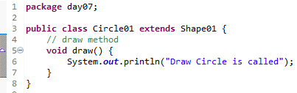
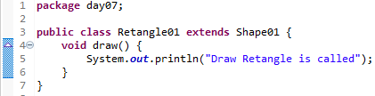
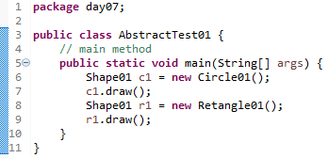
Understanding the real scenario of Abstract class

Slide 11

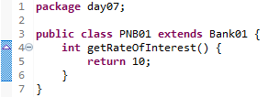
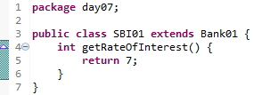
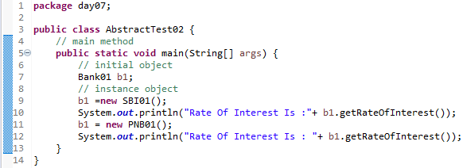
Understanding the real scenario of Abstract class

Slide 12
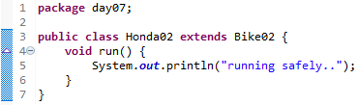
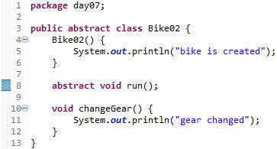
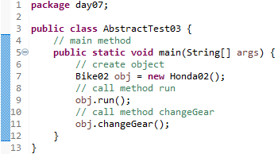
Abstract class having constructor, data member and methods
An abstract class can have a data member, abstract method, method body (non-abstract method), constructor, and even main() method.

Slide 13
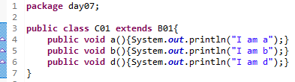
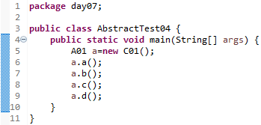
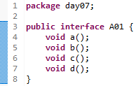
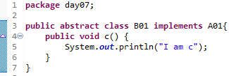
Another real scenario of abstract class
The abstract class can also be used to provide some implementation of the interface. In such case, the end user may not be forced to override all the methods of the interface.

Slide 14
Day 07
3
Interface

Slide 15
interface in java
An interface in java is a blueprint of a class. It has static constants and abstract methods.
The interface in Java is a mechanism to achieve abstraction. There can be only abstract methods in the Java interface, not method body. It is used to achieve abstraction and multiple inheritance in Java.
In other words, you can say that interfaces can have abstract methods and variables. It cannot have a method body.
Java Interface also represents the IS-A relationship.
It cannot be instantiated just like the abstract class.
Since Java 8, we can have default and static methods in an interface.
Since Java 9, we can have private methods in an interface.

Slide 16
Why use Java interface?
There are mainly three reasons to use interface. They are given below.
It is used to achieve abstraction.
By interface, we can support the functionality of multiple inheritance.
It can be used to achieve loose coupling.
How to declare an interface?
An interface is declared by using the interface keyword. It provides total abstraction; means all the methods in an interface are declared with the empty body, and all the fields are public, static and final by default. A class that implements an interface must implement all the methods declared in the interface.

Slide 17
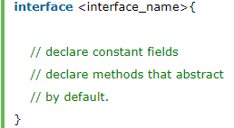
Syntax

Slide 18
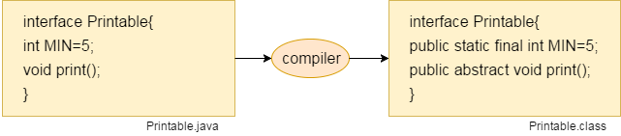
Internal addition by the compiler
In other words, Interface fields are public, static and final by default, and the methods are public and abstract.

Slide 19
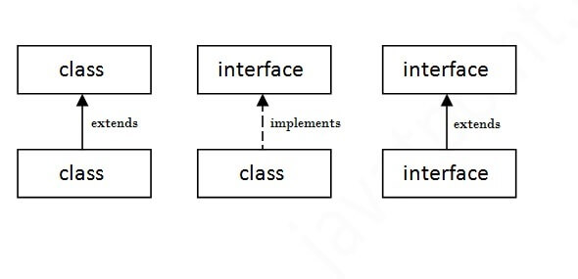
The relationship between classes and interfaces
As shown in the figure given below, a class extends another class, an interface extends another interface, but a class implements an interface.

Slide 20

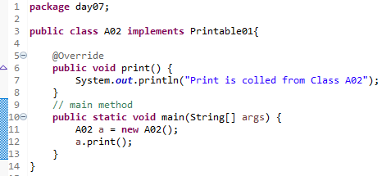
Java Interface Example
In this example, the Printable interface has only one method, and its implementation is provided in the A6 class.

Slide 21
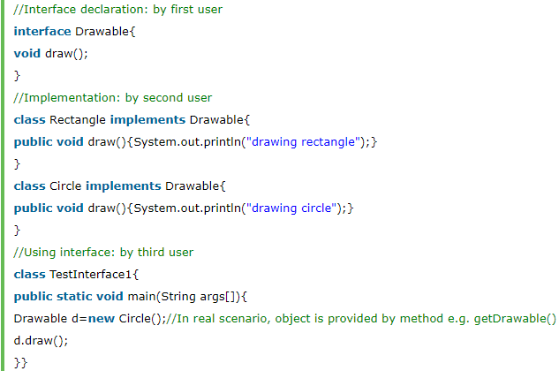
Java Interface Example: Drawable
In this example, the Drawable interface has only one method. Its implementation is provided by Rectangle and Circle classes. In a real scenario, an interface is defined by someone else, but its implementation is provided by different implementation providers. Moreover, it is used by someone else. The implementation part is hidden by the user who uses the interface.

Slide 22
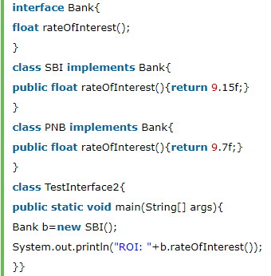
Java Interface Example: Bank
Let's see another example of java interface which provides the implementation of Bank interface.

Slide 23
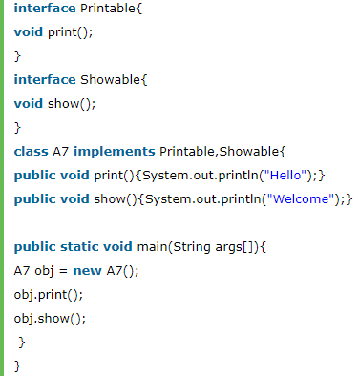
Multiple inheritance in Java by interface
If a class implements multiple interfaces, or an interface extends multiple interfaces, it is known as multiple inheritance.

Slide 24
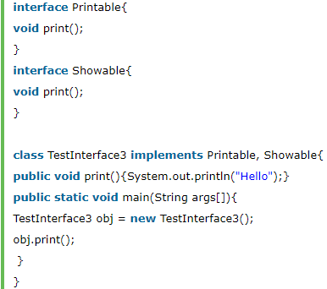
Question and Answer
Q) Multiple inheritance is not supported through class in java, but it is possible by an interface, why?
As we have explained in the inheritance chapter, multiple inheritance is not supported in the case of class because of ambiguity. However, it is supported in case of an interface because there is no ambiguity. It is because its implementation is provided by the implementation class. For example:
As you can see in the above example, Printable and Showable interface have same methods but its implementation is provided by class TestTnterface1, so there is no ambiguity.

Slide 25
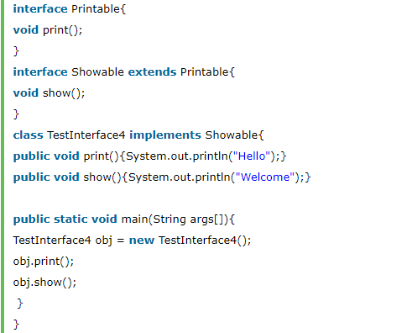
Interface inheritance
A class implements an interface, but one interface extends another interface.

Slide 26
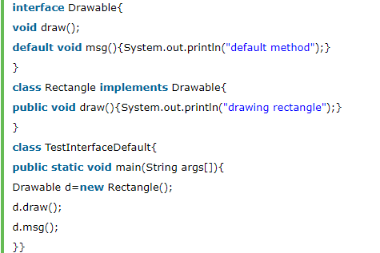
Java 8 Default Method in Interface
Since Java 8, we can have method body in interface. But we need to make it default method. Let's see an example:

Slide 27
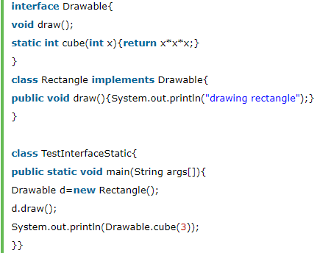
Java 8 Static Method in Interface
Since Java 8, we can have static method in interface. Let's see an example:

Slide 28

Q) What is marker or tagged interface?
An interface which has no member is known as a marker or tagged interface, for example, Serializable, Cloneable, Remote, etc. They are used to provide some essential information to the JVM so that JVM may perform some useful operation.

Slide 29
Day 07
4
Nested Interface

Slide 30
Java Nested Interface
An interface i.e. declared within another interface or class is known as nested interface. The nested interfaces are used to group related interfaces so that they can be easy to maintain. The nested interface must be referred by the outer interface or class. It can't be accessed directly.
Points to remember for nested interfaces :
There are given some points that should be remembered by the java programmer.
Nested interface must be public if it is declared inside the interface but it can have any access modifier if declared within the class.
Nested interfaces are declared static implicitely.

Slide 31
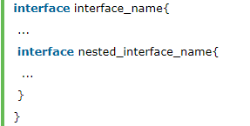
Syntax
Syntax of nested interface which is declared within the interface
Syntax of nested interface which is declared within the class

Slide 32
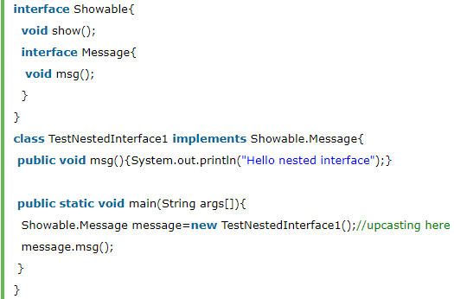
Example of nested interface which is declared within the interface
In this example, we are going to learn how to declare the nested interface and how we can access it.
As you can see in the above example, we are acessing the Message interface by its outer interface Showable because it cannot be accessed directly. It is just like almirah inside the room, we cannot access the almirah directly because we must enter the room first. In collection frameword, sun microsystem has provided a nested interface Entry. Entry is the subinterface of Map i.e. accessed by Map.Entry.

Slide 33

Internal code generated by the java compiler for nested interface Message
The java compiler internally creates public and static interface as displayed below:.

Slide 34
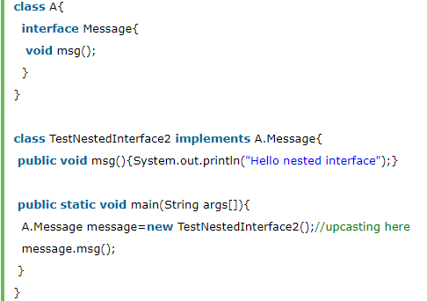
Example of nested interface which is declared within the class
Let's see how can we define an interface inside the class and how can we access it.

Slide 35

Can we define a class inside the interface?
Yes, If we define a class inside the interface, java compiler creates a static nested class. Let's see how can we define a class within the interface:

Slide 36
Day 07
5
Abtraction vs Interface

Slide 37
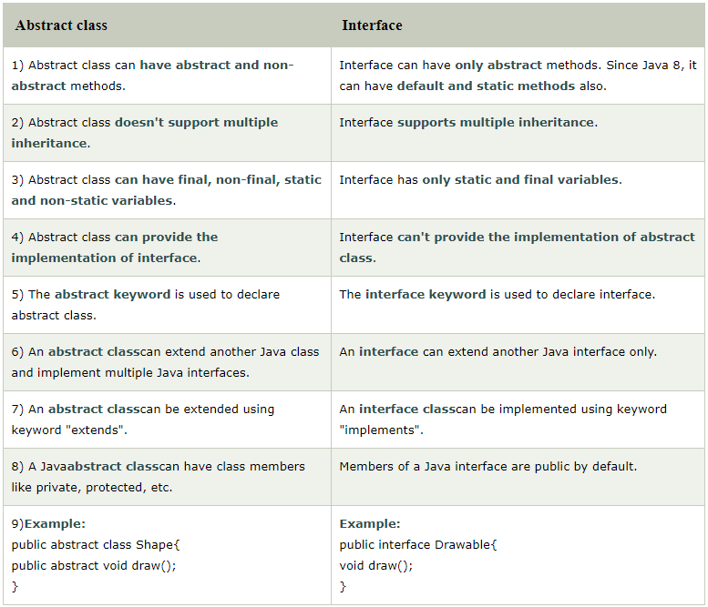

Slide 38
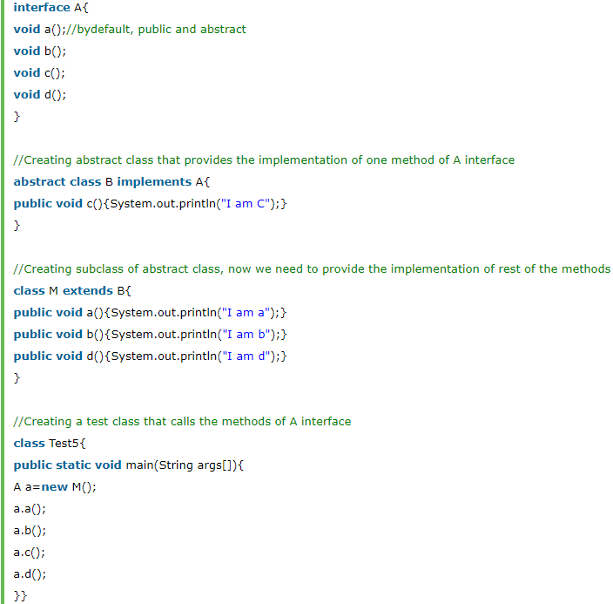

Slide 39
Day 07
6
Package

Slide 40
java package
A java package is a group of similar types of classes, interfaces and sub-packages.
Package in java can be categorized in two form, built-in package and user-defined package.
There are many built-in packages such as java, lang, awt, javax, swing, net, io, util, sql etc.
Here, we will have the detailed learning of creating and using user-defined packages.
Advantage of Java Package
1) Java package is used to categorize the classes and interfaces so that they can be easily maintained.
2) Java package provides access protection.
3) Java package removes naming collision.

Slide 41
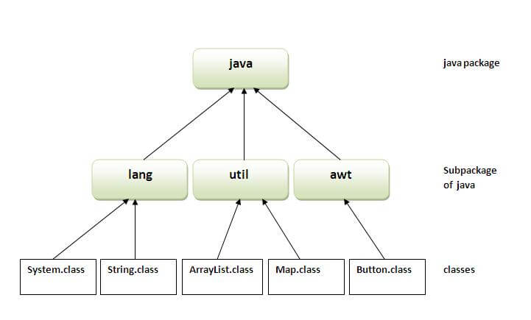
Package

Slide 42
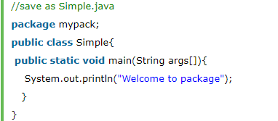
Simple example of java package
The package keyword is used to create a package in java.

Slide 43
How to access package from another package?
There are three ways to access the package from outside the package.
import package.*;
import package.classname;
fully qualified name.

Slide 44
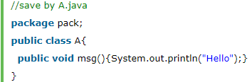
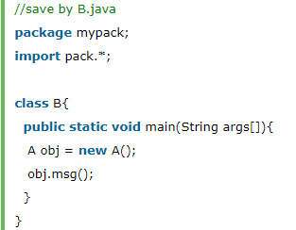
1) Using packagename.*
If you use package.* then all the classes and interfaces of this package will be accessible but not subpackages.
The import keyword is used to make the classes and interface of another package accessible to the current package.
Example of package that import the packagename.*

Slide 45
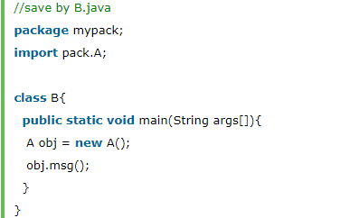
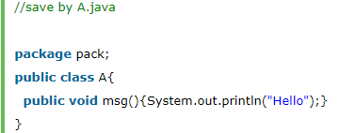
2) Using packagename.classname
If you import package.classname then only declared class of this package will be accessible.

Slide 46
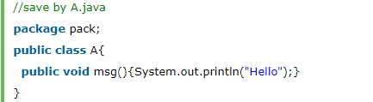
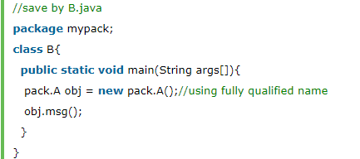
3) Using fully qualified name
If you use fully qualified name then only declared class of this package will be accessible. Now there is no need to import. But you need to use fully qualified name every time when you are accessing the class or interface.
It is generally used when two packages have same class name e.g. java.util and java.sql packages contain Date class.

Slide 47
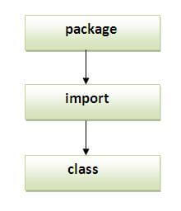
Sequence of the program must be package

Slide 48
Subpackage in java
Package inside the package is called the subpackage. It should be created to categorize the package further.
Let's take an example, Sun Microsystem has definded a package named java that contains many classes like System, String, Reader, Writer, Socket etc. These classes represent a particular group e.g. Reader and Writer classes are for Input/Output operation, Socket and ServerSocket classes are for networking etc and so on. So, Sun has subcategorized the java package into subpackages such as lang, net, io etc. and put the Input/Output related classes in io package, Server and ServerSocket classes in net packages and so on.

Slide 49
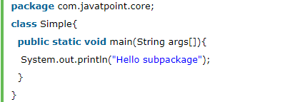
Example of Subpackage

Slide 50
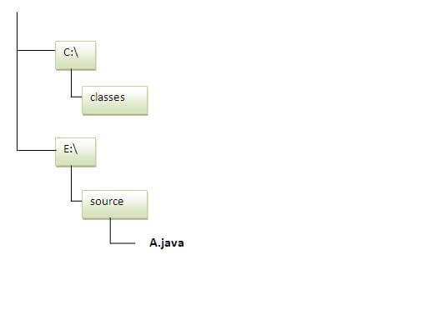
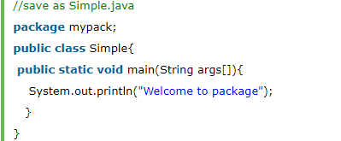
How to send the class file to another directory or drive?
There is a scenario, I want to put the class file of A.java source file in classes folder of c: drive. For example:
To Compile:
e:>sources> javac -d c:>classes Simple.java
To Run:
To run this program from e:>source directory, you need to set classpath of the directory where the class file resides.
e:>sources> set classpath=c:>classes;.;
e:>sources> java mypack.Simple

Slide 51
Another way to run this program by -classpath switch of java:
The -classpath switch can be used with javac and java tool.
To run this program from e:\source directory, you can use -classpath switch of java that tells where to look for class file. For example:
e:\sources> java -classpath c:\classes mypack.Simple

Slide 52
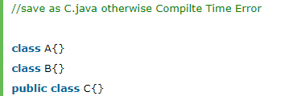
Ways to load the class files or jar files
There are two ways to load the class files temporary and permanent.
Temporary
By setting the classpath in the command prompt
By -classpath switch
Permanent
By setting the classpath in the environment variables
By creating the jar file, that contains all the class files, and copying the jar file in the jre/lib/ext folder.

Slide 53


How to put two public classes in a package?
If you want to put two public classes in a package, have two java source files containing one public class, but keep the package name same. For example:

Slide 54
Day 07
7
Access Modifier

Slide 55
Access Modifiers in java
There are two types of modifiers in java: access modifiers and non-access modifiers.
The access modifiers in java specifies accessibility (scope) of a data member, method, constructor or class.
There are 4 types of java access modifiers:
private
default
protected
public
There are many non-access modifiers such as static, abstract, synchronized, native, volatile, transient etc. Here, we will learn access modifiers.

Slide 56
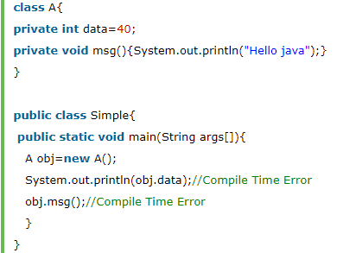
1) private access modifier
The private access modifier is accessible only within class.
Simple example of private access modifier
In this example, we have created two classes A and Simple. A class contains private data member and private method. We are accessing these private members from outside the class, so there is compile time error.

Slide 57
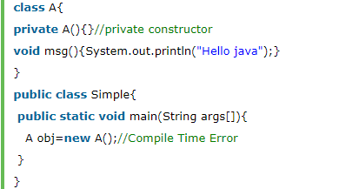
Role of Private Constructor
If you make any class constructor private, you cannot create the instance of that class from outside the class. For example:

Slide 58
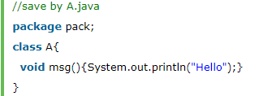
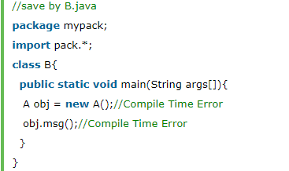
2) default access modifier
If you don't use any modifier, it is treated as default bydefault. The default modifier is accessible only within package.
Example of default access modifier
In this example, we have created two packages pack and mypack. We are accessing the A class from outside its package, since A class is not public, so it cannot be accessed from outside the package.

Slide 59
3) protected access modifier
The protected access modifier is accessible within package and outside the package but through inheritance only.
The protected access modifier can be applied on the data member, method and constructor. It can't be applied on the class.

Slide 60
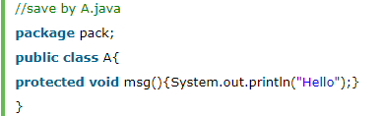
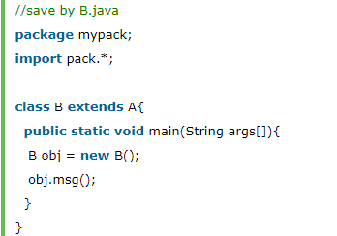
3) protected access modifier
Example of protected access modifier
In this example, we have created the two packages pack and mypack. The A class of pack package is public, so can be accessed from outside the package. But msg method of this package is declared as protected, so it can be accessed from outside the class only through inheritance.

Slide 61


4) public access modifier
The public access modifier is accessible everywhere. It has the widest scope among all other modifiers.

Slide 62

Understanding all java access modifiers
Let's understand the access modifiers by a simple table.

Slide 63

Java access modifiers with method overriding
If you are overriding any method, overridden method (i.e. declared in subclass) must not be more restrictive.

Slide 64
Day 07
8
Encaptulation

Slide 65
Encapsulation in Java
Encapsulation in Java is a process of wrapping code and data together into a single unit, for example, a capsule which is mixed of several medicines.
We can create a fully encapsulated class in Java by making all the data members of the class private. Now we can use setter and getter methods to set and get the data in it.
The Java Bean class is the example of a fully encapsulated class.

Slide 66
Advantage of Encapsulation in Java
By providing only a setter or getter method, you can make the class read-only or write-only. In other words, you can skip the getter or setter methods.
It provides you the control over the data. Suppose you want to set the value of id which should be greater than 100 only, you can write the logic inside the setter method. You can write the logic not to store the negative numbers in the setter methods.
It is a way to achieve data hiding in Java because other class will not be able to access the data through the private data members.
The encapsulate class is easy to test. So, it is better for unit testing.
The standard IDE's are providing the facility to generate the getters and setters. So, it is easy and fast to create an encapsulated class in Java.

Slide 67


Simple Example of Encapsulation in Java
Let's see the simple example of encapsulation that has only one field with its setter and getter methods.

Slide 68

Read-Only class
Now, you can't change the value of the college data member which is "AKG".

Slide 69


Write-Only class
Now, you can't get the value of the college, you can only change the value of college data member.

Slide 70
Day 07
9
Study Case

Slide 71
GOOD LUCK!

Slide 72
THANKS!
Any questions?
Contact Your Trainer

