Slide 1


Java – Logic Day 08
Ver. 0.1

Slide 2
Day 08
1
SQL Introduction

Slide 3
SQL Introduction
SQL tutorial provides basic and advanced concepts of SQL. Our SQL tutorial is designed for beginners and professionals.
SQL (Structured Query Language) is used to perform operations on the records stored in database such as updating records, deleting records, creating and modifying tables, views etc.
SQL is just a query language, it is not a database. To perform SQL queries, you need to install any database for example Oracle, MySQL, MongoDB, PostGre SQL, SQL Server, DB2 etc.
What is SQL?
SQL stands for Structured Query Language.
It is designed for managing data in a relational database management system (RDBMS).
It is pronounced as S-Q-L or sometime See-Qwell.
SQL is a database language, it is used for database creation, deletion, fetching rows and modifying rows etc.
SQL is based on relational algebra and tuple relational calculus.
All DBMS like MySQL, Oracle, MS Access, Sybase, Informix, Postgres and SQL Server use SQL as standard database language.

Slide 4
SQL Introduction
Why SQL is required?
SQL is required:
To create new databases, tables and views
To insert records in a database
To update records in a database
To delete records from a database
To retrieve data from a database
What SQL does?
With SQL, we can query our database in a numbers of ways, using English-like statements.
With SQL, user can access data from relational database management system.
It allows user to describe the data.
It allows user to define the data in database and manipulate it when needed.
It allows user to create and drop database and table.
It allows user to create view, stored procedure, function in a database.
It allows user to set permission on tables, procedure and view.

Slide 5
What is Database?
A database is an organized collection of data.
Database handlers create database in such a way that only one set of software program provide access of data to all the users.
The main purpose of database is to operate large amount of information by storing, retrieving and managing.
There are many dynamic websites on the world wide web now a days which are handled through databases. For example, a model to checks the availability of rooms in a hotel. It is an example of dynamic website that uses database.
There are many database available like MySQL, Sybase, Oracle, Mango DB, Informix, Postgre, SQL Server etc.
SQL or Structured Query Language is used to perform operation on the data stored in a database. SQL depends on relational algebra and tuple relational calculus.
A cylindrical structure is used to display the image of a database.

Slide 6
Day 08
2
RDBMS

Slide 7
RDBMS
What is RDBMS
RDBMS stands for Relational Database Management Systems..
All modern database management systems like SQL, MS SQL Server, IBM DB2, ORACLE, My-SQL and Microsoft Access are based on RDBMS.
It is called Relational Data Base Management System (RDBMS) because it is based on relational model introduced by E.F. Codd.
How it works
Data is represented in terms of tuples (rows) in RDBMS.
Relational database is most commonly used database. It contains number of tables and each table has its own primary key.
Due to a collection of organized set of tables, data can be accessed easily in RDBMS.

Slide 8
RDBMS
What is table
The RDBMS database uses tables to store data. A table is a collection of related data entries and contains rows and columns to store data.
A table is the simplest example of data storage in RDBMS.
Let's see the example of student table.
What is field
Field is a smaller entity of the table which contains specific information about every record in the table. In the above example, the field in the student table consist of id, name, age, course.
What is row or record
A row of a table is also called record. It contains the specific information of each individual entry in the table. It is a horizontal entity in the table. For example: The above table contains 5 records.
Let's see one record/row in the table.
What is column
A column is a vertical entity in the table which contains all information associated with a specific field in a table. For example: "name" is a column in the above table which contains all information about student's name.

Slide 9
Data Integrity
There are the following categories of data integrity exist with each RDBMS:
Entity integrity: It specifies that there should be no duplicate rows in a table.
Domain integrity: It enforces valid entries for a given column by restricting the type, the format, or the range of values.
Referential integrity: It specifies that rows cannot be deleted, which are used by other records.
User-defined integrity: It enforces some specific business rules that are defined by users. These rules are different from entity, domain or referential integrity.
NULL Value
The NULL value of the table specifies that the field has been left blank during record creation. It is totally different from the value filled with zero or a field that contains space.

Slide 10
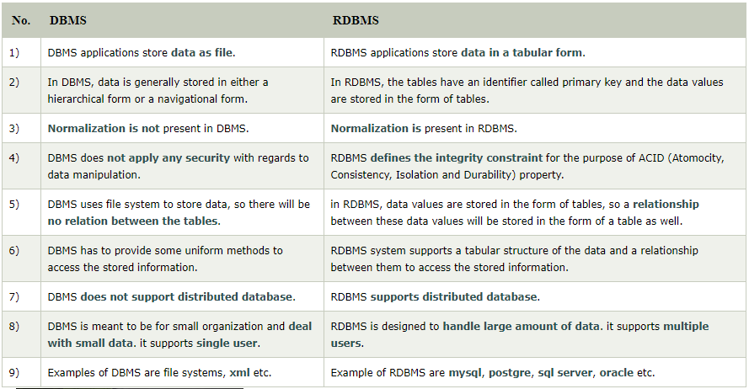
DBMS and RDBMS

Slide 11
Day 08
3
SQL Syntax

Slide 12
SQL Syntax
SQL Syntax
SQL follows some unique set of rules and guidelines called syntax. Here, we are providing all the basic SQL syntax.
SQL is not case sensitive. Generally SQL keywords are written in uppercase.
SQL statements are dependent on text lines. We can place a single SQL statement on one or multiple text lines.
You can perform most of the action in a database with SQL statements.
SQL depends on relational algebra and tuple relational calculus.
SQL statement
SQL statements are started with any of the SQL commands/keywords like SELECT, INSERT, UPDATE, DELETE, ALTER, DROP etc. and the statement ends with a semicolon (;).
Example of SQL statement:
Why semicolon is used after SQL statements:
Semicolon is used to separate SQL statements. It is a standard way to separate SQL statements in a database system in which more than one SQL statements are used in the same call.
In this tutorial, we will use semicolon at the end of each SQL statement.

Slide 13
SQL Syntax
SQL Commands
These are the some important SQL command:
SELECT: it extracts data from a database.
UPDATE: it updates data in database.
DELETE: it deletes data from database.
CREATE TABLE: it creates a new table.
ALTER TABLE: it is used to modify the table.
DROP TABLE: it deletes a table.
CREATE DATABASE: it creates a new database.
ALTER DATABASE: It is used to modify a database.
INSERT INTO: it inserts new data into a database.
CREATE INDEX: it is used to create an index (search key).
DROP INDEX: it deletes an index.

Slide 14
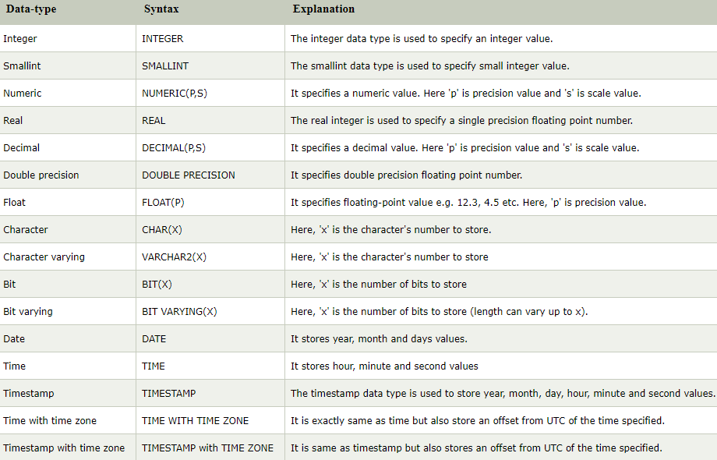
SQL Data-type

Slide 15
Day 08
4
SQL Operator

Slide 16
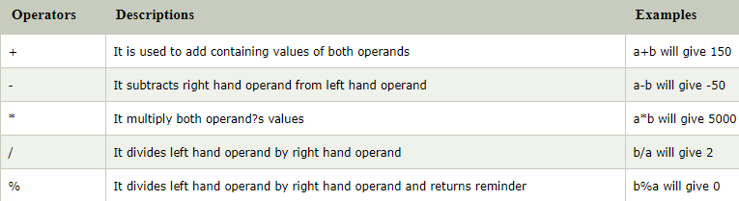
SQL Arithmetic Operators:
Let's assume two variables "a" and "b". Here "a" is valued 50 and "b" valued 100.
Example:

Slide 17
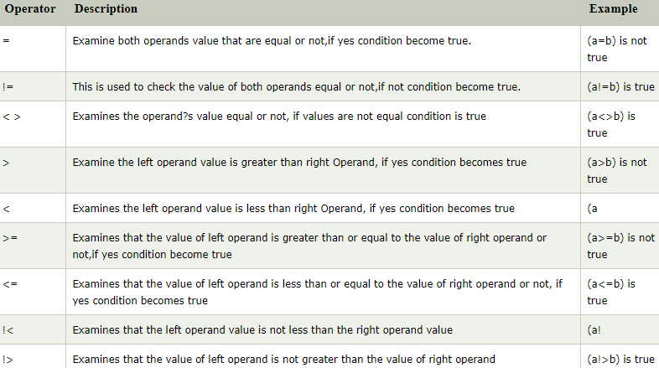
SQL Comparison Operators:
Let's assume two variables "a" and "b". Here "a" is valued 50 and "b" valued 100.
Example:

Slide 18
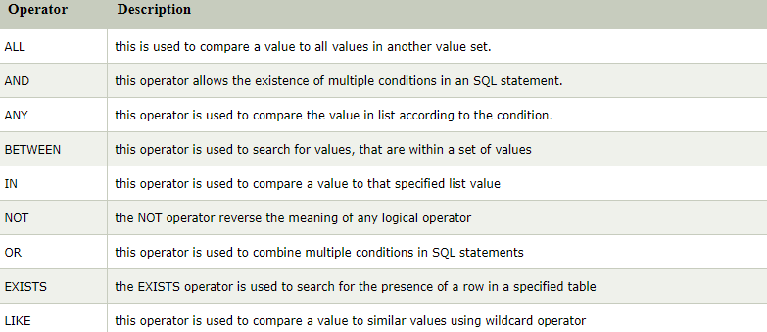
SQL Logical Operators:
This is the list of logical operators used in SQL.

Slide 19
Day 08
2
Goal Material

Slide 20
What is SQL?
SQL stands for Structured Query Language
SQL lets you access and manipulate databases
SQL became a standard of the American National Standards Institute (ANSI) in 1986, and of the International Organization for Standardization (ISO) in 1987

Slide 21
What Can SQL do?
SQL can execute queries against a database
SQL can retrieve data from a database
SQL can insert records in a database
SQL can update records in a database
SQL can delete records from a database
SQL can create new databases
SQL can create new tables in a database
SQL can create stored procedures in a database
SQL can create views in a database
SQL can set permissions on tables, procedures, and views

Slide 22
SQL is a Standard - BUT....
Although SQL is an ANSI/ISO standard, there are different versions of the SQL language.
However, to be compliant with the ANSI standard, they all support at least the major commands (such as SELECT, UPDATE, DELETE, INSERT, WHERE) in a similar manner.

Slide 23
Using SQL in Your Web Site
To build a web site that shows data from a database, you will need:
An RDBMS database program (i.e. MS Access, SQL Server, MySQL)
To use a server-side scripting language, like PHP or ASP
To use SQL to get the data you want
To use HTML / CSS to style the page

Slide 24
RDBMS
RDBMS stands for Relational Database Management System.
RDBMS is the basis for SQL, and for all modern database systems such as MS SQL Server, IBM DB2, Oracle, MySQL, and Microsoft Access.
The data in RDBMS is stored in database objects called tables. A table is a collection of related data entries and it consists of columns and rows.
Every table is broken up into smaller entities called fields.
A record, also called a row, is each individual entry that exists in a table.
A column is a vertical entity in a table that contains all information associated with a specific field in a table.

Slide 25
Day 08
3
DDL

Slide 26
DDL(Data Definition Language)
DDL or Data Definition Language actually consists of the SQL commands that can be used to define the database schema. It simply deals with descriptions of the database schema and is used to create and modify the structure of database objects in database.

Slide 27
Examples of DDL commands
CREATE – is used to create the database or its objects (like table, index, function, views, store procedure and triggers).
DROP – is used to delete objects from the database.
ALTER-is used to alter the structure of the database.
TRUNCATE–is used to remove all records from a table, including all spaces allocated for the records are removed.
COMMENT –is used to add comments to the data dictionary.
RENAME –is used to rename an object existing in the database.

Slide 28
Database
The SQL CREATE DATABASE Statement
The CREATE DATABASE statement is used to create a new SQL database.
CREATE DATABASE testDB;
The SQL DROP DATABASE Statement
The DROP DATABASE statement is used to drop an existing SQL database.
DROP DATABASE testDB;

Slide 29
Table Create
The SQL CREATE TABLE Statement
The CREATE TABLE statement is used to create a new table in a database.
CREATE TABLE Persons (
PersonID int,
LastName varchar(255),
FirstName varchar(255),
Address varchar(255),
City varchar(255)
);
The PersonID column is of type int and will hold an integer.
The LastName, FirstName, Address, and City columns are of type varchar and will hold characters, and the maximum length for these fields is 255 characters.

Slide 30
Table Create
Create Table Using Another Table
A copy of an existing table can also be created using CREATE TABLE.
The new table gets the same column definitions. All columns or specific columns can be selected.
If you create a new table using an existing table, the new table will be filled with the existing values from the old table
Syntax
CREATE TABLE TestTable AS
SELECT customername, contactname
FROM customers;

Slide 31
Table Drop
The SQL DROP TABLE Statement
The DROP TABLE statement is used to drop an existing table in a database
DROP TABLE Shippers;
SQL TRUNCATE TABLE
The TRUNCATE TABLE statement is used to delete the data inside a table, but not the table itself.
TRUNCATE TABLE table_name;

Slide 32
SQL ALTER TABLE Statement
The ALTER TABLE statement is used to add, delete, or modify columns in an existing table.
The ALTER TABLE statement is also used to add and drop various constraints on an existing table.
ALTER TABLE - ADD Column
To add a column in a table, use the following syntax:
ALTER TABLE Customers ADD Email varchar(255);
ALTER TABLE - DROP COLUMN
To delete a column in a table, use the following syntax (notice that some database systems don't allow deleting a column):
ALTER TABLE Customers DROP COLUMN Email;

Slide 33
SQL ALTER TABLE Statement
ALTER TABLE - ALTER/MODIFY COLUMN
To change the data type of a column in a table, use the following syntax:
Ms. SQL Server :
ALTER TABLE table_name
ALTER COLUMN column_name datatype;
My SQL / Oracle (prior version 10G):
ALTER TABLE table_name
MODIFY COLUMN column_name datatype;
Oracle 10G and later:
ALTER TABLE table_name
MODIFY column_name datatype;
PostgreSQL:
ALTER TABLE table_name
ALTER COLUMN column_name

Slide 34
SQL Constraints
SQL constraints are used to specify rules for the data in a table.
Constraints are used to limit the type of data that can go into a table. This ensures the accuracy and reliability of the data in the table. If there is any violation between the constraint and the data action, the action is aborted.
Constraints can be column level or table level. Column level constraints apply to a column, and table level constraints apply to the whole table.

Slide 35
SQL Constraints
The following constraints are commonly used in SQL:
NOT NULL - Ensures that a column cannot have a NULL value
UNIQUE - Ensures that all values in a column are different
PRIMARY KEY - A combination of a NOT NULL and UNIQUE. Uniquely identifies each row in a table
FOREIGN KEY - Uniquely identifies a row/record in another table
CHECK - Ensures that all values in a column satisfies a specific condition
DEFAULT - Sets a default value for a column when no value is specified
INDEX - Used to create and retrieve data from the database very quickly

Slide 36
Day 08
4
Study Case

Slide 37
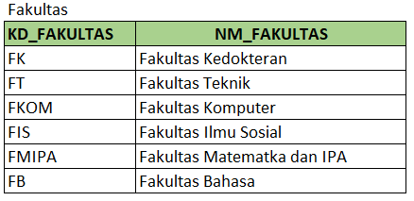
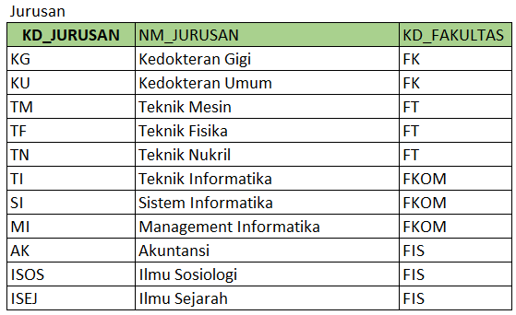
Study Case – Logic 08

Slide 38
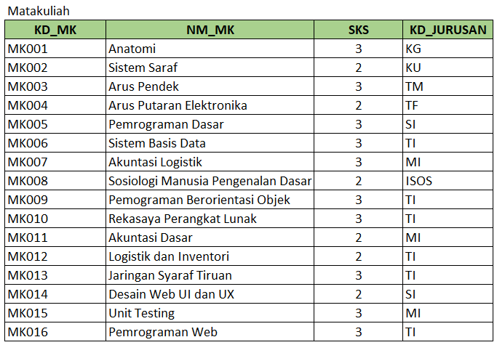
Study Case – Logic 08

Slide 39
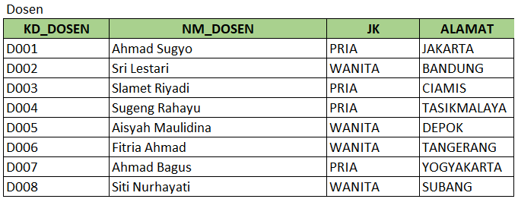
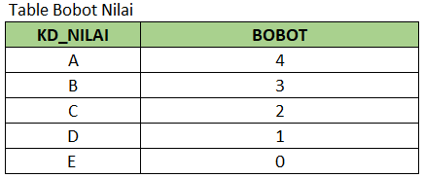
Study Case – Logic 08

Slide 40
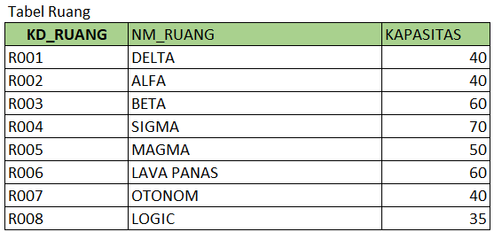
Study Case – Logic 08

Slide 41
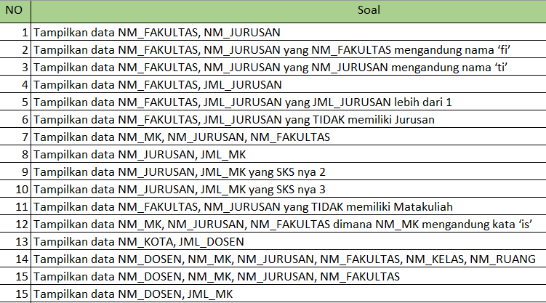
Study Case – Logic 08

Slide 42
GOOD LUCK!

Slide 43
THANKS!
Any questions?
Contact Your Trainer

