Slide 1


Java – Technology Day 01
Ver. 0.1

Slide 2
Day 01
1
What Is HTML

Slide 3
What is HTML
HTML is an acronym which stands for Hyper Text Markup Language which is used for creating web pages and web applications. Let's see what is meant by Hypertext Markup Language, and Web page.
Hyper Text: HyperText simply means "Text within Text." A text has a link within it, is a hypertext. Whenever you click on a link which brings you to a new webpage, you have clicked on a hypertext. HyperText is a way to link two or more web pages (HTML documents) with each other.
Markup language: A markup language is a computer language that is used to apply layout and formatting conventions to a text document. Markup language makes text more interactive and dynamic. It can turn text into images, tables, links, etc.
Web Page: A web page is a document which is commonly written in HTML and translated by a web browser. A web page can be identified by entering an URL. A Web page can be of the static or dynamic type. With the help of HTML only, we can create static web pages.
Hence, HTML is a markup language which is used for creating attractive web pages with the help of styling, and which looks in a nice format on a web browser. An HTML document is made of many HTML tags and each HTML tag contains different content.

Slide 4
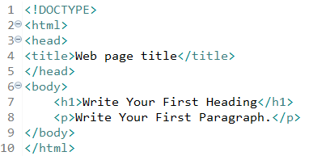
What is HTML
Example :
<!DOCTYPE>: It defines the document type or it instruct the browser about the version of HTML.
<html > :This tag informs the browser that it is an HTML document. Text between html tag describes the web document. It is a container for all other elements of HTML except <!DOCTYPE>
<head>: It should be the first element inside the <html> element, which contains the metadata(information about the document). It must be closed before the body tag opens.
<title>: As its name suggested, it is used to add title of that HTML page which appears at the top of the browser window. It must be placed inside the head tag and should close immediately. (Optional)
<body> : Text between body tag describes the body content of the page that is visible to the end user. This tag contains the main content of the HTML document.
<h1> : Text between <h1> tag describes the first level heading of the webpage.
<p> : Text between <p> tag describes the paragraph of the webpage.

Slide 5
HTML Version
HTML 1.0: The first version of HTML was 1.0, which was the barebones version of HTML language, and it was released in1991.
HTML 2.0: This was the next version which was released in 1995, and it was standard language version for website design. HTML 2.0 was able to support extra features such as form-based file upload, form elements such as text box, option button, etc.
HTML 3.2: HTML 3.2 version was published by W3C in early 1997. This version was capable of creating tables and providing support for extra options for form elements. It can also support a web page with complex mathematical equations. It became an official standard for any browser till January 1997. Today it is practically supported by most of the browsers.
HTML 4.01: HTML 4.01 version was released on December 1999, and it is a very stable version of HTML language. This version is the current official standard, and it provides added support for stylesheets (CSS) and scripting ability for various multimedia elements.
HTML5 : HTML5 is the newest version of HyperText Markup language. The first draft of this version was announced in January 2008. There are two major organizations one is W3C (World Wide Web Consortium), and another one is WHATWG( Web Hypertext Application Technology Working Group) which are involved in the development of HTML 5 version, and still, it is under development

Slide 6
Features of HTML
1) It is a very easy and simple language. It can be easily understood and modified.
2) It is very easy to make an effective presentation with HTML because it has a lot of formatting tags.
3) It is a markup language, so it provides a flexible way to design web pages along with the text.
4) It facilitates programmers to add a link on the web pages (by html anchor tag), so it enhances the interest of browsing of the user.
5) It is platform-independent because it can be displayed on any platform like Windows, Linux, and Macintosh, etc.
6) It facilitates the programmer to add Graphics, Videos, and Sound to the web pages which makes it more attractive and interactive.
7) HTML is a case-insensitive language, which means we can use tags either in lower-case or upper-case.

Slide 7
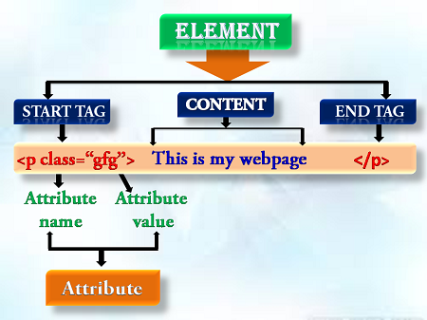
Building blocks of HTML
An HTML document consist of its basic building blocks which are:
Tags: An HTML tag surrounds the content and apply meaning to it. It is written between < and > brackets.
Attribute: An attribute in HTML provides extra information about the element, and it is applied within the start tag. An HTML attribute contains two fields: name & value.
Syntax :
Elements: An HTML element is an individual component of an HTML file. In an HTML file, everything written within tags are termed as HTML elements.

Slide 8
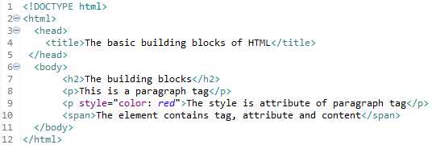
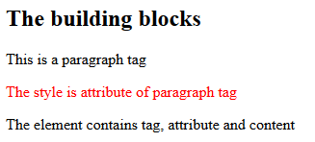
Block HTML Example
Example :
Output :

Slide 9
Day 01
2
HTML Tag

Slide 10
HTML Tag
HTML tags are like keywords which defines that how web browser will format and display the content. With the help of tags, a web browser can distinguish between an HTML content and a simple content. HTML tags contain three main parts: opening tag, content and closing tag. But some HTML tags are unclosed tags.
When a web browser reads an HTML document, browser reads it from top to bottom and left to right. HTML tags are used to create HTML documents and render their properties. Each HTML tags have different properties.
An HTML file must have some essential tags so that web browser can differentiate between a simple text and HTML text. You can use as many tags you want as per your code requirement.
All HTML tags must enclosed within < > these brackets.
Every tag in HTML perform different tasks.
If you have used an open tag <tag>, then you must use a close tag </tag> (except some tags)

Slide 11
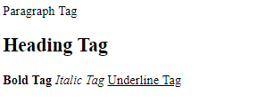
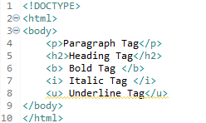
HTML Tag
Syntax :
<tag>content</tag>
Example :
Output :

Slide 12
Day 04
3
Multiple Catch Block

Slide 13
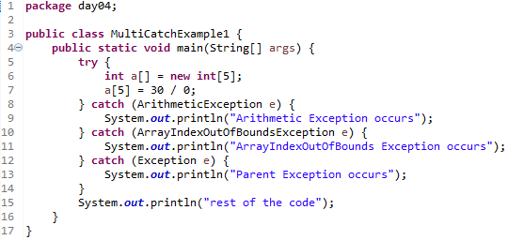

Java Multi-catch block
A try block can be followed by one or more catch blocks. Each catch block must contain a different exception handler. So, if you have to perform different tasks at the occurrence of different exceptions, use java multi-catch block.
Points to remember
At a time only one exception occurs and at a time only one catch block is executed.
All catch blocks must be ordered from most specific to most general, i.e. catch for ArithmeticException must come before catch for Exception.
Example 1 :
Output 1 :

Slide 14
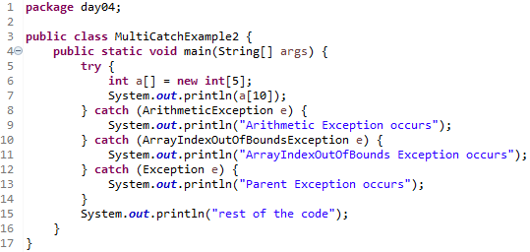
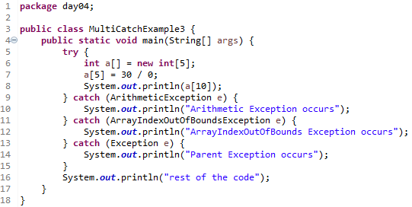


Example 2 :
Output 2:
Example 3 :
Output 3 :

Slide 15
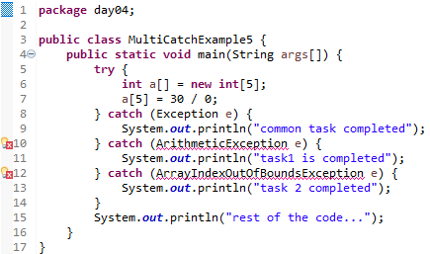
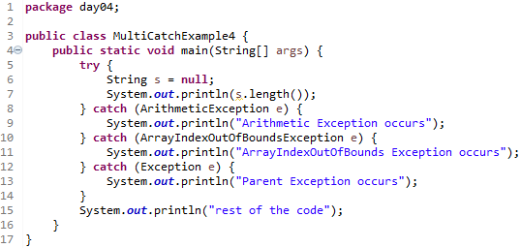


In this example, we generate NullPointerException, but didn't provide the corresponding exception type. In such case, the catch block containing the parent exception class Exception will invoked.
Example 4 :
Output 4:
Let's see an example, to handle the exception without maintaining the order of exceptions (i.e. from most specific to most general).
Example 5 :
Output 5 :

Slide 16
Day 04
4
Java Nested try block

Slide 17
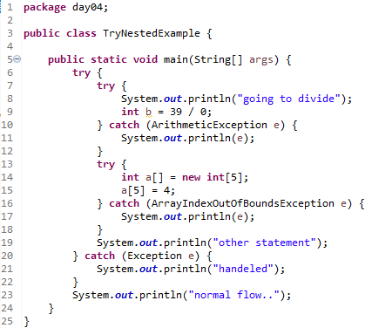
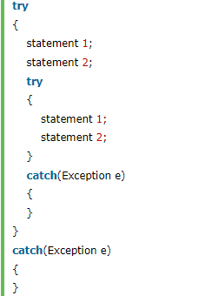
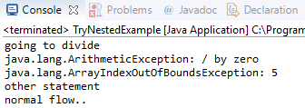
Why use nested try block
Sometimes a situation may arise where a part of a block may cause one error and the entire block itself may cause another error. In such cases, exception handlers have to be nested.
Syntax :
Example :
Output :

Slide 18
Day 04
5
Java finally block

Slide 19
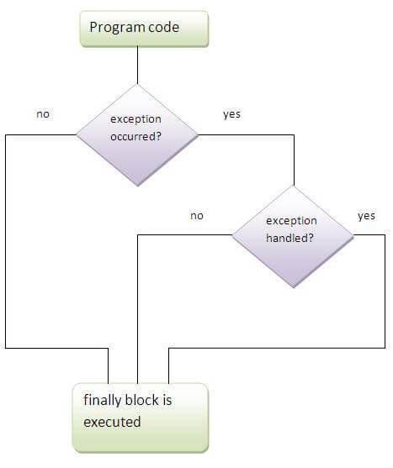
Java finally block
Java finally block is a block that is used to execute important code such as closing connection, stream etc.
Java finally block is always executed whether exception is handled or not.
Java finally block follows try or catch block.
Why use java finally
Finally block in java can be used to put "cleanup" code such as closing a file, closing connection etc.

Slide 20
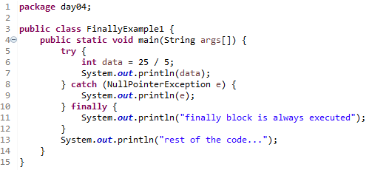
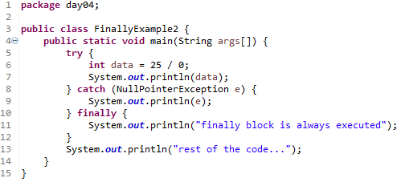


Usage of Java finally
The java finally example where exception doesn't occur.
Example 1:
Output 1 :
The java finally example where exception occurs and not handled.
Example 2:
Output 2 :

Slide 21


Usage of Java finally
The java finally example where exception occurs and handled.
Example 3:
Output 3:

Slide 22
Day 04
6
Java throw keyword

Slide 23
Java throw keyword
The Java throw keyword is used to explicitly throw an exception.
We can throw either checked or uncheked exception in java by throw keyword. The throw keyword is mainly used to throw custom exception. We will see custom exceptions later.
The syntax of java throw keyword is given below.
Example :

Slide 24

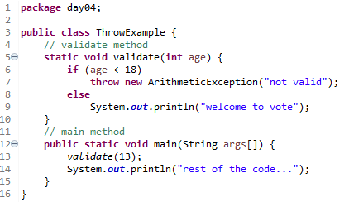
Java throw keyword
we create the validate method that takes integer value as a parameter. If the age is less than 18, we are throwing the ArithmeticException otherwise print a message welcome to vote.
Example :
Output :

Slide 25
Day 04
7
Java Exception propagation

Slide 26
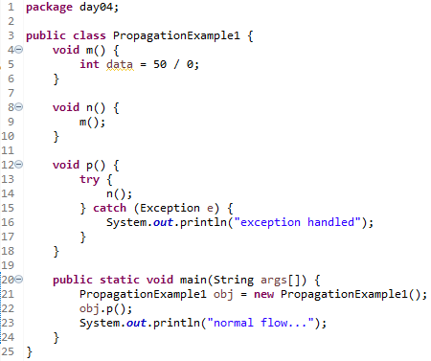
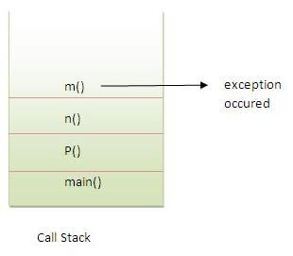

Java Exception propagation
An exception is first thrown from the top of the stack and if it is not caught, it drops down the call stack to the previous method,If not caught there, the exception again drops down to the previous method, and so on until they are caught or until they reach the very bottom of the call stack.This is called exception propagation.
Example 1:
Output 1:

Slide 27
Java Exception propagation
In the above example exception occurs in m() method where it is not handled,so it is propagated to previous n() method where it is not handled, again it is propagated to p() method where exception is handled.
Exception can be handled in any method in call stack either in main() method,p() method,n() method or m() method.
Example 1:
Output 1:

Slide 28
Day 04
8
Java throws keyword

Slide 29

Java throws keyword
The Java throws keyword is used to declare an exception. It gives an information to the programmer that there may occur an exception so it is better for the programmer to provide the exception handling code so that normal flow can be maintained.
Exception Handling is mainly used to handle the checked exceptions. If there occurs any unchecked exception such as NullPointerException, it is programmers fault that he is not performing check up before the code being used.
Syntax :
Which exception should be declared ?
Ans) checked exception only, because:
unchecked Exception: under your control so correct your code.
error: beyond your control e.g. you are unable to do anything if there occurs VirtualMachineError or StackOverflowError.
Advantage of Java throws keyword
Now Checked Exception can be propagated (forwarded in call stack).
It provides information to the caller of the method about the exception.

Slide 30
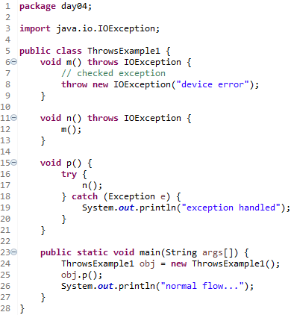

Java throws keyword
Example :
Output :

Slide 31
Java throws keyword - Rule
Rule: If you are calling a method that declares an exception, you must either caught or declare the exception.
There are two cases:
Case1:You caught the exception i.e. handle the exception using try/catch.
Case2:You declare the exception i.e. specifying throws with the method.

Slide 32
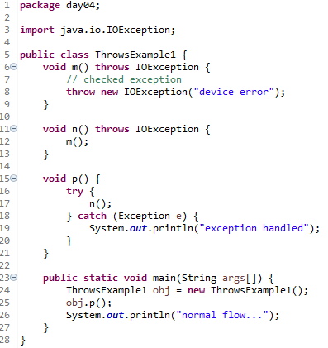

Java throws keyword - Case
Case1:You caught the exception i.e. handle the exception using try/catch.
In case you handle the exception, the code will be executed fine whether exception occurs during the program or not.

Slide 33
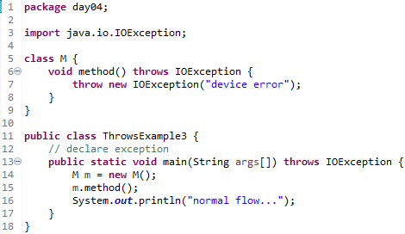
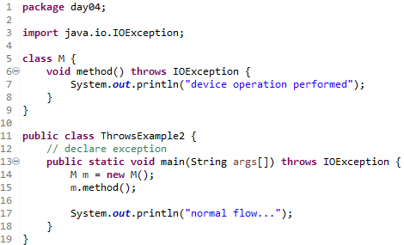


Java throws keyword - Case
A)In case you declare the exception, if exception does not occur, the code will be executed fine.
B)In case you declare the exception if exception occures, an exception will be thrown at runtime because throws does not handle the exception.

Slide 34
Day 04
9
Differences between throw and throws

Slide 35
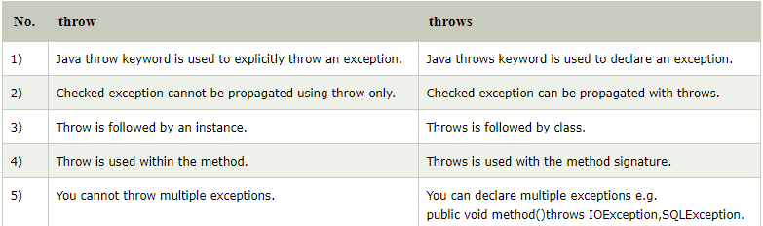
Differences between throw and throws
There are many differences between throw and throws keywords. A list of differences between throw and throws are given below:

Slide 36
Day 04
10
final, finally and finalize

Slide 37
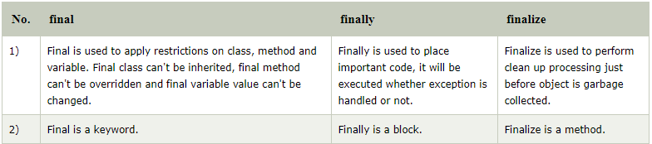
Differences between final, finally and finalize
There are many differences between final, finally and finalize. A list of differences between final, finally and finalize are given below:

Slide 38
Day 04
11
Study Case

Slide 39
GOOD LUCK!

Slide 40
THANKS!
Any questions?
Contact Your Trainer

