Slide 1


Java – Logic Day 02
Ver. 0.1

Slide 2
Day 02
1
Java if-else

Slide 3
Java If-else Statement
The Java if statement is used to test the condition. It checks boolean condition: true or false. There are various types of if statement in java.
if statement
if-else statement
if-else-if ladder
nested if statement

Slide 4
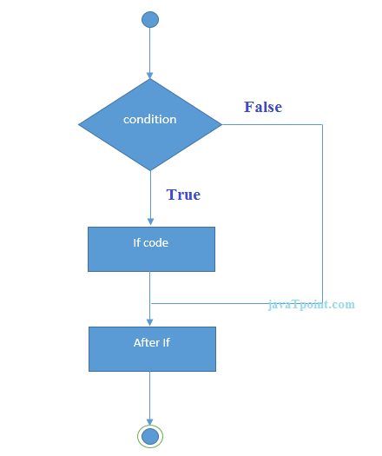

Java if Statement
Example :
The Java if statement tests the condition. It executes the if block if condition is true.
Syntax :

Slide 5
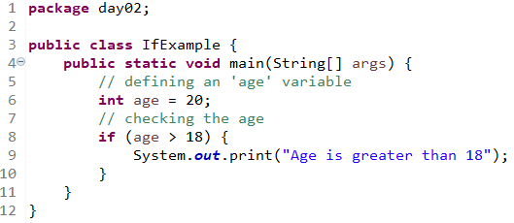
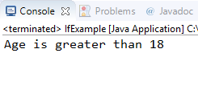
Java if Statement
Example :
Output :

Slide 6
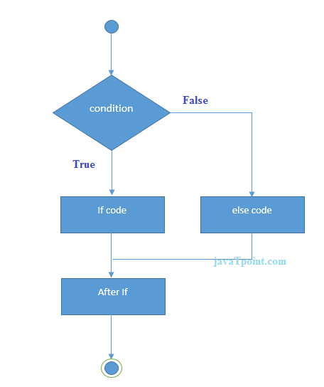
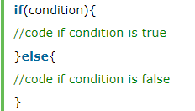
Java if-else Statement
The Java if-else statement also tests the condition. It executes the if block if condition is true otherwise else block is executed.
Syntax :

Slide 7
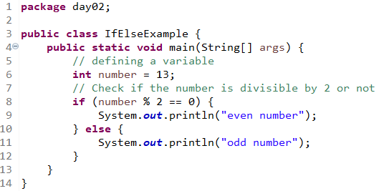
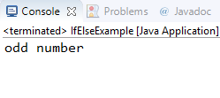
Java if-else Statement
Example :
Output :

Slide 8
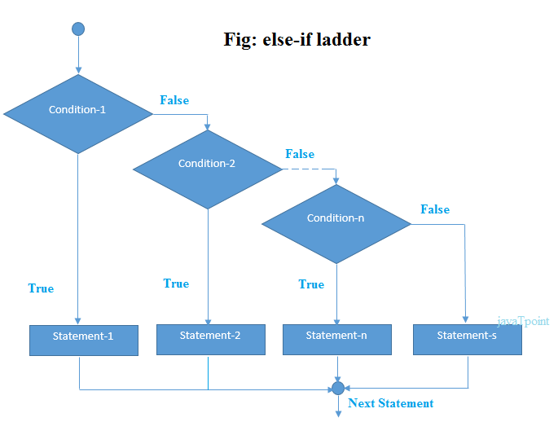
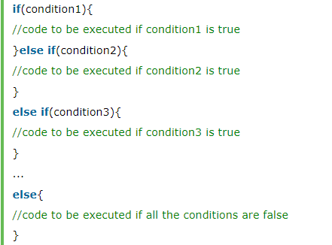
Java if-else-if ladder Statement
The if-else-if ladder statement executes one condition from multiple statements.
Syntax :

Slide 9
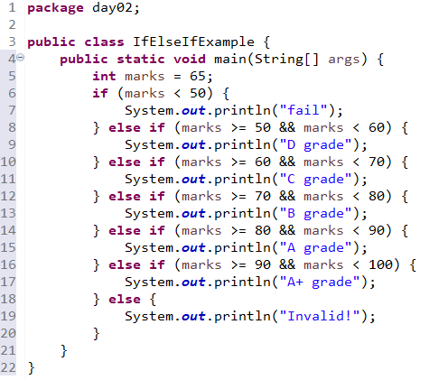

Java if-else-if ladder Statement
Example :
Output :

Slide 10
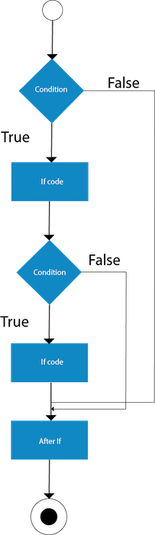
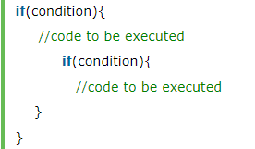
Java Nested if statement
The nested if statement represents the if block within another if block. Here, the inner if block condition executes only when outer if block condition is true.
Syntax :

Slide 11
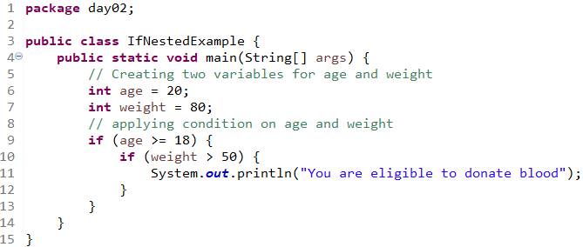

Java Nested if statement
Example 1 :
Output 1:

Slide 12
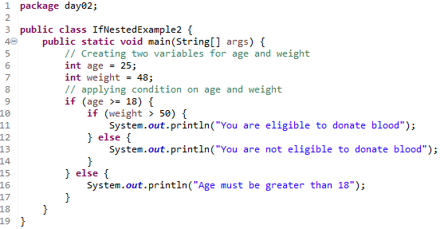

Java Nested if statement
Example 2 :
Output 2 :

Slide 13
Day 02
2
Switch

Slide 14
Java Switch Statement
The Java switch statement executes one statement from multiple conditions. It is like if-else-if ladder statement. The switch statement works with byte, short, int, long, enum types, String and some wrapper types like Byte, Short, Int, and Long. Since Java 7, you can use strings in the switch statement.
In other words, the switch statement tests the equality of a variable against multiple values.

Slide 15
Java Switch Statement
Points to Remember
There can be one or N number of case values for a switch expression.
The case value must be of switch expression type only. The case value must be literal or constant. It doesn't allow variables.
The case values must be unique. In case of duplicate value, it renders compile-time error.
The Java switch expression must be of byte, short, int, long (with its Wrapper type), enums and string.
Each case statement can have a break statement which is optional. When control reaches to the break statement, it jumps the control after the switch expression. If a break statement is not found, it executes the next case.
The case value can have a default label which is optional.

Slide 16
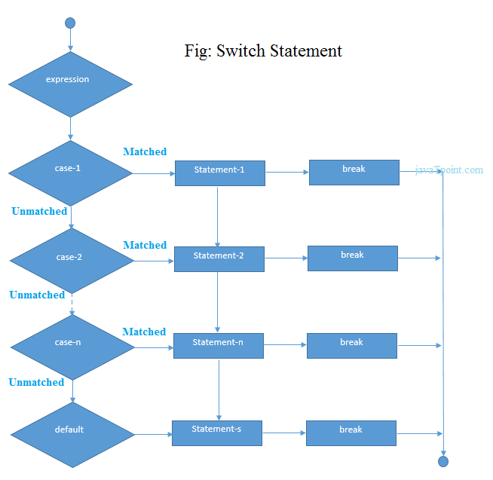
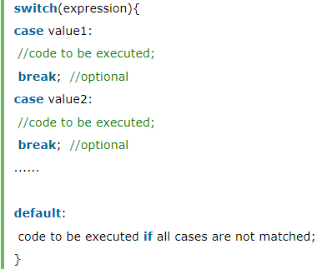
Java Switch Statement
Syntax :

Slide 17
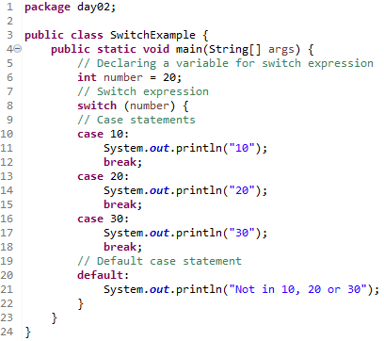

Java Switch Statement
Example 1 :
Output 1 :

Slide 18
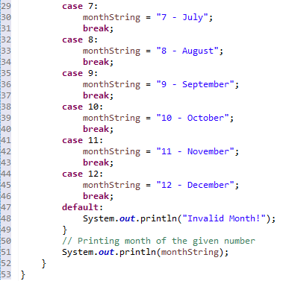
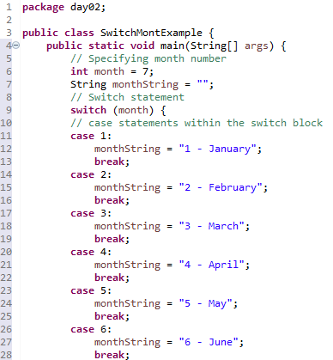

Java Switch Statement
Example 2 :
Output 2 :

Slide 19
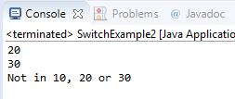
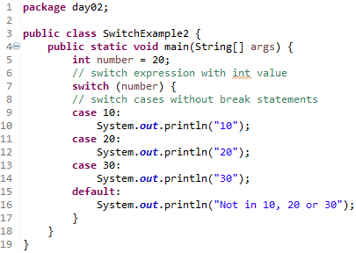
Java Switch Statement is fall-through
The Java switch statement is fall-through. It means it executes all statements after the first match if a break statement is not present.
Example :
Output :

Slide 20

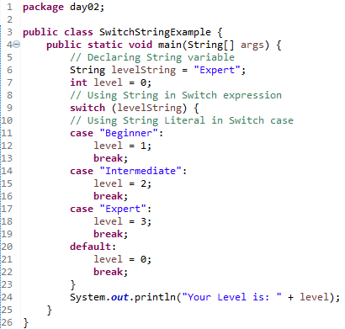
Java Switch Statement with String
Java allows us to use strings in switch expression since Java SE 7. The case statement should be string literal.
Example :
Output :

Slide 21
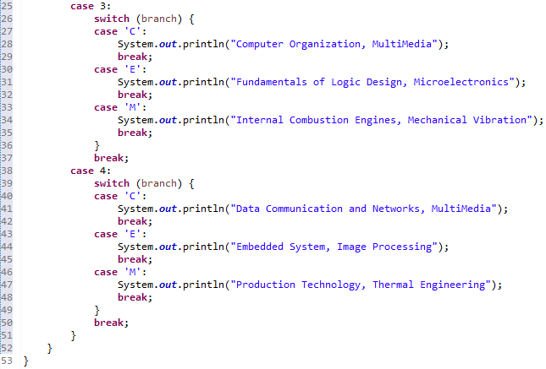
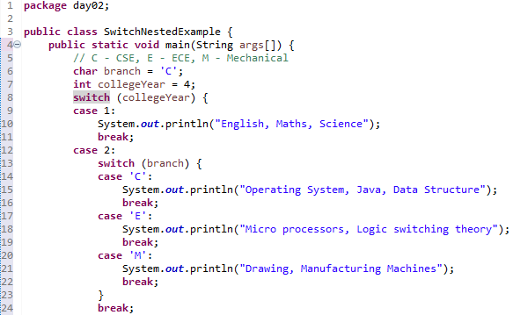
Java Nested Switch Statement
We can use switch statement inside other switch statement in Java. It is known as nested switch statement.
Example :
Output :

Slide 22
Day 02
3
Java Method

Slide 23

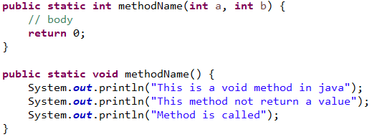
Java method
A method is basically a behavior. A class can contain many methods. It is in methods where the logics are written, data is manipulated and all the actions are executed.
A Java method is a collection of statements that are grouped together to perform an operation. When you call the System.out.println() method, for example, the system actually executes several statements in order to display a message on the console.
Now you will learn how to create your own methods with or without return values, invoke a method with or without parameters, and apply method abstraction in the program design.
Syntax :
Example :

Slide 24
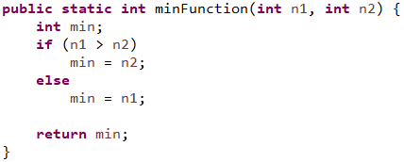
Syntax Method
modifier − It defines the access type of the method and it is optional to use.
returnType − Method may return a value.
nameOfMethod − This is the method name. The method signature consists of the method name and the parameter list.
Parameter List − The list of parameters, it is the type, order, and number of parameters of a method. These are optional, method may contain zero parameters.
method body − The method body defines what the method does with the statements.
Example :

Slide 25
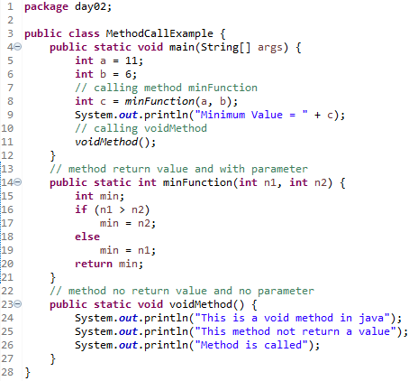
Calling Method
For using a method, it should be called. There are two ways in which a method is called i.e., method returns a value or returning nothing (no return value).
The process of method calling is simple. When a program invokes a method, the program control gets transferred to the called method. This called method then returns control to the caller in two conditions, when −
the return statement is executed.
it reaches the method ending closing brace.
Example :

Slide 26

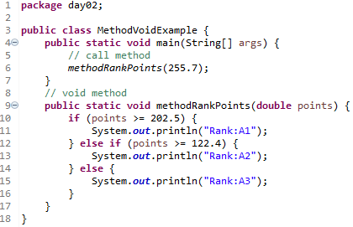
The void Keyword
The void keyword allows us to create methods which do not return a value. Here, in the following example we're considering a void method methodRankPoints
Example :
Output :

Slide 27
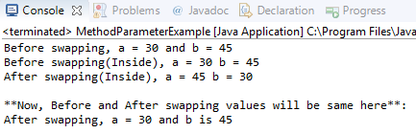
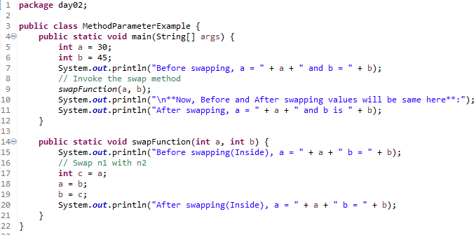
Passing Parameters by Value
Passing Parameters by Value means calling a method with a parameter. Through this, the argument value is passed to the parameter.
Example :
Output :

Slide 28
Day 02
4
Method Overloading

Slide 29
Method Overloading
When a class has two or more methods by the same name but different parameters, it is known as method overloading.
If we have to perform only one operation, having same name of the methods increases the readability of the program.
Suppose you have to perform addition of the given numbers but there can be any number of arguments, if you write the method such as a(int,int) for two parameters, and b(int,int,int) for three parameters then it may be difficult for you as well as other programmers to understand the behavior of the method because its name differs.
So, we perform method overloading to figure out the program quickly.
Advantage of method overloading :
Method overloading increases the readability of the program.
Different ways to overload the method :
There are two ways to overload the method in java :
By changing number of arguments
By changing the data type

Slide 30

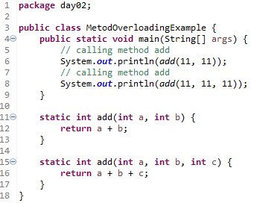
1. Changing no. of arguments
In this example, we have created two methods, first add() method performs addition of two numbers and second add method performs addition of three numbers.
In this example, we are creating static methods so that we don't need to create instance for calling methods.
Example :
Output :

Slide 31

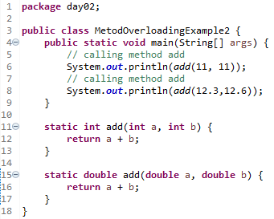
2. Changing data type of arguments
In this example, we have created two methods that differs in data type. The first add method receives two integer arguments and second add method receives two double arguments.
Example :
Output :

Slide 32
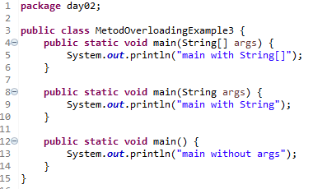
Overload main method
You can have any number of main methods in a class by method overloading. But JVM calls main() method which receives string array as arguments only.
Example:

Slide 33
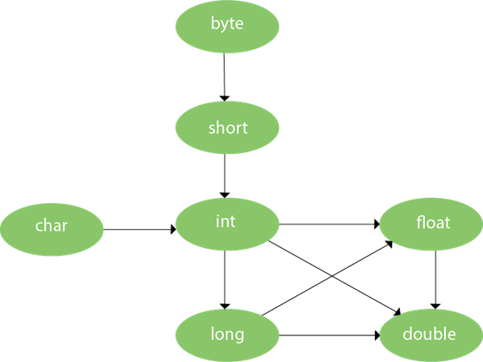
Method Overloading and Type Promotion
One type is promoted to another implicitly if no matching datatype is found. Let's understand the concept by the figure given below:
As displayed in the above diagram, byte can be promoted to short, int, long, float or double. The short datatype can be promoted to int,long,float or double. The char datatype can be promoted to int,long,float or double and so on.

Slide 34
Day 02
5
Study Case – Logic 02

Slide 35
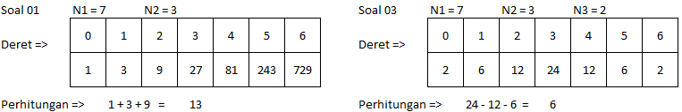
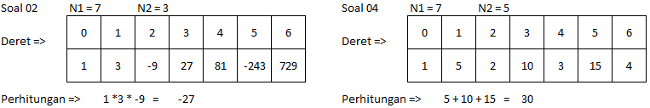
Study Case – Logic 02

Slide 36
GOOD LUCK!

Slide 37
THANKS!
Any questions?
Contact Your Trainer

