Slide 1


Java – Logic Day 04
Ver. 0.1

Slide 2
Day 04
1
Exception Handling

Slide 3
What Is Exception Handling?
The Exception Handling in Java is one of the powerful mechanism to handle the runtime errors so that normal flow of the application can be maintained.
In this page, we will learn about Java exceptions, its type and the difference between checked and unchecked exceptions.
Exception Handling is a mechanism to handle runtime errors such as ClassNotFoundException, IOException, SQLException, RemoteException, etc.
The Exception Handling in Java is one of the powerful mechanism to handle the runtime errors so that normal flow of the application can be maintained.
In this page, we will learn about Java exceptions, its type and the difference between checked and unchecked exceptions

Slide 4
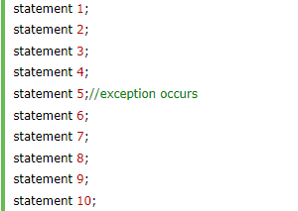
Advantage of Exception Handling
The core advantage of exception handling is to maintain the normal flow of the application. An exception normally disrupts the normal flow of the application that is why we use exception handling. Let's take a scenario:
Suppose there are 10 statements in your program and there occurs an exception at statement 5, the rest of the code will not be executed i.e. statement 6 to 10 will not be executed. If we perform exception handling, the rest of the statement will be executed. That is why we use exception handling in Java.

Slide 5
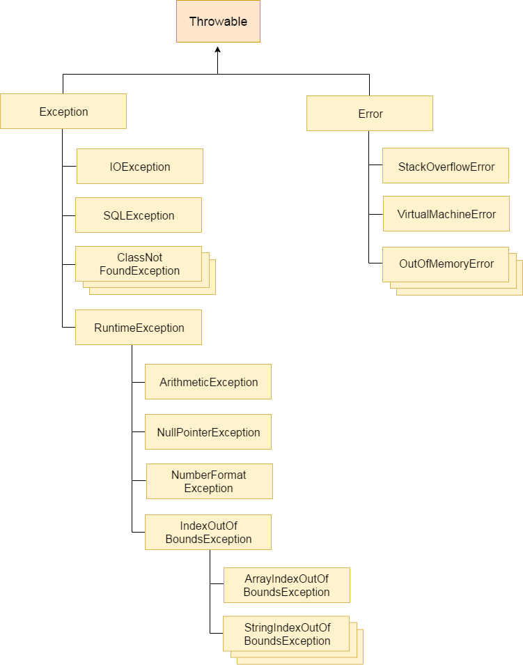
Hierarchy of Java Exception classes
The java.lang.Throwable class is the root class of Java Exception hierarchy which is inherited by two subclasses: Exception and Error. A hierarchy of Java Exception classes are given below:

Slide 6
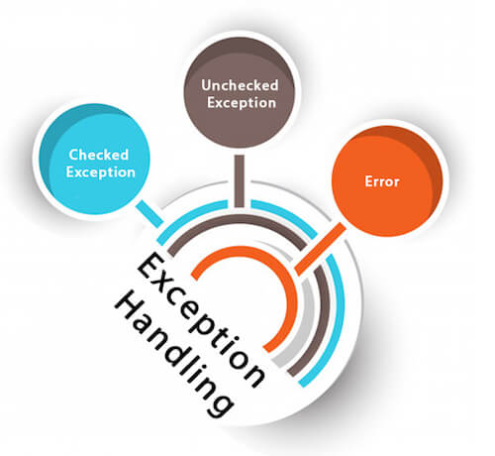
Types of Java Exceptions
There are mainly two types of exceptions: checked and unchecked. Here, an error is considered as the unchecked exception. According to Oracle, there are three types of exceptions:
Checked Exception
Unchecked Exception
Error

Slide 7
Difference between Checked and Unchecked Exceptions
1) Checked Exception
The classes which directly inherit Throwable class except RuntimeException and Error are known as checked exceptions e.g. IOException, SQLException etc. Checked exceptions are checked at compile-time.
2) Unchecked Exception
The classes which inherit RuntimeException are known as unchecked exceptions e.g. ArithmeticException, NullPointerException, ArrayIndexOutOfBoundsException etc. Unchecked exceptions are not checked at compile-time, but they are checked at runtime.
3) Error
Error is irrecoverable e.g. OutOfMemoryError, VirtualMachineError, AssertionError etc.

Slide 8
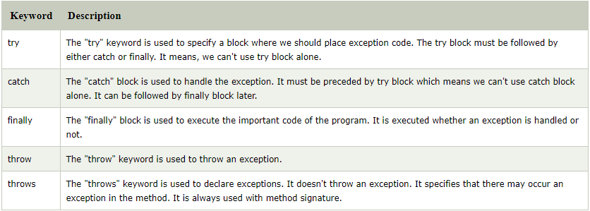
Java Exception Keywords
There are 5 keywords which are used in handling exceptions in Java.

Slide 9
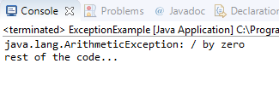
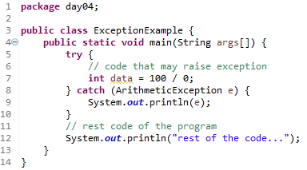
Java Exception Handling Example
Let's see an example of Java Exception Handling where we using a try-catch statement to handle the exception.
Exampale :
Output :
In the above example, 100/0 raises an ArithmeticException which is handled by a try-catch block.

Slide 10




Common Scenarios of Java Exceptions
1) A scenario where ArithmeticException occurs
If we divide any number by zero, there occurs an ArithmeticException.
2) A scenario where NullPointerException occurs
If we have a null value in any variable, performing any operation on the variable throws a NullPointerException.
3) A scenario where NumberFormatException occurs
The wrong formatting of any value may occur NumberFormatException. Suppose I have a string variable that has characters, converting this variable into digit will occur NumberFormatException.
4) A scenario where ArrayIndexOutOfBoundsException occurs
If you are inserting any value in the wrong index, it would result in ArrayIndexOutOfBoundsException as shown below:

Slide 11
Day 04
2
Try-Catch Block

Slide 12


Java try block
Java try block is used to enclose the code that might throw an exception. It must be used within the method.
If an exception occurs at the particular statement of try block, the rest of the block code will not execute. So, it is recommended not to keeping the code in try block that will not throw an exception.
Java try block must be followed by either catch or finally block.
Syntax try – catch block :
Syntax try – finally block :

Slide 13
Java catch block
Java catch block is used to handle the Exception by declaring the type of exception within the parameter. The declared exception must be the parent class exception ( i.e., Exception) or the generated exception type. However, the good approach is to declare the generated type of exception.
The catch block must be used after the try block only. You can use multiple catch block with a single try block.

Slide 14
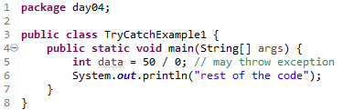
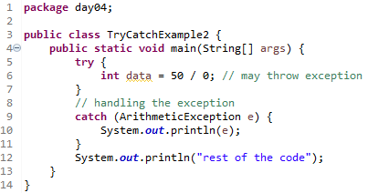
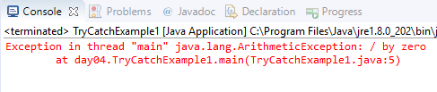

Problem without exception handling
Example 1 :
Output 2 :
Example 2 :
Output 2 :
Now, as displayed in the above example, the rest of the code is executed, i.e., the rest of the code statement is printed.

Slide 15
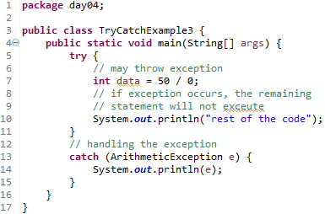
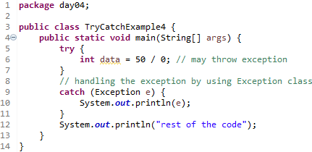


Problem without exception handling
Example 3 :
Output 3 :
Example 4 :
Output 4 :

Slide 16
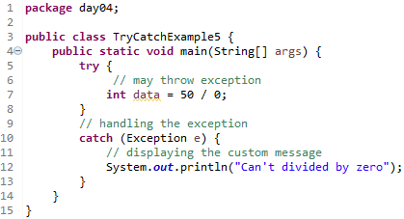
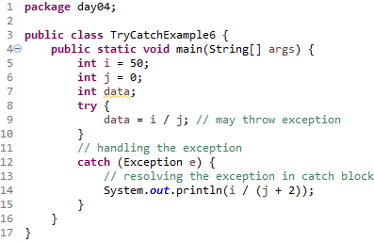


Problem without exception handling
Example 5 :
Output 5 :
Example 6:
Output 6 :

Slide 17
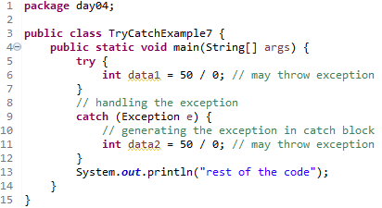
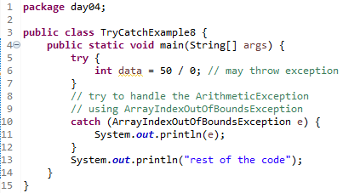


Problem without exception handling
Example 7 :
Output 7 :
Here, we can see that the catch block didn't contain the exception code. So, enclose exception code within a try block and use catch block only to handle the exceptions.
Example 8:
Output 8 :

Slide 18
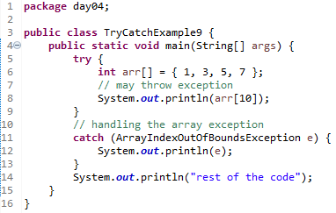
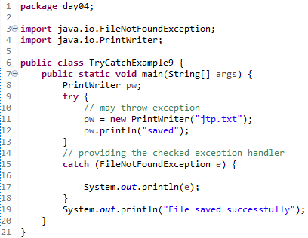


Problem without exception handling
Example 9 :
Output 9 :
Example 10:
Output 10 :

Slide 19
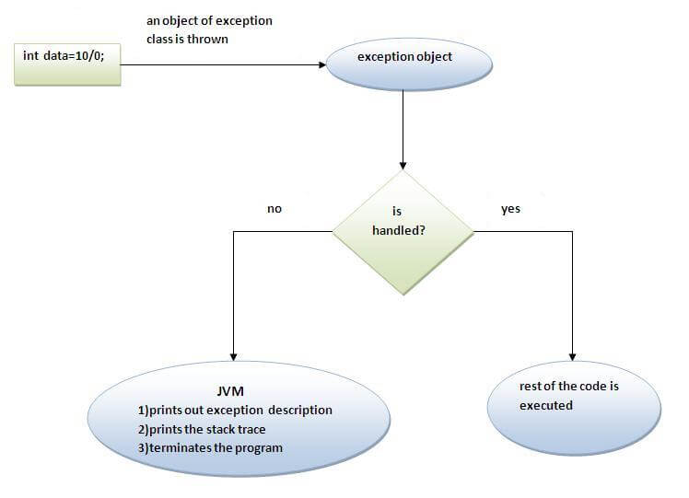
Internal working of java try-catch block
The JVM firstly checks whether the exception is handled or not. If exception is not handled, JVM provides a default exception handler that performs the following tasks:
Prints out exception description.
Prints the stack trace (Hierarchy of methods where the exception occurred).
Causes the program to terminate.
But if exception is handled by the application programmer, normal flow of the application is maintained i.e. rest of the code is executed.

Slide 20
Day 04
3
Multiple Catch Block

Slide 21
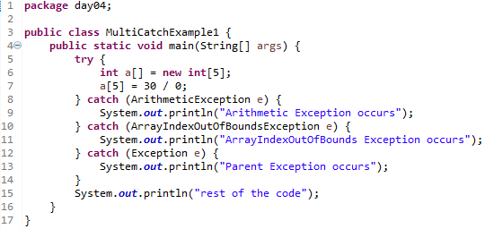

Java Multi-catch block
A try block can be followed by one or more catch blocks. Each catch block must contain a different exception handler. So, if you have to perform different tasks at the occurrence of different exceptions, use java multi-catch block.
Points to remember
At a time only one exception occurs and at a time only one catch block is executed.
All catch blocks must be ordered from most specific to most general, i.e. catch for ArithmeticException must come before catch for Exception.
Example 1 :
Output 1 :

Slide 22
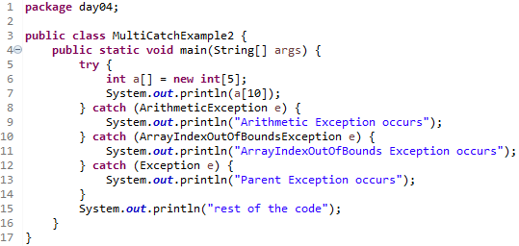
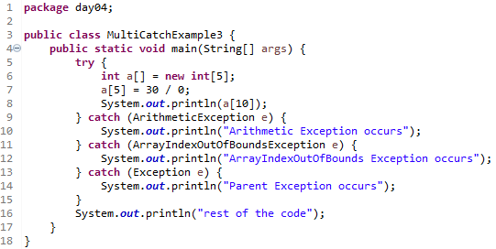


Example 2 :
Output 2:
Example 3 :
Output 3 :

Slide 23
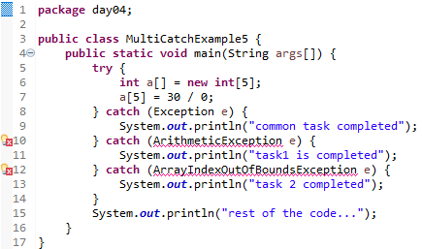
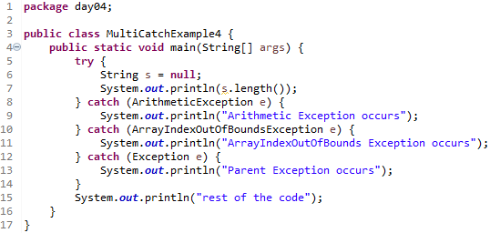


In this example, we generate NullPointerException, but didn't provide the corresponding exception type. In such case, the catch block containing the parent exception class Exception will invoked.
Example 4 :
Output 4:
Let's see an example, to handle the exception without maintaining the order of exceptions (i.e. from most specific to most general).
Example 5 :
Output 5 :

Slide 24
Day 04
4
Java Nested try block

Slide 25
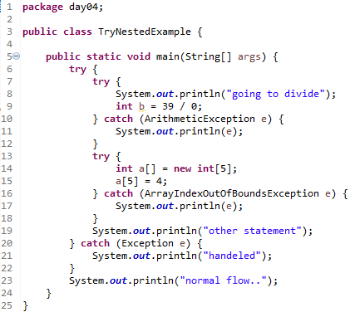
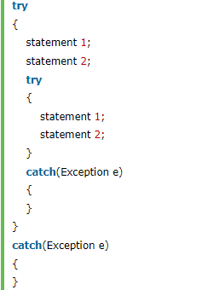
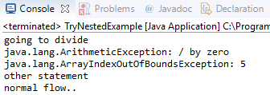
Why use nested try block
Sometimes a situation may arise where a part of a block may cause one error and the entire block itself may cause another error. In such cases, exception handlers have to be nested.
Syntax :
Example :
Output :

Slide 26
Day 04
5
Java finally block

Slide 27
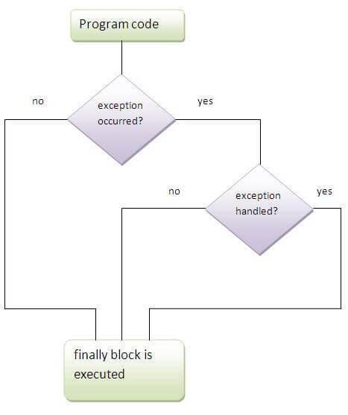
Java finally block
Java finally block is a block that is used to execute important code such as closing connection, stream etc.
Java finally block is always executed whether exception is handled or not.
Java finally block follows try or catch block.
Why use java finally
Finally block in java can be used to put "cleanup" code such as closing a file, closing connection etc.

Slide 28
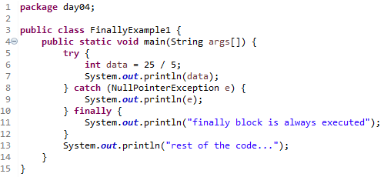
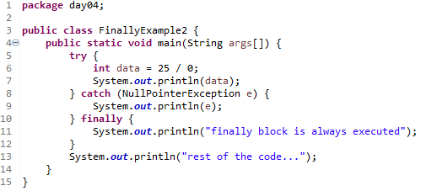


Usage of Java finally
The java finally example where exception doesn't occur.
Example 1:
Output 1 :
The java finally example where exception occurs and not handled.
Example 2:
Output 2 :

Slide 29


Usage of Java finally
The java finally example where exception occurs and handled.
Example 3:
Output 3:

Slide 30
Day 04
6
Java throw keyword

Slide 31
Java throw keyword
The Java throw keyword is used to explicitly throw an exception.
We can throw either checked or uncheked exception in java by throw keyword. The throw keyword is mainly used to throw custom exception. We will see custom exceptions later.
The syntax of java throw keyword is given below.
Example :

Slide 32

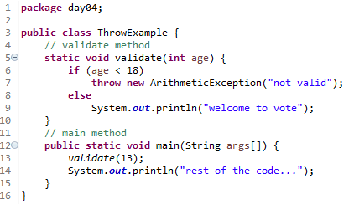
Java throw keyword
we create the validate method that takes integer value as a parameter. If the age is less than 18, we are throwing the ArithmeticException otherwise print a message welcome to vote.
Example :
Output :

Slide 33
Day 04
7
Java Exception propagation

Slide 34
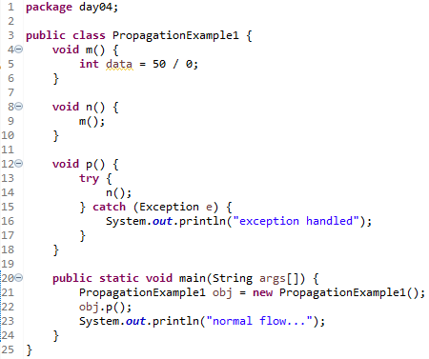
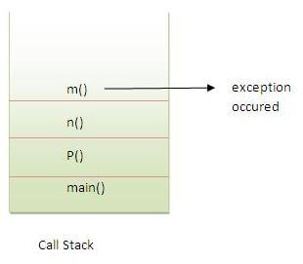

Java Exception propagation
An exception is first thrown from the top of the stack and if it is not caught, it drops down the call stack to the previous method,If not caught there, the exception again drops down to the previous method, and so on until they are caught or until they reach the very bottom of the call stack.This is called exception propagation.
Example 1:
Output 1:

Slide 35
Java Exception propagation
In the above example exception occurs in m() method where it is not handled,so it is propagated to previous n() method where it is not handled, again it is propagated to p() method where exception is handled.
Exception can be handled in any method in call stack either in main() method,p() method,n() method or m() method.
Example 1:
Output 1:

Slide 36
Day 04
8
Java throws keyword

Slide 37

Java throws keyword
The Java throws keyword is used to declare an exception. It gives an information to the programmer that there may occur an exception so it is better for the programmer to provide the exception handling code so that normal flow can be maintained.
Exception Handling is mainly used to handle the checked exceptions. If there occurs any unchecked exception such as NullPointerException, it is programmers fault that he is not performing check up before the code being used.
Syntax :
Which exception should be declared ?
Ans) checked exception only, because:
unchecked Exception: under your control so correct your code.
error: beyond your control e.g. you are unable to do anything if there occurs VirtualMachineError or StackOverflowError.
Advantage of Java throws keyword
Now Checked Exception can be propagated (forwarded in call stack).
It provides information to the caller of the method about the exception.

Slide 38
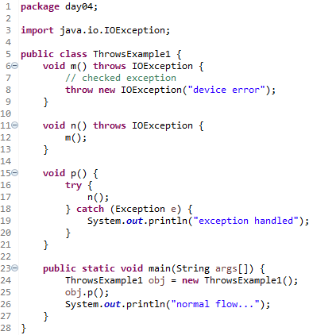

Java throws keyword
Example :
Output :

Slide 39
Java throws keyword - Rule
Rule: If you are calling a method that declares an exception, you must either caught or declare the exception.
There are two cases:
Case1:You caught the exception i.e. handle the exception using try/catch.
Case2:You declare the exception i.e. specifying throws with the method.

Slide 40
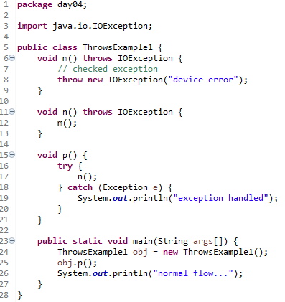

Java throws keyword - Case
Case1:You caught the exception i.e. handle the exception using try/catch.
In case you handle the exception, the code will be executed fine whether exception occurs during the program or not.

Slide 41
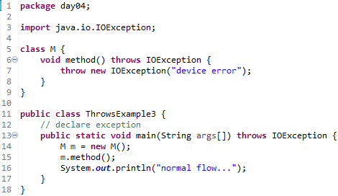
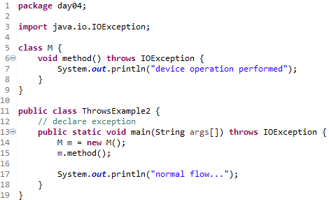


Java throws keyword - Case
A)In case you declare the exception, if exception does not occur, the code will be executed fine.
B)In case you declare the exception if exception occures, an exception will be thrown at runtime because throws does not handle the exception.

Slide 42
Day 04
9
Differences between throw and throws

Slide 43
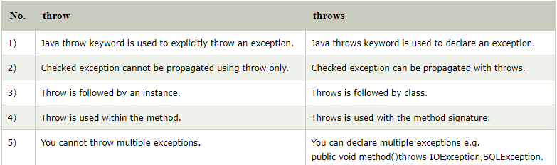
Differences between throw and throws
There are many differences between throw and throws keywords. A list of differences between throw and throws are given below:

Slide 44
Day 04
10
final, finally and finalize

Slide 45
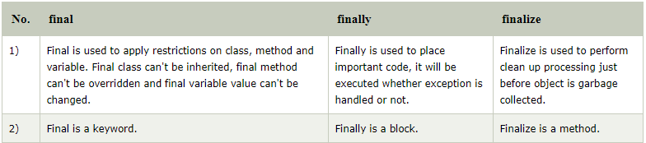
Differences between final, finally and finalize
There are many differences between final, finally and finalize. A list of differences between final, finally and finalize are given below:

Slide 46
Day 04
11
Study Case

Slide 47
GOOD LUCK!

Slide 48
THANKS!
Any questions?
Contact Your Trainer

