Slide 1


Java – Logic Day 05
Ver. 0.1

Slide 2
Day 05
1
OOPs Concepts

Slide 3
Java OOPs Concepts
Object-Oriented Programming is a paradigm that provides many concepts such as inheritance, data binding, polymorphism, etc.
Simula is considered the first object-oriented programming language. The programming paradigm where everything is represented as an object is known as a truly object-oriented programming language.
Smalltalk is considered the first truly object-oriented programming language.
The popular object-oriented languages are Java, C#, PHP, Python, C++, etc.
The main aim of object-oriented programming is to implement real-world entities for example object, classes, abstraction, inheritance, polymorphism, etc.

Slide 4
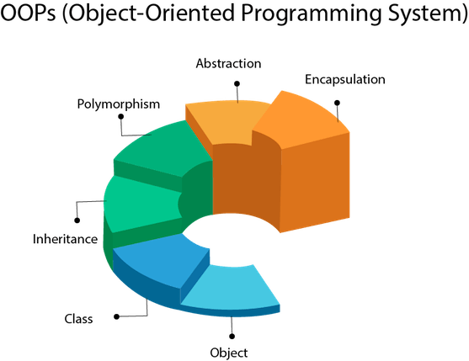
OOPs (Object-Oriented Programming System)
Object means a real-world entity such as a pen, chair, table, computer, watch, etc. Object-Oriented Programming is a methodology or paradigm to design a program using classes and objects. It simplifies the software development and maintenance by providing some concepts:
Object
Class
Inheritance
Polymorphism
Abstraction
Encapsulation

Slide 5
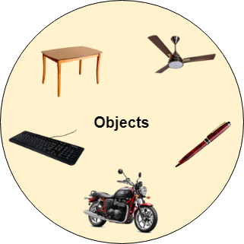
OOPs (Object-Oriented Programming System)
Object
Any entity that has state and behavior is known as an object. For example a chair, pen, table, keyboard, bike, etc. It can be physical or logical.
An Object can be defined as an instance of a class. An object contains an address and takes up some space in memory. Objects can communicate without knowing the details of each other's data or code. The only necessary thing is the type of message accepted and the type of response returned by the objects.
Example: A dog is an object because it has states like color, name, breed, etc. as well as behaviors like wagging the tail, barking, eating, etc.

Slide 6
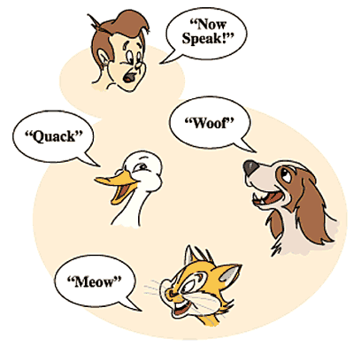
OOPs (Object-Oriented Programming System)
Class
Collection of objects is called class. It is a logical entity.
A class can also be defined as a blueprint from which you can create an individual object. Class doesn't consume any space.
Inheritance
When one object acquires all the properties and behaviors of a parent object, it is known as inheritance. It provides code reusability. It is used to achieve runtime polymorphism
Polymorphism
If one task is performed by different ways, it is known as polymorphism. For example: to convince the customer differently, to draw something, for example, shape, triangle, rectangle, etc.
In Java, we use method overloading and method overriding to achieve polymorphism.
Another example can be to speak something; for example, a cat speaks meow, dog barks woof, etc.

Slide 7

OOPs (Object-Oriented Programming System)
Abstraction
Hiding internal details and showing functionality is known as abstraction. For example phone call, we don't know the internal processing.
In Java, we use abstract class and interface to achieve abstraction.
Encapsulation
Binding (or wrapping) code and data together into a single unit are known as encapsulation. For example capsule, it is wrapped with different medicines.
A java class is the example of encapsulation. Java bean is the fully encapsulated class because all the data members are private here.

Slide 8
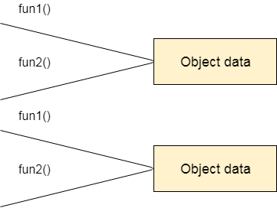
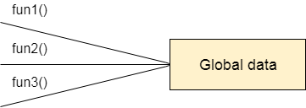
Advantage of OOPs over Procedure-oriented
1) OOPs makes development and maintenance easier whereas in a procedure-oriented programming language it is not easy to manage if code grows as project size increases.
2) OOPs provides data hiding whereas in a procedure-oriented programming language a global data can be accessed from anywhere.
Procedure Oriented:
Object Oriented :
3) OOPs provides the ability to simulate real-world event much more effectively. We can provide the solution of real word problem if we are using the Object-Oriented Programming language.

Slide 9
Day 05
2
Java Naming conventions

Slide 10
Java Naming conventions
Java naming convention is a rule to follow as you decide what to name your identifiers such as class, package, variable, constant, method, etc.
But, it is not forced to follow. So, it is known as convention not rule. These conventions are suggested by several Java communities such as Sun Microsystems and Netscape.
All the classes, interfaces, packages, methods and fields of Java programming language are given according to the Java naming convention. If you fail to follow these conventions, it may generate confusion or erroneous code.
Advantage of naming conventions in java
By using standard Java naming conventions, you make your code easier to read for yourself and other programmers. Readability of Java program is very important. It indicates that less time is spent to figure out what the code does.
The following are the key rules that must be followed by every identifier:
The name must not contain any white spaces.
The name should not start with special characters like & (ampersand), $ (dollar), _ (underscore).
Let's see some other rules that should be followed by identifiers.

Slide 11


Java Naming conventions
Class
It should start with the uppercase letter.
It should be a noun such as Color, Button, System, Thread, etc.
Use appropriate words, instead of acronyms.
Example : -
Interface
It should start with the uppercase letter.
It should be an adjective such as Runnable, Remote, ActionListener.
Use appropriate words, instead of acronyms.
Example: -

Slide 12
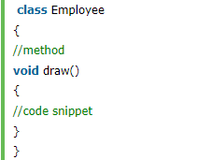
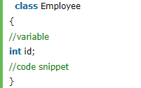
Java Naming conventions
Method
It should start with lowercase letter.
It should be a verb such as main(), print(), println().
If the name contains multiple words, start it with a lowercase letter followed by an uppercase letter such as actionPerformed().
Example:-
Variable
It should start with a lowercase letter such as id, name.
It should not start with the special characters like & (ampersand), $ (dollar), _ (underscore).
If the name contains multiple words, start it with the lowercase letter followed by an uppercase letter such as firstName, lastName.
Avoid using one-character variables such as x, y, z.
Example: -

Slide 13
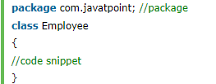
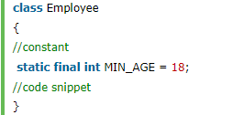
Java Naming conventions
Package
It should be a lowercase letter such as java, lang.
If the name contains multiple words, it should be separated by dots (.) such as java.util, java.lang.
Example :-
Constant
It should be in uppercase letters such as RED, YELLOW.
If the name contains multiple words, it should be separated by an underscore(_) such as MAX_PRIORITY.
It may contain digits but not as the first letter.
Example :-

Slide 14
CamelCase in java naming conventions
Java follows camel-case syntax for naming the class, interface, method, and variable.
If the name is combined with two words, the second word will start with uppercase letter always such as actionPerformed(), firstName, ActionEvent, ActionListener, etc.

Slide 15
Day 05
3
Objects and Classes

Slide 16

What is an object in Java?
An entity that has state and behavior is known as an object e.g. chair, bike, marker, pen, table, car etc. It can be physical or logical (tangible and intangible). The example of an intangible object is the banking system.
An object has three characteristics:
State:represents the data (value) of an object.
Behavior: represents the behavior (functionality) of an object such as deposit, withdraw, etc.
Identity: An object identity is typically implemented via a unique ID. The value of the ID is not visible to the external user. However, it is used internally by the JVM to identify each object uniquely

Slide 17
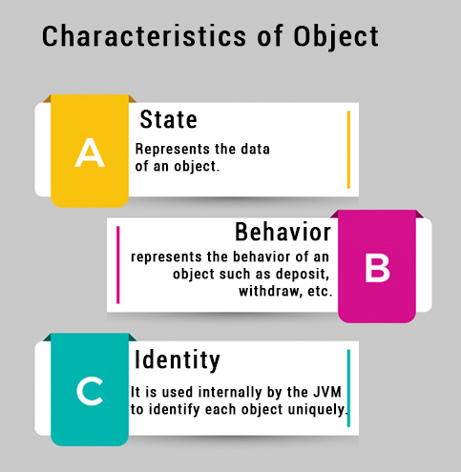
What is an object in Java ?
An object is an instance of a class. A class is a template or blueprint from which objects are created. So, an object is the instance(result) of a class.
Object Definitions:
An object is a real-world entity.
An object is a runtime entity.
The object is an entity which has state and behavior.
The object is an instance of a class.

Slide 18
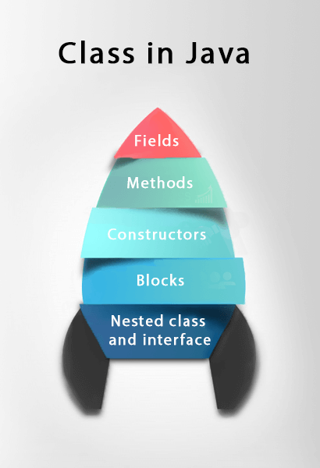

What is a class in Java
A class is a group of objects which have common properties. It is a template or blueprint from which objects are created. It is a logical entity. It can't be physical.
A class in Java can contain:
Fields
Methods
Constructors
Blocks
Nested class and interface
Syntax :

Slide 19
Instance variable and method in Java
Instance variable in Java
A variable which is created inside the class but outside the method is known as an instance variable. Instance variable doesn't get memory at compile time. It gets memory at runtime when an object or instance is created. That is why it is known as an instance variable.
Method in Java
In Java, a method is like a function which is used to expose the behavior of an object.
Advantage of Method :
Code Reusability
Code Optimization
new keyword in Java
The new keyword is used to allocate memory at runtime. All objects get memory in Heap memory area.

Slide 20

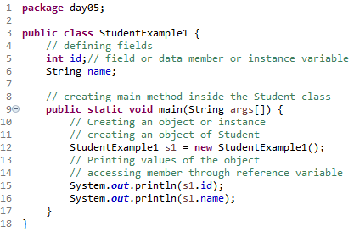
Object and Class Example: main within the class
In this example, we have created a Student class which has two data members id and name. We are creating the object of the Student class by new keyword and printing the object's value.
Example :
Output :

Slide 21
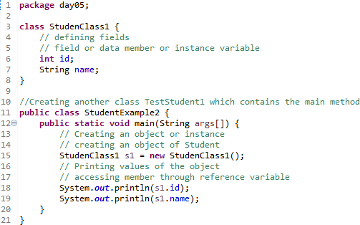

Object and Class Example: main outside the class
In real time development, we create classes and use it from another class. It is a better approach than previous one. Let's see a simple example, where we are having main() method in another class.
We can have multiple classes in different java files or single java file. If you define multiple classes in a single java source file, it is a good idea to save the file name with the class name which has main() method.
Example :
Output :

Slide 22
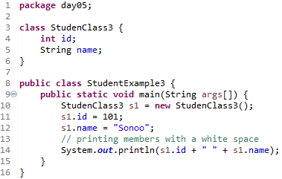

Initialize Object
There are 3 ways to initialize object in java.
By reference variable
By method
By constructor
1) Object and Class Example: Initialization through reference
Initializing an object means storing data into the object. Let's see a simple example where we are going to initialize the object through a reference variable.
Example :
Output :

Slide 23
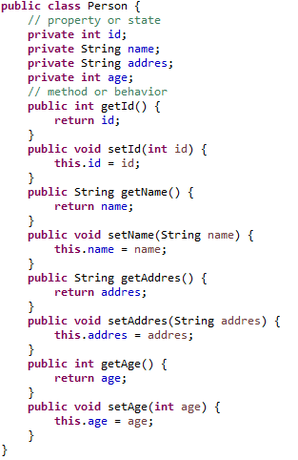
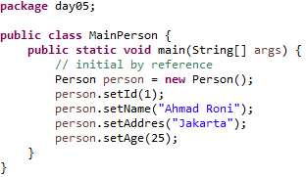
Initial By Reference
Class Person :

Slide 24
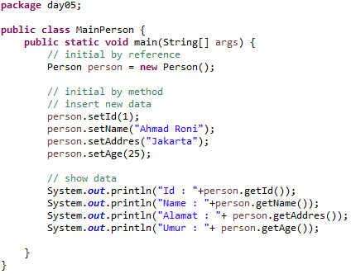
Initial By Method

Slide 25
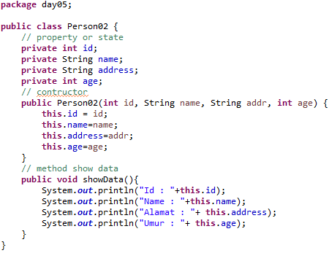
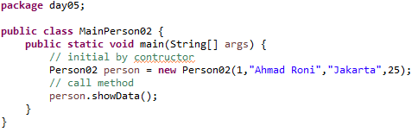
Initial By Constructor

Slide 26
Day 05
3
Constructor

Slide 27
Constructor
In Java, a constructor is a block of codes similar to the method. It is called when an instance of the object is created, and memory is allocated for the object.
It is a special type of method which is used to initialize the object.

Slide 28
When is a constructor called
Every time an object is created using new() keyword, at least one constructor is called. It calls a default constructor.
Note: It is called constructor because it constructs the values at the time of object creation. It is not necessary to write a constructor for a class. It is because java compiler creates a default constructor if your class doesn't have any.

Slide 29
Rules for creating Java constructor
There are two rules defined for the constructor.
Constructor name must be the same as its class name
A Constructor must have no explicit return type
A Java constructor cannot be abstract, static, final, and synchronized

Slide 30
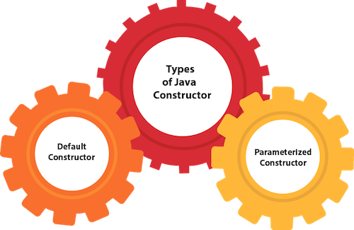
Types of Java constructors
There are two types of constructors in Java:
Default constructor (no-arg constructor)
Parameterized constructor

Slide 31
Java Default Constructor
A constructor is called "Default Constructor" when it doesn't have any parameter.
Syntax of default constructor:

Slide 32
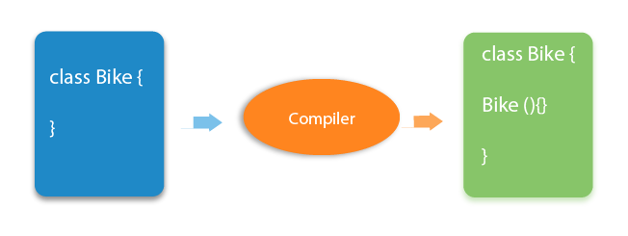
Java Default Constructor
What is the purpose of a default constructor?
The default constructor is used to provide the default values to the object like 0, null, etc., depending on the type.

Slide 33
Java Parameterized Constructor
A constructor which has a specific number of parameters is called a parameterized constructor.
Why use the parameterized constructor?
The parameterized constructor is used to provide different values to the distinct objects. However, you can provide the same values also.

Slide 34
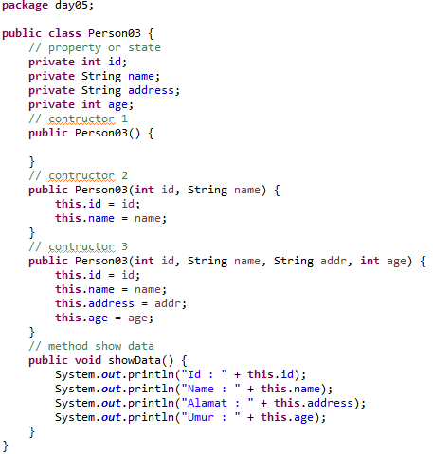
Constructor Overloading in Java
In Java, a constructor is just like a method but without return type. It can also be overloaded like Java methods.
Constructor overloading in Java is a technique of having more than one constructor with different parameter lists. They are arranged in a way that each constructor performs a different task. They are differentiated by the compiler by the number of parameters in the list and their types.

Slide 35
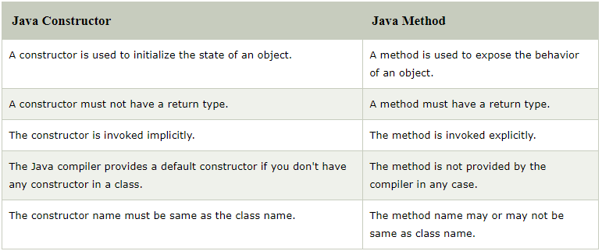
Constructor Vs Method

Slide 36
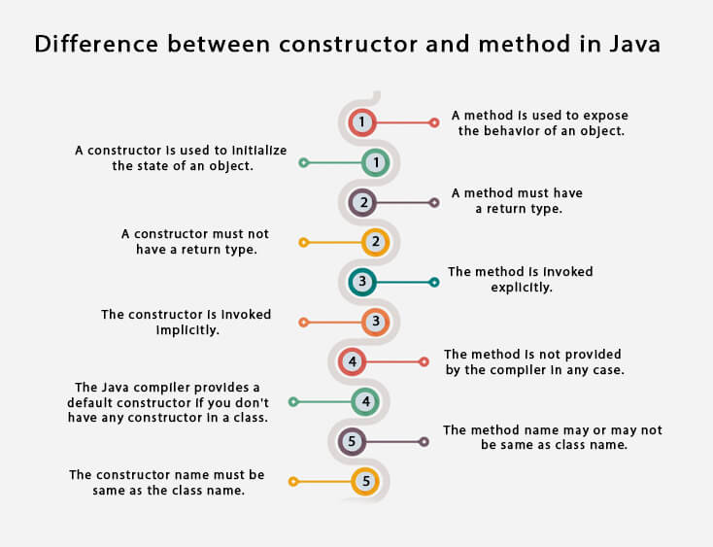
Constructor Vs Method

Slide 37
Day 05
5
static Keyword

Slide 38
Java static keyword
The static keyword in Java is used for memory management mainly. We can apply java static keyword with variables, methods, blocks and nested class. The static keyword belongs to the class than an instance of the class.
The static can be:
Variable (also known as a class variable)
Method (also known as a class method)
Block
Nested class

Slide 39
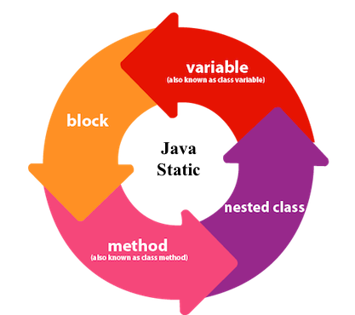
Java static variable
If you declare any variable as static, it is known as a static variable.
The static variable can be used to refer to the common property of all objects (which is not unique for each object), for example, the company name of employees, college name of students, etc.
The static variable gets memory only once in the class area at the time of class loading.

Slide 40
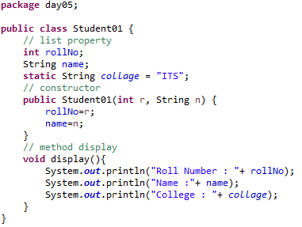
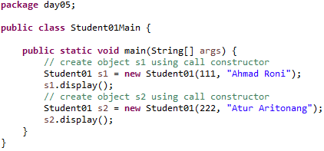
Java static variable - Example

Slide 41
Java static method
If you apply static keyword with any method, it is known as static method.
A static method belongs to the class rather than the object of a class.
A static method can be invoked without the need for creating an instance of a class.
A static method can access static data member and can change the value of it..

Slide 42
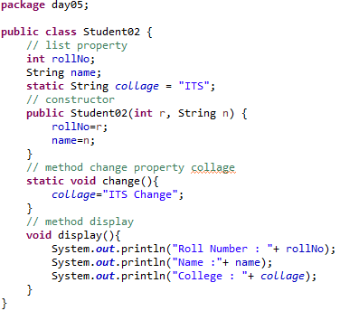
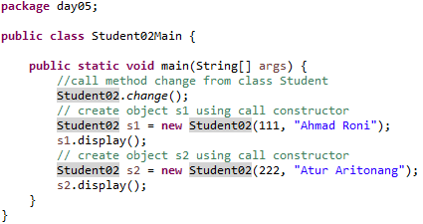
Java static method - Example

Slide 43
Restrictions for the static method
There are two main restrictions for the static method. They are:
The static method can not use non static data member or call non-static method directly.
this and super cannot be used in static context.
Why is the Java main method static?
It is because the object is not required to call a static method. If it were a non-static method, JVM creates an object first then call main() method that will lead the problem of extra memory allocation.

Slide 44
Java static block
Is used to initialize the static data member.
It is executed before the main method at the time of classloading.
Can we execute a program without main() method?
No, one of the ways was the static block, but it was possible till JDK 1.6. Since JDK 1.7, it is not possible to execute a java class without the main method.

Slide 45
Day 05
6
this Keyword

Slide 46
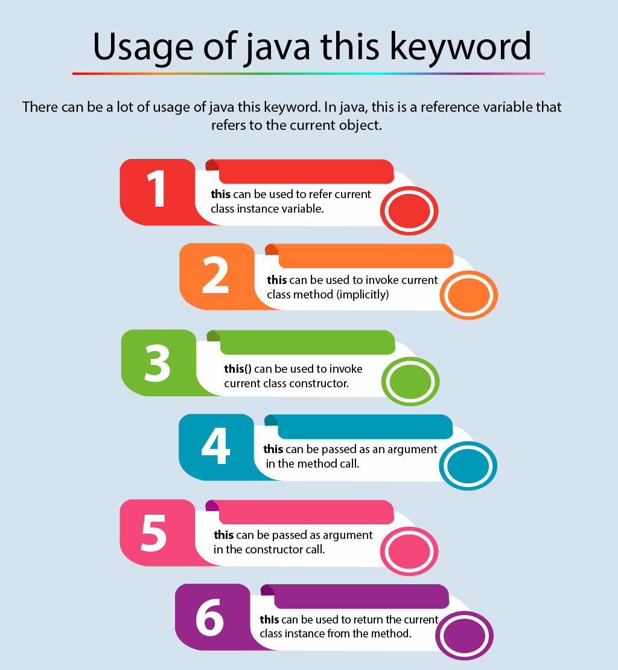
There can be a lot of usage of java this keyword. In java, this is a reference variable that refers to the current object.
Here is given the 6 usage of java this keyword:
this can be used to refer current class instance variable.
this can be used to invoke current class method (implicitly)
this() can be used to invoke current class constructor.
this can be passed as an argument in the method call.
this can be passed as argument in the constructor call.
this can be used to return the current class instance from the method.

Slide 47
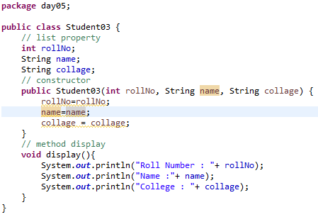
1. this: to refer current class instance variable
The this keyword can be used to refer current class instance variable. If there is ambiguity between the instance variables and parameters, this keyword resolves the problem of ambiguity.

Slide 48
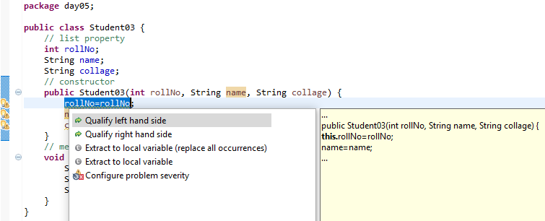
1. this: to refer current class instance variable

Slide 49
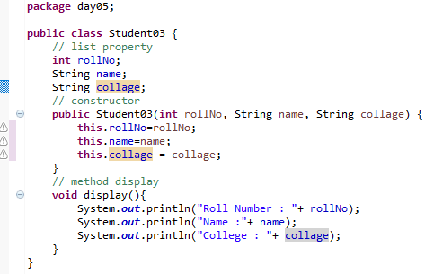
1. this: to refer current class instance variable

Slide 50
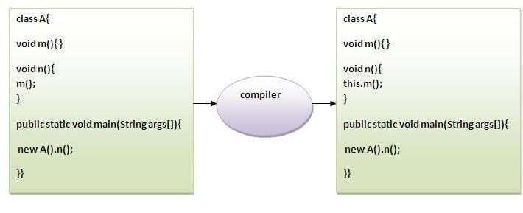
2) this: to invoke current class method
You may invoke the method of the current class by using the this keyword. If you don't use the this keyword, compiler automatically adds this keyword while invoking the method. Let's see the example

Slide 51
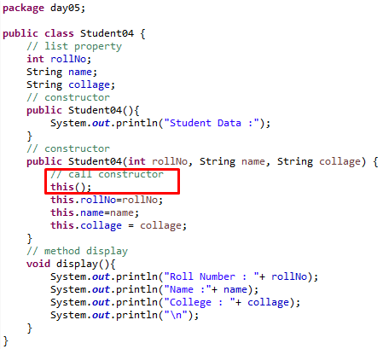
3) this() : to invoke current class constructor
The this() constructor call can be used to invoke the current class constructor. It is used to reuse the constructor. In other words, it is used for constructor chaining.

Slide 52
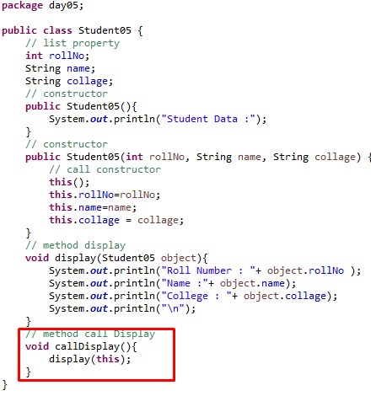
4) this: to pass as an argument in the method
The this keyword can also be passed as an argument in the method. It is mainly used in the event handling

Slide 53
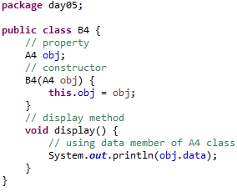
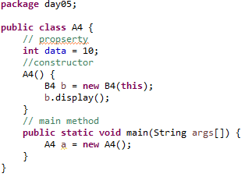
5) this: to pass as argument in the constructor call
We can pass the this keyword in the constructor also. It is useful if we have to use one object in multiple classes. Let's see the example:

Slide 54
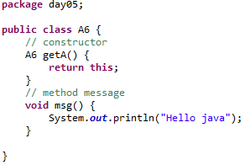
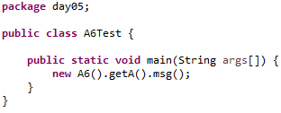
6) this keyword can be used to return current class instance
We can return this keyword as an statement from the method. In such case, return type of the method must be the class type (non-primitive). Let's see the example:

Slide 55
Day 05
7
Study Case

Slide 56
01. Correctness and the Loop Invariant
Loop Invariant
In computer science, you could prove it formally with a loop invariant, where you state that a desired property is maintained in your loop. Such a proof is broken down into the following parts:
Initialization: It is true (in a limited sense) before the loop runs.
Maintenance: If it's true before an iteration of a loop, it remains true before the next iteration.
Termination: It will terminate in a useful way once it is finished.

Slide 57


01. Correctness and the Loop Invariant
Insertion Sort's Invariant
Say, you have some InsertionSort code, where the outer loop goes through the whole array :
You could then state the following loop invariant:

Slide 58
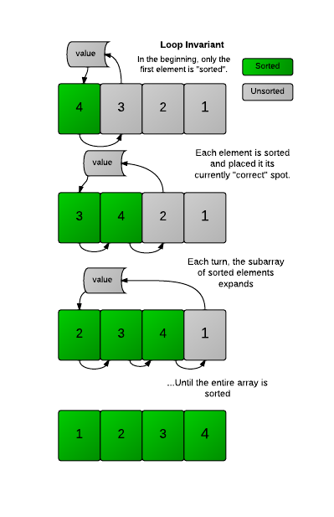
01. Correctness and the Loop Invariant
To prove Insertion Sort is correct, you will then demonstrate it for the three stages:
Initialization - The subarray starts with the first element of the array, and it is (obviously) sorted to begin with.
Maintenance - Each iteration of the loop expands the subarray, but keeps the sorted property. An element gets inserted into the array only when it is greater than the element to its left. Since the elements to its left have already been sorted, it means is greater than all the elements to its left, so the array remains sorted. (In Insertion Sort 2 we saw this by printing the array each time an element was properly inserted.)
Termination - The code will terminate after has reached the last element in the array, which means the sorted subarray has expanded to encompass the entire array. The array is now fully sorted.

Slide 59
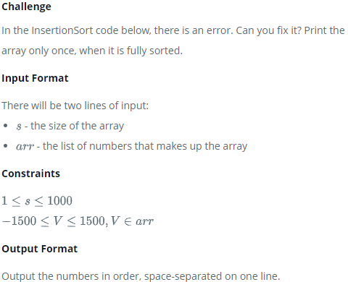
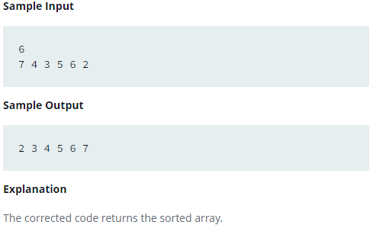
01. Correctness and the Loop Invariant

Slide 60
GOOD LUCK!

Slide 61
THANKS!
Any questions?
Contact Your Trainer

