Slide 1

Fixed Point Analysis in RSA Encryption
Research and Tool Development by Aron Schwartz, Professor John Acken
Portland State University | Winter 2020 | ECE Department

Slide 2
Why this Project?
Very Interesting! In my opinion ☺
Showcase of attention to detail, problem solving, and practical coding
Represents modeling of an observed phenomenon, which would be relevant for Applied Physicist Role

Slide 3
Overview
What is RSA Encryption?
Fixed Points Overview
Totient Patterns and Transparency Profiles
Implications and future work
Research Tool Development
Questions?
Demonstration and code walkthrough if time

Slide 4
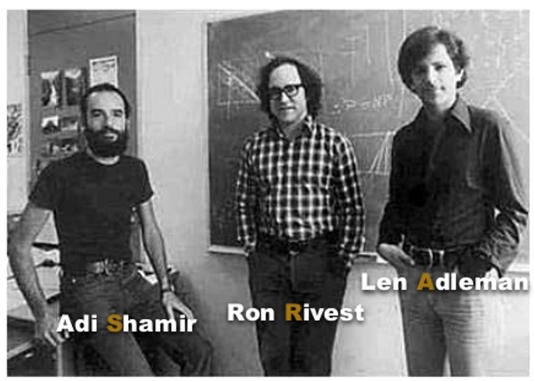
RSA Overview
RSA – Rivest-Shamir-Adleman
Developed by the above 3 in 1977 at MIT
Asymmetric Encryption/Decryption algorithm based in Modular Mathematics to encrypt/decrypt integers
Asymmetric -> Encryption/Decryption Keys are Different
Symmetric -> Same key to Encrypt and Decrypt
In modern security era, used for initial key distribution to utilize a Symmetric System to ensure key distribution is protected
(E, N) -> Public Key
(D, N) -> Private Key
There are 7 primary parameters involved: P, Q, N, T, E, K D

Slide 5
The Seven Parameters
There are 7 primary parameters involved: P, Q, N, T, E, K D
P, Q -> Two Initial prime numbers chosen at random, typically extremely large (1024 or 2048 bits for a practical RSA scheme)
N -> The product of P and Q, part of the encryption/decryption keys
T -> The Euler Totient function -> T = (P-1)*(Q-1) ***************
E - > The Encryption Exponent, Public Information. Must be coprime with totient
K - > Factor relating E and D (not super important for this discussion)
D - > The Decryption Exponent. Private information
.

Slide 6
RSA Mathematical Process
1. Choose two prime numbers: P, Q
2. Calculate N = P*Q
3. Calculate the Euler Totient T = (P-1)*(Q-1) ******* Important for these findings *******
3. Choose a value E, such that Totient and E are co-prime with each other (No common factors other than 1)
Ex: 18 and 35 are coprime (not necessarily prime themselves)
4. Calculate D to satisfy co-modularity with N, K is internal parameter to calculate D
CipherText = C = M^e mod(n)
Plaintext = M = C^d mod(n)
All 7 values are considered a “septuple”, a modular unit with all information needed to perform RSA
SEPTUPLE = [P, Q, N, T, E, K, D]

Slide 7
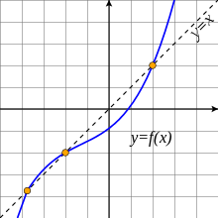
What is a fixed point?
A fixed point is mathematical term where the input to a function maps back to the input itself
F(x) = x
Another way to think about it is the set of values in the domain of the function that lie on the line y = x
From Wiki (Example of 3 fixed points) -------------------------------------→
Not all functions have fixed points. Ex: F(x) = x + 1

Slide 8
RSA Fixed Points
RSA fixpoints therefore…
F (m) = C = M^E (mod n) = M
A fixed point in RSA constitutes a failure to encrypt! The plaintext == the ciphertext…as if nothing happened
A fixed point in RSA is a problem. In indicates a failure of the encryption process, since the cipher text is the same as the plaintext. A security concern for any system utilizing RSA.
Two examples of a “good” septuple and a “bad” septuple (next slide)

Slide 9
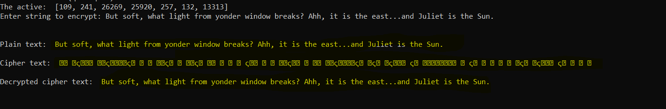
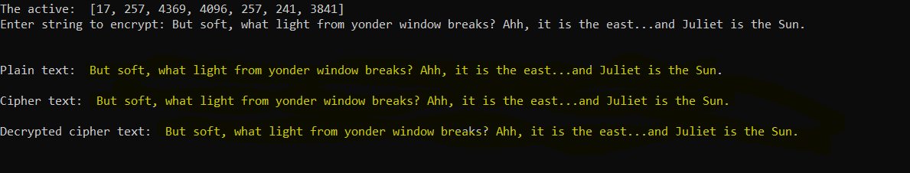
P Q N T E K D
A “good” septuple ---- [109, 141, 26269, 25920, 257, 132, 13313]
Good = All characters encrypted…what we want to happen
P Q N T E K D
A “bad” septuple ---- [17, 257, 4369, 4096, 257, 241, 3841]
Bad = Poor encryption, in this example nothing changed at all

Slide 10
Question: What makes a “good” vs “bad” septuple?
No good answer exists
RSA Fixed points are nothing new…proven to exist a couple years after original paper (1979)
Testing for fixed points is done statistically
A quick google search shows examples of “Bad RSA key distribution” causing significant security issues for companies
The question: What causes fixed points? What is the relationship between the choice of p, q, e, etc that increases or decreases the “likelihood” of a fixed point occurring?
→ These questions spawned the first phase of research – Generating and testing thousands of septuples, looking for fixed points, and studying emergent mathematical patterns

Slide 11
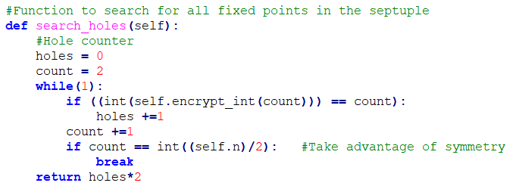
Python to generate septuples
Goal: Generate thousands of septuples in Python
Randomly combine prime numbers (All combinations of P and Q up to some limit)
Check the transparency of each septuple and compare them
What patterns (if any) will emerge with regards to the input parameters and the poorest performing septuples?
Over 22,000 septuples created
P, Q randomly chosen among the first one thousand prime numbers
E chosen among the recommended “Public Keys” : 3, 5, 17, 257, 65537

Slide 12
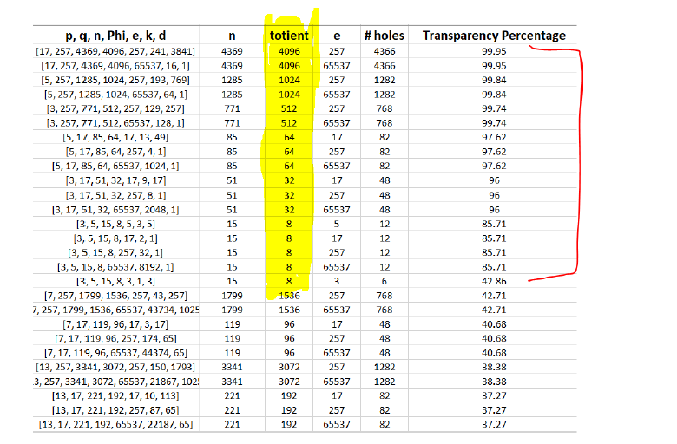
Results: Powers-of-two Totients
A pattern emerged among the value of the totient (P-1)*(Q-1)
The highest transparency septuples had a common pattern

Slide 13
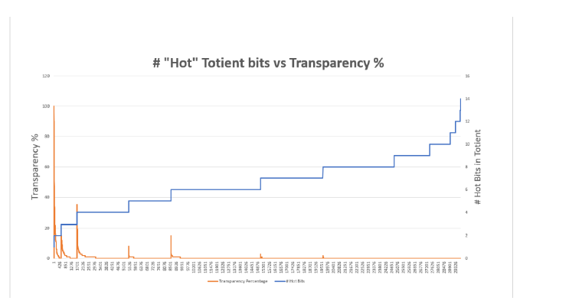
Power of two proximity relationship
Orange = Transparency % Blue = Totient “Power of two” proximity
As the totient trends away from a power of two, the peak transparency decreases. Interesting…

Slide 14
Does this pattern hold?
Not always…totients at or near power of two didn’t always mean poor encryption
What other factors matter? Perhaps E?
Next task: Pick some “bad” septuples, vary the E parameter, and observe the results
Vary E between all primes from 2 to 65537and observer results…do the “bad” septuples remain bad? Do the “good” septuples remain good?

Slide 15
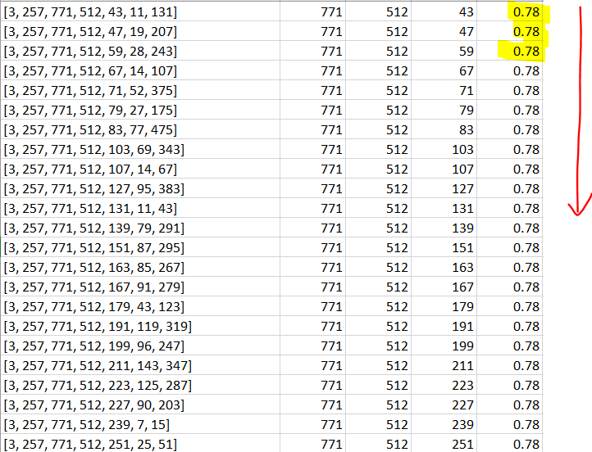
Transparency Profiles based on E
Answer: Yes, the Choice of E matters for resulting transparency.
Transparency “profile” shows keys sorted by strength
E

Slide 16

Discovery: Septuples can have identical transparency profiles
Common profiles emerged among seemingly different septuples
Septuples with different N can have a 1-to-1 match in their transparency profiles
The same E values cause the same encryption failures….wow!
Next slide shows 3 common profiles to further illustrate this…

Slide 17
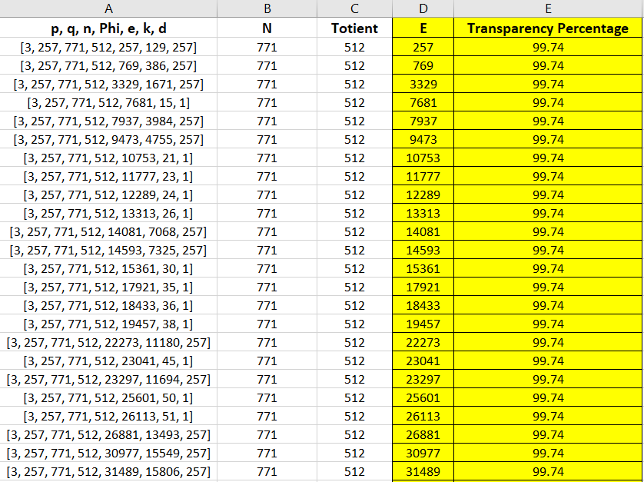
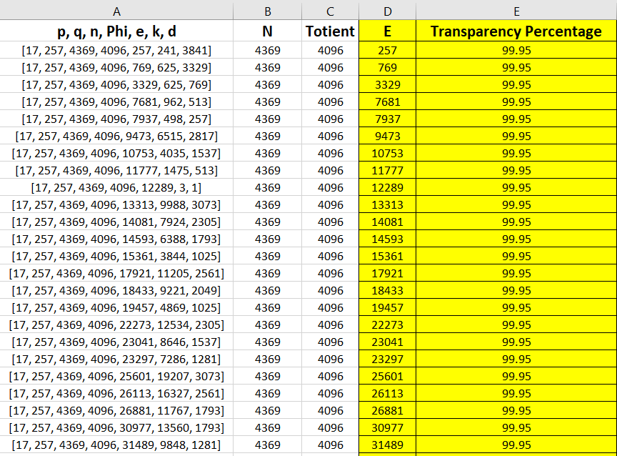
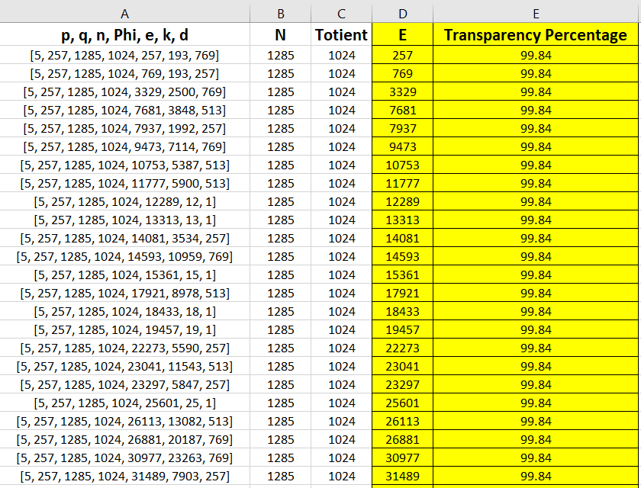

Slide 18
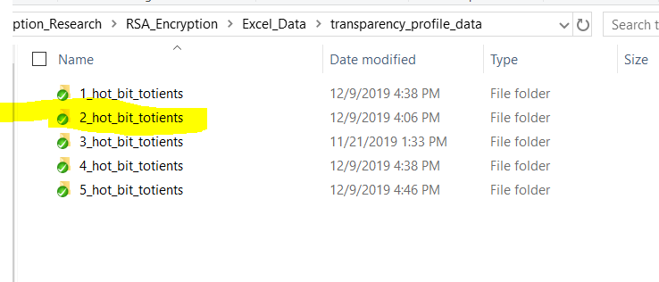
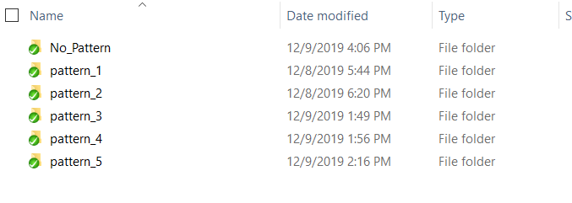
Many other patterns found…
Common patterns grouped by common totients complexity
2 hot-bit totient had 5 patterns for example
No common profiles were found where the totient complexity was not identical…

Slide 19
What does this all mean?
A mathematical relationship exists that governs the resulting transparency of a septuple
Randomly creating septuples shows that those with totients near a power of two have the highest transparency, with transparency improving as the totient complexity increases
Transparency involves both the totient and the choice of E…but the exact relationship is still mysterious
Some septuples have identical profiles. Many profiles were found,
Implication: Every septuple has a “profile”, and some septuples have the same profile!
Septuples with the same profile had a common initial prime
If the link between a septuple and its profile can be discovered, a list of good and bad keys can be generated from any septuple and ensure good keys are chosen. Or more maliciously, this info could be used to break an RSA scheme
Remember: E is public information

Slide 20
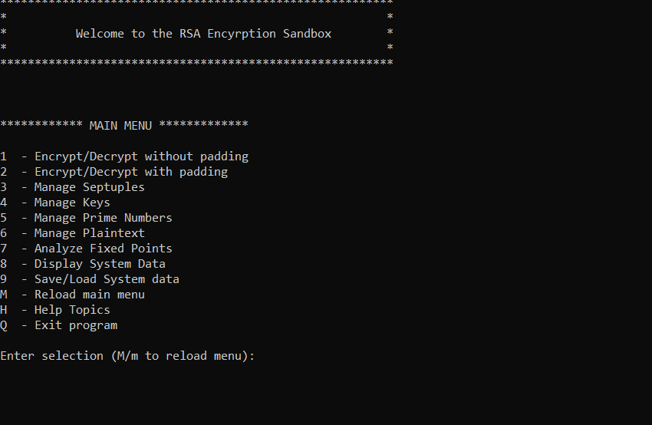
RSA Sandbox Research Tool
Python tool developed to continue this work
Allows easy creation of septuples, keys, prime numbers, and allows arbitrary experimentation with various combinations
Built-in septuple comparison and transparency profile generation
File I/O functionality for large data sets

Slide 21

Questions? Demo Time!

