Slide 1
IFS simulator
Maxime Rizzo

Slide 2
Background
Software based on CHARIS simulator
Plays a number of tricks to increase computation speed
Python-based
Parallel-processing available
CHARIS code works for single wavelength

Slide 3
How it works
Takes an input complex field, already rotated by the interlacing angle
Splits it into NxN lenslets
Fourier-propagate each lenslet
Uses M x M “pixels” for each lenslet
Custom Fourier transform that includes quadratic term
FT into an array 3M x 3M, to include crosstalk
Take intensity
Apply pinhole mask
Add array to large image plane array (subsequently “the pinhole plane”)
Rotate array by interlacing angle
Apply distortion & dispersion using polynomial expression (as in the IDL simulator)

Slide 4
How it works
Load spot diagram files that represent the PSF in 9 different field positions at the detector focal plane
These consist of kernels that will be used to convolve with the pinhole plane
Scale these kernels to the appropriate sampling to match the pixel sampling in pinhole plane
Convolve kernels with any other defocus, WFE kernel that is provided
Convolve each kernel by a detector pixel response kernel
For final detector plane image, interpolate between existing 9 kernels to get an effective “PSF” for each location on detector
Manual convolution of pinhole plane with this interpolated kernel map; forms detector plane

Slide 5
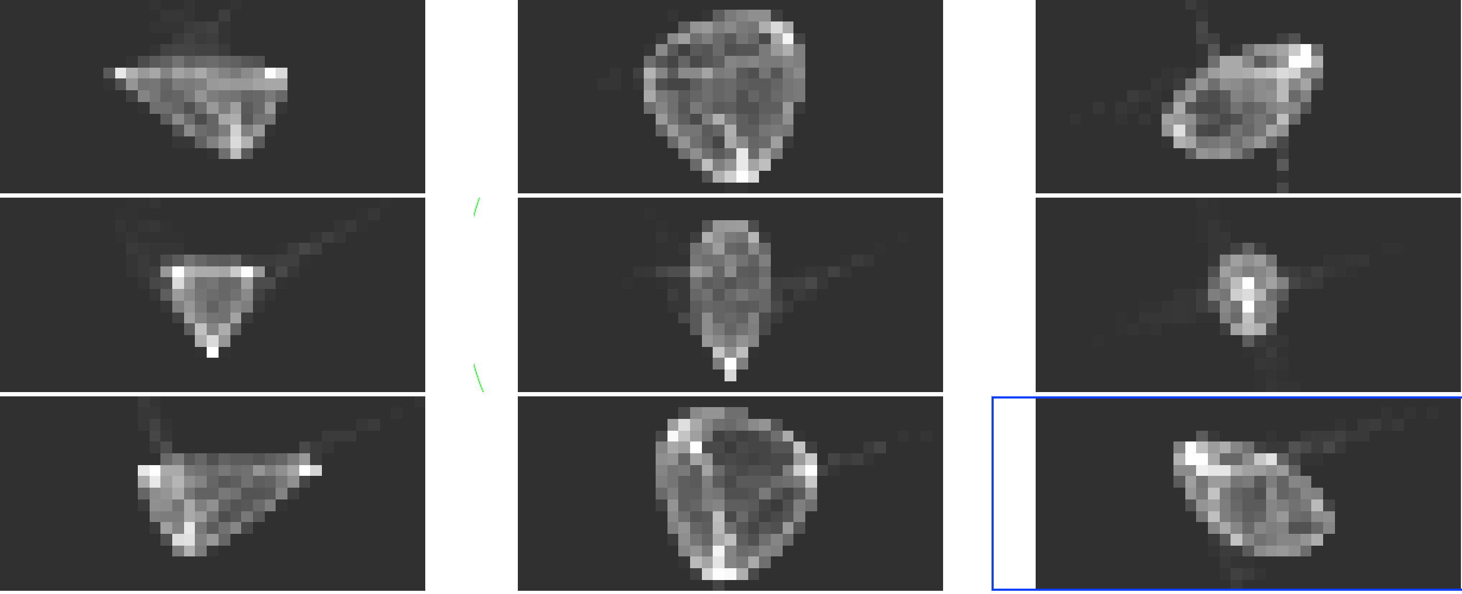
Normalized spot diagrams

Slide 6
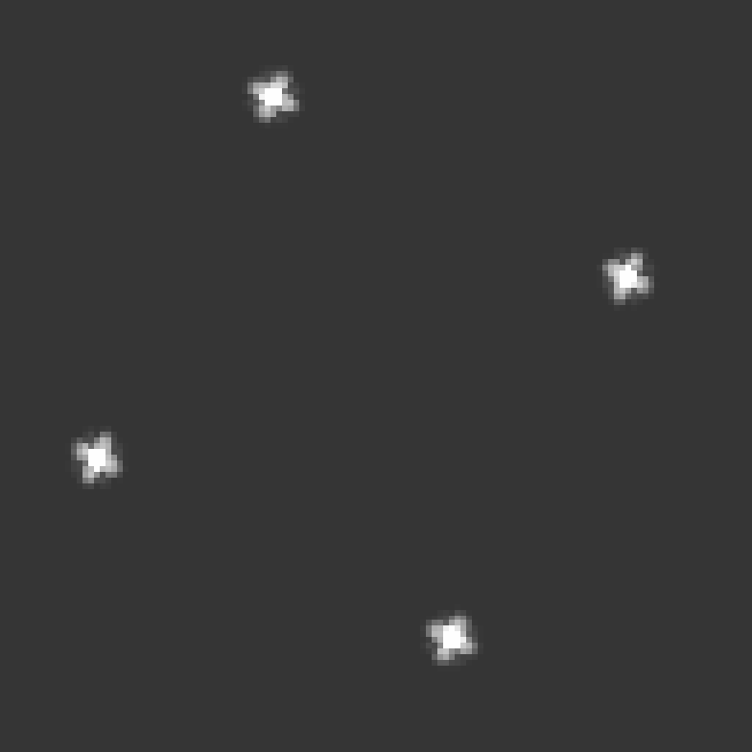
Pinhole plane
After applying pinhole mask, but before convolution with kernels
Plate scale is same as input lenslet (174microns/N pixels)
Lam/D ~ 4 micron for each spot

Slide 7
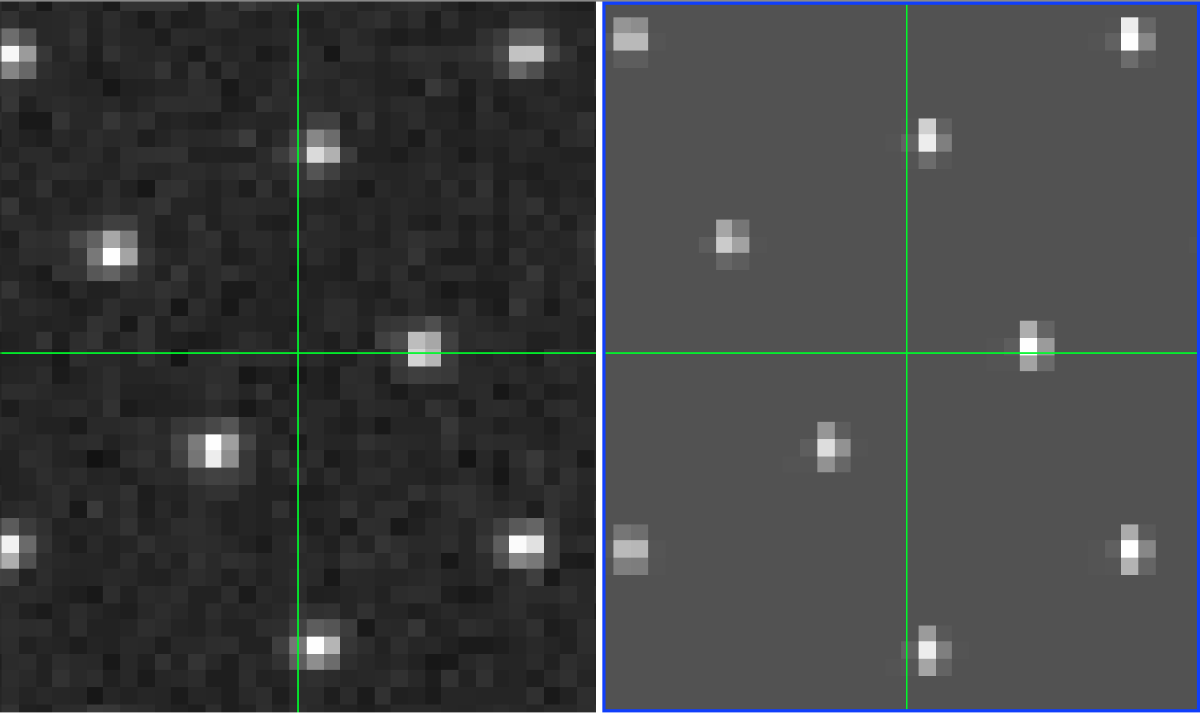
Detector plane (637nm)
Distorted, dispersed
Convolved with kernels
Camilo’s calibration data
Simulation results

Slide 8
Need spot diagrams
Detector PSF seems larger than simulated PSF
But… these simulations were using the CHARIS spot diagrams! -> Need to generate our own
Can add defocus, WFE/Zernike by simulating their effects through a convolution following CHARIS recipe (not physically accurate, but much faster)
Because field is not centered on detector in PISCES, distortion is currently off; need to adjust simulations/move detector

Slide 9
Caveats & further study
Unclear that treatment is correct for both on-axis and off-axis light (Qian)
Could replace kernel convolution by FT from pinhole plane to pupil, apply Zernike/defocus, and FT from pupil to detector
Other option is to find kernel that best mimics lab data (although then we loose the ability to play with physical parameters like defocus)
Qian suggested to simulate the lenslet array by a simple phase function and use FTs for all steps -> worth looking into?

